Slide 1
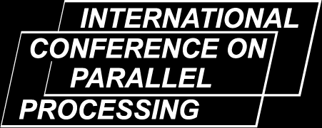


TileSpMM: A Variable-Size Tiled Algorithm for Sparse Matrix-Matrix Multiplication on Tensor Cores
Hongwei Zeng, Shuqin Feng, Haocheng Lian, Yuechen Lu, Weifeng Liu
Super Scientific Software Laboratory, China University of Petroleum-Beijing, China
1

Slide 2


Background
Motivation
TileSpMM
Evaluation
Conclusion
Outline
Zeng et al., TileSpMM: A Variable-Size Tiled Algorithm for Sparse Matrix-Matrix Multiplication on Tensor Cores
2

Slide 3
Background
Motivation
TileSpMM
Evaluation
Conclusion
Outline
Zeng et al., TileSpMM: A Variable-Size Tiled Algorithm for Sparse Matrix-Matrix Multiplication on Tensor Cores
3

Slide 4
Sparse Matrix-Matrix Multiplication（SpMM）
SpMM is an operation that multiplies a sparse matrix A and a dense matrix B to give a resulting dense matrix C, and is widely used in graph neural networks, scientific computing, and sparse deep learning.
a
b
1
c
d
e
f
g
h
i
sparse matrix A
dense matrix B
dense matrix C
Zeng et al., TileSpMM: A Variable-Size Tiled Algorithm for Sparse Matrix-Matrix Multiplication on Tensor Cores
4

Slide 5
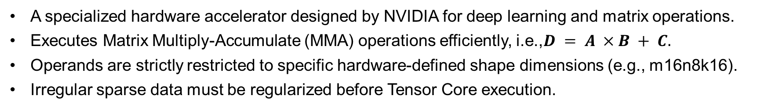
Tensor Core
A specialized hardware accelerator designed by NVIDIA for deep learning and matrix operations.
Executes Matrix Multiply-Accumulate (MMA) operations efficiently, i.e.,$D = A ×B + C.$
Operands are strictly restricted to specific hardware-defined shape dimensions (e.g., m16n8k16).
Irregular sparse data must be regularized before Tensor Core execution.
MMA_N
MMA_K
frag_b
Supported Operand Shapes for Tensor Cores
Type | Precision | Operand shapes
MMA | TF32 | m16n8k4,m16n8k8
MMA | FP16 | m8n8k4,m16n8k8,m16n8k16
WMMA | TF32 | m16n16k8
WMMA | FP16 | m16n16k16, m8n32k16,m32n8k16
MMA_K
MMA_M
frag_a
frag_c
Tensor Core MMA Data Fragment Layout
Zeng et al., TileSpMM: A Variable-Size Tiled Algorithm for Sparse Matrix-Matrix Multiplication on Tensor Cores
5

Slide 6
Window-based sparse matrix format
Row Window Tiling:
Horizontal Partitioning: Slice the sparse matrix into row windows of a fixed height.
Compression & Padding: Nonempty columns are packed into dense blocks, and empty positions are padded with zeros.
0
1
2
3
4
5
0
1
2
3
4
5
0
a
b
0
a
b
Padding Zero
1
c
d
Window 0
c
d
1
Tile_RowPtr = [0, 2, 3]
2
e
f
2
e
f
g
g
Tile_ColIdx = [0, 1, 2, 4, 5, 0, 0, 2, 4]
3
3
4
h
Window 1
h
Tile_Values =
4
a
b
g
5
i
5
i
c
d
h
e
f
i
Zeng et al., TileSpMM: A Variable-Size Tiled Algorithm for Sparse Matrix-Matrix Multiplication on Tensor Cores
6

Slide 7
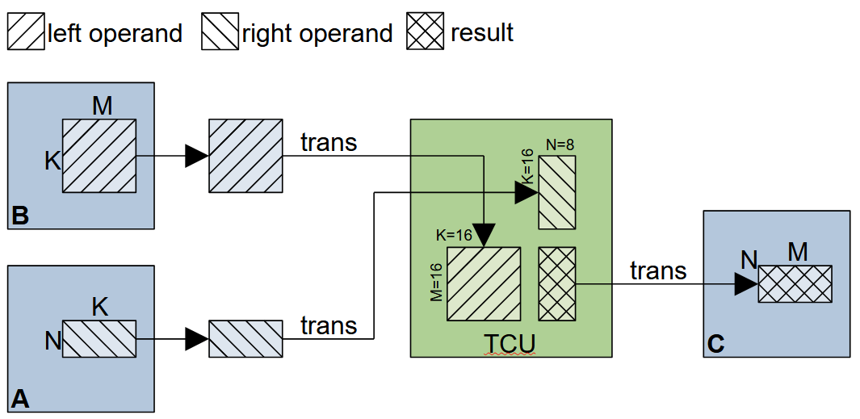
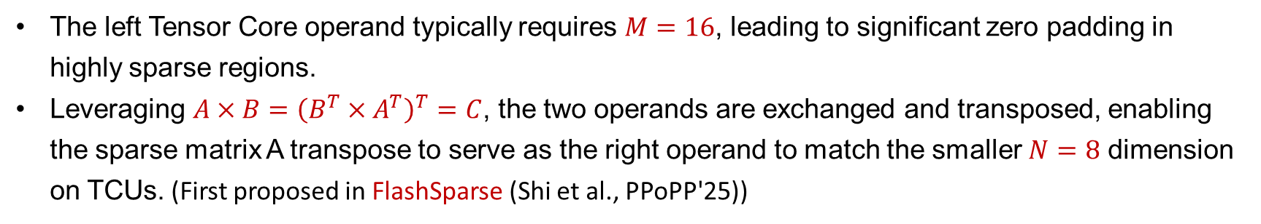
Swap-and-Transpose strategy
The left Tensor Core operand typically requires $M=16$, leading to significant zero padding in highly sparse regions.
Leveraging $A×B={\left(B^{T}×A^{T}\right)}^{T}=C$, the two operands are exchanged and transposed, enabling the sparse matrix A transpose to serve as the right operand to match the smaller $N=8$ dimension on TCUs. (First proposed in FlashSparse (Shi et al., PPoPP'25))
Zeng et al., TileSpMM: A Variable-Size Tiled Algorithm for Sparse Matrix-Matrix Multiplication on Tensor Cores
7

Slide 8
Background
Motivation
TileSpMM
Evaluation
Conclusion
Outline
Zeng et al., TileSpMM: A Variable-Size Tiled Algorithm for Sparse Matrix-Matrix Multiplication on Tensor Cores
8

Slide 9
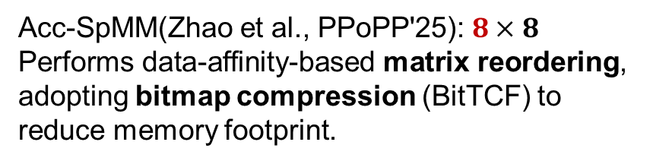
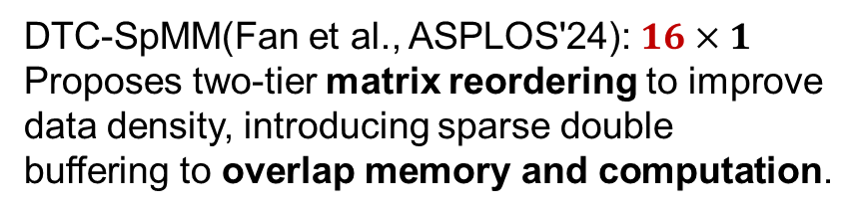
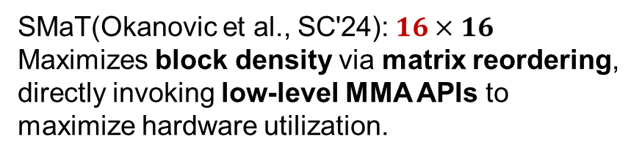
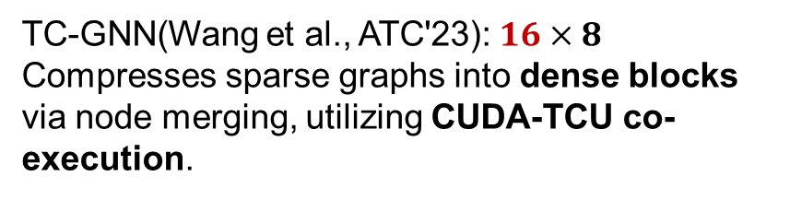
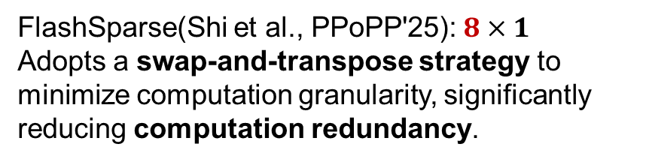
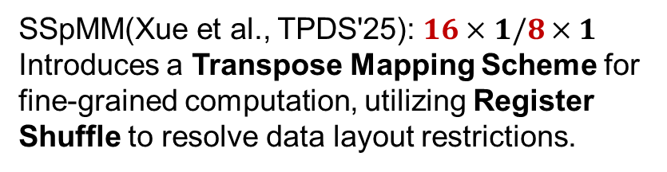
Related Work
TC-GNN(Wang et al., ATC'23):$16×8$
Compresses sparse graphs into dense blocks via node merging, utilizing CUDA-TCU co-execution.
DTC-SpMM(Fan et al., ASPLOS'24):$16×1$
Proposes two-tier matrix reordering to improve data density, introducing sparse double buffering to overlap memory and computation.
SMaT(Okanovic et al., SC'24):$16×16$
Maximizes block density via matrix reordering, directly invoking low-level MMA APIs to maximize hardware utilization.
Acc-SpMM(Zhao et al., PPoPP'25): $8×8$
Performs data-affinity-based matrix reordering, adopting bitmap compression (BitTCF) to reduce memory footprint.
FlashSparse(Shi et al., PPoPP'25): $8×1$
Adopts a swap-and-transpose strategy to minimize computation granularity, significantly reducing computation redundancy.
SSpMM(Xue et al., TPDS'25): $16×1/8×1$
Introduces a Transpose Mapping Scheme for fine-grained computation, utilizing Register Shuffle to resolve data layout restrictions.
Zeng et al., TileSpMM: A Variable-Size Tiled Algorithm for Sparse Matrix-Matrix Multiplication on Tensor Cores
9

Slide 10
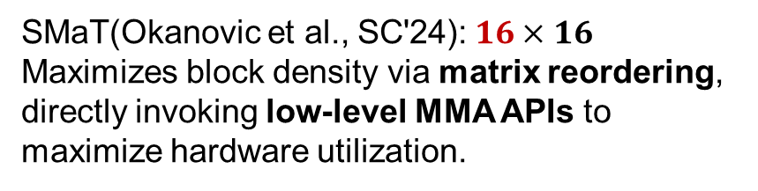
Related Work
TC-GNN(Wang et al., ATC'23):$16×8$
Compresses sparse graphs into dense blocks via node merging, utilizing CUDA-TCU co-execution.
DTC-SpMM(Fan et al., ASPLOS'24):$16×1$
Proposes two-tier matrix reordering to improve data density, introducing sparse double buffering to overlap memory and computation.
SMaT(Okanovic et al., SC'24):$16×16$
Maximizes block density via matrix reordering, directly invoking low-level MMA APIs to maximize hardware utilization.
Existing studies apply a single, fixed sparse granularity across the entire matrix.
Acc-SpMM(Zhao et al., PPoPP'25): $8×8$
Performs data-affinity-based matrix reordering, adopting bitmap compression (BitTCF) to reduce memory footprint.
FlashSparse(Shi et al., PPoPP'25): $8×1$
Adopts a swap-and-transpose strategy to minimize computation granularity, significantly reducing computation redundancy.
SSpMM(Xue et al., TPDS'25): $16×1/8×1$
Introduces a Transpose Mapping Scheme for fine-grained computation, utilizing Register Shuffle to resolve data layout restrictions.
Zeng et al., TileSpMM: A Variable-Size Tiled Algorithm for Sparse Matrix-Matrix Multiplication on Tensor Cores
10

Slide 11
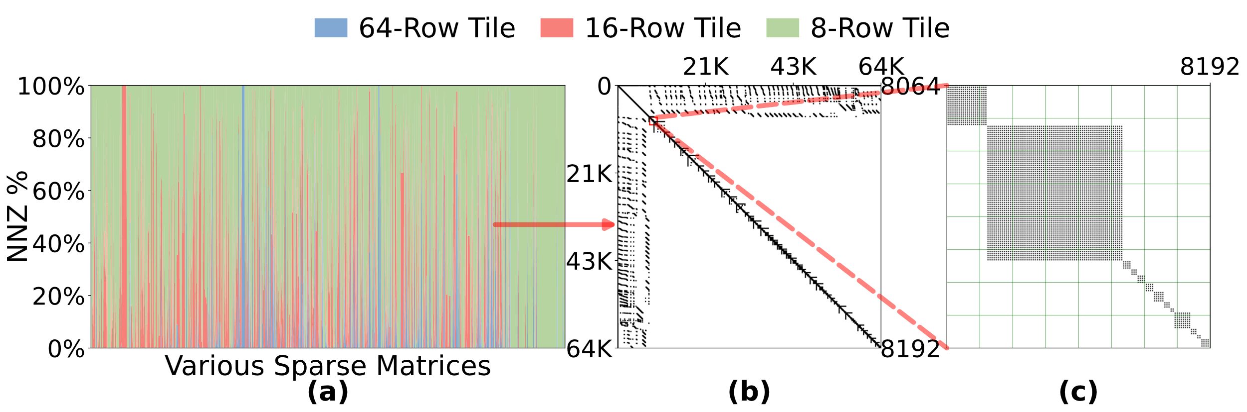
One Tile Size Does Not Fit All
Real sparse matrices contain both dense clusters and sparse regions; a single static tile is globally sub-optimal.
Trade-offs:
Small Tiles: Reduce zero-padding in sparse regions, but destroy spatial locality in dense areas and incur higher addressing and memory access overheads.
Large Tiles: Maximize data reuse in dense regions, but cause severe zero-padding in sparse areas.
Zeng et al., TileSpMM: A Variable-Size Tiled Algorithm for Sparse Matrix-Matrix Multiplication on Tensor Cores
11

Slide 12
One Tile Size Does Not Fit All
✄
✄
Strategy: Design variable-size row windows to partition the matrix, adapting to different sparsity patterns.
Zeng et al., TileSpMM: A Variable-Size Tiled Algorithm for Sparse Matrix-Matrix Multiplication on Tensor Cores
12

Slide 13
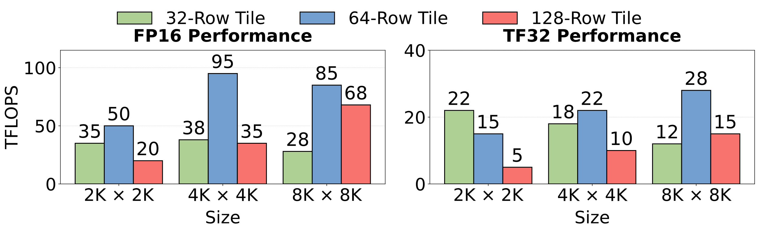
Tile Size Selection for TCU Execution
GEMM Performance with different tile sizes
Window size cannot be arbitrary.
Tensor Cores are efficient only for specific computation shapes.
Larger tiles are not always faster.
128-row tiles may introduce more zero padding and register pressure, so they can be less efficient.
We therefore keep three hardware-efficient sizes:
64 rows for dense regions, 16 rows for the MMA M dimension, and 8 rows with swap + transpose for sparse regions.
Zeng et al., TileSpMM: A Variable-Size Tiled Algorithm for Sparse Matrix-Matrix Multiplication on Tensor Cores
13

Slide 14
Background
Motivation
TileSpMM
Evaluation
Conclusion
Outline
Zeng et al., TileSpMM: A Variable-Size Tiled Algorithm for Sparse Matrix-Matrix Multiplication on Tensor Cores
14

Slide 15
How to Partition the Matrix?
N_{i}: # distinct nonempty cols in an i-row tile
S_{i}: sum of N values over i-Row sub-tiles
0
a
b
0
a
b
1
c
d
1
c
d
2
e
f
6-Row Tile
N₆=5
2
e
f
3
g
3
g
4
h
4
h
5
i
5
i
N_{i} = columns kept after grouping the rows
Zeng et al., TileSpMM: A Variable-Size Tiled Algorithm for Sparse Matrix-Matrix Multiplication on Tensor Cores
15

Slide 16
How to Partition the Matrix?
N_{i}: # distinct nonempty cols in an i-row tile
S_{i}: sum of N values over i-Row sub-tiles
0
a
b
0
a
b
1
c
d
1
c
d
3-Row Tile
N₃₋₁=5
N₃₋₂=3
S₃=8
2
e
f
2
e
f
3
g
3
g
4
h
4
h
5
i
5
i
Large S/N → more shared columns → better reuse → larger tile
S/N ≈ 1 → fewer shared columns → less reuse → smaller tile
Zeng et al., TileSpMM: A Variable-Size Tiled Algorithm for Sparse Matrix-Matrix Multiplication on Tensor Cores
16

Slide 17
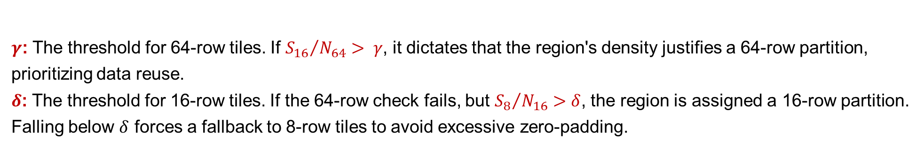
How to Partition the Matrix?
N_{i}: non-empty cols in i-Row Tile
S_{i}: sum of N values over i-Row sub-tiles
0
a
b
0
a
b
1
c
d
1
c
d
3-Row Tile
N₃₋₁=5
N₃₋₂=3
S₃=8
2
e
f
6-Row Tile
N₆=5
2
e
f
3
g
3
g
4
h
4
h
5
i
5
i
$γ$: The threshold for 64-row tiles. If ${S_{16}}/{N_{64}}> γ$, it dictates that the region's density justifies a 64-row partition, prioritizing data reuse.
$δ$: The threshold for 16-row tiles. If the 64-row check fails, but ${S_{8}}/{N_{16}}>δ$, the region is assigned a 16-row partition. Falling below $δ$ forces a fallback to 8-row tiles to avoid excessive zero-padding.
Zeng et al., TileSpMM: A Variable-Size Tiled Algorithm for Sparse Matrix-Matrix Multiplication on Tensor Cores
17

Slide 18
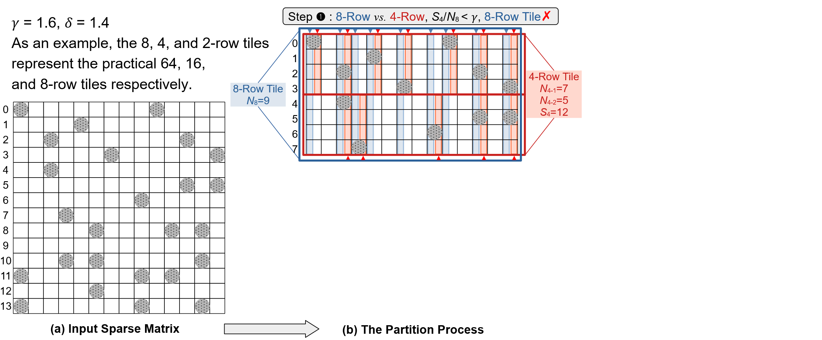
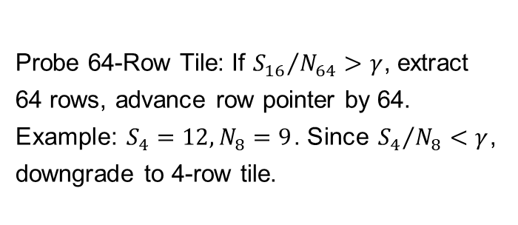
How to Partition the Matrix?
Probe 64-Row Tile: If ${S_{16}}/{N_{64}}>γ$, extract 64 rows, advance row pointer by 64.
Example: $S_{4}=12, N_{8}=9$. Since ${S_{4}}/{N_{8}}<γ$, downgrade to 4-row tile.
Zeng et al., TileSpMM: A Variable-Size Tiled Algorithm for Sparse Matrix-Matrix Multiplication on Tensor Cores
18

Slide 19
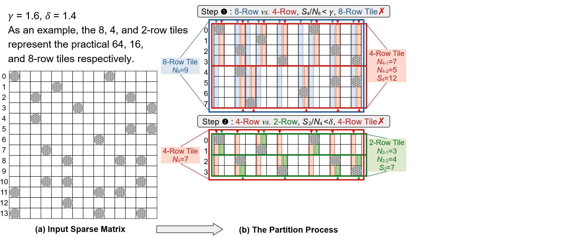
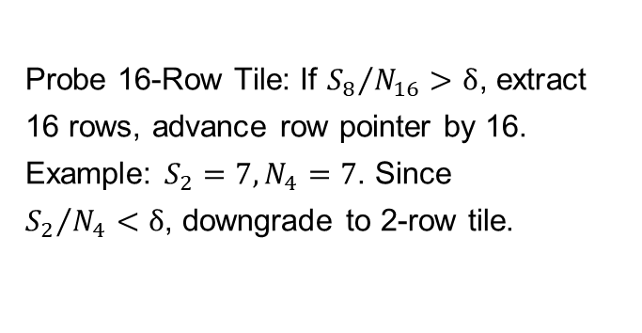
How to Partition the Matrix?
Probe 64-Row Tile: If ${S_{16}}/{N_{64}}>γ$, extract 64 rows, advance row pointer by 64.
Example: $S_{4}=12, N_{8}=9$. Since ${S_{4}}/{N_{8}}<γ$, downgrade to 4-row tile.
Probe 16-Row Tile: If ${S_{8}}/{N_{16}}>δ$, extract 16 rows, advance row pointer by 16.
Example: $S_{2}=7, N_{4}=7$. Since
${S_{2}}/{N_{4}}<δ$, downgrade to 2-row tile.
Zeng et al., TileSpMM: A Variable-Size Tiled Algorithm for Sparse Matrix-Matrix Multiplication on Tensor Cores
19

Slide 20
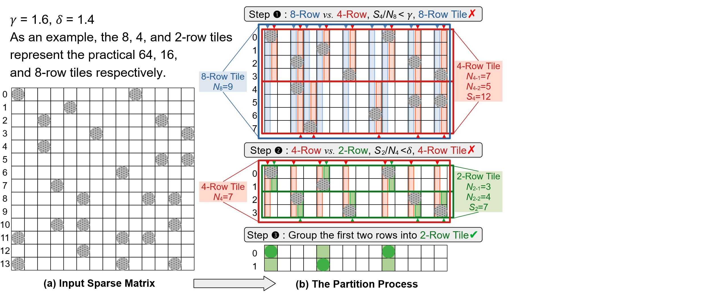
How to Partition the Matrix?
Probe 64-Row Tile: If ${S_{16}}/{N_{64}}>γ$, extract 64 rows, advance row pointer by 64.
Example: $S_{4}=12, N_{8}=9$. Since ${S_{4}}/{N_{8}}<γ$, downgrade to 4-row tile.
Probe 16-Row Tile: If ${S_{8}}/{N_{16}}>δ$, extract 16 rows, advance row pointer by 16.
Example: $S_{2}=7, N_{4}=7$. Since
${S_{2}}/{N_{4}}<δ$, downgrade to 2-row tile.
8-Row Tile: If both fail, use 8 rows, Little column sharing means a large tile is not useful. Move row pointer by 8.
Example: Use 2 rows, move pointer by 2.
Zeng et al., TileSpMM: A Variable-Size Tiled Algorithm for Sparse Matrix-Matrix Multiplication on Tensor Cores
20

Slide 21
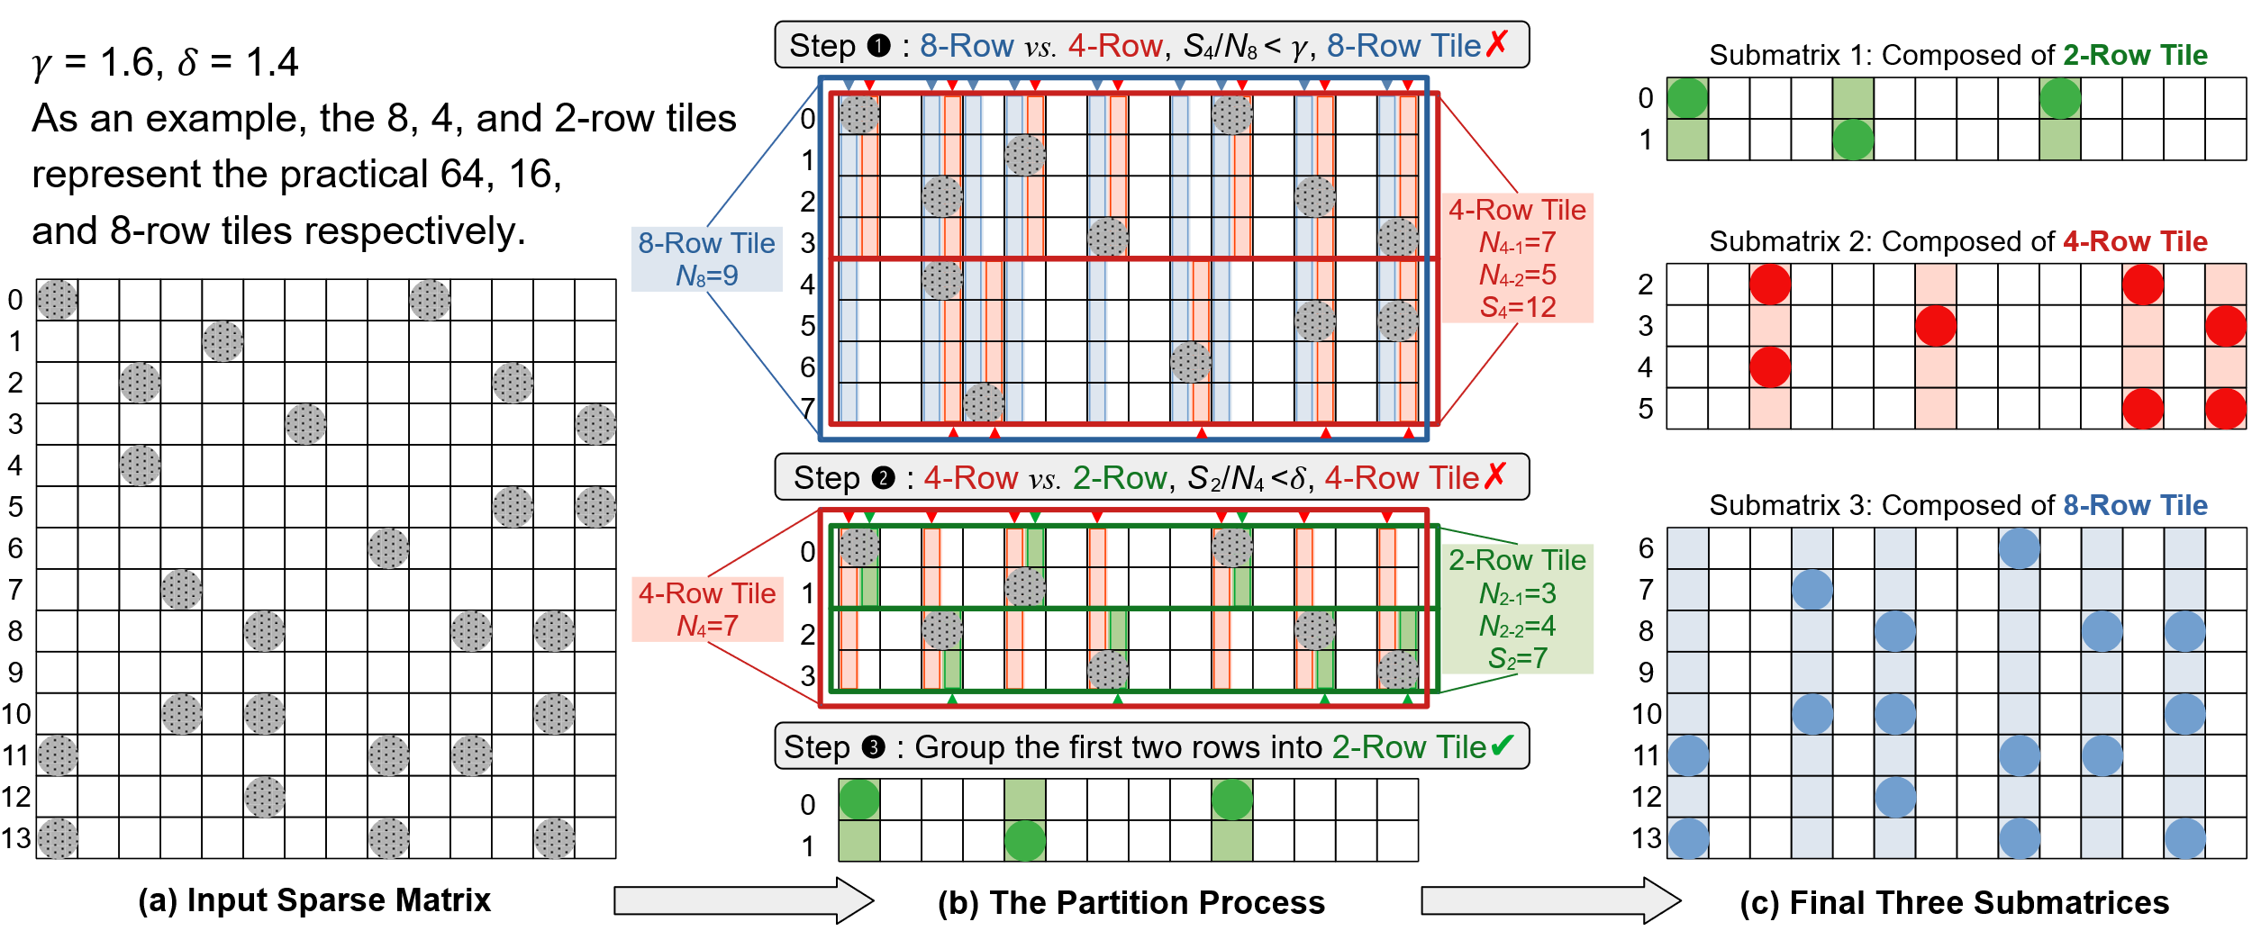
.
How to Partition the Matrix?
Repeat this process → one linear scan → 64/16/8-row sub-matrices → no global reorder → row mapping to original rows
Zeng et al., TileSpMM: A Variable-Size Tiled Algorithm for Sparse Matrix-Matrix Multiplication on Tensor Cores
21

Slide 22
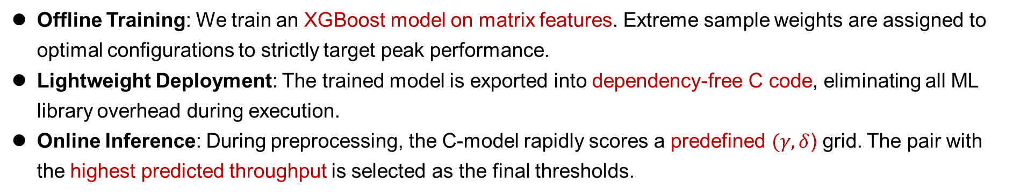

Generation Mechanism of $γ$and $δ$
Matrix Features & Historical Throughput
Predefined Candidate Grid for $γ$ and $δ$
XGBoost Training
Heavy Weighting on Optimal Configs
Efficient Scoring via C-Model
Trained Scoring Model
Select Pair with Highest Predicted Score
Offline Training: We train an XGBoost model on matrix features. Extreme sample weights are assigned to optimal configurations to strictly target peak performance.
Lightweight Deployment: The trained model is exported into dependency-free C code, eliminating all ML library overhead during execution.
Online Inference: During preprocessing, the C-model rapidly scores a predefined $(γ, δ$) grid. The pair with the highest predicted throughput is selected as the final thresholds.
Zeng et al., TileSpMM: A Variable-Size Tiled Algorithm for Sparse Matrix-Matrix Multiplication on Tensor Cores
22

Slide 23
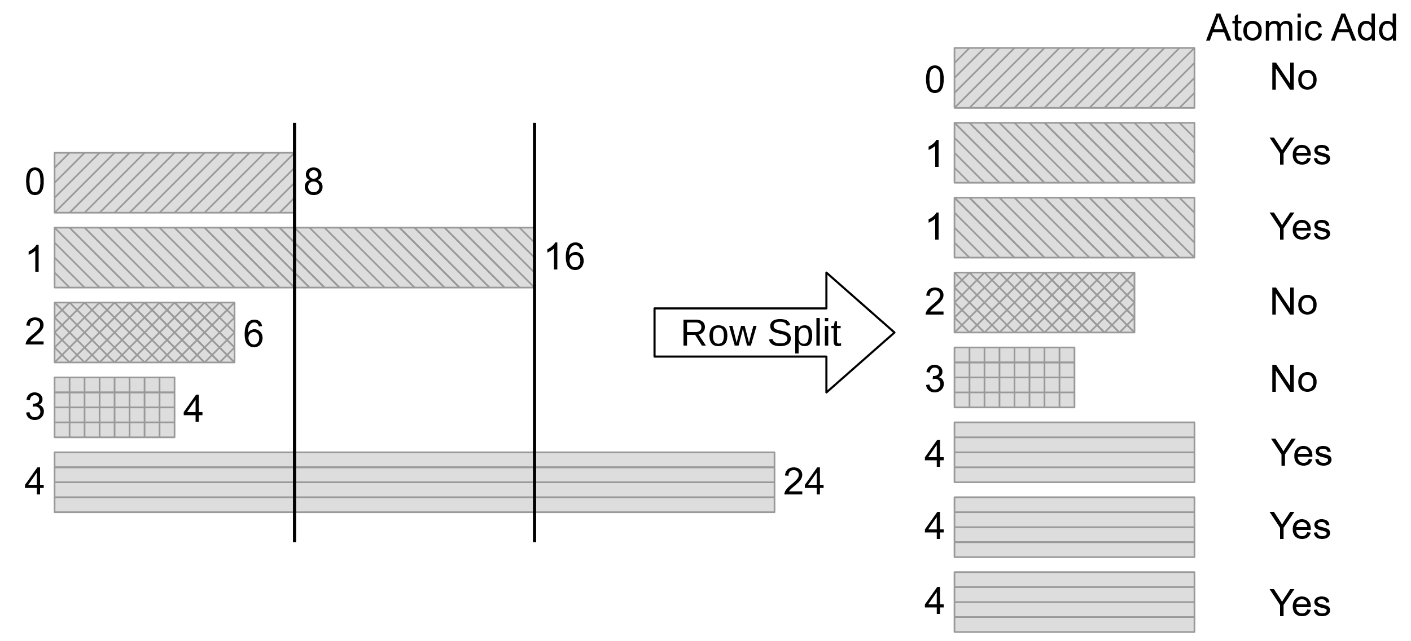
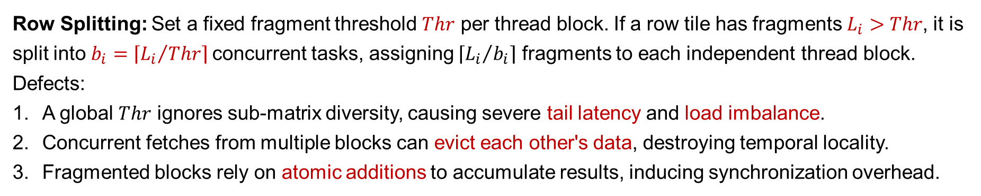
Load Balancing Strategy
Row Splitting: Set a fixed fragment threshold $Thr$ per thread block. If a row tile has fragments $L_{i}>Thr$, it is split into $b_{i}=\left\lceil {L_{i}}/{Thr}\right\rceil$concurrent tasks, assigning $\left\lceil {L_{i}}/{b_{i}}\right\rceil$ fragments to each independent thread block.
Defects:
A global $Thr$ ignores sub-matrix diversity, causing severe tail latency and load imbalance.
Concurrent fetches from multiple blocks can evict each other's data, destroying temporal locality.
Fragmented blocks rely on atomic additions to accumulate results, inducing synchronization overhead.
Zeng et al., TileSpMM: A Variable-Size Tiled Algorithm for Sparse Matrix-Matrix Multiplication on Tensor Cores
23

Slide 24
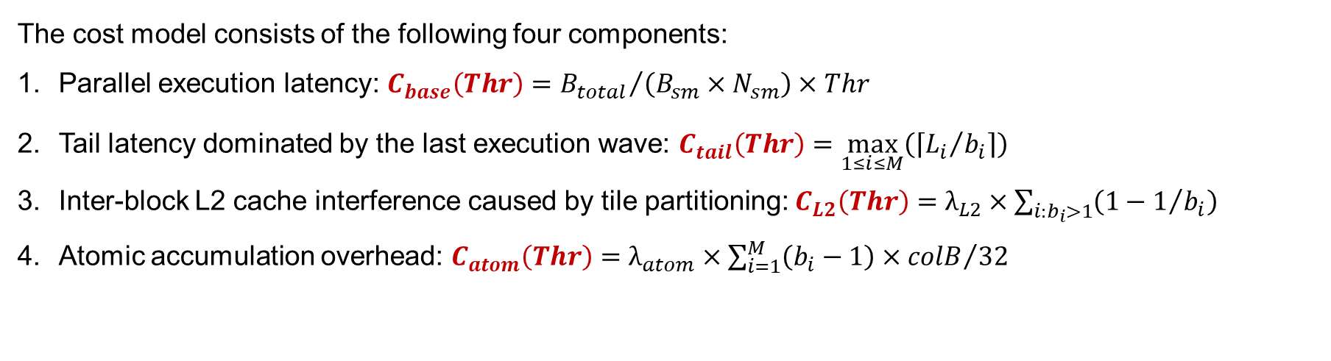
Load Balancing Strategy
We formulate a cost model to identify the optimal $Thr$:
$$Cost\left(Thr\right)=C_{base}\left(Thr\right)+C_{tail}\left(Thr\right)+C_{L2}\left(Thr\right)+C_{atom}\left(Thr\right)$$
The cost model consists of the following four components:
Parallel execution latency: $C_{base}\left(Thr\right)={B_{total}}/{\left(B_{sm}×N_{sm}\right)}×Thr$
Tail latency dominated by the last execution wave: $C_{tail}\left(Thr\right)=\max_{1≤i≤M}\left(\left\lceil {L_{i}}/{b_{i}}\right\rceil \right)$
Inter-block L2 cache interference caused by tile partitioning: $C_{L2}\left(Thr\right)=λ_{L2}×\sum_{i:b_{i}>1}{\left(1−1/{b_{i}}\right)}$
Atomic accumulation overhead: $C_{atom}\left(Thr\right)=λ_{atom}×\sum_{i=1}^{M}{\left(b_{i}−1\right)}×{colB}/{32}$
Select 4 lowest-cost Thr candidates, then test and choose the fastest one.
Zeng et al., TileSpMM: A Variable-Size Tiled Algorithm for Sparse Matrix-Matrix Multiplication on Tensor Cores
24

Slide 25
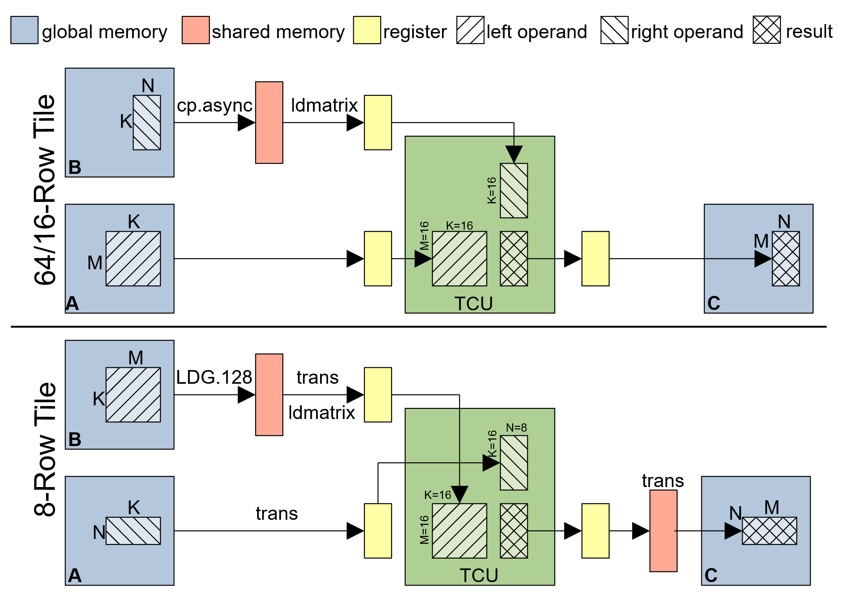
Algorithm Description
64/16-Row: Tailored for dense regions. Driven by Asynchronous Pipelining and Double Buffers to hide memory latency.
8-Row: Tailored for extremely sparse regions. Driven by an Operand Swapping Strategy to break hardware dimensional limits.
Zeng et al., TileSpMM: A Variable-Size Tiled Algorithm for Sparse Matrix-Matrix Multiplication on Tensor Cores
25

Slide 26
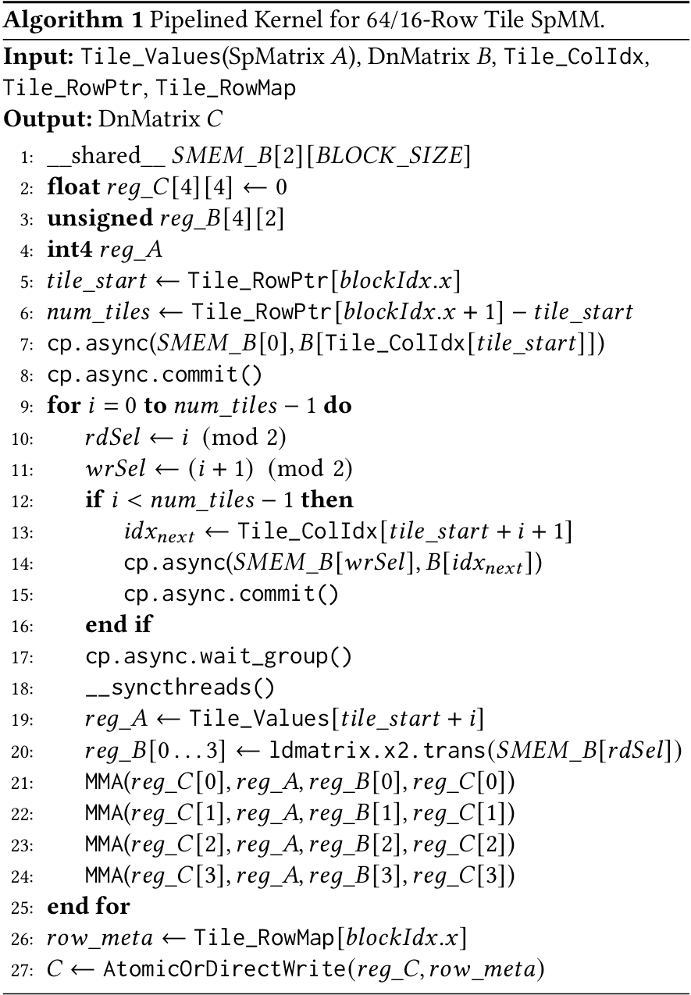
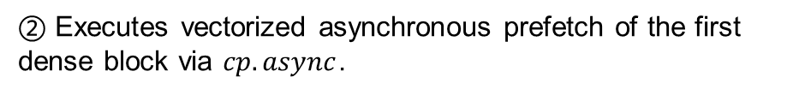
Algorithm for 64/16-Row Tile
① Initializes registers and allocates double buffers in SMEM.
①
② Executes vectorized asynchronous prefetch of the first dense block via $cp.async$.
②
③ Alternates buffer pointers in the loop to prefetch the next block while synchronizing the current one.
③
④ Loads sparse fragments directly to registers and extracts dense matrix B via ldmatrix.x2.trans
④
⑤ Executes repeated MMA operations on fragments.
⑤
⑥ Retrieves the mapped row address and writes results back to global memory.
⑥
Zeng et al., TileSpMM: A Variable-Size Tiled Algorithm for Sparse Matrix-Matrix Multiplication on Tensor Cores
26

Slide 27
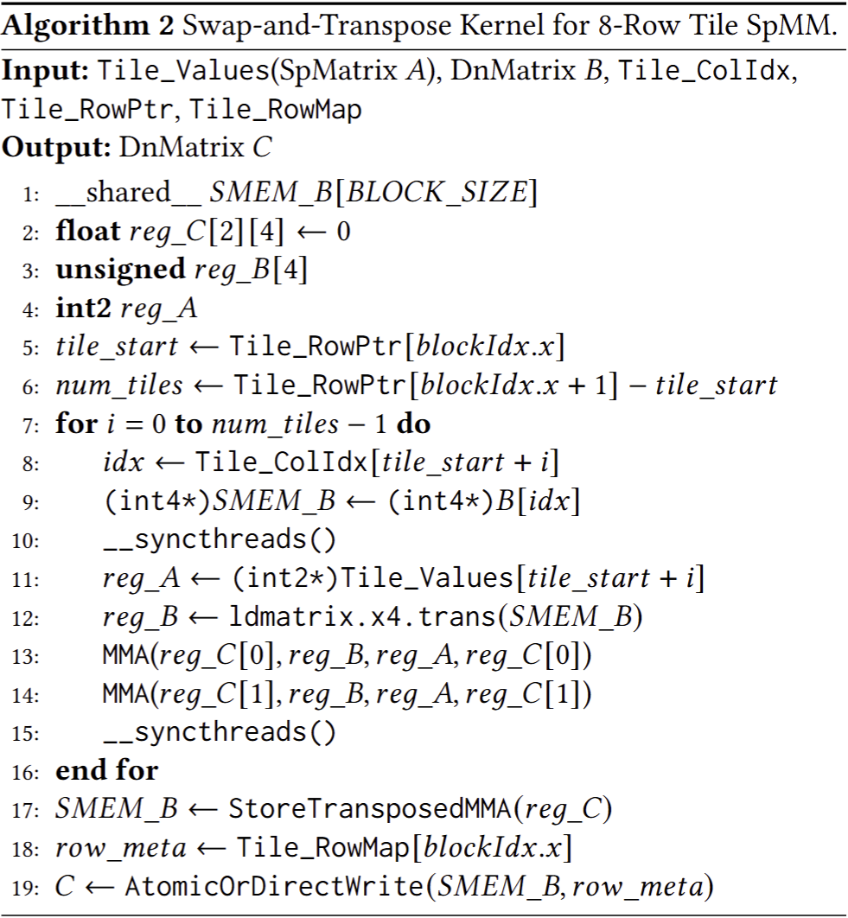
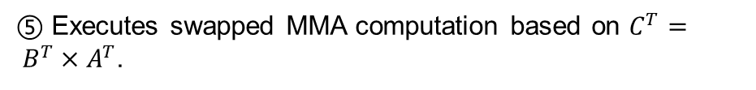
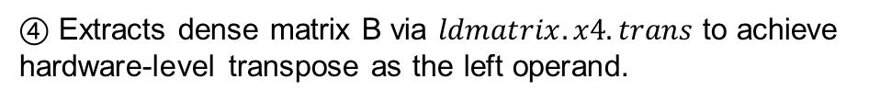
Algorithm for 8-Row Tile
① Initializes registers and allocates a single buffer in SMEM.
①
② Fetches dense matrix into SMEM via vectorized loads.
③ Loads sparse matrix A directly to registers to serve as the right operand.
④ Extracts dense matrix B via $ldmatrix.x4.trans$ to achieve hardware-level transpose as the left operand.
②
③
④
⑤ Executes swapped MMA computation based on $C^{T}= B^{T}×A^{T}$.
⑤
⑥ Remaps transposed results via StoreTransposedMMA and writes back to global memory.
⑥
Zeng et al., TileSpMM: A Variable-Size Tiled Algorithm for Sparse Matrix-Matrix Multiplication on Tensor Cores
27

Slide 28
Background
Motivation
TileSpMM
Evaluation
Conclusion
Outline
Zeng et al., TileSpMM: A Variable-Size Tiled Algorithm for Sparse Matrix-Matrix Multiplication on Tensor Cores
28

Slide 29
Experimental Setup
Platform:
Dataset | Abbr | #Vertex | #Edge | AvgL
roadNet-CA | rCA | 1,971,281 | 5,533,214 | 2.81
roadNet-PA | rPA | 1,090,920 | 3,083,796 | 2.83
web-BerkStan | WB | 685,230 | 7,600,595 | 11.09
PROTEINS_full | PR | 43,466 | 162,088 | 3.73
DD | DD | 334,925 | 1,686,092 | 5.03
Yeast | Yt | 1,710,902 | 3,636,546 | 2.13
YeastH | YH | 3,138,114 | 6,487,230 | 2.07
citeseer | cite | 3,327 | 9,228 | 2.77
pubmed | pub | 19,717 | 88,651 | 4.50
ppi | ppi | 56,944 | 818,716 | 14.38
amazon0505 | ama | 410,236 | 4,878,874 | 11.89
reddit | red | 232,965 | 114,848,857 | 492.99
protein | prot | 132,534 | 79,255,038 | 598.00
com-amazon | com | 334,863 | 1,851,744 | 5.53
soc-BlogCatalog | soc | 88,784 | 2,093,195 | 23.58
NVIDIA GPU | Precision | Perf. (TFLOPS)
RTX 5090 32 GB GDDR7, 1.79 TB/s | FP16/FP32 (mixed) | 209.5
 | TF32 | 104.8
H100 SXM 80 GB HBM3, 3.35 TB/s | FP16/FP32 (mixed) | 1000
 | TF32 | 500
Baseline:
FP16/FP32 (mixed): cuSPARSE、FlashSparse、SMaT、SSpMM
TF32: cuSPARSE、FlashSparse、Acc-SpMM、RoDe(FP32)
Dataset:
DLMC: Pruned neural network weights for AI workloads.
SuiteSparse Collection: Diverse irregular matrices for scientific computing.
15 Graph Datasets: Real-world graphs for graph analytics and GCN scenarios.
Zeng et al., TileSpMM: A Variable-Size Tiled Algorithm for Sparse Matrix-Matrix Multiplication on Tensor Cores
29

Slide 30
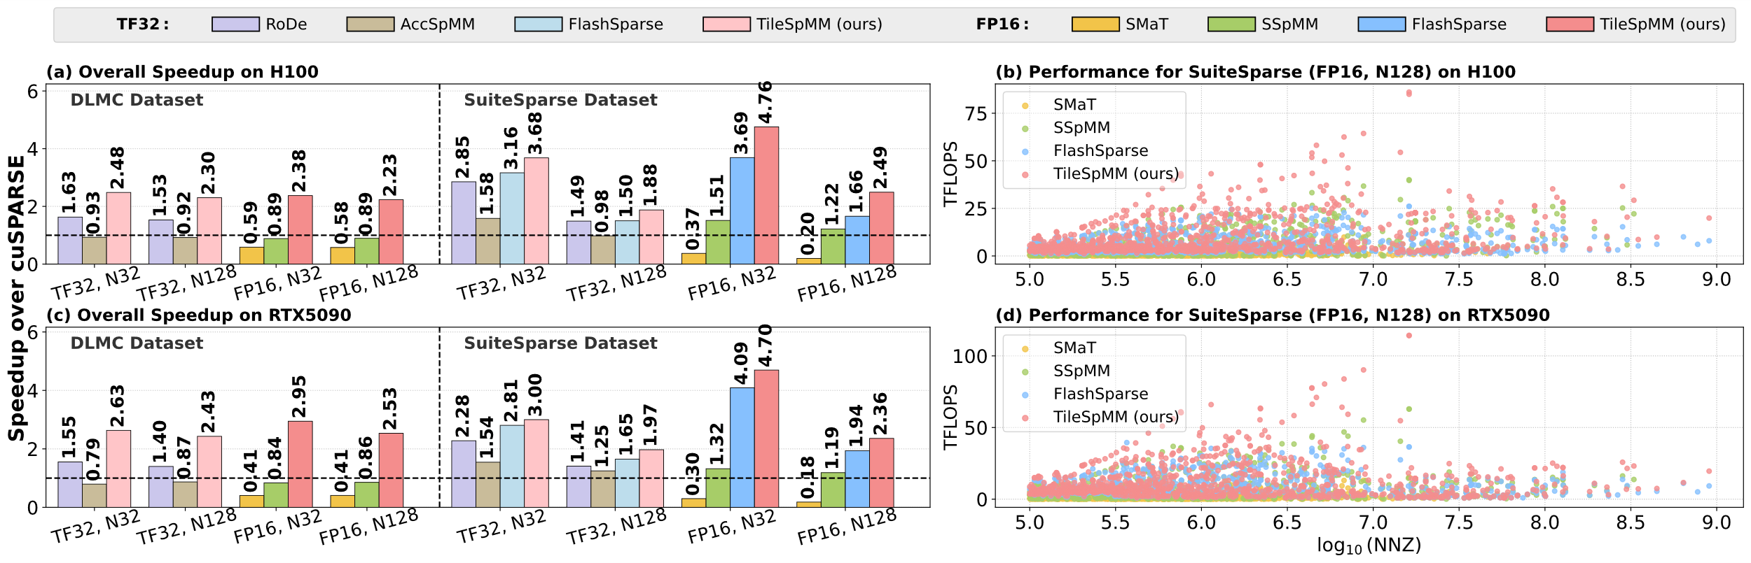
Performance Comparison
Kernel performance on H100 and RTX 5090 GPUs. (a, c) TileSpMM speedup over cuSPARSE. (b, d) Absolute TFLOPS on SuiteSparse with FP16 and colB = 128.
DLMC Dataset: TileSpMM achieves 2.23×–2.48× speedup over cuSPARSE on H100, and 2.43×–2.95× on RTX 5090 across TF32 and FP16 settings.
SuiteSparse Dataset: TileSpMM achieves 1.88×–4.76× speedup over cuSPARSE on H100, and 1.97×–4.70× on RTX 5090 across TF32 and FP16 settings.
Zeng et al., TileSpMM: A Variable-Size Tiled Algorithm for Sparse Matrix-Matrix Multiplication on Tensor Cores
30

Slide 31
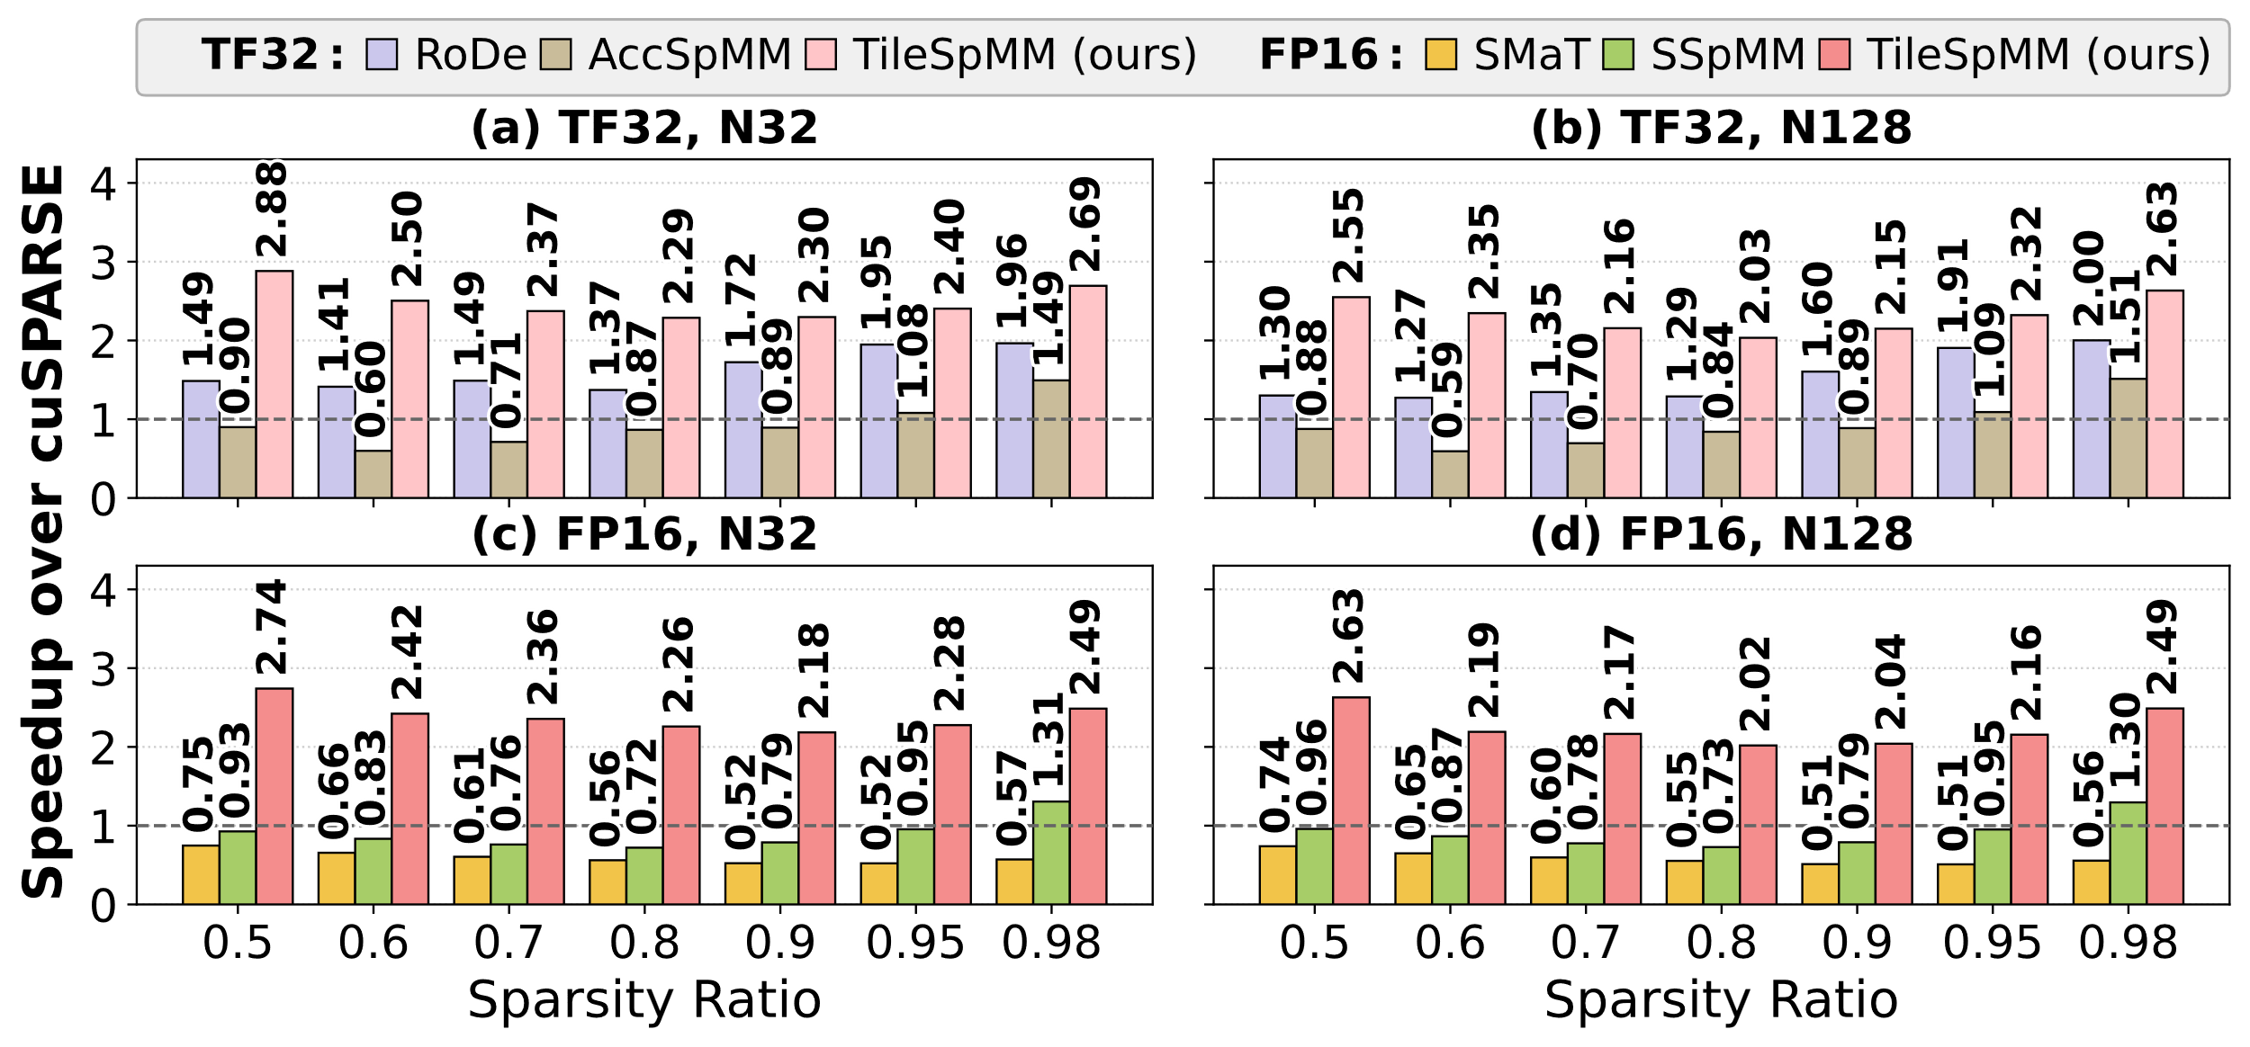
Performance Comparison
Across varying sparsity ratios and configurations on the H100 GPU, TileSpMM achieves a speedup of at least 2.0x over cuSPARSE in every group, reaching up to 2.7x.
Performance Speedup Distribution of TileSpMM on the SuiteSparse Dataset Using an RTX 5090
 | FP16/FP32 (mixed) |  |  |  | TF32
Speedup | Flash. | SMaT | SSpMM | cuSP. | Flash. | Acc. | RoDe | cuSP.
<1 | 9.50% | 0.10% | 2.89% | 0.26% | 13.33% | 32.45% | 28.47% | 2.26%
1–1.5 | 73.75% | 0.00% | 56.23% | 13.80% | 66.30% | 30.77% | 33.21% | 38.02%
1.5–2 | 12.59% | 0.21% | 16.40% | 31.60% | 16.85% | 13.21% | 14.86% | 23.52%
≥2 | 4.16% | 99.69% | 24.47% | 54.34% | 3.52% | 23.57% | 23.46% | 36.20%
Mean | 1.27x | 13.72x | 2.00x | 2.36x | 1.25x | 1.64x | 1.41x | 1.97x
Max | 4.95x | 253.62x | 110.69x | 24.45x | 3.20x | 194.99x | 7.05x | 15.54x
Performance comparison of TileSpMM and other baselines across different sparsity levels on the DLMC dataset using the H100 GPU.
On the RTX 5090 GPU, TileSpMM achieves a >2.0x speedup over cuSPARSE on 54% of the matrices under FP16, and outperforms cuSPARSE on 97% of the test matrices under TF32.
Zeng et al., TileSpMM: A Variable-Size Tiled Algorithm for Sparse Matrix-Matrix Multiplication on Tensor Cores
31

Slide 32
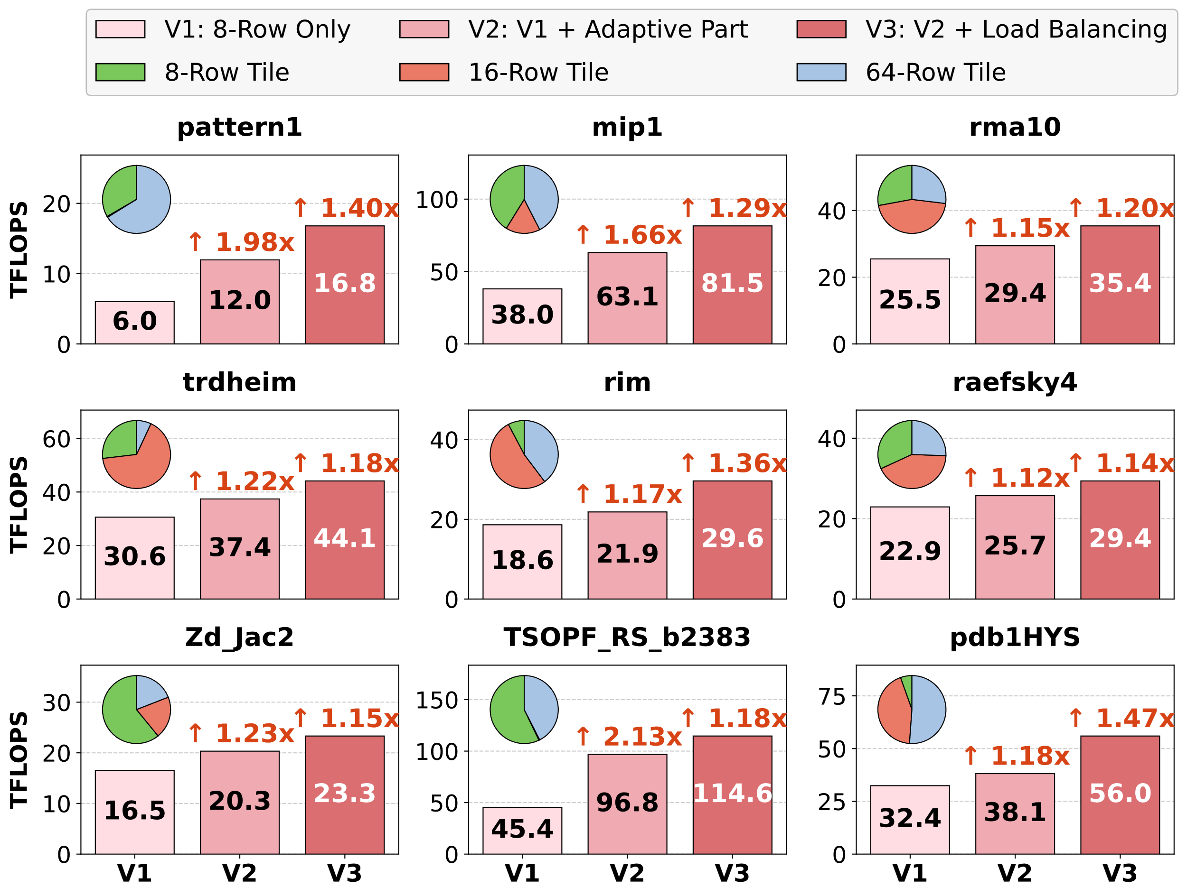
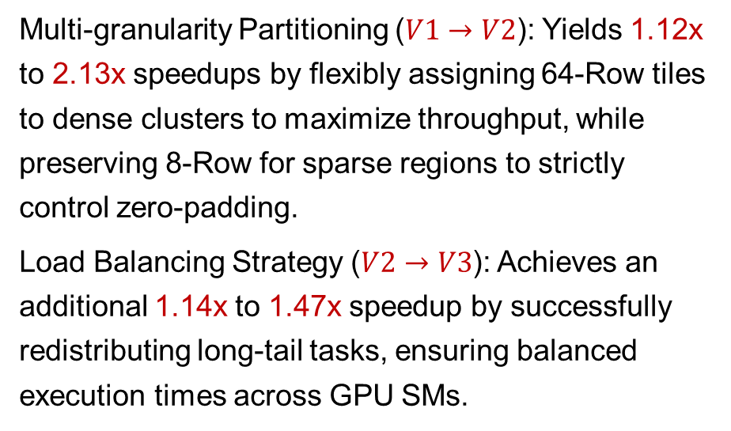
Ablation Study
Multi-granularity Partitioning ($V1→V2$): Yields 1.12x to 2.13x speedups by flexibly assigning 64-Row tiles to dense clusters to maximize throughput, while preserving 8-Row for sparse regions to strictly control zero-padding.
Load Balancing Strategy ($V2→V3$): Achieves an additional 1.14x to 1.47x speedup by successfully redistributing long-tail tasks, ensuring balanced execution times across GPU SMs.
Ablation study of TileSpMM. V1, V2, and V3 progressively incorporate multi-granularity partitioning and load balancing. The inset pie charts show the selected 64/16/8-row tile distribution for each matrix.
Zeng et al., TileSpMM: A Variable-Size Tiled Algorithm for Sparse Matrix-Matrix Multiplication on Tensor Cores
32

Slide 33
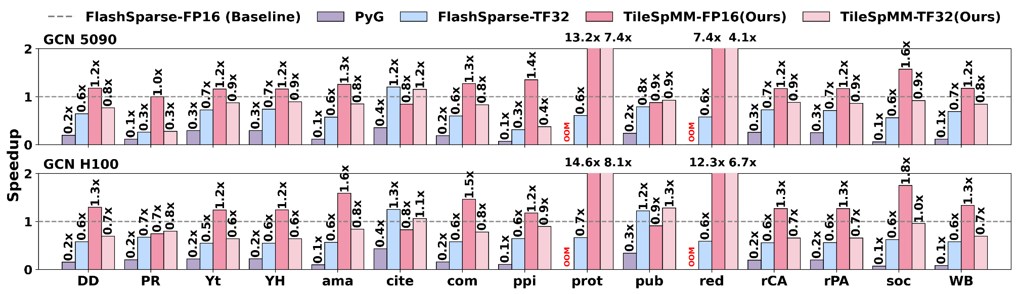
End-to-end GCNs Performance
End-to-end GCN performance speedup on RTX 5090 (top) and H100 (bottom) GPUs. Speedups are normalized to FlashSparse FP16 (1.0× baseline); FP16 and TF32 results are shown.
Experimental Setup: Evaluated on a 5-layer GCN in PyTorch; one-time preprocessing overhead is cached and fully amortized.
Overall Speedup: Compared to FlashSparse in FP16, achieves geometric mean speedups of 1.5x (up to 13.2x) on RTX 5090, and 1.7x (up to 14.6x) on H100.
Zeng et al., TileSpMM: A Variable-Size Tiled Algorithm for Sparse Matrix-Matrix Multiplication on Tensor Cores
33

Slide 34
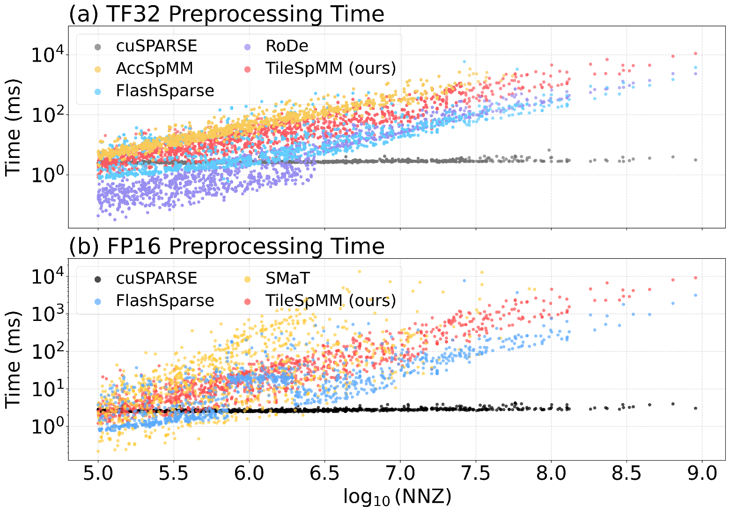
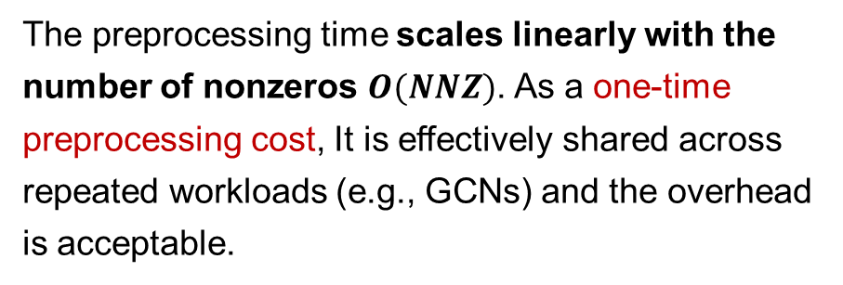
Preprocessing Overhead Analysis
Preprocessing:
Feature Extraction
Threshold Prediction
Load Balancing
Partitioning
Format Conversion
The preprocessing time scales linearly with the number of nonzeros $O(NNZ)$. As a one-time preprocessing cost, It is effectively shared across repeated workloads (e.g., GCNs) and the overhead is acceptable.
Preprocessing time of different SpMM methods under (a) TF32 and (b) FP16
Zeng et al., TileSpMM: A Variable-Size Tiled Algorithm for Sparse Matrix-Matrix Multiplication on Tensor Cores
34

Slide 35
Background
Motivation
TileSpMM
Evaluation
Conclusion
Outline
Zeng et al., TileSpMM: A Variable-Size Tiled Algorithm for Sparse Matrix-Matrix Multiplication on Tensor Cores
35

Slide 36
This work introduces TileSpMM, an algorithmic approach designed to accelerate unstructured SpMM by leveraging the computational capabilities of modern Tensor Core Units.
To address the inherent trade-off between zero-padding overhead and data locality found in traditional single-granularity tiling, we use a locality-aware dynamic partitioning method with a specific load balancing strategy to improve hardware utilization.
Experimental evaluations on the NVIDIA H100 and RTX 5090 GPUs indicate that our proposed method can provide consistent and positive performance improvements when compared with existing SpMM baselines.
Zeng et al., TileSpMM: A Variable-Size Tiled Algorithm for Sparse Matrix-Matrix Multiplication on Tensor Cores
36

Slide 37
Thanks！
TileSpMM: A Variable-Size Tiled Algorithm for Sparse Matrix-Matrix Multiplication on Tensor Cores
Hongwei Zeng, Shuqin Feng, Haocheng Lian, Yuechen Lu, Weifeng Liu
Super Scientific Software Laboratory, China University of Petroleum-Beijing, China
37

