Slide 1
Non-Delayed Cholesky Factorization
Yuchen Luo¹, Hongyu Chen¹, Shaoshuai Zhang², Weifeng Liu¹
¹China University of Petroleum-Beijing
²University of Electronic Science and Technology of China
2026.07.09

Slide 2
1
Background
2
Non-Delayed Cholesky Factorization
OUTLINE
3
Experiments
4
Conclusion

Slide 3







































Background - Cholesky Factorization
Cholesky factorization：$A=LL^{T}$
$$a$$
$$a$$
$$a$$
$$a$$
$$l$$
$$0$$
$$0$$
$$0$$
$$l$$
$$l$$
$$l$$
$$l$$
$$11$$
$$12$$
$$13$$
$$14$$
$$11$$
$$11$$
$$21$$
$$31$$
$$41$$
$$a$$
$$a$$
$$a$$
$$a$$
$$l$$
$$l$$
$$0$$
$$0$$
$$0$$
$$l$$
$$l$$
$$l$$
$$21$$
$$22$$
$$23$$
$$24$$
=
$$22$$
$$22$$
$$22$$
$$32$$
$$42$$
$$a$$
$$a$$
$$a$$
$$a$$
$$l$$
$$l$$
$$l$$
$$0$$
$$0$$
$$0$$
$$l$$
$$l$$
$$31$$
$$32$$
$$33$$
$$34$$
$$31$$
$$32$$
$$33$$
$$33$$
$$43$$
$$a$$
$$a$$
$$a$$
$$a$$
$$l$$
$$l$$
$$l$$
$$l$$
$$0$$
$$0$$
$$0$$
$$l$$
$$41$$
$$42$$
$$43$$
$$44$$
$$41$$
$$42$$
$$43$$
$$44$$
$$44$$
Cholesky factorization computes a lower triangular matrix L for a symmetric positive definite matrix A such that A = LL^T. It can be viewed as a special case of LU factorization. Because A is symmetric, only the lower triangular part is used in the computation.

Slide 4
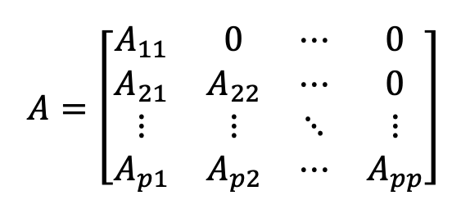
Background - Cholesky factorization
High-Performance Implementation: Tiled Cholesky
To improve data reuse and exploit the memory hierarchy, the matrix is partitioned into tiles, and the computation is organized as operations on these tiles.
Two classical variants: left-looking and right-looking
Never Touched
Never Touched
Left-looking
Right-looking
Already Factorized
Already Factorized
UPDATE
UPDATE

Slide 5
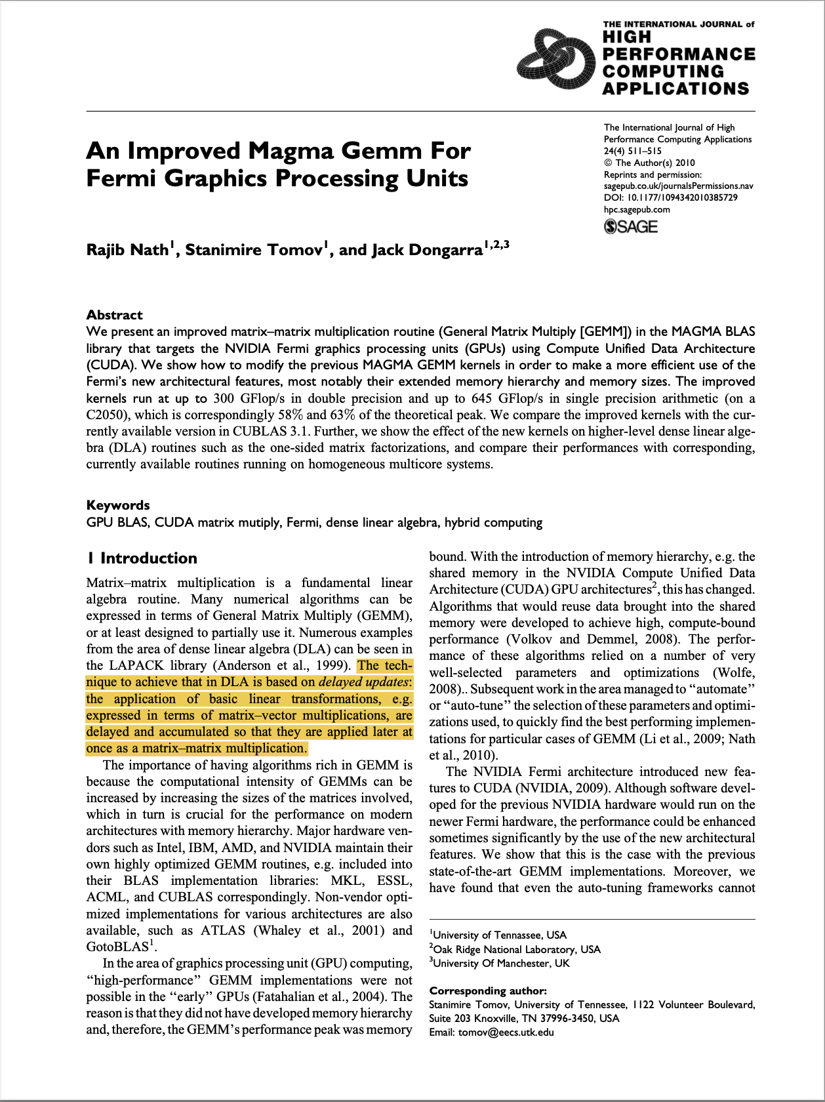
Background - Delayed Update Paradigm in Tiled Cholesky
The technique to achieve that in DLA is based on delayed updates ... applied later at once as a matrix-matrix multiplication.
Delayed update is a common execution strategy in dense linear algebra: updates are not applied immediately, but accumulated and later applied in bulk through GEMM or other Level-3 BLAS operations.
An Improved Magma Gemm For Fermi Graphics Processing Units. Nath, Rajib and Tomov, Stanimire and Dongarra, Jack. 2010. The International Journal of High Performance Computing Applications.

Slide 6
Background - Delayed Update Paradigm in Tiled Cholesky
Left-looking
Right-looking
Both left-looking and right-looking tiled Cholesky fall into the delayed-update paradigm.
Their updates are organized at the panel granularity, typically through GEMM-based Level-3 BLAS operations.
Never Touched
Never Touched
Already Factorized
Already Factorized
UPDATE
UPDATE

Slide 7
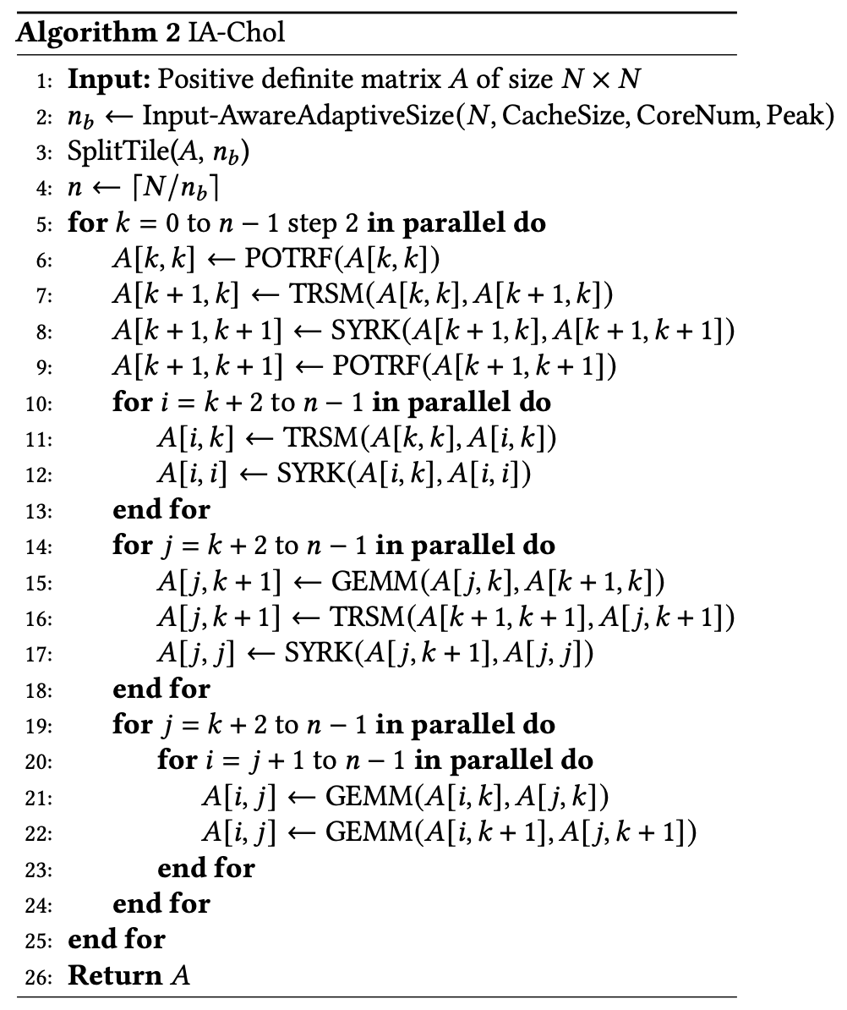
Background - Delayed Update Paradigm in Tiled Cholesky
Left-looking
Right-looking
Operator fusion
Never Touched
Never Touched
panel-level synchronization
Already Factorized
Already Factorized
UPDATE
UPDATE
IA-Chol: Input-Aware Cholesky Decomposition on CPU and GPU. Deng, Jixiao and Wang, Qinglin and Chen, Lin and Li, Tun and Yang, Bo and Chen, Xinhai and Liu, Jie. 2025. Proceedings of the 39th ACM International Conference on Supercomputing.

Slide 8
Background - Delayed Update Paradigm in Tiled Cholesky
Left-looking
Right-looking
Operator fusion
GEMM invocation is no longer a sufficient criterion.
The key question is whether a tile can proceed independently once its dependencies are ready.
Never Touched
Never Touched
Already Factorized
Already Factorized
UPDATE
UPDATE
IA-Chol: Input-Aware Cholesky Decomposition on CPU and GPU. Deng, Jixiao and Wang, Qinglin and Chen, Lin and Li, Tun and Yang, Bo and Chen, Xinhai and Liu, Jie. 2025. Proceedings of the 39th ACM International Conference on Supercomputing.

Slide 9
BACKGROUND - Delayed Update Paradigm in Tiled Cholesky
We therefore move beyond GEMM invocation and adopt a stricter tile-centric definition based on tile readiness and independent progress.
Definition 1 (Delayed Update, Tile-Centric)
An algorithm uses a delayed update scheme if there exists at least one tile whose update, although all its data dependencies are already satisfied, is not executed independently but is forced to start and finish together with operations on other tiles.

Slide 10
BACKGROUND - GEMM as the Non-Delayed Ideal
j
C ← C + A * B
Each output-tile update C_{ij} ← C_{ij} + A_{ik} * B_{kj}, is executed immediately after the operand tiles A_{ik} and B_{kj} are fetched. The progress of tile C_{ij} is completely independent of any other tile. One thread block computes one tile, and the tile remains resident in the block’s on-chip memory (registers and shared memory) throughout its lifetime.
Maximizes parallelism and data reuse
B
A
C
i

Slide 11
BACKGROUND - GEMM as the Non-Delayed Ideal
GEMM is the ideal non-delayed model because each tile can proceed independently as soon as its required data becomes ready. Based on this observation, we give a tile-centric definition of non-delayed update.
Definition 2(Non-Delayed Update, Tile-Centric)
An algorithm uses a non-delayed update scheme if, for every tile, each update whose data dependencies are satisfied is executed independently and applied to that tile as soon as it becomes ready.

Slide 12
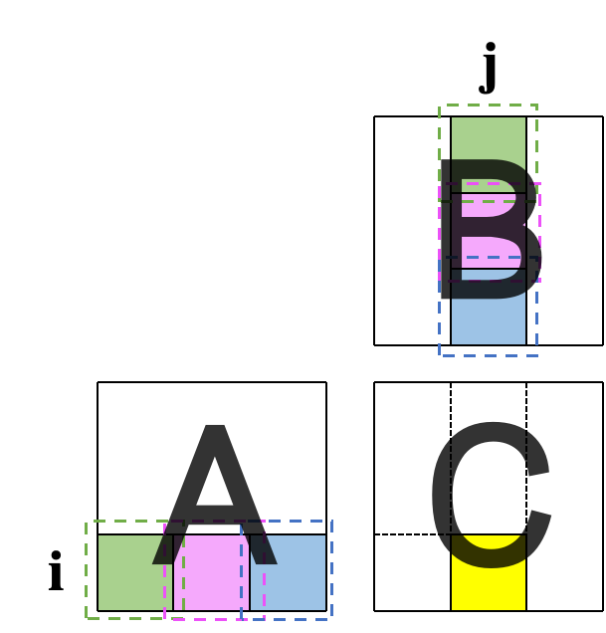
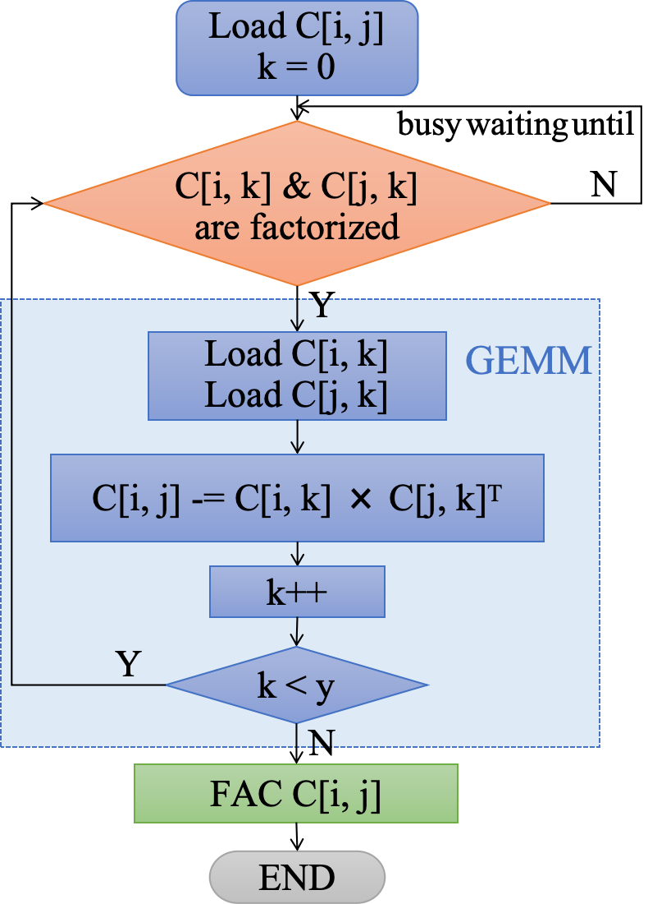
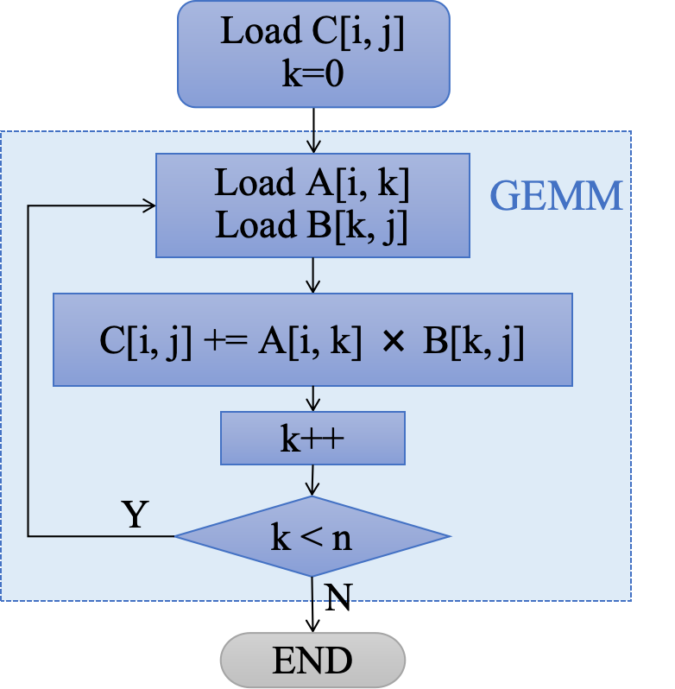
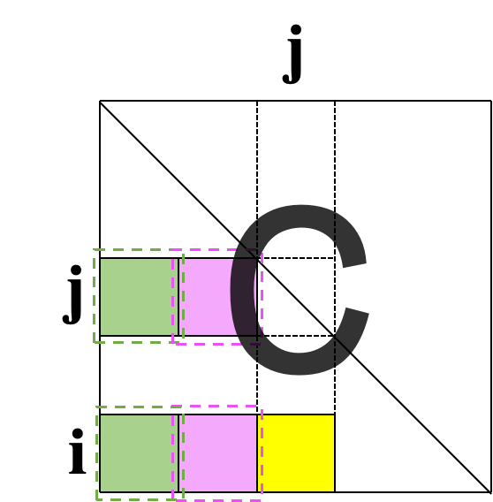
Why Cholesky Updates Are GEMM-Like
(a) Tile update in GEMM
(b) Tile update in Cholesky
(a) GEMM update loop
(b) Cholesky tile compute loop

Slide 13
Non-Delayed Cholesky Factorization
Monolithic Persistent Kernel The entire Cholesky factorization is encapsulated within a single persistent kernel, eliminating repeated kernel launches and inter-kernel synchronization overhead. Intra-Kernel, Tile-Centric Scheduling All computations associated with a tile are assigned to a single thread block. A lightweight asynchronous flag-polling mechanism allows execution to proceed immediately once dependencies are satisfied. Full-Lifetime On-Chip Residency Each tile is loaded from global memory only once, completes all updates and factorization steps in registers and shared memory, and is written back only once.

Slide 14
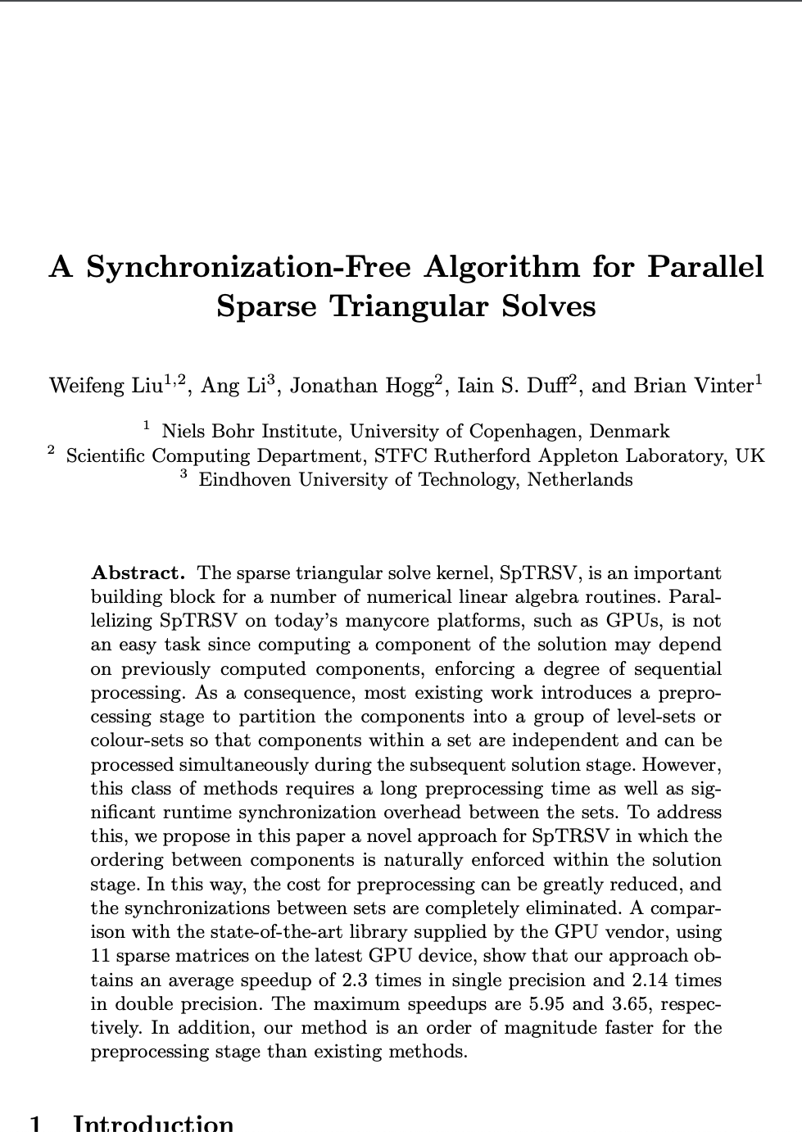
Synchronization-Free Design
Global readiness array for execution control
Busy-waiting before dependencies are satisfied
A synchronization-free algorithm for parallel sparse triangular solves. Liu, Weifeng and Li, Ang and Hogg, Jonathan and Duff, Iain S and Vinter, Brian. 2016. Euro-Par.

Slide 15
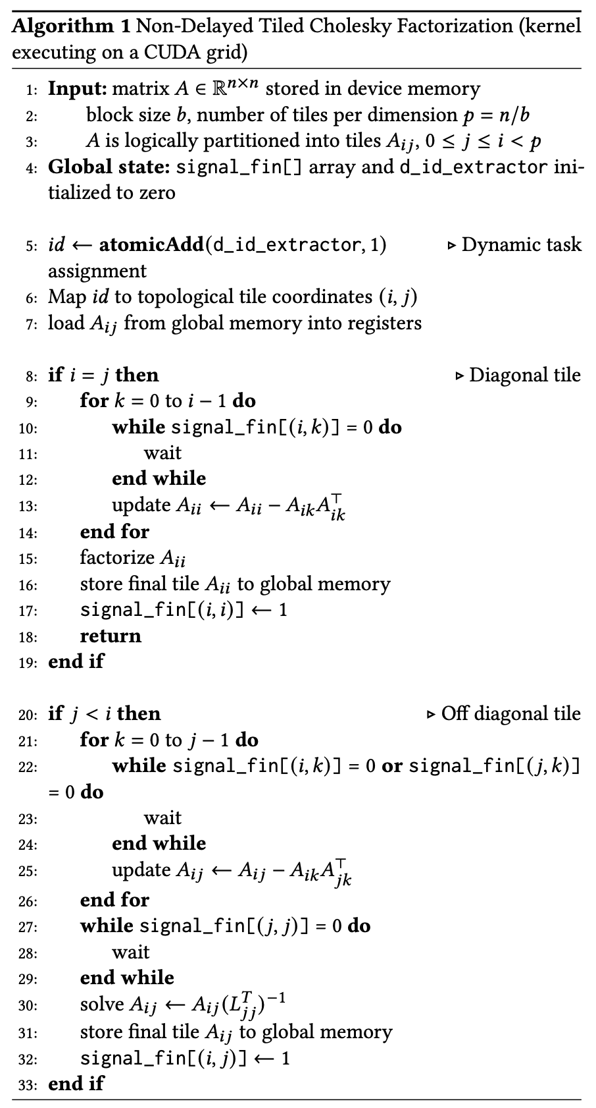
Synchronization-Free Design
Deadlock-Free Dynamic Task Assignment
Tile Partitioning
0
An atomic counter in global memory (atomicAdd) allows active thread blocks to dynamically fetch tile IDs. This enforces a monotonic claim order aligned with the dependency topology and eliminates the risk of deadlock.
1
3
2
4
5
GPU Launch Order

Slide 16
Non-Delayed Cholesky Factorization
Original matrix
Busy Waiting
Done
Trailing Tile Update
Diagonal Tile Factorization
Column Tile Solve
0
load
compute
store
CUDA BLOCK BEHAVIOR
1
3
Global array: signal_fin[] | 0 | 0 | 0 | 0 | 0 | 0
2
4
5
WAITING FOR
CUDA Block
0
1
2
3
4
5

Slide 17
Non-Delayed Cholesky Factorization
Busy Waiting
Done
Trailing Tile Update
1
Diagonal Tile Factorization
Column Tile Solve
0
load
compute
store
0
0
0
1
3
2
4
5
Tile 0 completes its diagonal factorization and sets signal_fin[0] to 1. After all work associated with this tile is finished, the corresponding CUDA block terminates and releases its resources. Tiles 1 and 2, which depend on tile 0, observe the update of signal_fin[0] and become ready to proceed.
Global array: signal_fin[] | 1 | 0 | 0 | 0 | 0 | 0
CUDA Block
0
1
2
3
4
5

Slide 18
Non-Delayed Cholesky Factorization
Busy Waiting
Done
Trailing Tile Update
2
Diagonal Tile Factorization
Column Tile Solve
0
load
compute
store
0
1
3
1
1
1
2
4
5
2
2
Tiles 1 and 2 begin their triangular solves. Tile 1 finishes first and sets signal_fin[1] to 1, while tile 2 has not yet completed. The next update of tile 3 depends only on tile 1, so once signal_fin[1] is set, tile 3 becomes ready to proceed. Tile 4 also depends on tile 1; however, because its next update additionally depends on tile 2, the completion of tile 1 alone is insufficient to satisfy its dependency conditions, and tile 4 therefore remains in the busy-wait state.
Global array: signal_fin[] | 1 | 1 | 0 | 0 | 0 | 0
CUDA Block
1
2
3
4
5

Slide 19
Non-Delayed Cholesky Factorization
Busy Waiting
Done
Trailing Tile Update
3
Diagonal Tile Factorization
Column Tile Solve
0
load
compute
store
1
3
1
3
2
4
5
2
2
The completion of tile 1 allows tile 3 to proceed with its next update, even while tile 2 is still running. This shows that updates and factorization naturally interleave in the non-delayed model. Once tile 2 completes, tile 4 can proceed with its next update, which depends on both tiles 1 and 2. Likewise, tile 5, whose next update depends only on tile 2, also enters the update phase.
Global array: signal_fin[] | 1 | 1 | 1 | 0 | 0 | 0
CUDA Block
2
3
4
5

Slide 20
Non-Delayed Cholesky Factorization
Busy Waiting
Done
Trailing Tile Update
4
Diagonal Tile Factorization
Column Tile Solve
0
load
compute
store
3
3
3
1
3
1
4
2
4
5
2
5
After finishing all of its updates, tile 3 immediately proceeds to diagonal factorization, since this operation has no remaining dependencies. Because tile 2 completed in the previous step, tiles 4 and 5 now satisfy all dependency conditions and can both begin their subsequent updates.
Global array: signal_fin[] | 1 | 1 | 1 | 1 | 0 | 0
CUDA Block
3
4
5

Slide 21
Non-Delayed Cholesky Factorization
Busy Waiting
Done
Trailing Tile Update
5
Diagonal Tile Factorization
Column Tile Solve
0
load
compute
store
3
4
4
1
3
4
5
2
4
5
Tile 4 completes its subsequent update. Since tile 3 has already finished its diagonal factorization, tile 4 can immediately proceed to its triangular solve. At the same time, tile 5 is still in the middle of its first update and therefore remains in the update phase.
Global array: signal_fin[] | 1 | 1 | 1 | 1 | 1 | 0
CUDA Block
4
5

Slide 22
Non-Delayed Cholesky Factorization
Busy Waiting
Done
Trailing Tile Update
6
Diagonal Tile Factorization
Column Tile Solve
0
load
compute
store
4
5
1
3
2
4
5
Tile 4 completes its next update. Since tile 3 has already finished its diagonal factorization, tile 4 can immediately proceed to its triangular solve. At the same time, tile 5 is still executing its first update and therefore remains in the update phase.
Global array: signal_fin[] | 1 | 1 | 1 | 1 | 1 | 0
CUDA Block
5

Slide 23
Non-Delayed Cholesky Factorization
Busy Waiting
Done
Trailing Tile Update
7
Diagonal Tile Factorization
Column Tile Solve
0
load
compute
store
5
5
5
1
3
2
4
5
Tile 5 has completed all of its updates. Because it lies on the diagonal, its diagonal factorization has no remaining tile dependencies and can begin immediately. This completes the work associated with tile 5 and marks the completion of the entire factorization.
Global array: signal_fin[] | 1 | 1 | 1 | 1 | 1 | 1
CUDA Block
5

Slide 24
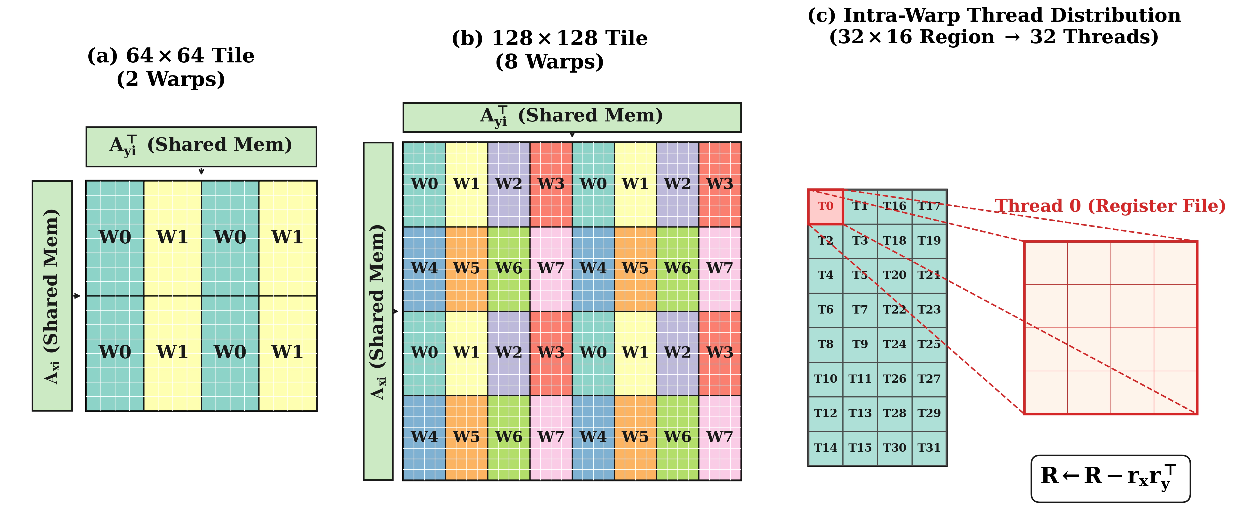
Mapping the Update to a GEMM-Like Kernel
We map the Cholesky update directly to a GEMM-like microkernel: the tile is decomposed into warp-level regions, each thread computes a fixed 4 × 4 subfragment entirely in registers, and a strict 2 × 2 interleaved layout is used to minimize shared-memory bank conflicts. In practice, we provide both 64 × 64 and 128 × 128 tile configurations to balance arithmetic intensity, parallelism, and resource usage.

Slide 25
Experiments

Slide 26
Experiments
Platform | A100 | H100 | RTX5090 | R9700
FP32 Peak (TFLOPS) | 19.5 | 66.9 | 104.8 | 47.8
Bandwidth (GB/s) | 1555 | 3352 | 1793 | 640
Evaluated FP32 Routines
cuSOLVER (v12.9) | cusolverDnSpotrf |  |  | -
rocSOLVER (v7.2) | - |  |  | rocsolver_spotrf
hipSOLVER (v7.2) | - |  |  | hipsolverSpotrf
MAGMA (v2.9) | magma_spotrf_native
Ours | Non-Delayed Cholesky (b = 64, 128)

Slide 27
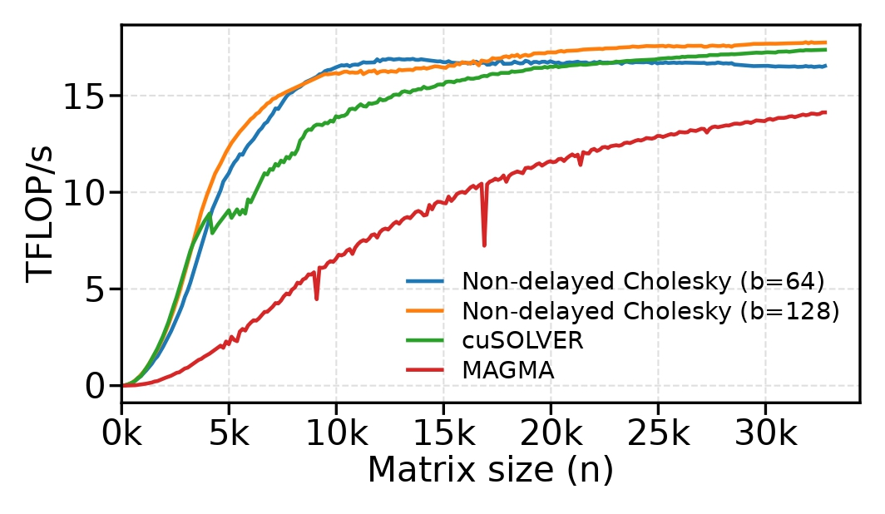
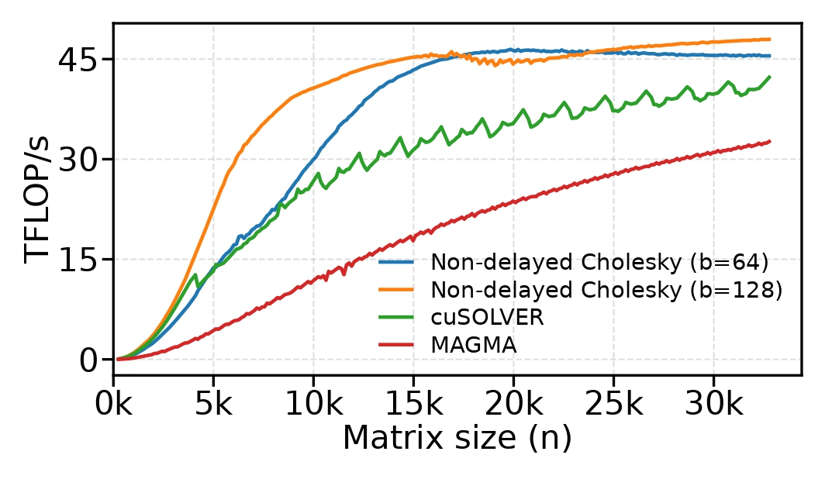
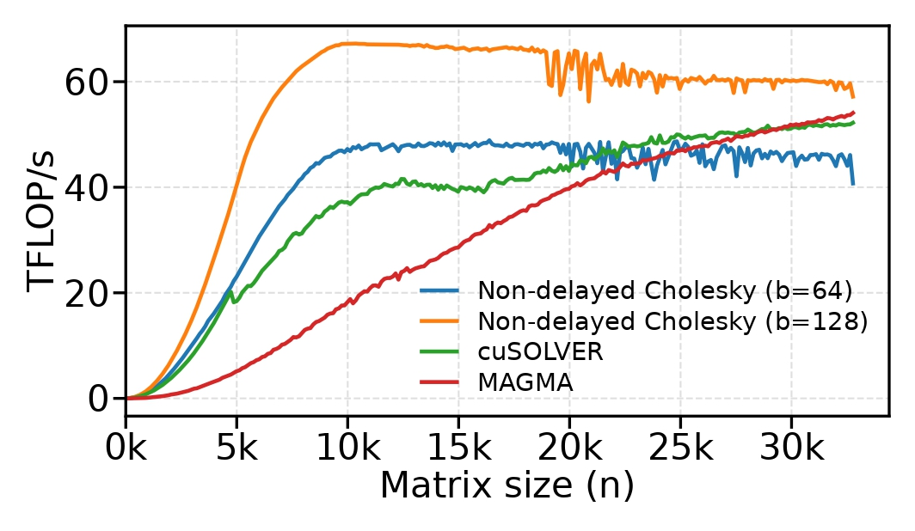
Experiments - NVIDIA
A100: Cholesky Performance
H100: Cholesky Performance
RTX 5090: Cholesky Performance
For the (b=128) variant, the peak speedups over cuSOLVER reach 1.51x on A100 (n=5760), 1.85x on H100 (n=6400), and 2.28x on RTX 5090 (n=5632).

Slide 28
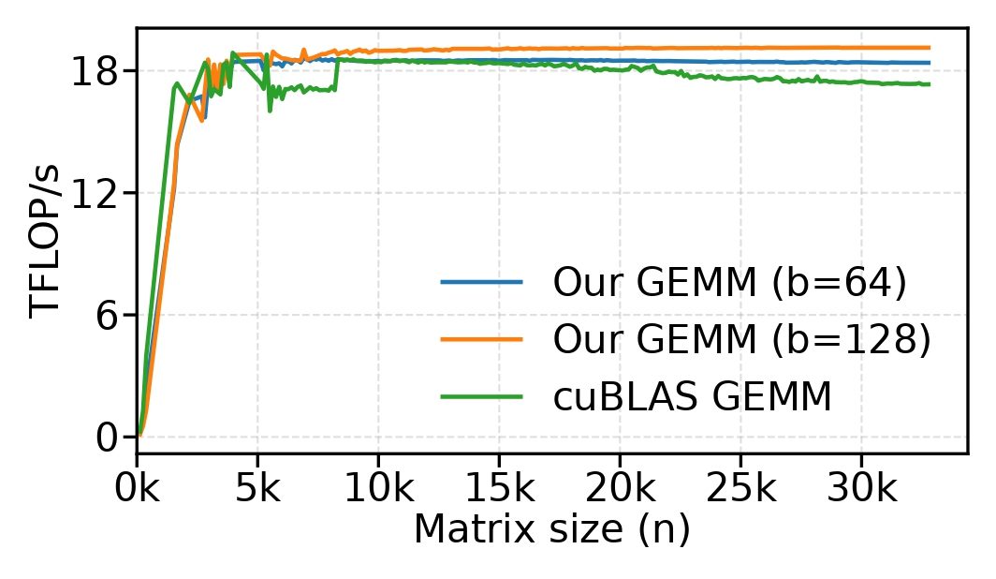
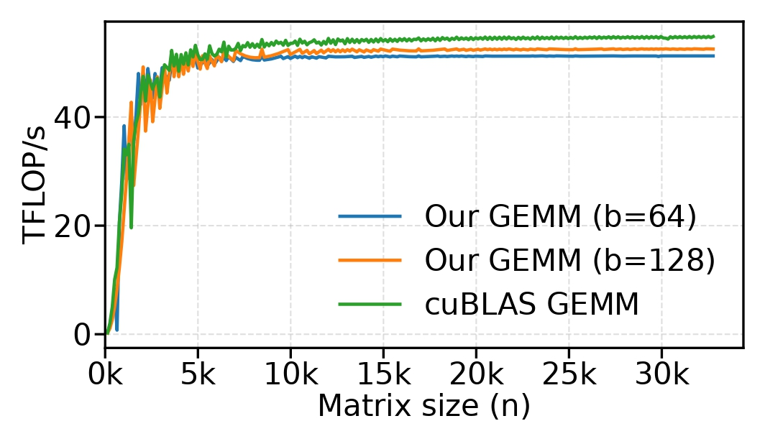
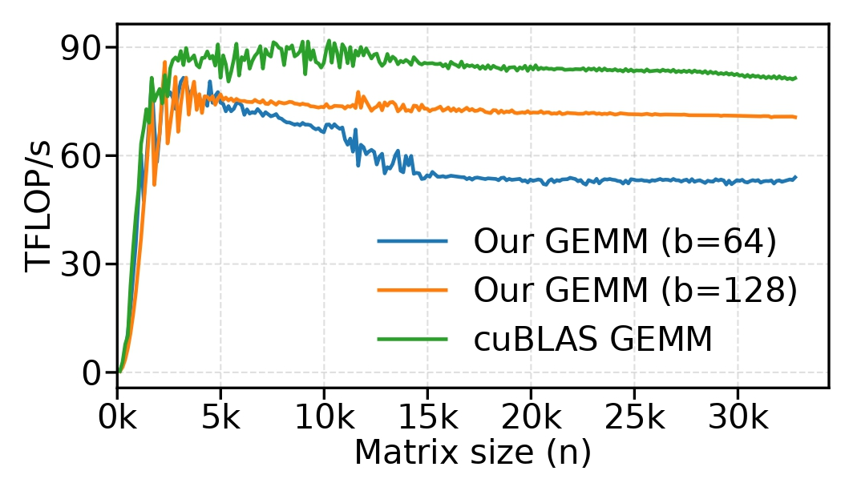
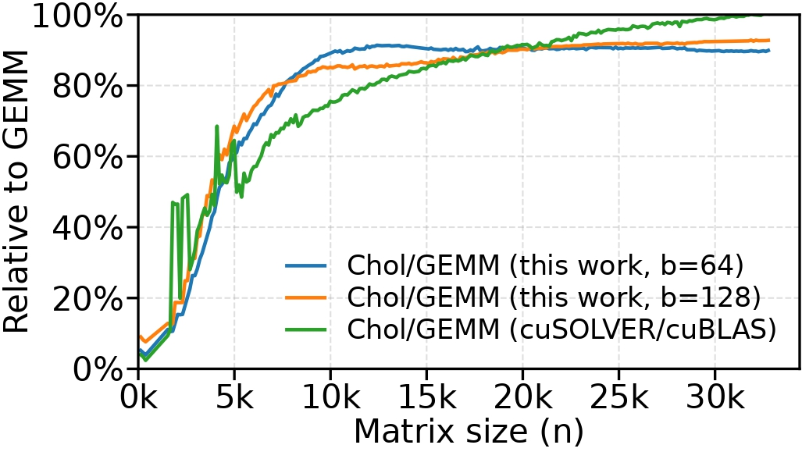
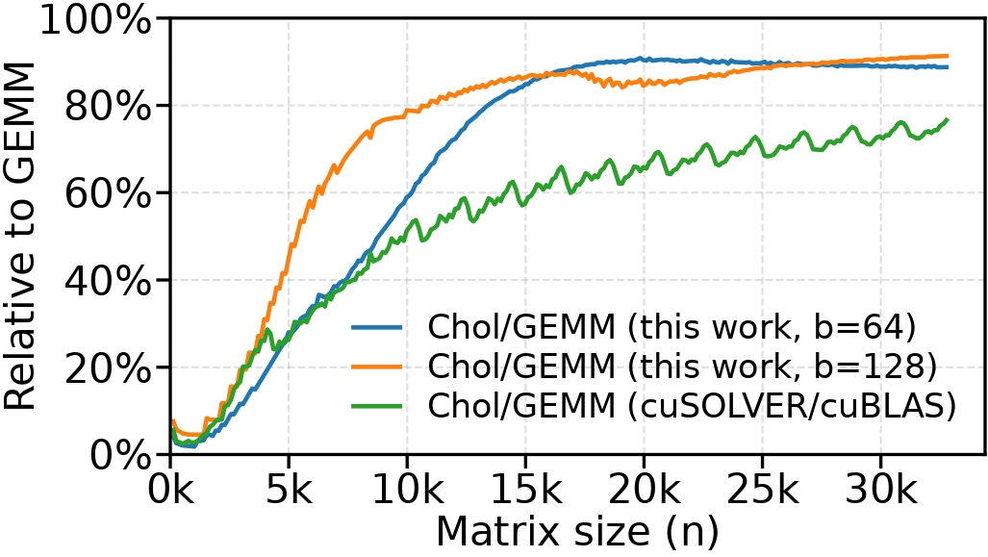
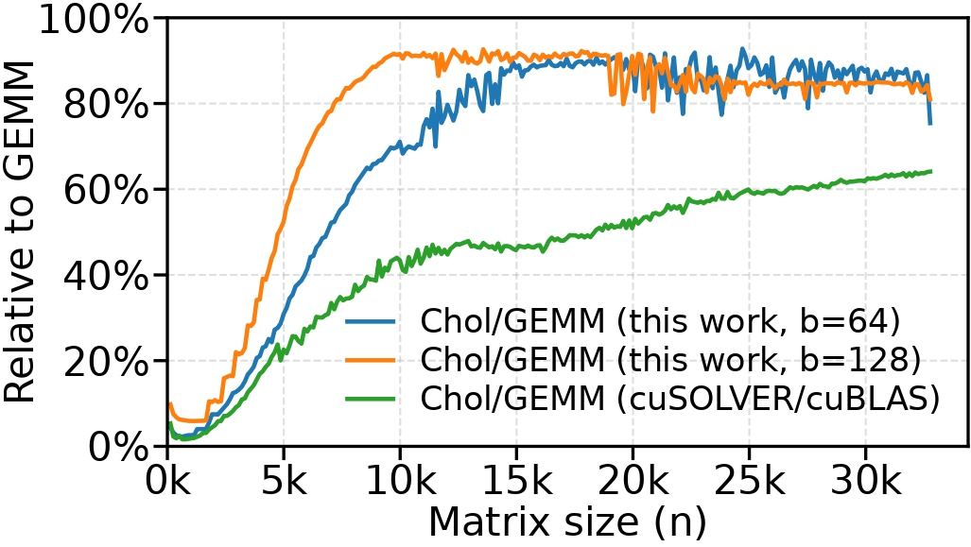
Experiments - NVIDIA
A100: GEMM Performance
H100: GEMM Performance
RTX 5090: GEMM Performance
A100: Conversion Efficiency
H100: Conversion Efficiency
RTX 5090: Conversion Efficiency
Over 90% GEMM-to-Cholesky conversion is maintained across all NVIDIA GPUs.

Slide 29
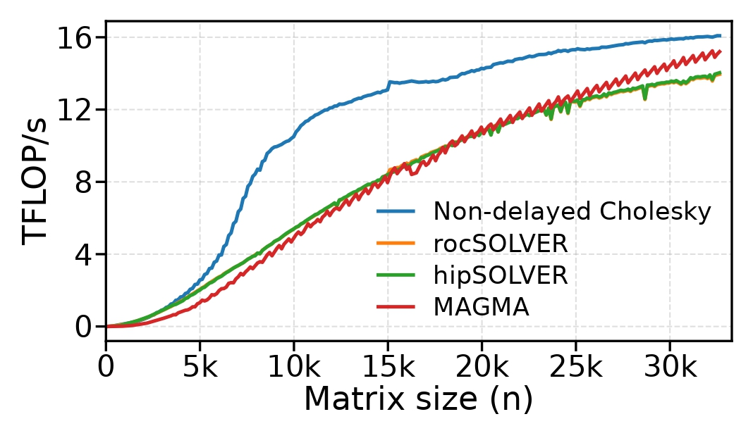
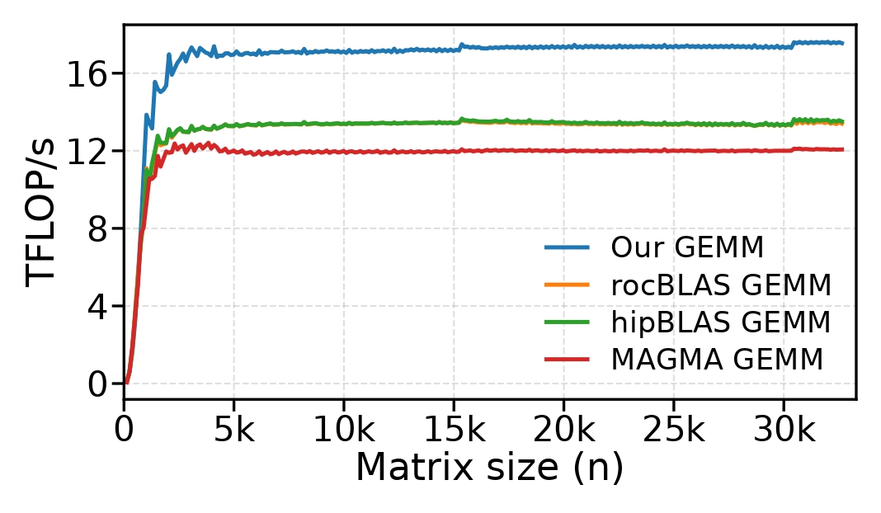
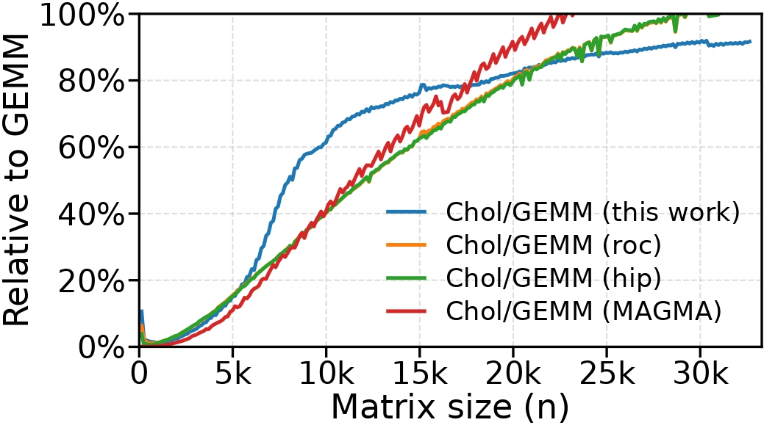
Experiments - AMD R9700
AMD R9700: Cholesky Performance
AMD R9700: GEMM Throughput*
AMD R9700: Conversion Efficiency
On AMD R9700, our method achieves up to 2.16× speedup over rocSOLVER, hipSOLVER, and MAGMA, while maintaining over 90% conversion efficiency.
*set ROCBLAS_USE_HIPBLASLT=0

Slide 30
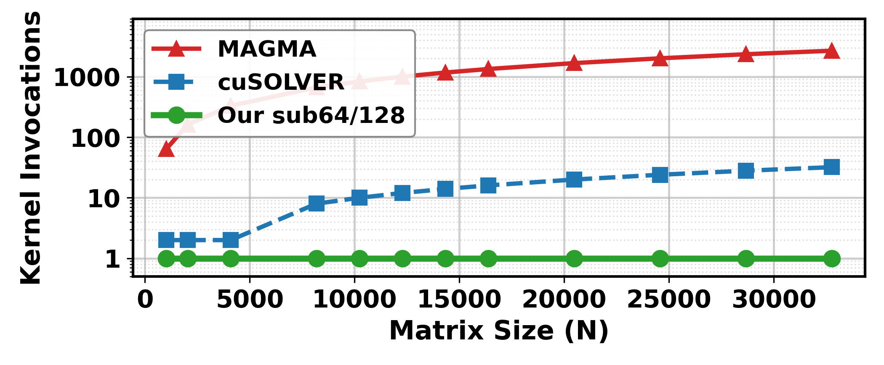
Experiments
Traditional methods require more kernel launches as matrix size grows, while our method always uses a single kernel launch, eliminating repeated launch overhead.
Kernel Launch Counts for Complete Cholesky Factorization on NVIDIA GPUs

Slide 31
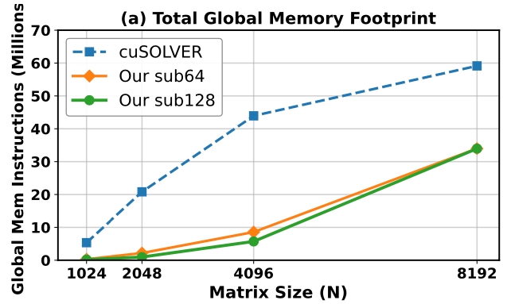
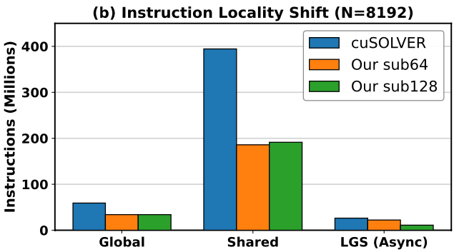
Experiments
Global Memory Instruction Count on RTX 5090
Instruction Locality Breakdown on RTX 5090 (N=8192)
Our method reduces overall data movement, cutting global-memory instructions by nearly half and shared-memory instructions by more than 50% (N=8192).

Slide 32
Conclusion

Slide 33
Conclusion
A non-delayed Cholesky factorization method for modern GPUs
A GEMM-like single-kernel execution model that improves on-chip data residency and eliminates kernel-launch overheads
Significant performance advantages across four GPU architectures, validating the effectiveness of this execution model for dense Cholesky factorization

Slide 34
THANKS
Presenter: Yuchen Luo
Super Scientific Software Laboratory (SSSLab)
China University of Petroleum-Beijing
July 2026

