Slide 1

Uni-STC: Unified Sparse Tensor Core
Haocheng Lian¹, Qiyue Zhang¹, Xinran Zhao¹, Meichen Dong¹, Zhengyi Zhao¹,
Junzhong Shen², Wei Guo², Chun Huang², Bingcai Sui², Weifeng Liu¹
1 China University of Petroleum-Beijing
2 National University of Defense Technology
Notes:
Hello. I am Haocheng Lian from the China University of Petroleum (Beijing). The title of my report is Uni-STC: Unified Sparse Tensor Core. This work is completed in collaboration with the National University of Defense Technology.

Slide 2
1
Background & Motivation
2
Uni-STC’s Architecture
OUTLINE
3
Uni-STC’s Dataflow
4
Evaluation
5
Conclusion
Notes:
My report is divided into these five parts

Slide 3
1
Background & Motivation
2
Uni-STC’s Architecture
OUTLINE
3
Uni-STC’s Dataflow
4
Evaluation
5
Conclusion
Notes:
First is the background and motivation section.

Slide 4
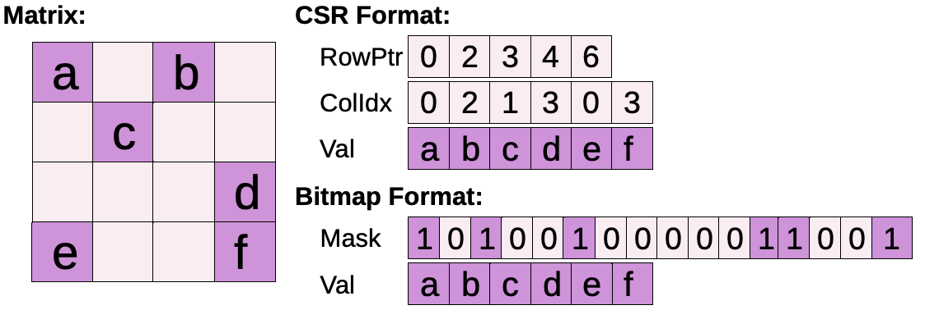

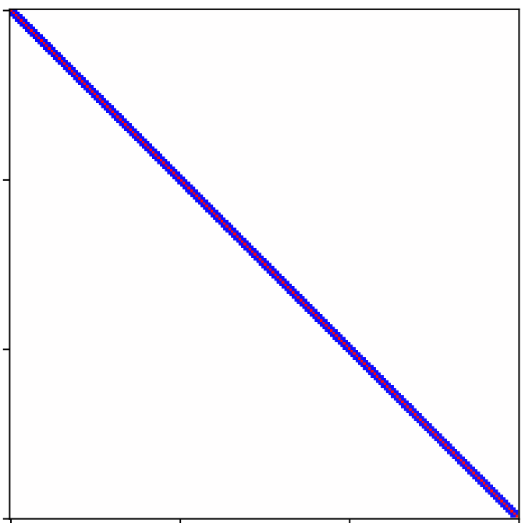
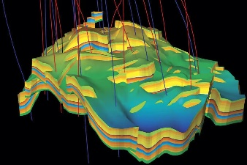
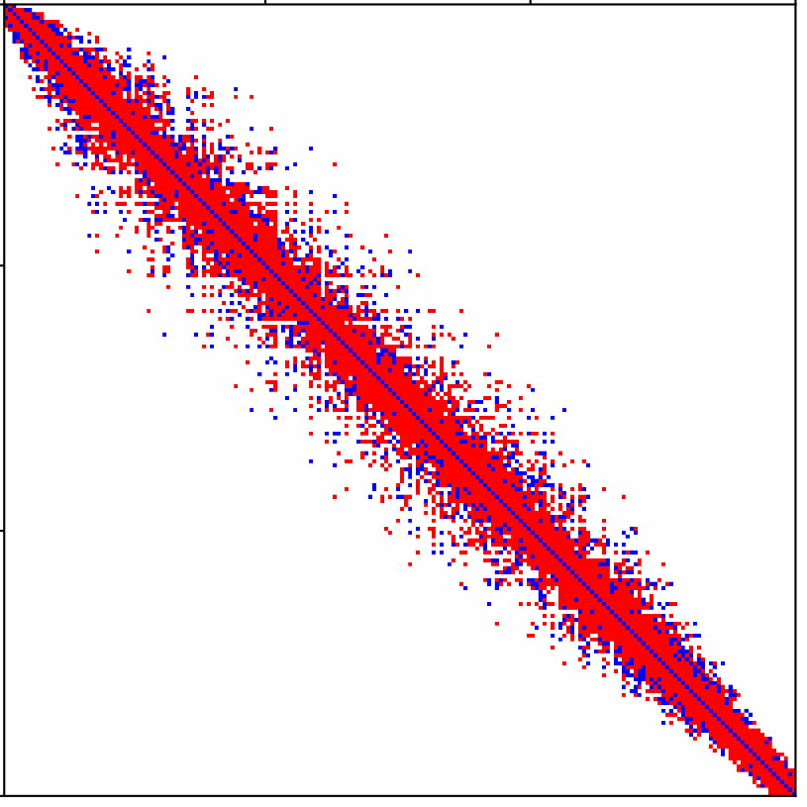
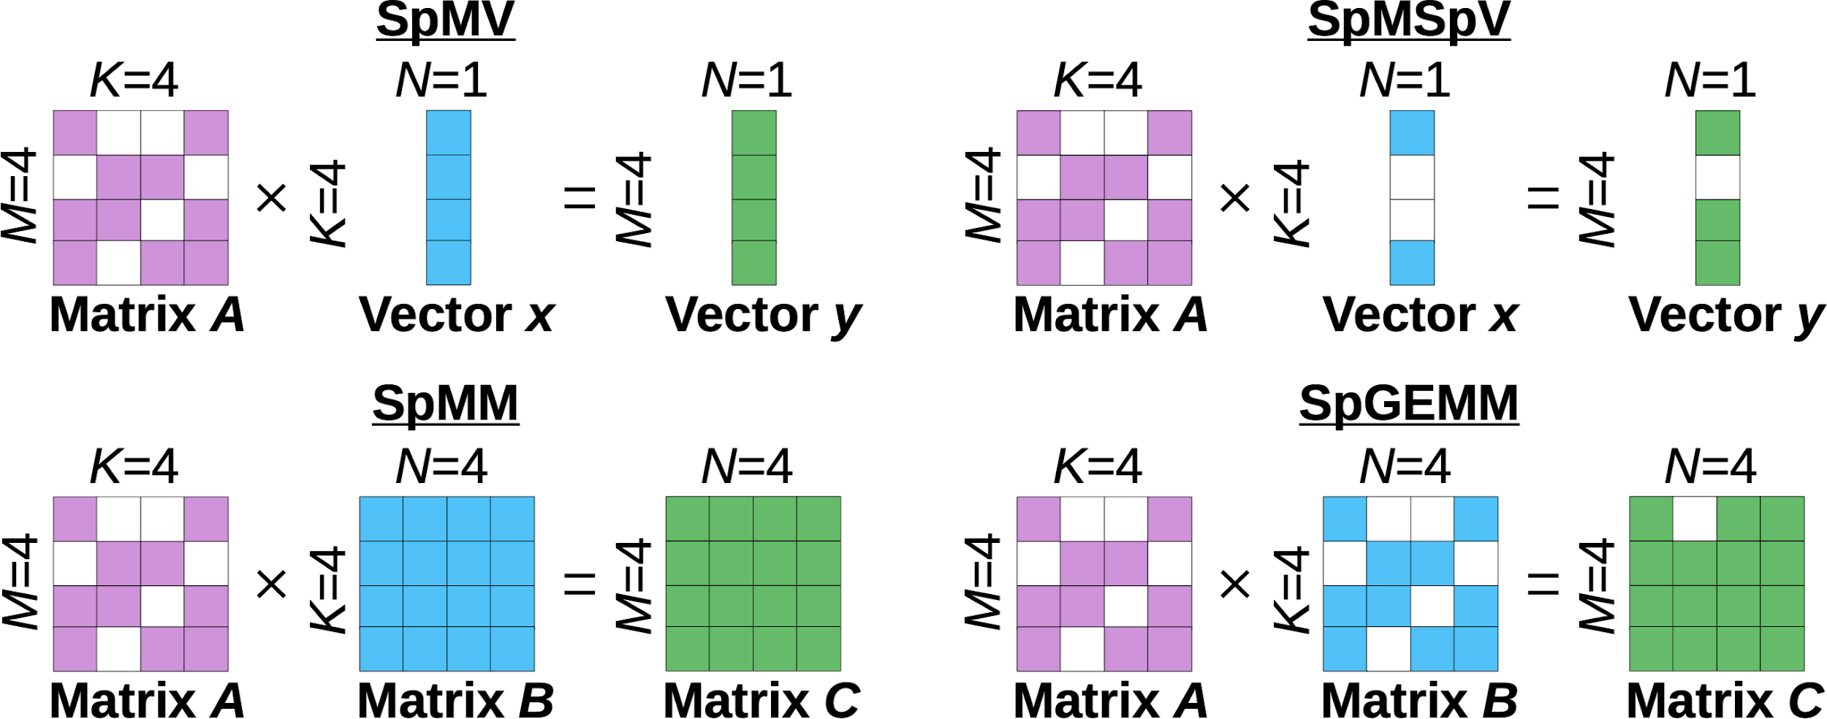
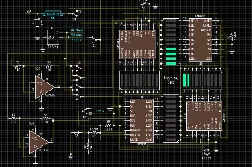
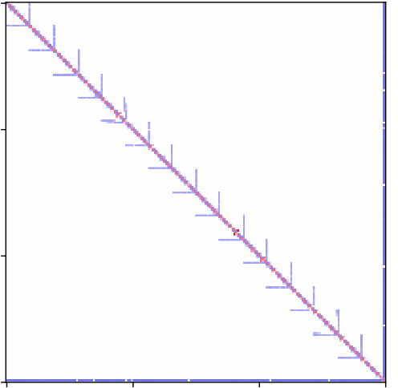
Applications and Sparse computation
Scientific computing and AI are the cornerstone of industrial development; in essence, it consists of calculations of sparse matrices with different structures.
These sparse matrices require specialized data structures for storage, commonly including CSR and bitmap formats.
Laser fusion is vividly called the "artificial sun" and is a key technological path for humanity to pursue infinite and clean energy.
Reservoir simulation plays a key role as the "digital brain" and "X-ray vision" in the petroleum industry.
Common workloads usually involve a mix of four different BLAS operators:
❶ BFS
❷ GNN
❸ AMG
To avoid format conversion costs, it is best to design a unified sparse format to accelerate various sparse operators.
Circuit simulation is the core guarantee for the completion of complex chip development.

Slide 5
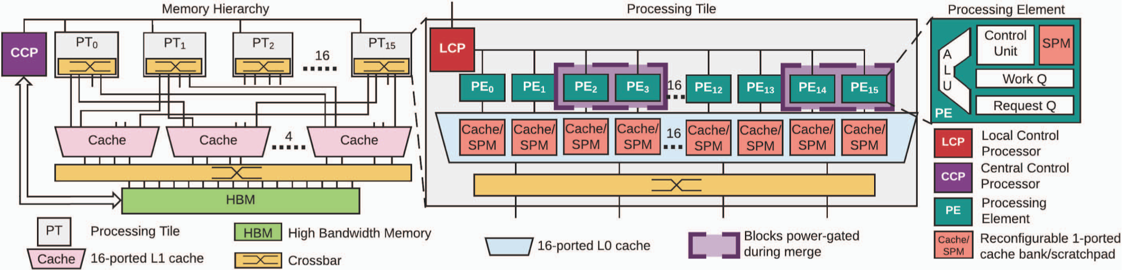
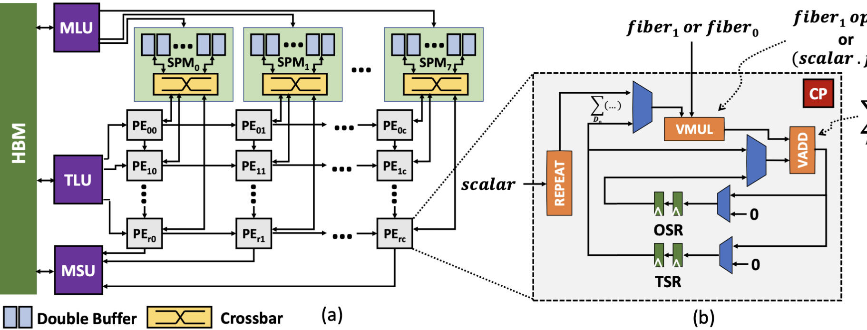
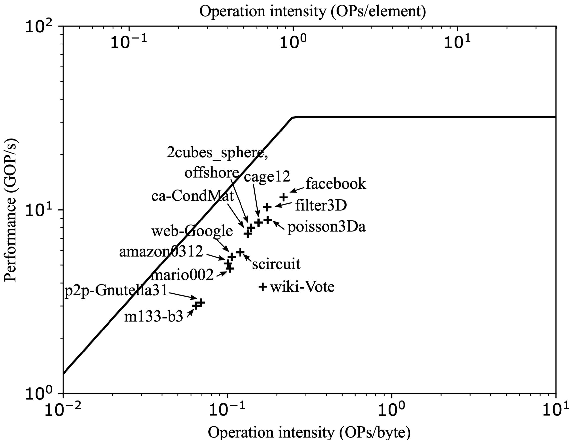
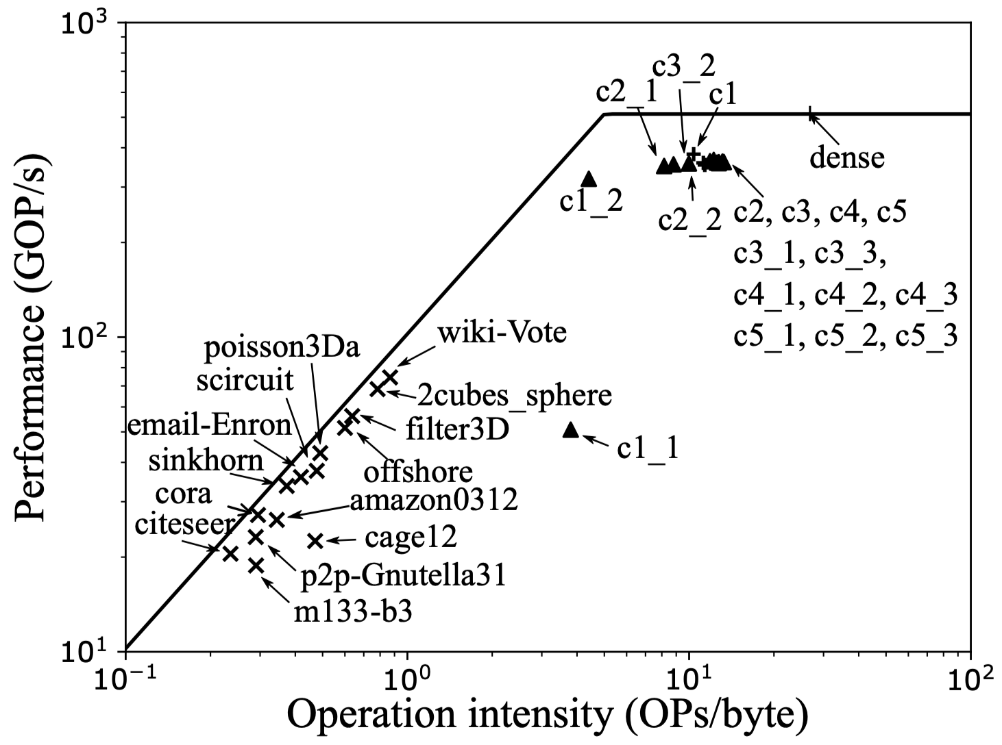
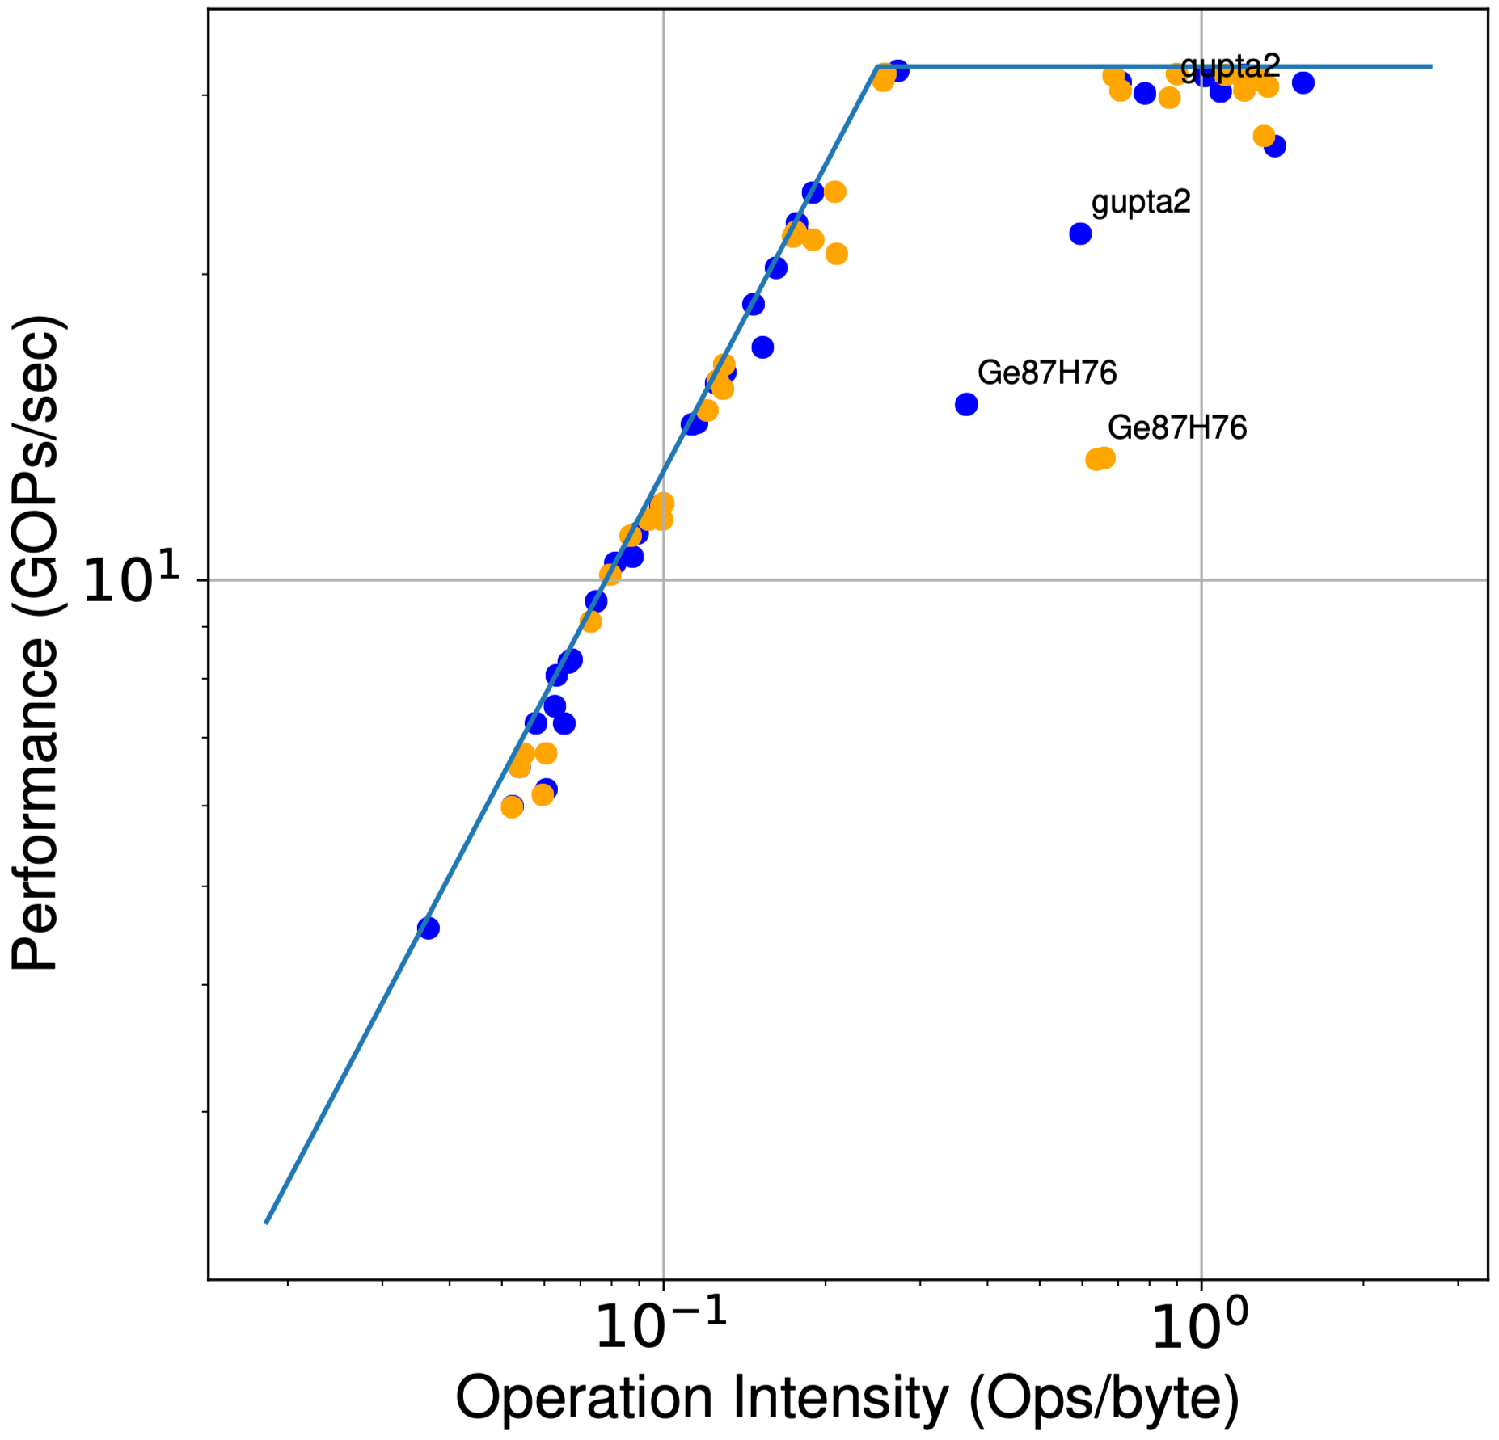
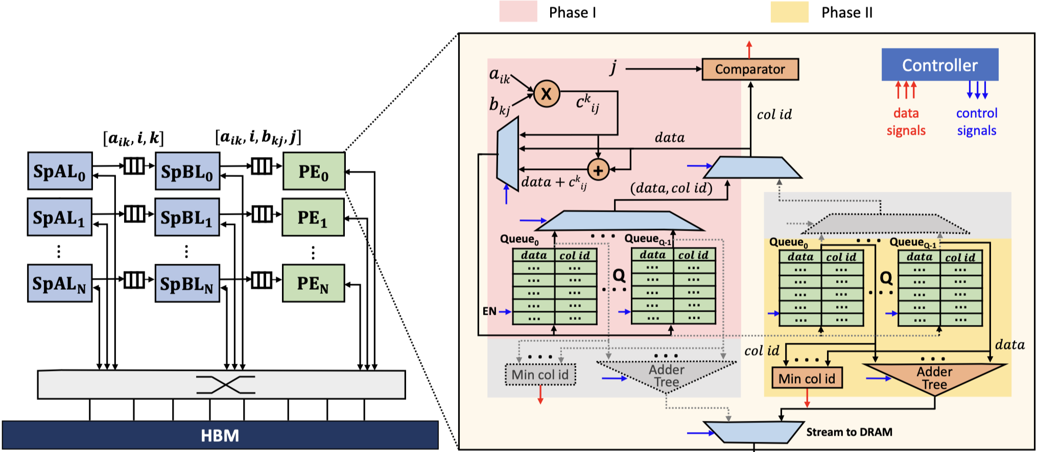
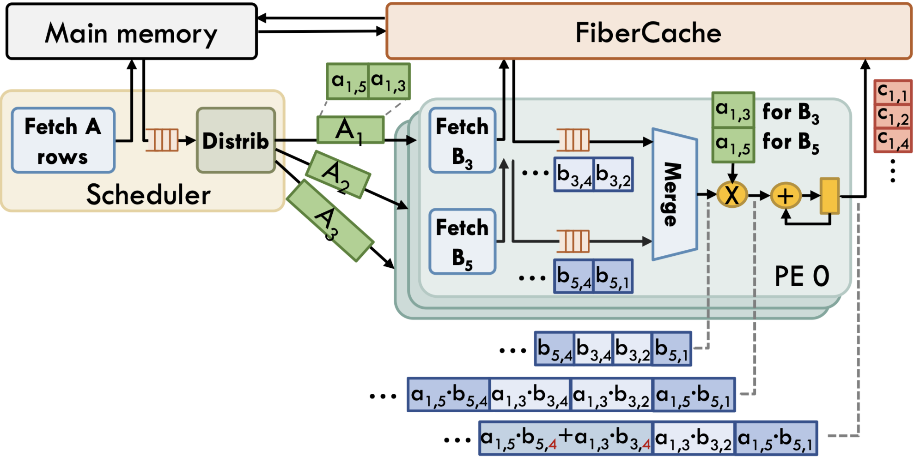
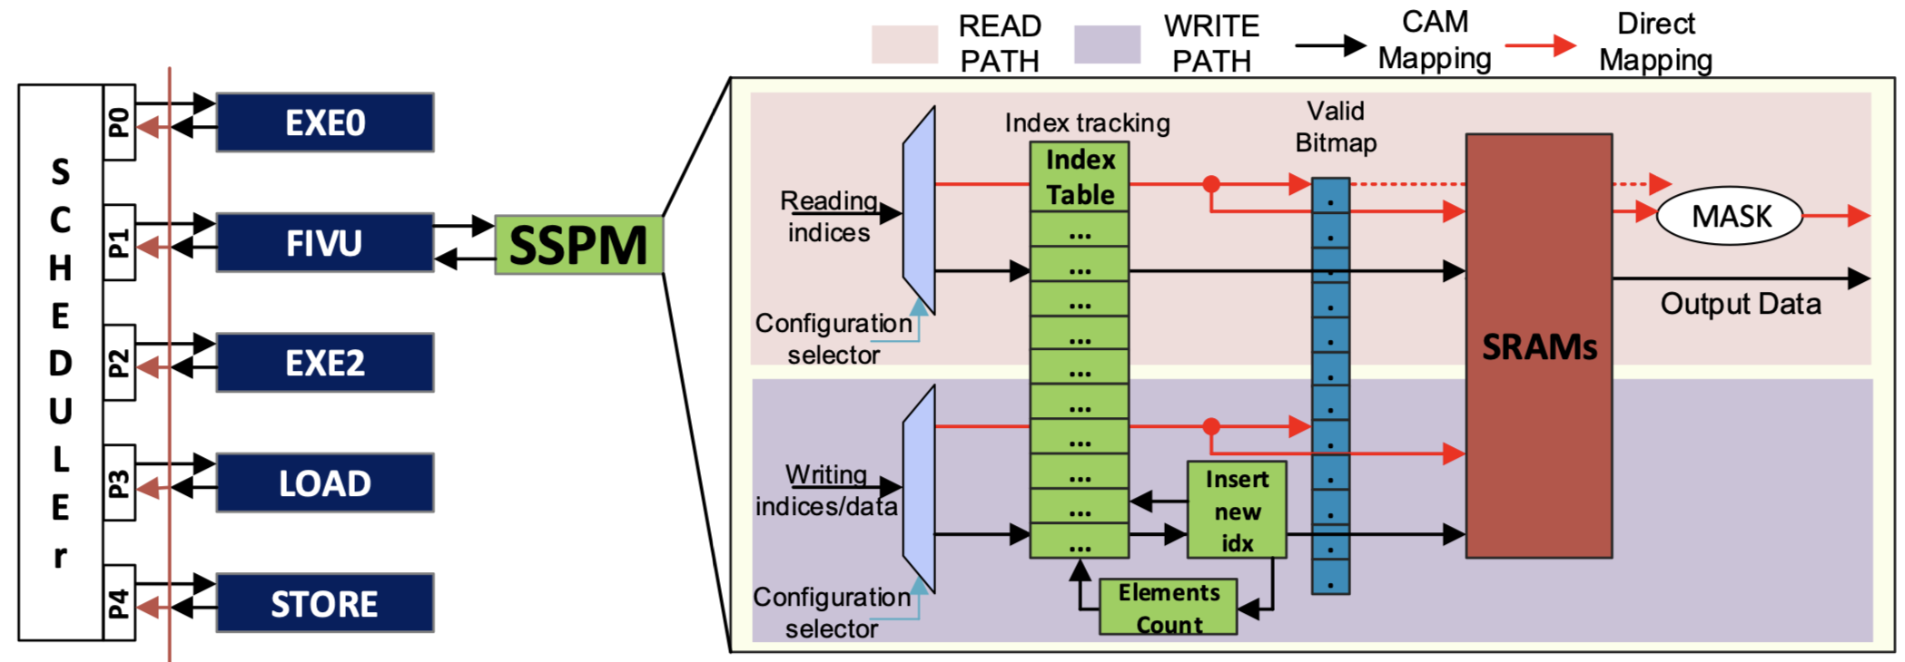
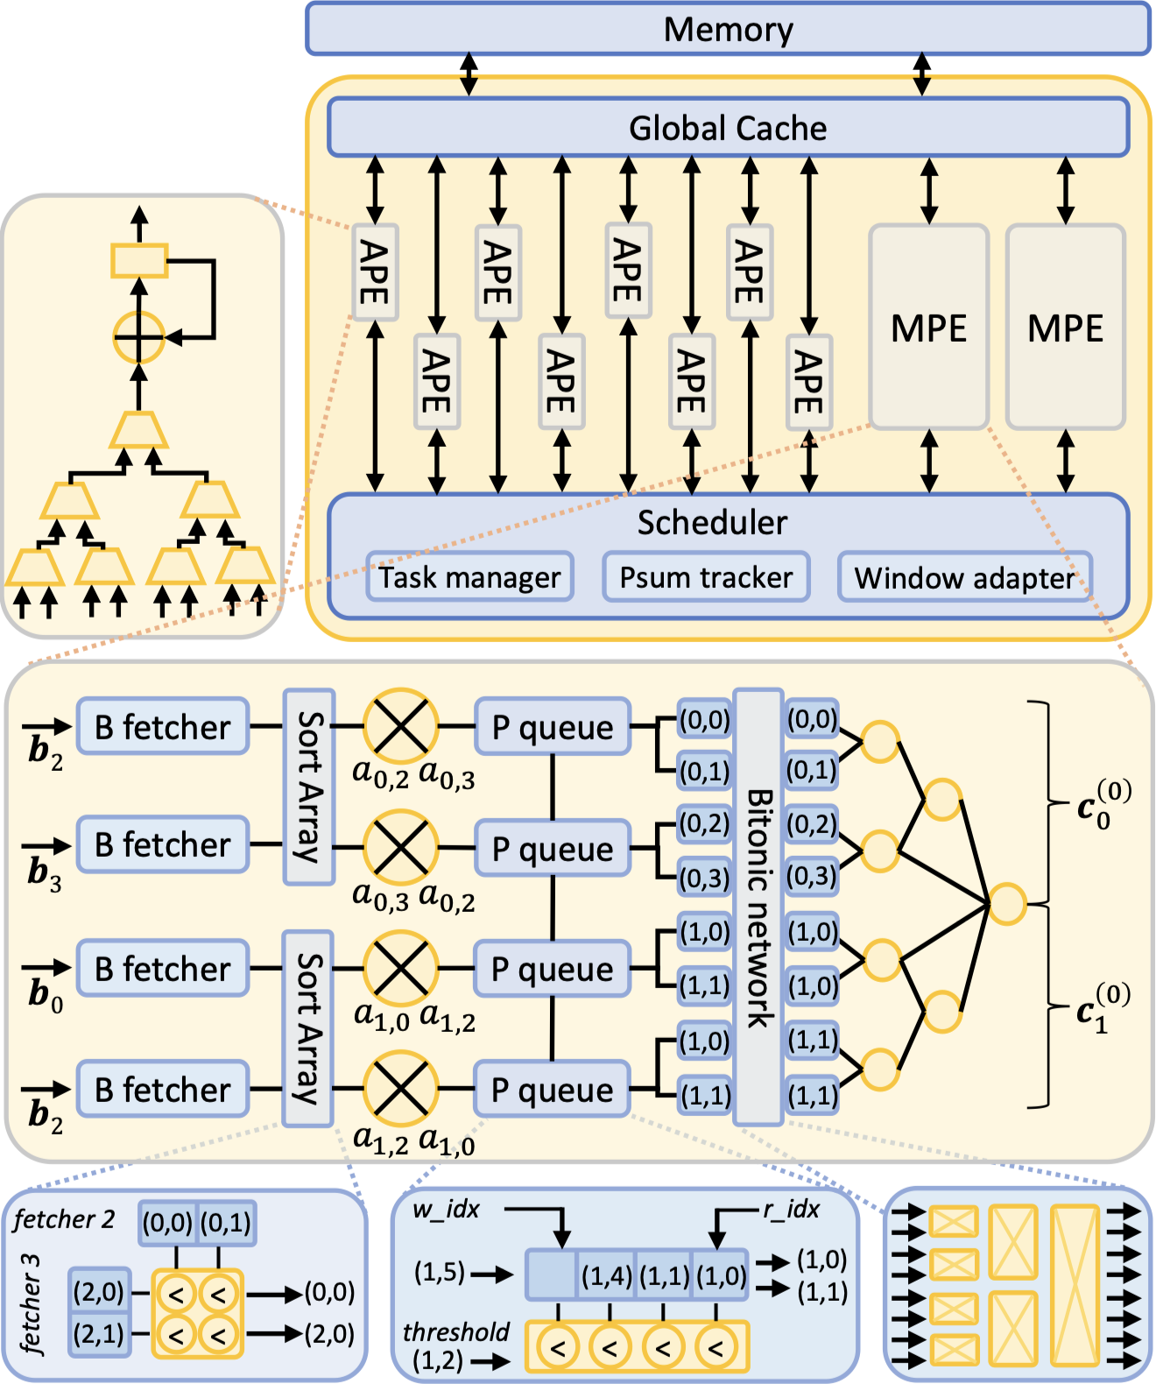
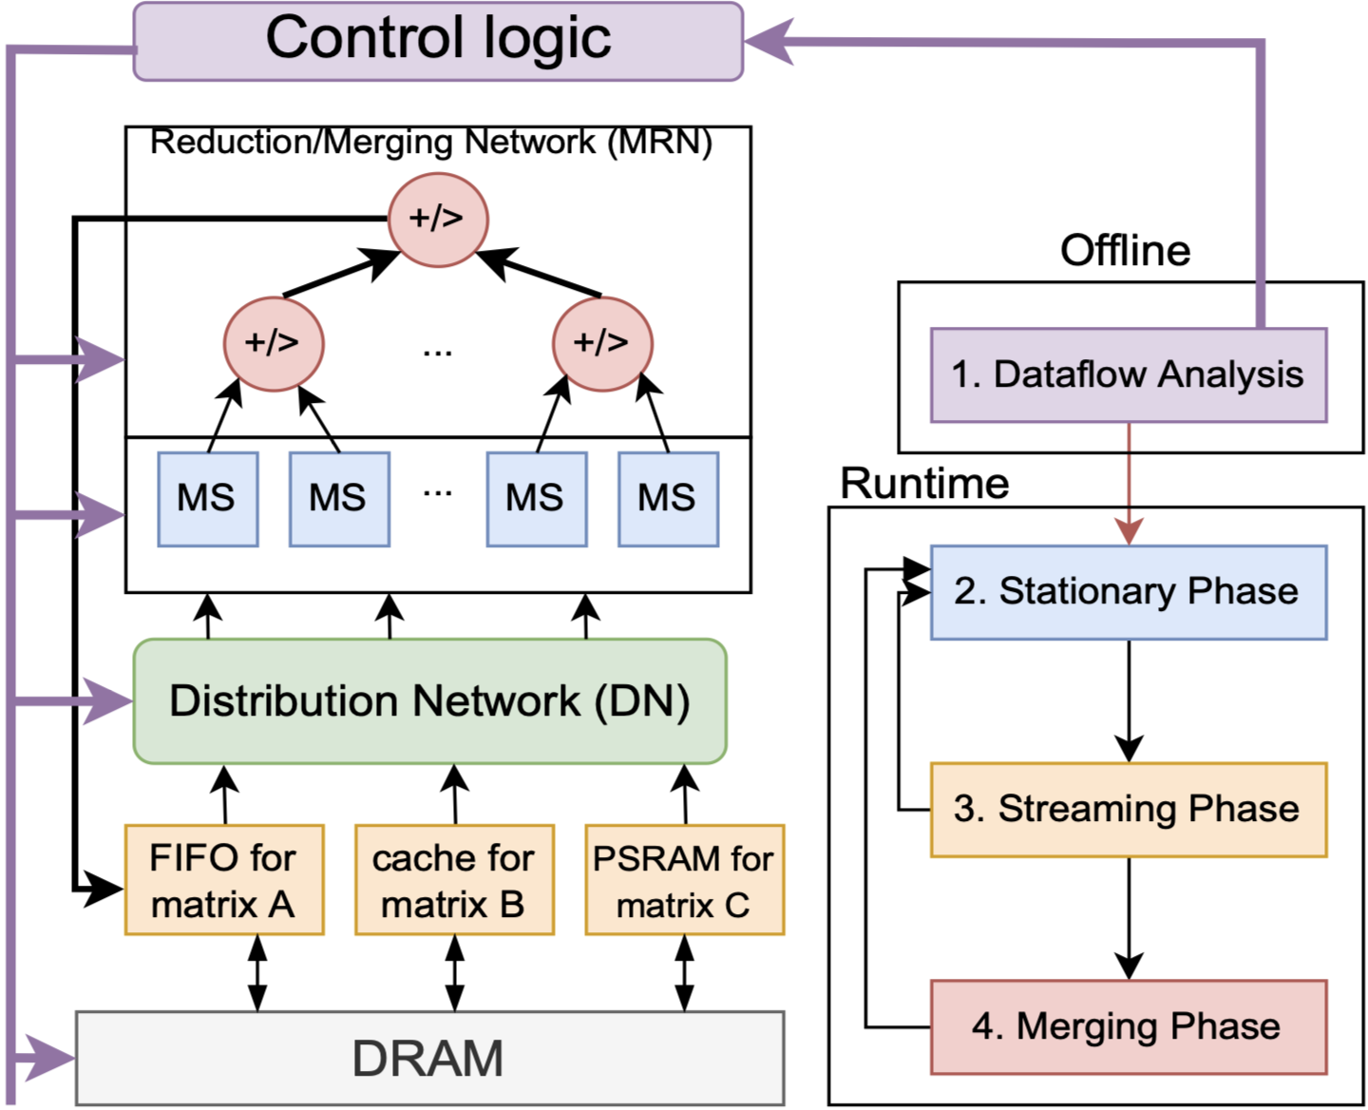
Sparse domain specific architecture (DSA)
SpGEMM
SpMV/SpMM
Sparse General Matrix-Matrix Multiplication (SpGEMM) accelerator implemented using outer products.
MatRaptor
Gamma
Tensaurus
OuterSPACE^{[1]}(HPCA’18)
Row-row method implementation for SpGEMM
Tensaurus^{[2]}(HPCA’20)
Advantages
Near-peak Roofline performance^{[1~7]}
But the costs are as follows
1. Difficult programming^{[1,2,4~7]}
2. Reliance on special data structures^{[1~5]}
3. Limited sparse operators support^{[1~7]}
4. Only local load balancing^{[5]}
Need to integrate DSA with the general platform.
MatRaptor^{[3]}(MICRO’20)
Gamma^{[4]}(ASPLOS’21)
Flexagon^{[6]}
(ASPLSOS’23)
Mixed calls
dot product,
outer product,
and row-row.
SPADA^{[5]}
(ASPLOS’23)
Row-row
VIA^{[7]}(HPCA’21)
[1] Pal S, ...; OuterSPACE: An Outer Product Based Sparse Matrix Multiplication Accelerator. HPCA’18.
[2] Srivastava N, ...; Tensaurus: A Versatile Accelerator for Mixed Sparse-Dense Tensor Computations. HPCA’20.
[3] Srivastava N, ...; MatRaptor: A Sparse-Sparse Matrix Multiplication Accelerator Based on Row-Wise Product. MICRO’20.
[4] Zhang G, et al. Gamma: leveraging Gustavson’s algorithm to accelerate sparse matrix multiplication. ASPLOS’21.
[5] Li Z, et al. Spada: Accelerating Sparse Matrix Multiplication with Adaptive Dataflow. ASPLOS’23.
[6] Muñoz-Martínez F, et al. Flexagon: A Multi-dataflow Sparse-Sparse Matrix Multiplication Accelerator for Efficient DNN Processing. ASPLOS’23.
[7] Pavon J, et al. VIA: A Smart Scratchpad for Vector Units with Application to Sparse Matrix Computations. HPCA’21.
Notes:
We have surveyed some existing sparse BLAS DSAs, all of which achieve near-peak performance under their respective Roofline models, but face various issues, including difficult programming, reliance on special data structures, limited operator support, and only local load balancing making it difficult to schedule tens of millions of non-zero elements in the matrix.

Slide 6
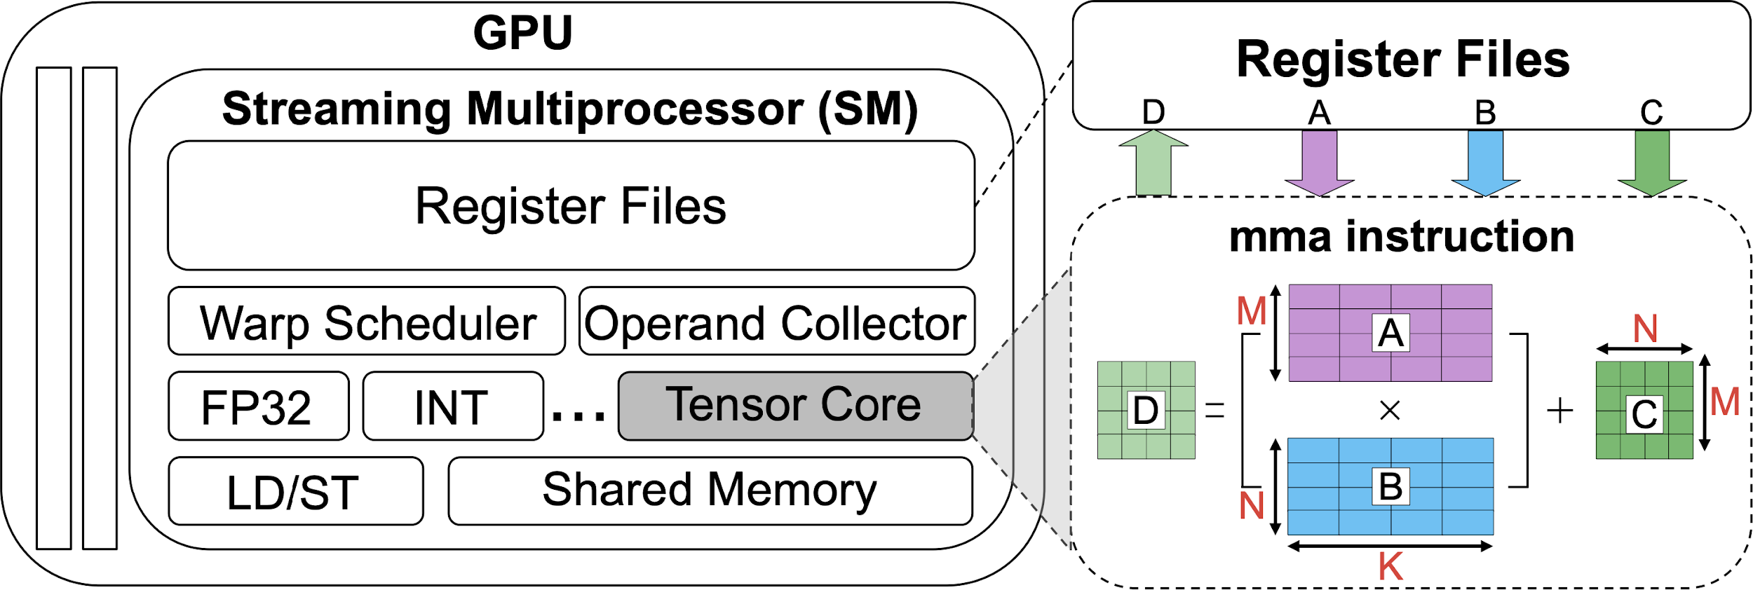
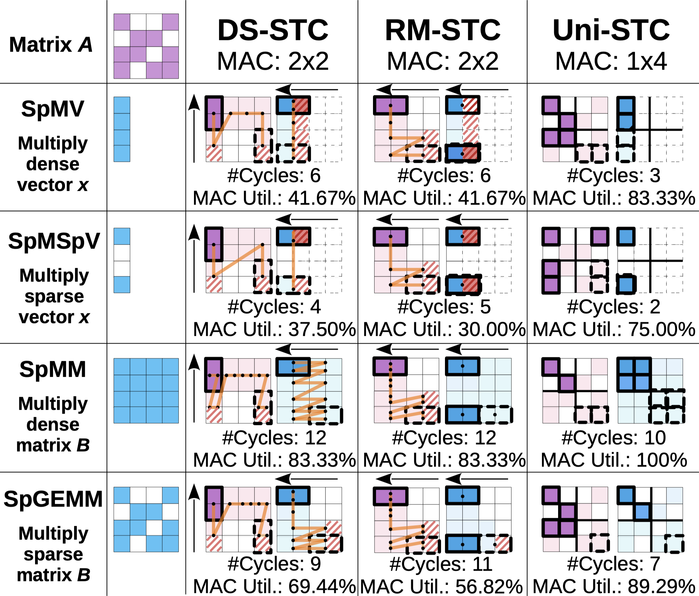
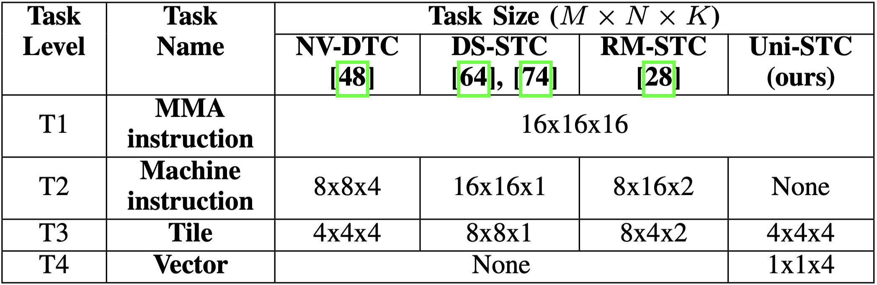
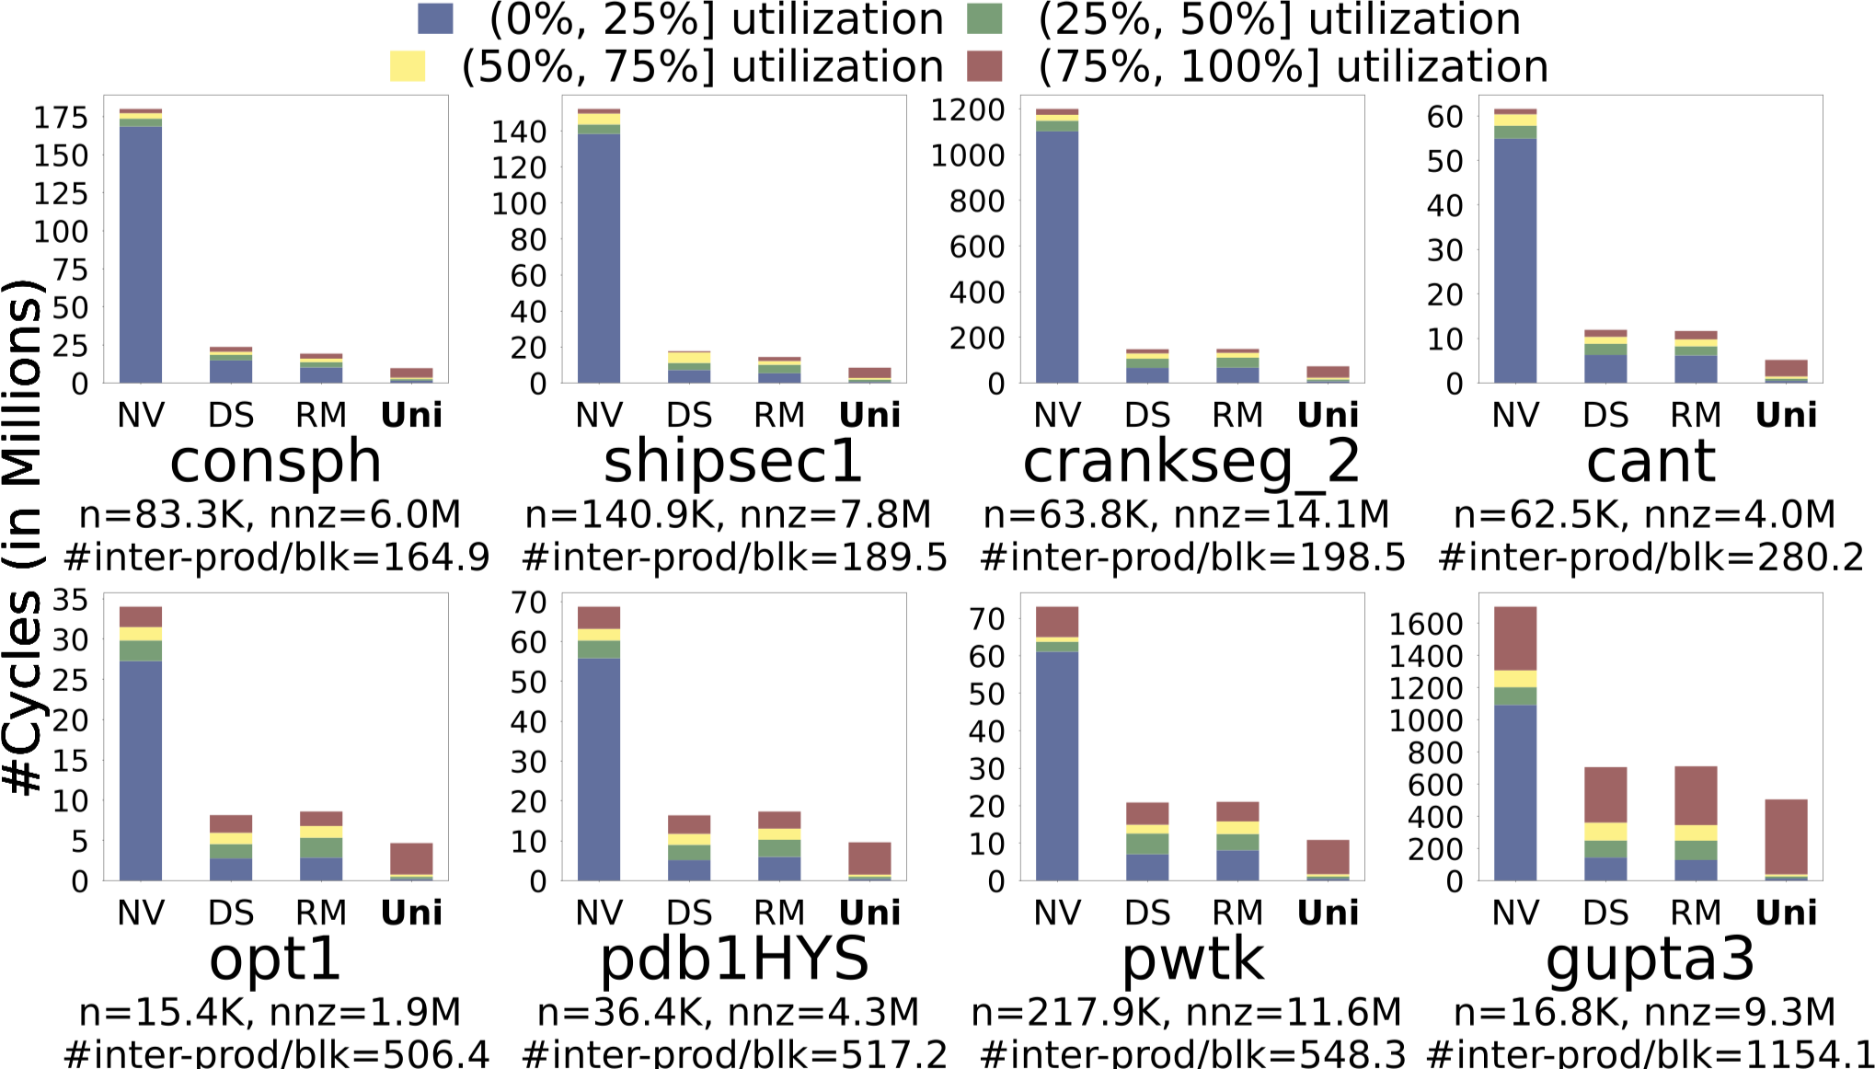
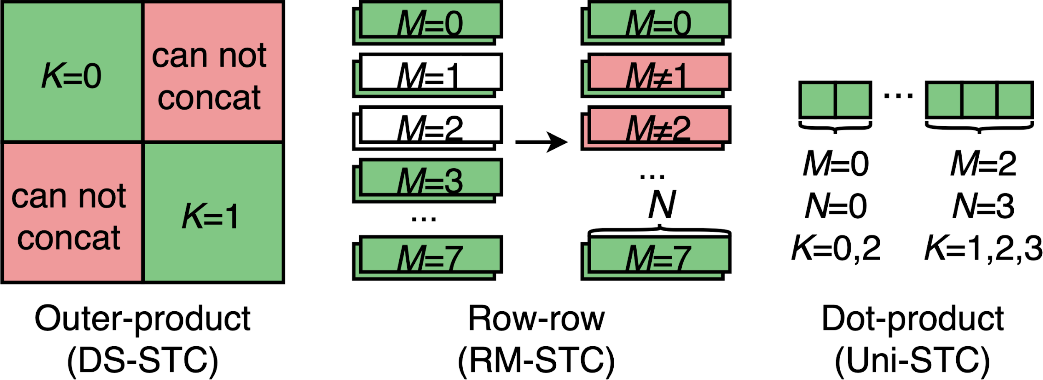
Sparse Tensor Core (STC)
User interface
Generate by compiler
Split in hardware
Data aggregation is hard to maintain utilization.
Need to improve parallelism.
1. Shift from data to task aggregation.
Task granularity is coarse.
Shapes are difficult to concatenate.
2. Refine the granularity into vector tasks.
Notes:
This brings us to STC, which replaces standard Tensor Cores to accelerate unstructured sparsity. 【click】The workflow operates on a hierarchy: An MMA instruction issues a T1-level (16x16x16) task, 【click】which the compiler breaks down into T2-level machine instructions for the STC. Internally, these are further split into T3 tasks for the MAC array. Our Uni-STC goes one step deeper, optimizing T3 execution based on accumulation capabilities. 【click】
For the comparing architectures, NV-DTC represents current GPU tensor cores, while DS-STC and RM-STC are recently proposed STCs. As shown on the left, these recent works aggregate sparse matrices into dense vectors with different length. However, this causes waste at the 'vector tails' (shown in red) due to a lack of parallelism. And we also simulated these STCs on eight real-world matrices from SuiteSparse, more than 60% cycles of these works had a MAC utilization of less than 50%.
To solve this, we need to shift from data aggregation to task aggregation.
While the task aggregation is not easy, the coarse-grained tasks with different shapes, and the computational unit design make them hard to concatenate, so we need to refine the granularity into vector tasks for efficienct concatenation.

Slide 7
1
Background & Motivation
2
Uni-STC’s Architecture
OUTLINE
3
Uni-STC’s Dataflow
4
Evaluation
5
Conclusion
Notes:
The next part is Uni-STC’s architecture

Slide 8
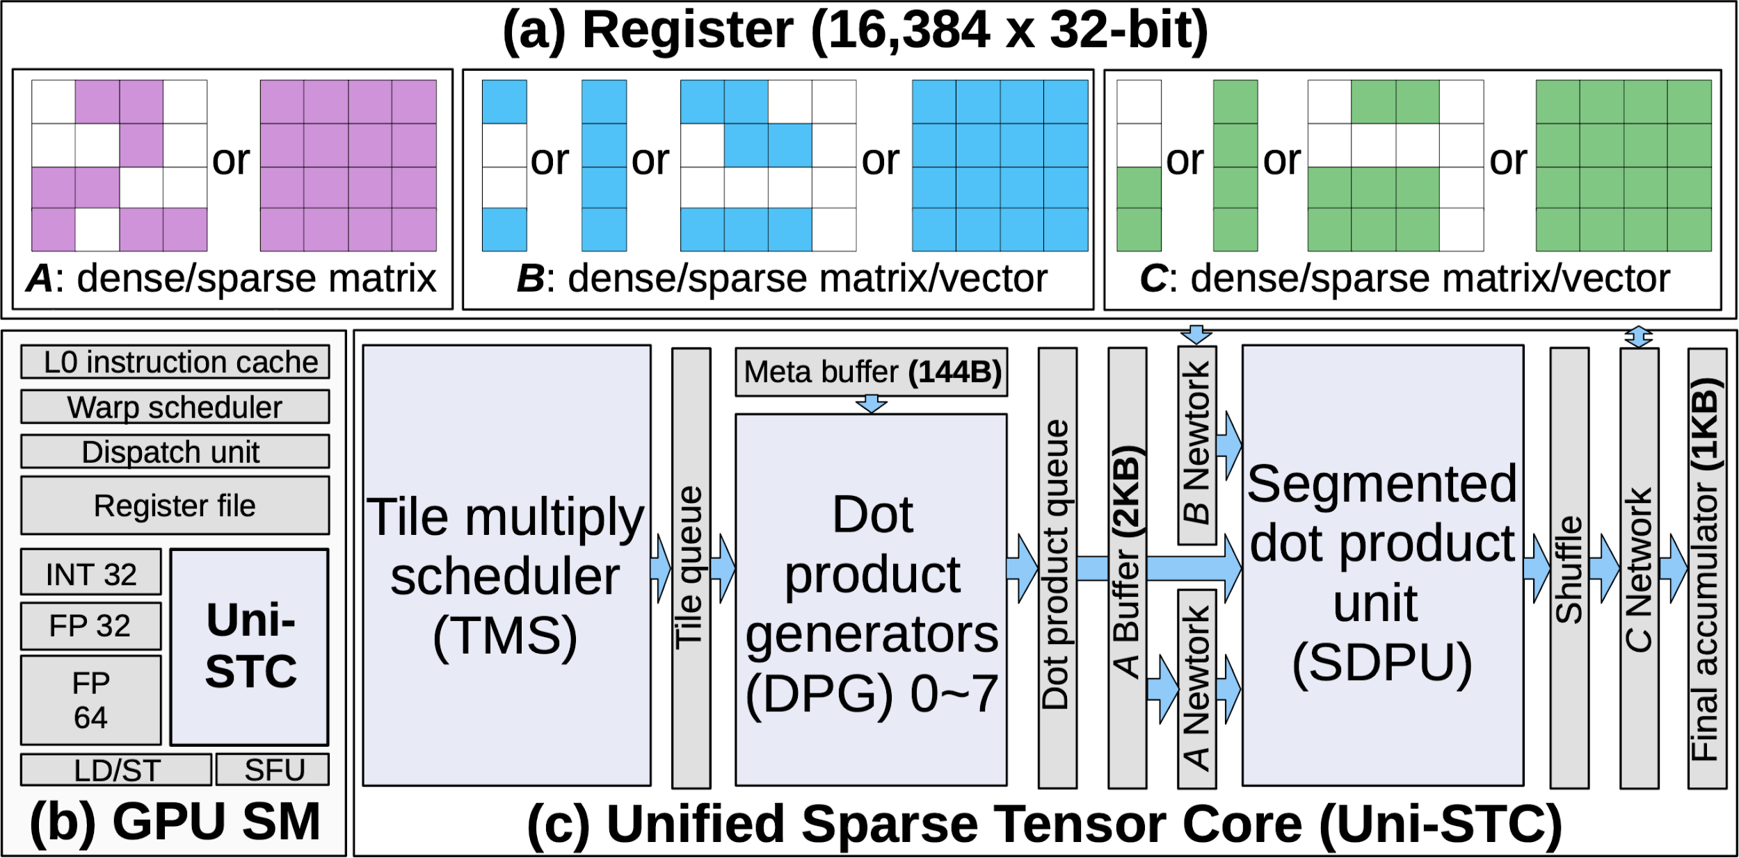
Overall Architecture
Uni-STC seamlessly supports various data patterns in registers, handling any combination of dense, sparse, or vector formats for matrices A, B, and C.
❶ TMS: Break down the T1 (16×16×16) task to multiple T3 (4×4×4) tasks by using upper-level bitmap.
❷ DPG: Break down the T3 task to multiple T4 (1×1×4) tasks and concatenate them by using low-level bitmap.
❶
❷
❸
❸ SDPU: Perform segmented dot product tasks from 1~8 DPGs in parallel.
❶+❷ Task Generation.
❸ Numeric computation.
Notes:
The overall architecture of Uni-STC is as follows, we integrate it into the GPU SM, and it can accecpt various data patterns.
Uni-STC includes three key components: 1. the TMS is designed to break...
2. the DPG is designed to break...
These two components make up the task generation logic.
the third components is the SDPU, which is designed to perform...
and this component is to complete numerical computation.

Slide 9
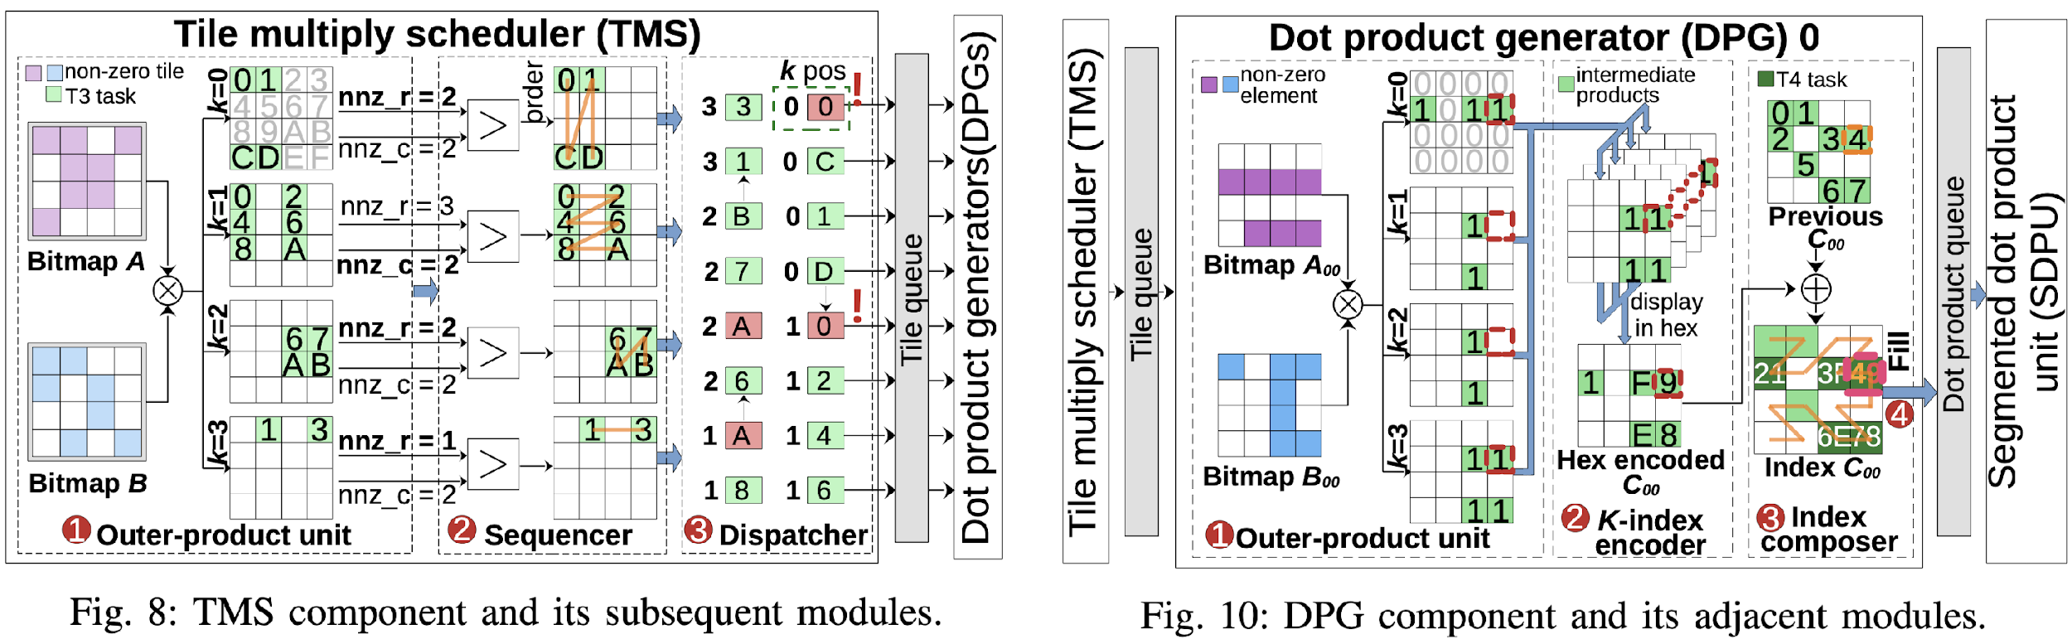
Task Generation (use TMS and DPG)
❶ Generate 4-layer tile tasks via upper-level bitmap multiply;
❶ Generate scalar tasks via lower-level bitmap multiply ;
❷ Gather tile tasks in outer-product order;
❷ Collect scaler tasks into vector tasks;
❸ Dispatch tile tasks to DPGs.
❸ Concatenate vector tasks via `Z`-shape order.
Notes:
We first focus on task generation part, the left figure is TMS’s architecture, which is used to generate tile-level tasks, and involves three steps: [123]
For DPG, we still use the outer product to generate scalar tasks, then collect these scalar tasks as vector dot product tasks, and finally concatenate them in a zigzag pattern.

Slide 10
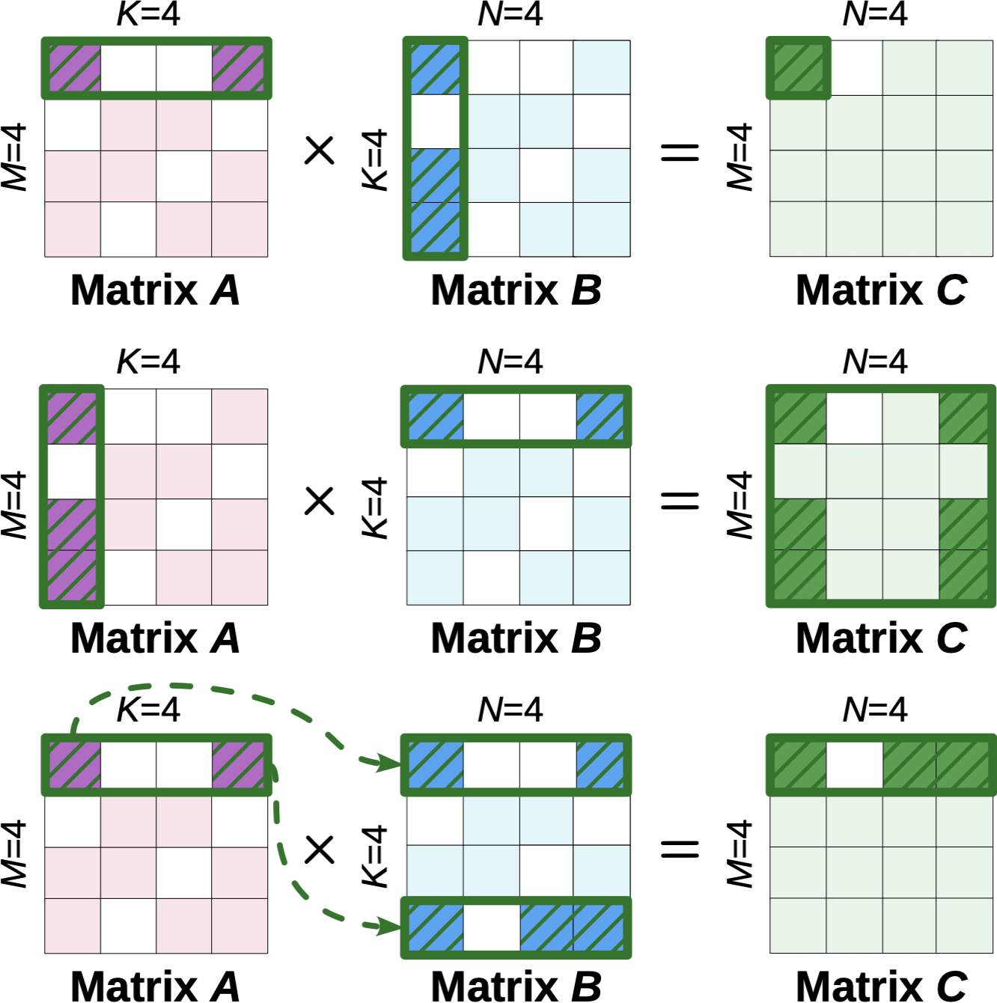
Task Generation (use TMS and DPG)
Dot-Product
for m in 0...M
for n in 0...N
for k in 0...K
C[m,n] += A[m,k] * B[k,n]
Outer-Product
for k in 0...K
for m in 0...M
for n in 0...N
C[m,n] += A[m,k] * B[k,n]
❶ Use bitmap multiplication to generate tile tasks;
Row-Row
for m in 0...M
for k in 0...K
for n in 0...N
C[m,n] += A[m,k] * B[k,n]
❷ Gather tile tasks in outer-product order;
❸ Dispatch tile tasks to DPGs.
Notes:
The outer product order used by TMS originates from three classic matrix multiplication dataflows, including the dot product, the outer product, and the row-row method.

Slide 11
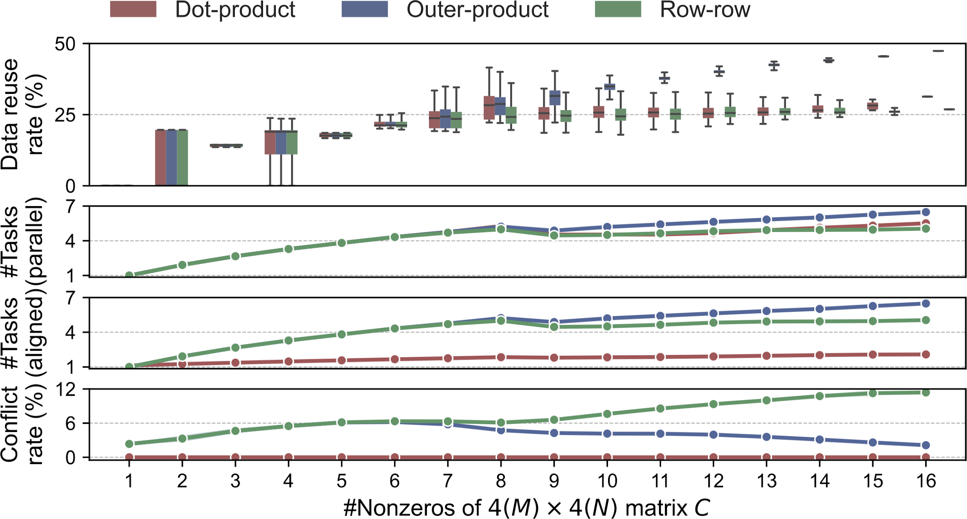
Task Generation (use TMS and DPG)
1. Parallelism: The outer product strategy has good parallelism, with an average of 4.54 concurrent tasks.
❶ Use bitmap multiplication to generate tile tasks;
2. K-dimensional Alignment: Achieves 47.38% peak alignment rate, reducing read overhead.
❷ Gather tile tasks in outer-product order;
❸ Dispatch tile tasks to DPGs.
3. Write conflicts: Low conflict rate (peak 6.2%), alleviating throughput bottlenecks.
Notes:
We designed an exhaustive experiment for these three execution orders, assuming that Uni-STC can execute 8 T-three tasks per cycle to analyze the data reuse rates of matrices A and B. The results show that, compared to the dot product and row-row orders, the outer product method is superior in terms of parallelism and data reuse capability.

Slide 12
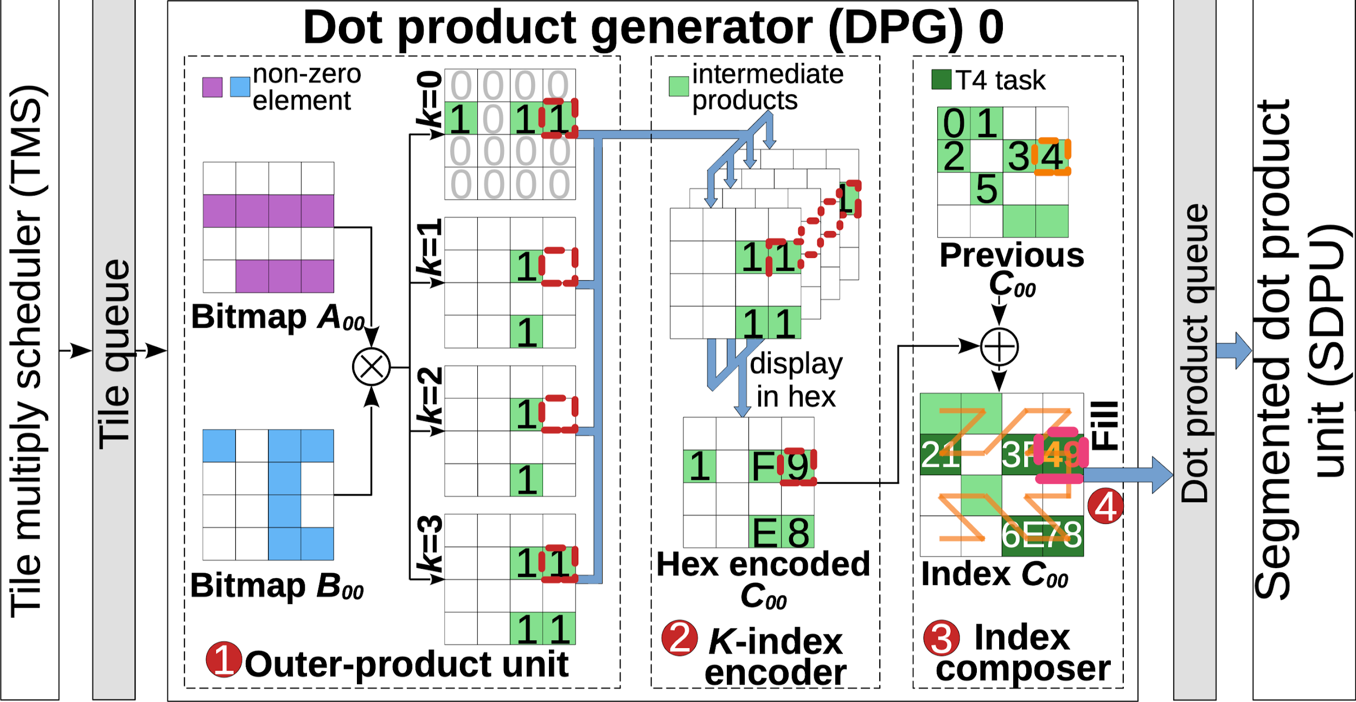
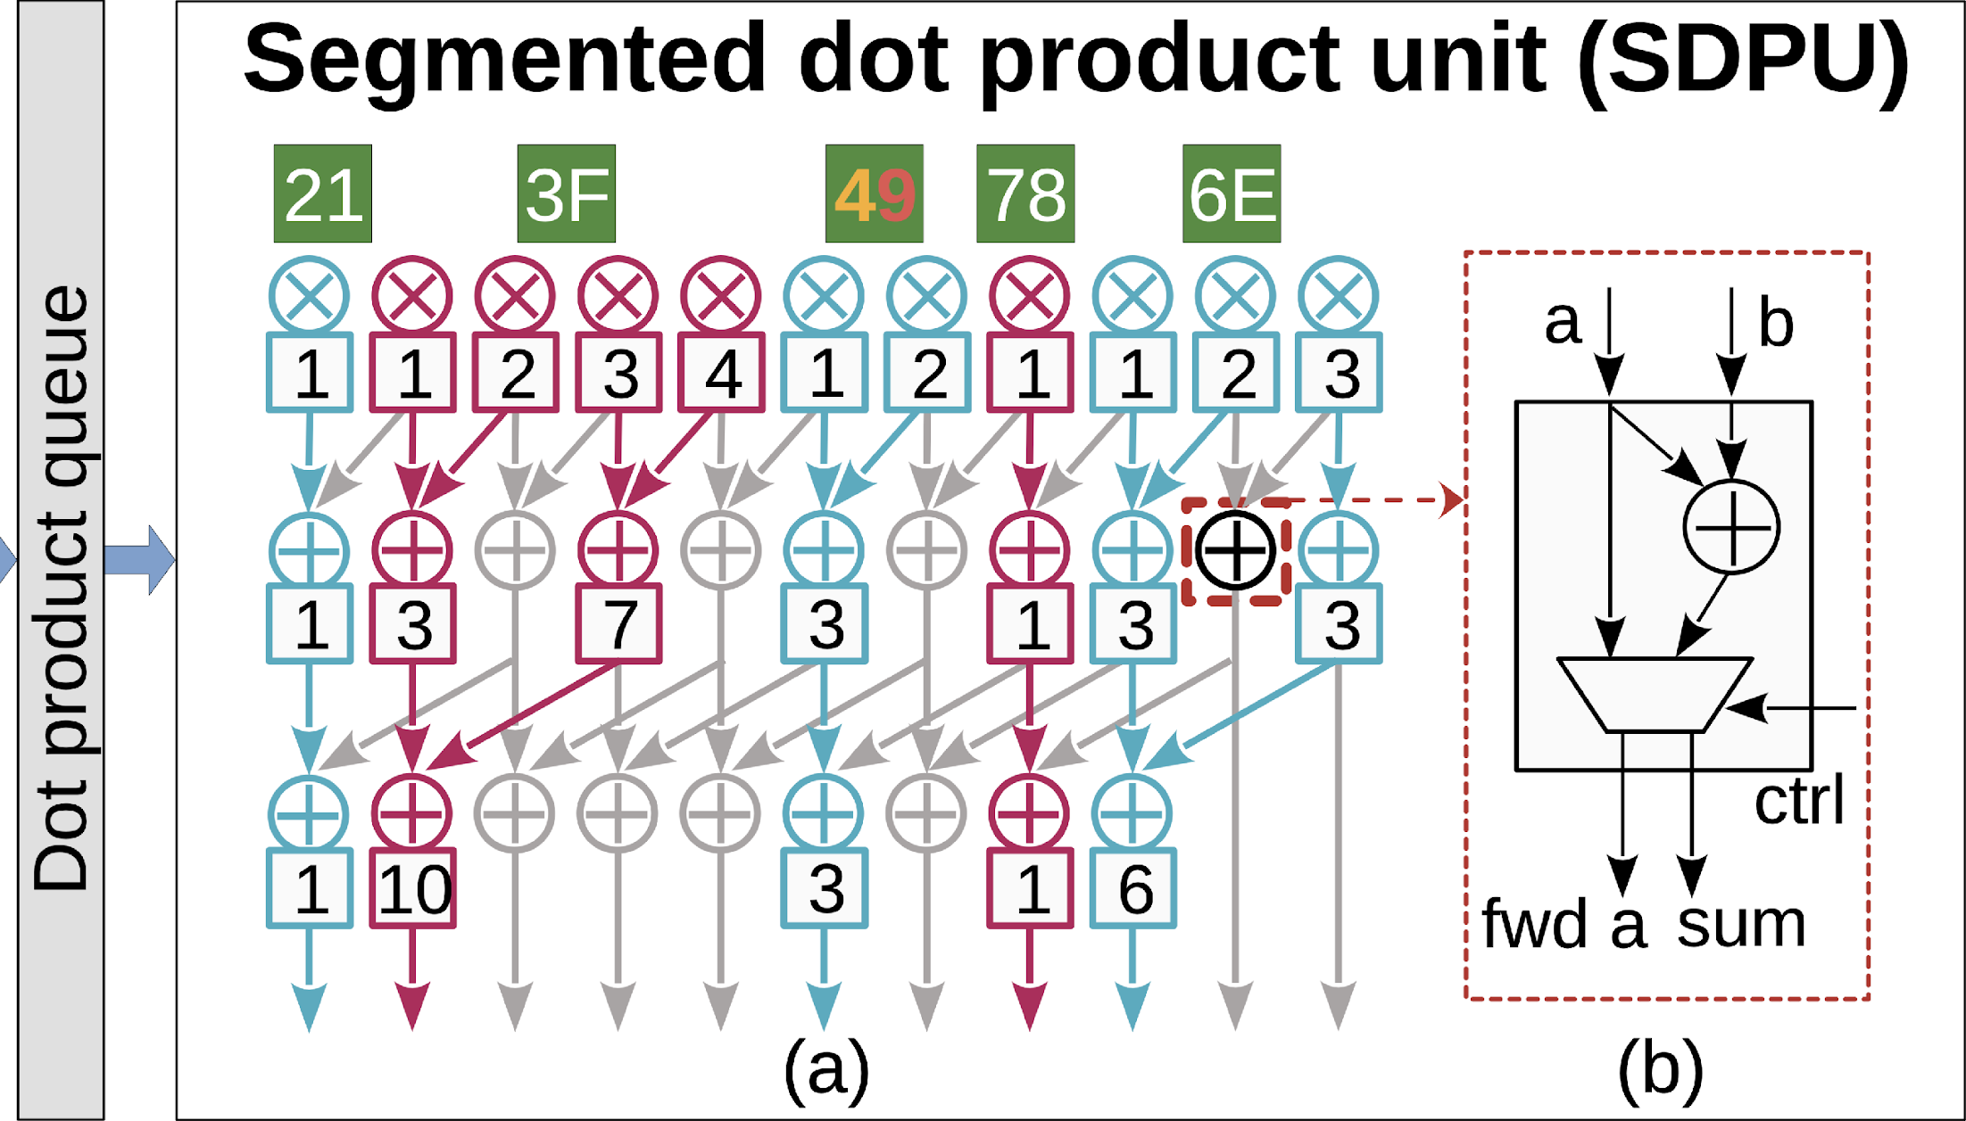
Numeric Computation
Use same A[1]
21: C[2] += A[1][0]×B[0][0]
3F: C[3] += A[1][0,1,2,3]×B[0][0,1,2,3]
49: C[4] += A[1][0,3]×B[0][0,3]
78: C[7] += A[3][3]×B[3][3]
The Segmented Dot Product Unit (SDPU) incorporates "merge and forward units" to enable the parallel execution of multiple T4 tasks within a single cycle.
6E: C[6] += A[3][1,2,3]×B[0][1,2,3]
Notes:
For the concatenated T-four tasks generated from DPG, we fill these tasks into the dot product queue in a Z-shaped order to improve locality and reduce network area.

Slide 13
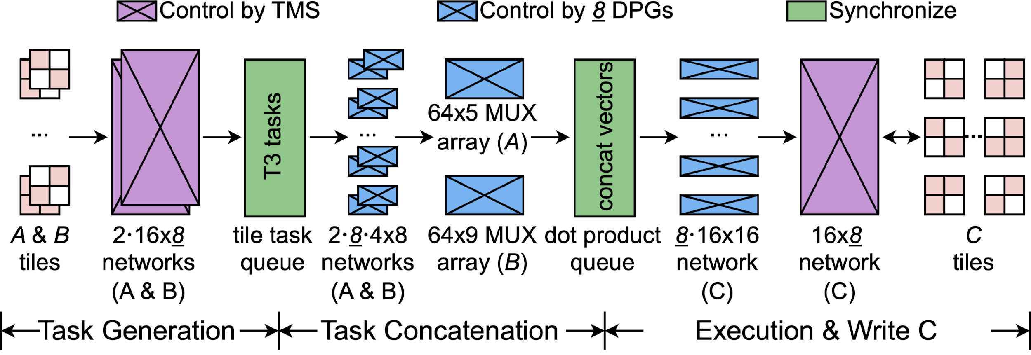
Datapath and Pipeline
Stage 1: TMS uses the upper-level bitmap to generate T3 (tile) tasks.
Stage 2: DPGs use the lower-level bitmap to generate vector dot product tasks and concatenate them.
Stage Three: SDPU executes multiple vector dot product tasks and accumulates the results into matrix C.
Notes:
With the above three components in place, we designed a three-stage pipeline to make them work together.

Slide 14
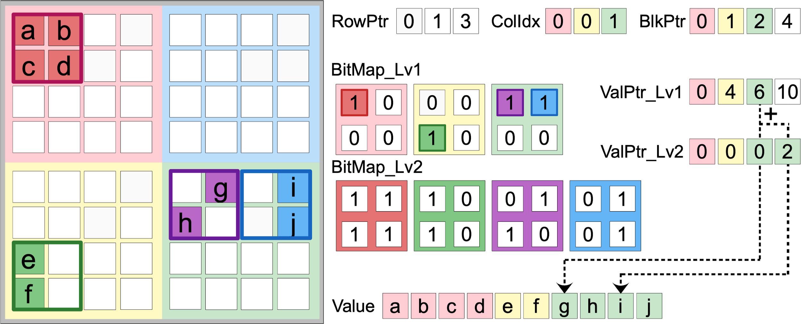
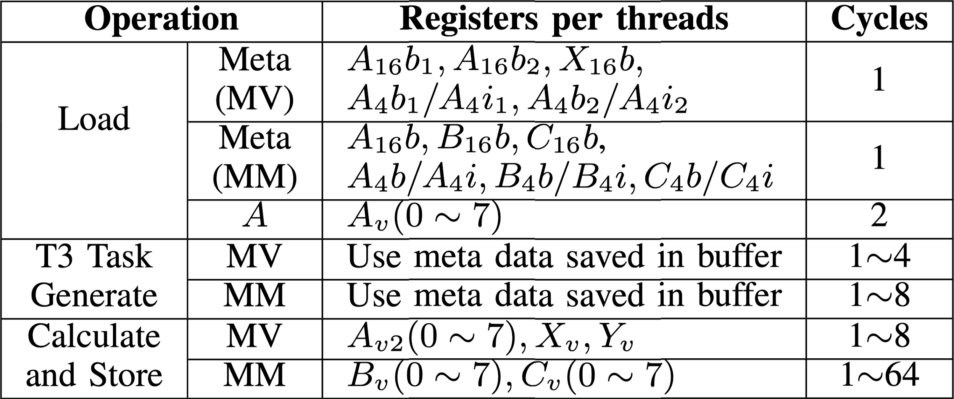
Data Structure and Instruction Set
1. Uses software-friendly CSR format to organize two-level bitmap blocks. (Users can also change it to ELL or HYB.)
2. A two-level bitmap and ValPtr index non-zero elements in 16×16 and 4×4 blocks to manage structures for TMS or DPG generate and schedule tasks.
3. Non-zero elements are stored contiguously according to the index order.
Uni-STC WMMA (UWMMA) Instruction set
1. Load the sparse structure or values of matrix A into the buffers inside Uni-STC.
2. Generate Tile tasks using the sparse structure in the meta buffer (144B total).
3. Perform segmented dot product computation and write the result back to matrix C or vector Y.
Notes:
Next are the data structures and instruction sets. For this downscaled sparse matrix on the left, 【click】 we first divide it into three non-zero blocks and then organize them using the CSR format. 【click】Within each non-zero block, we use a two-level bitmap and ValPtr to index the non-zero elements. 【click】 Finally, all non-zero elements are stored contiguously according to the index order.
The instruction set of Uni-STC is divided into three parts:
1. Loading part
2. Task generation part
3. Calculation and storage part

Slide 15
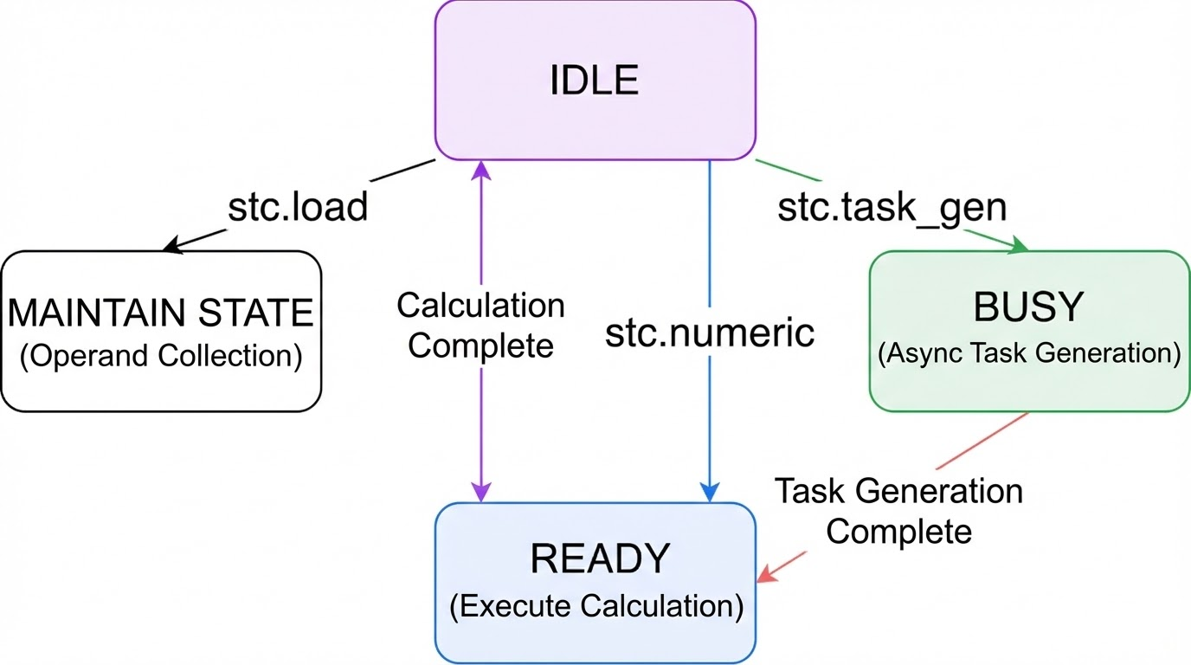
Integration Method and Internal State Machine
Integration Method
❷
❶ Modify Warp scheduler frontend to support UWMMA dispatch.
❶
❷ Use the `mma.sync.aligned.m16n8k16.row.col. f64.f64.f64.f64` instruction format, we skip operand A; and use the 20 slots in to pass B and C, and for C's write-back.
Internal State Machine
To enable asynchronous task generation, Uni-STC leverages an internal status registers.
Notes:
This part is integration method and internal state machine. The integration method contains two changes of GPU frontend, the first is to modify...，the second, we add mma instruction by using the m16n8k16 mma instruction format. And we skip ...【看PPT念】
To handle T3 task generation, we added an internal state machine. This ensures asynchronous execution, so numeric calculations only begin once task generation is complete.

Slide 16
1
Background & Motivation
2
Uni-STC’s Architecture
OUTLINE
3
Uni-STC’s Dataflow
4
Evaluation
5
Conclusion
Notes:
The next part is uni-stc’s dataflow.

Slide 17
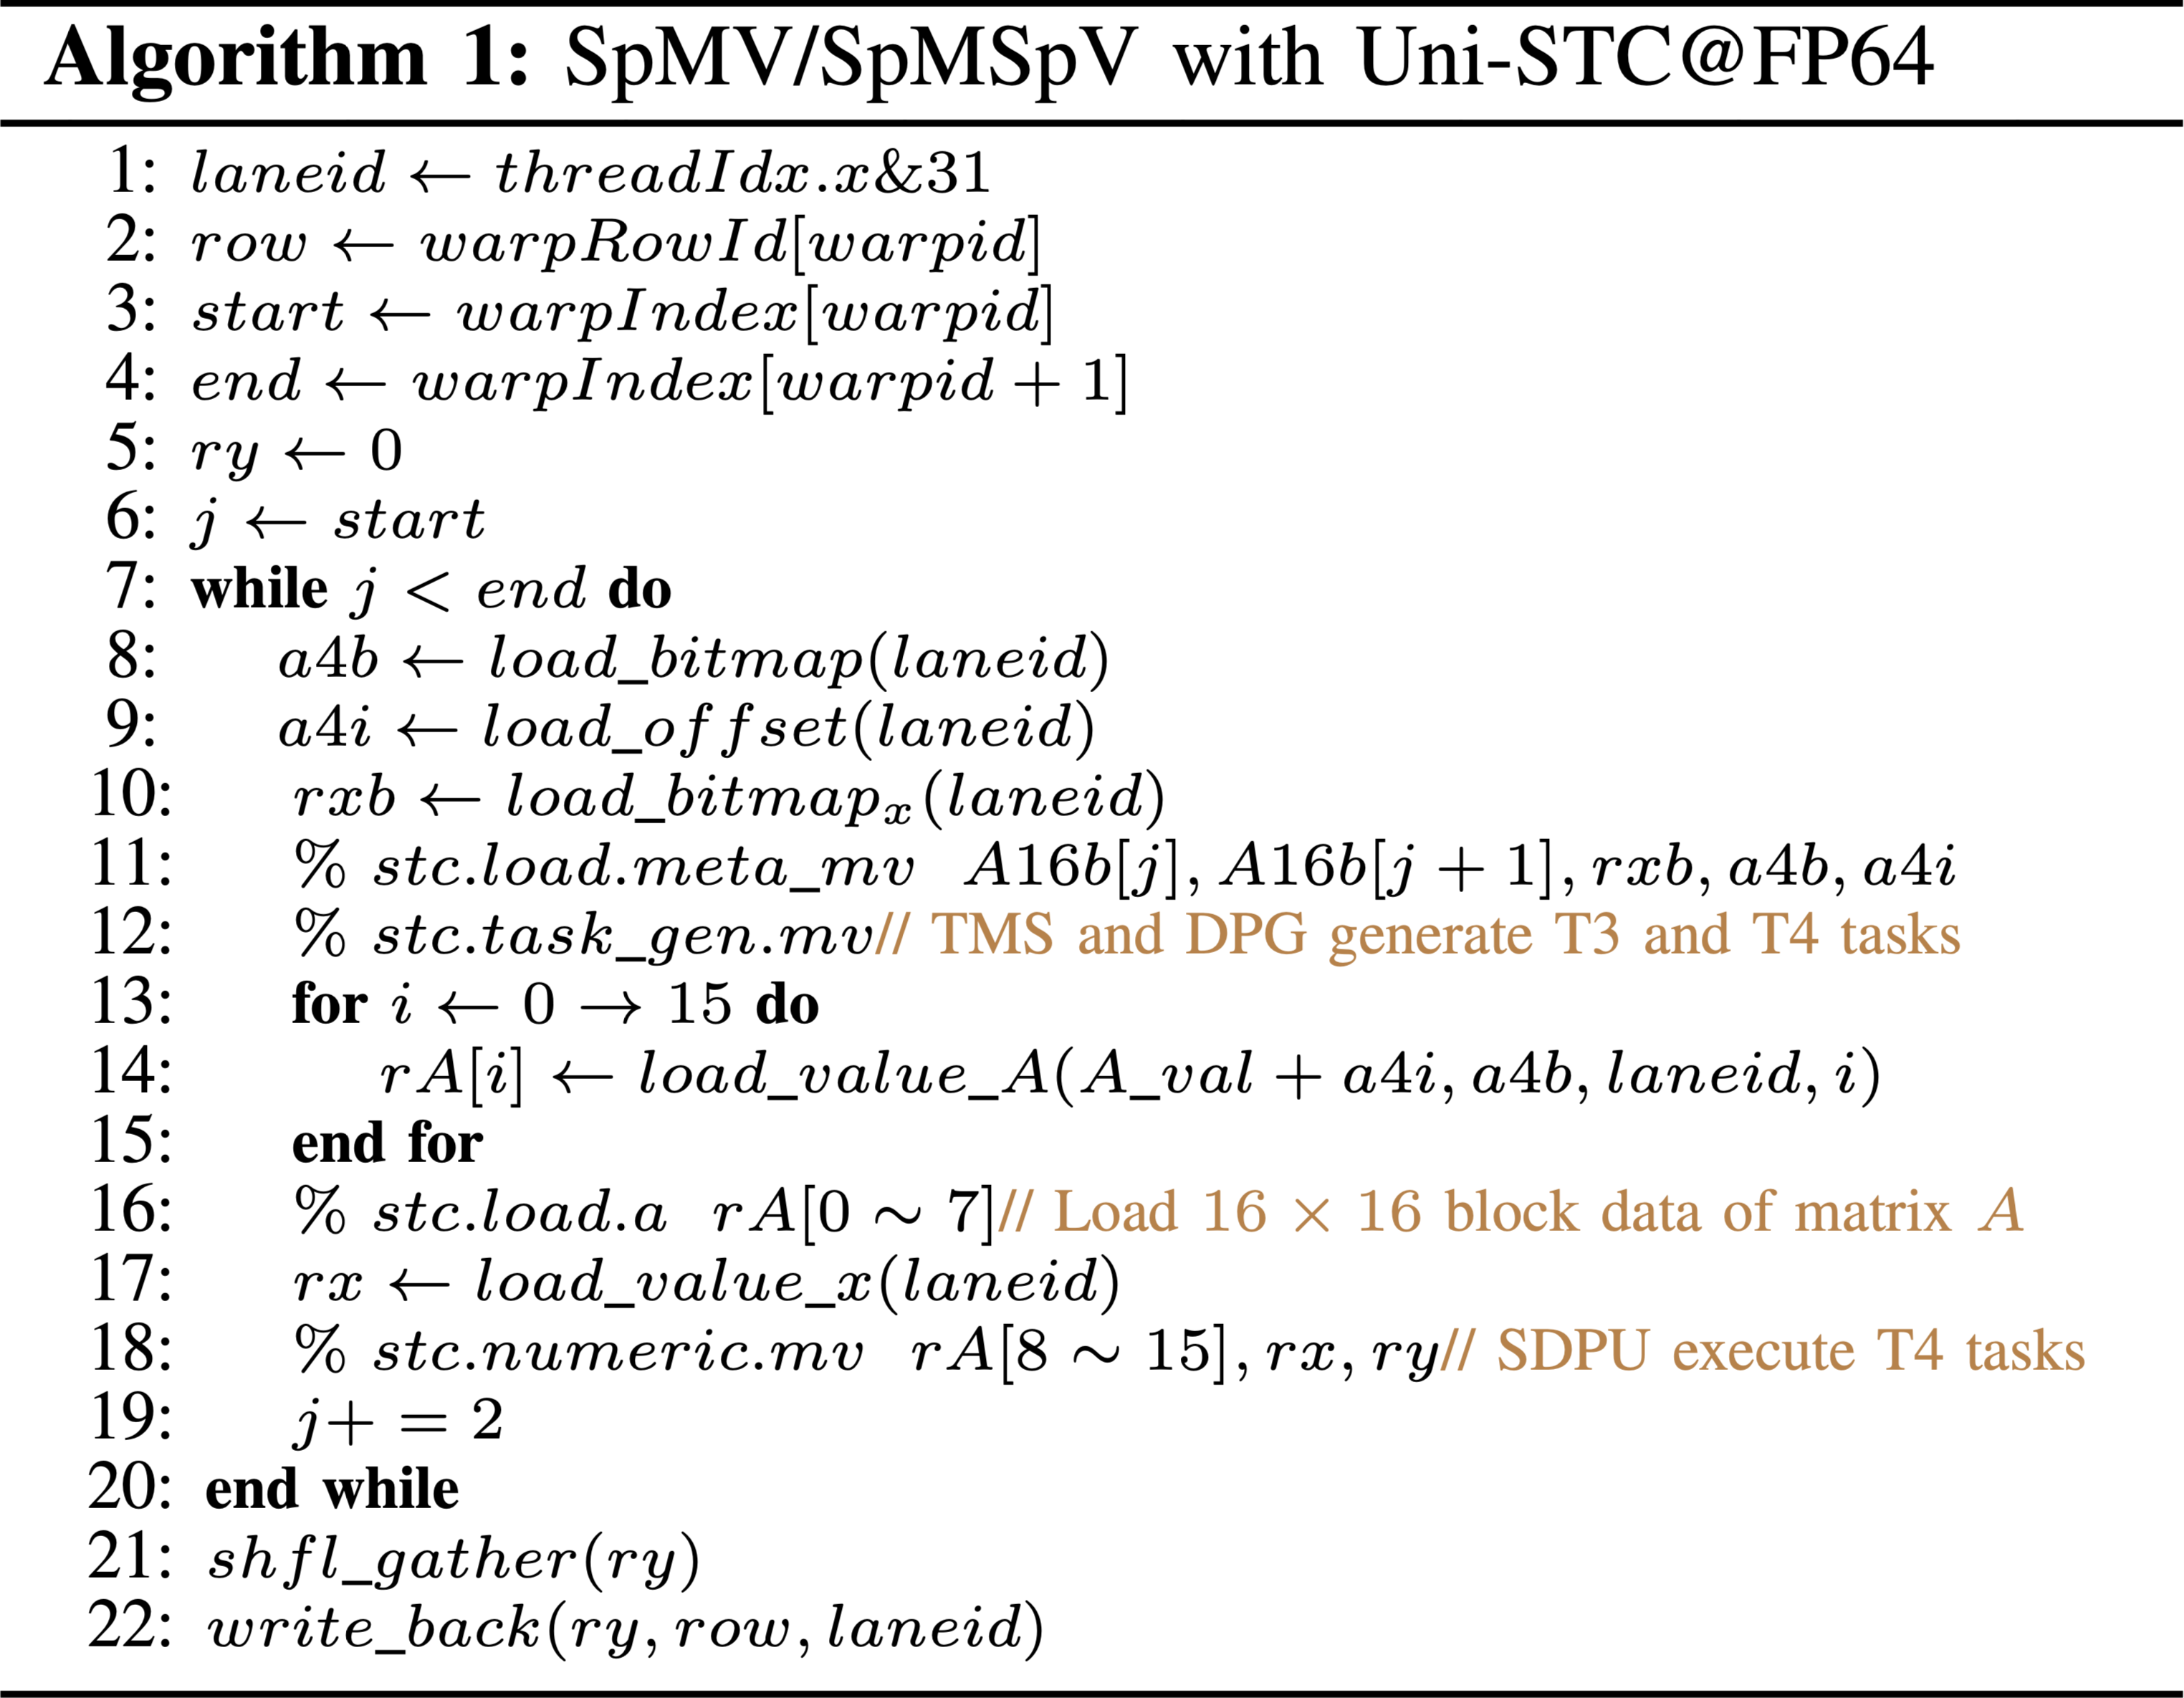
Software Operator Implementation
UWMMA instruction set.
❶
❶ To ensure load balancing, we use the BBC outer CSR structure and cap each warp at processing just 8 blocks.
❷
❸
❷ Load matrix block’s structure from registers.
❹
❸ Generate tasks in Uni-STC. [ASYNC]
❺
❹ Load matrix block’s value.
❺ Perform numeric computation.
Notes:
The algorithm implementation of SpMV or SpMSpV using Uni-STC consists of five parts: 【click】12345

Slide 18
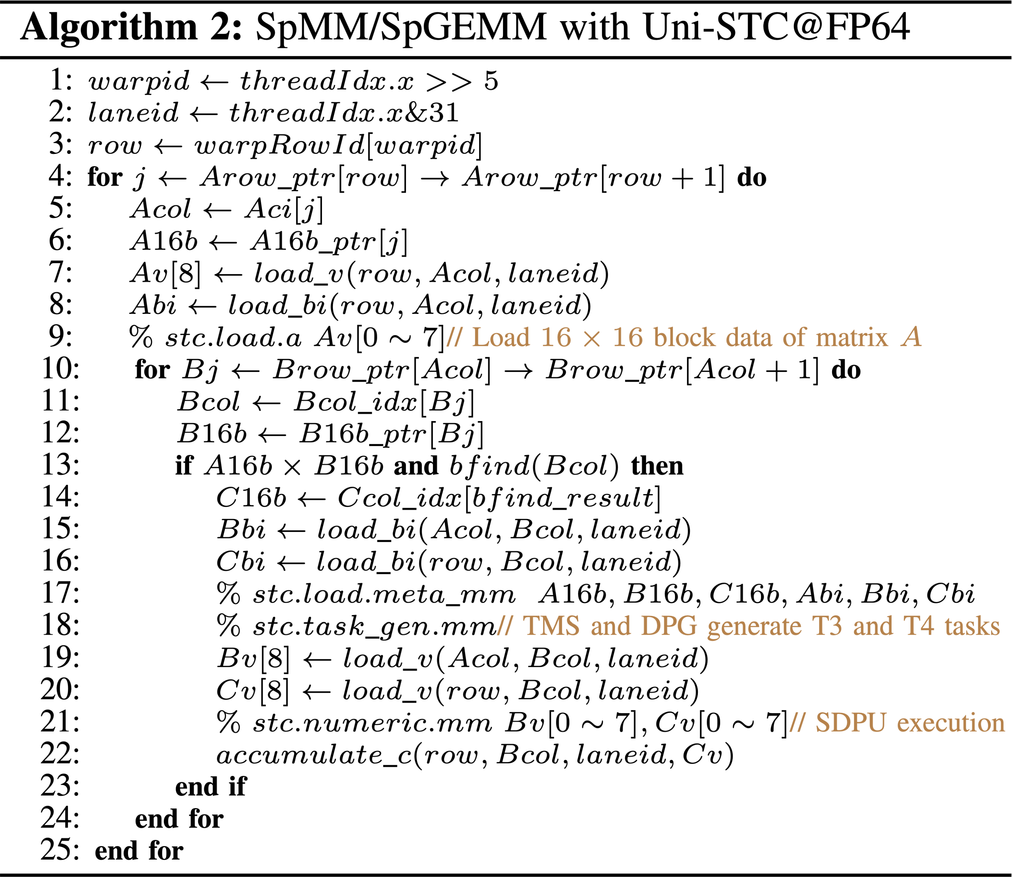
Software Operator Implementation
UWMMA instruction set.
❶
❶ Implement row-row SpMM / SpGEMM using the CSR structure in BBC format.
❷ Load block’s structure from registers.
❷
❸ Generate tasks in Uni-STC. [ASYNC]
❸
❹
❹ Load block’s value.
❺
❺ Perform numeric computation.
Notes:
The implementations of SpMM and SpGEMM are also similar; the difference is that at the software level, we utilize the row-row method for implementation.

Slide 19
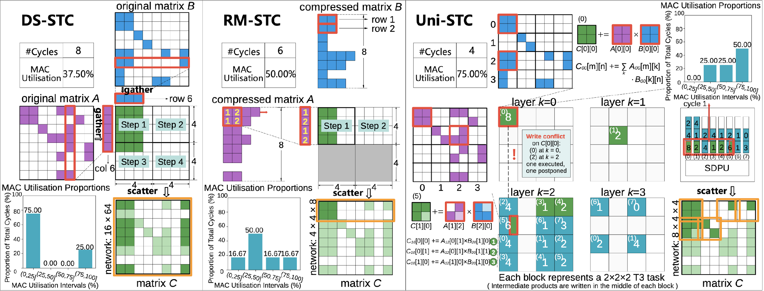
Hardware dataflow
Each T2 task select one column of A and row of B, runs 1~4 T3 tasks serially. Each T3 task updates the entire matrix C.
Each T2 task selects a sub-block of A, and rows of B, runs 1~2 T3 tasks serially. Each T3 task updates two rows of matrix C.
Generate 1~64 T3 tasks from the T1 task directly, select 1~8 T3 tasks for concurrent execution, with each T3 task updating a tile of matrix C.
Notes:
At the hardware level, unlike DS-STC and RM-STC, which can only generate and execute T3 tasks serially based on T2 tasks, our Uni-STC can...

Slide 20
1
Background & Motivation
2
Uni-STC’s Architecture
OUTLINE
3
Uni-STC’s Dataflow
4
Evaluation
5
Conclusion

Slide 21
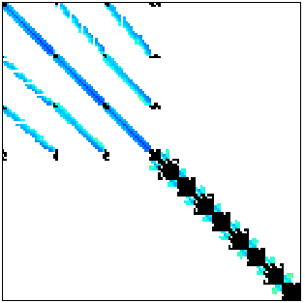
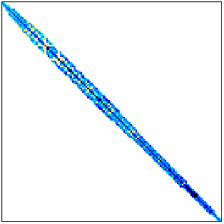
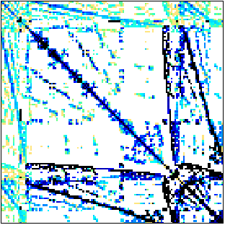
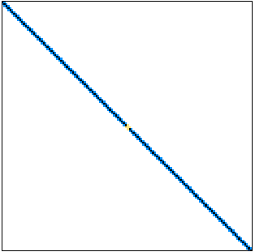
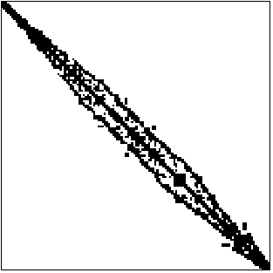
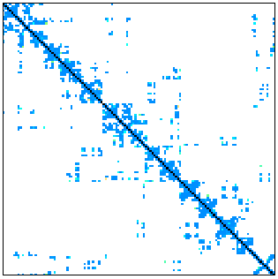
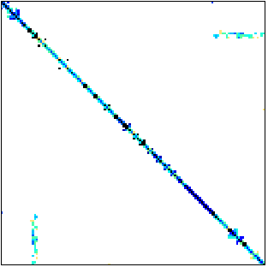
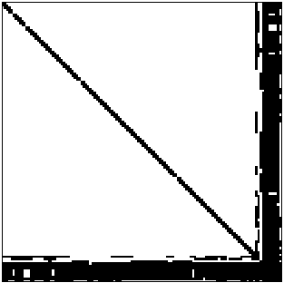
Experimental Setup
Methodology Summary
Representative Matrices in SuiteSparse
Dataset:
2,893 sparse matrices from the SuiteSparse Matrix Collection.
302 sparse weight matrices from DLMC.
Workloads:
Four sparse kernels.
Inference process of ResNet-50 and Transformer.
AMG solver.
Matrix A | n(A) | nnz(A) | plot | nnz(C) | #inter-prod/blk
consph | 83K | 6.0M |  | 26.5M | 164.9
shipsec1 | 140K | 7.8M |  | 24.1M | 189.5
crankseg_2 | 64K | 14.1M |  | 104.6M | 198.5
cant | 62K | 4.0M |  | 17.4M | 280.2
opt1 | 15K | 1.9M |  | 8.2M | 506.4
pdb1HYS | 36K | 4.3M |  | 19.6M | 517.2
pwtk | 218K | 11.6M |  | 32.8M | 548.3
gupta3 | 17K | 9.3M |  | 270.9M | 1154.1
Simulation Environment: Modified AccelSim for asynchronous memory; custom C++ simulator for internal compute of hardware below.
Configuration of STCs/DSAs
STC | Task Dimensions (128 or 64 MACs) (M × N × K)
GAMMA | 16×8×1 or 16×4×1
SIGMA | 1×8×16 or 1×4×16
Trapezoid | TrIP : 16×4×2 or 16×2×2 TrGT : 16×4×2 or 16×4×1 TrGS : 8×4×4 or 8×4×2
NV-DTC | 8×4×4 or 4×4×4
DS-STC | 8×16×1 or 8×8×1
RM-STC | 16×4×2 or 8×4×2
Uni-STC (this work) | T3 task: 4×4×4 | T4 task: 1×1×4
Notes:
This experiment utilizes 2,893 sparse matrices from SuiteSparse and 302 sparse weight matrices from DLMC. The workload covers four sparse kernels, ResNet-50 and Transformer inference, and the AMG solver. The simulation environment uses an modified AccelSim to handle asynchronous memory access, while internal computations are processed by a custom C++ simulator.
The work we compared is shown in the table below. In addition to STC, which is used for the primary comparison, we implemented STC versions of several DSAs for performance comparison. The table on the right displays the 8 representative matrices we used for detailed performance analysis.

Slide 22
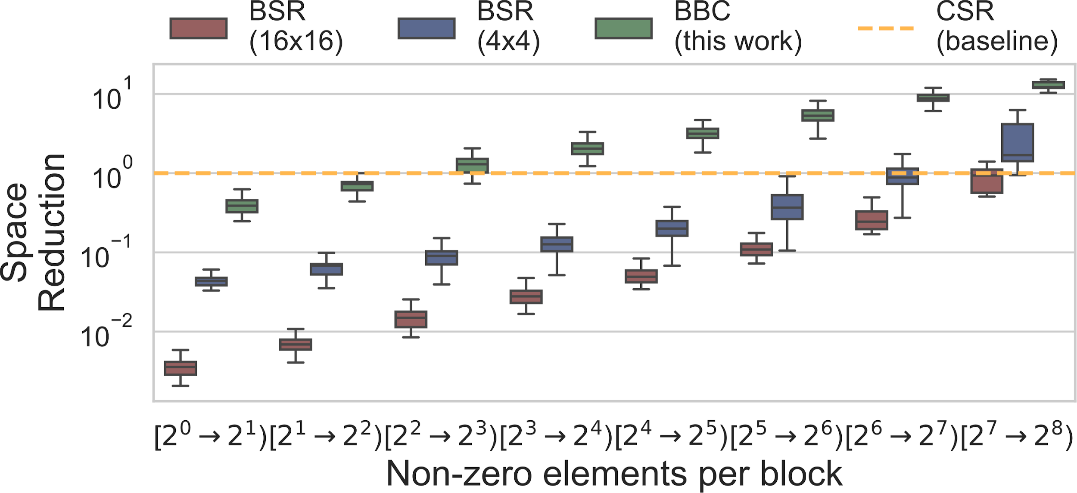
Data Structure Comparison
BBC reduces index overhead across 2,585 matrices, achieving up to 15.26x space savings over the CSR format. Its conversion cost is equivalent to several hundred SpMV, which is acceptable for GNNs and iterative solvers.
Notes:
We first conducted a comparative analysis of the data structures.

Slide 23
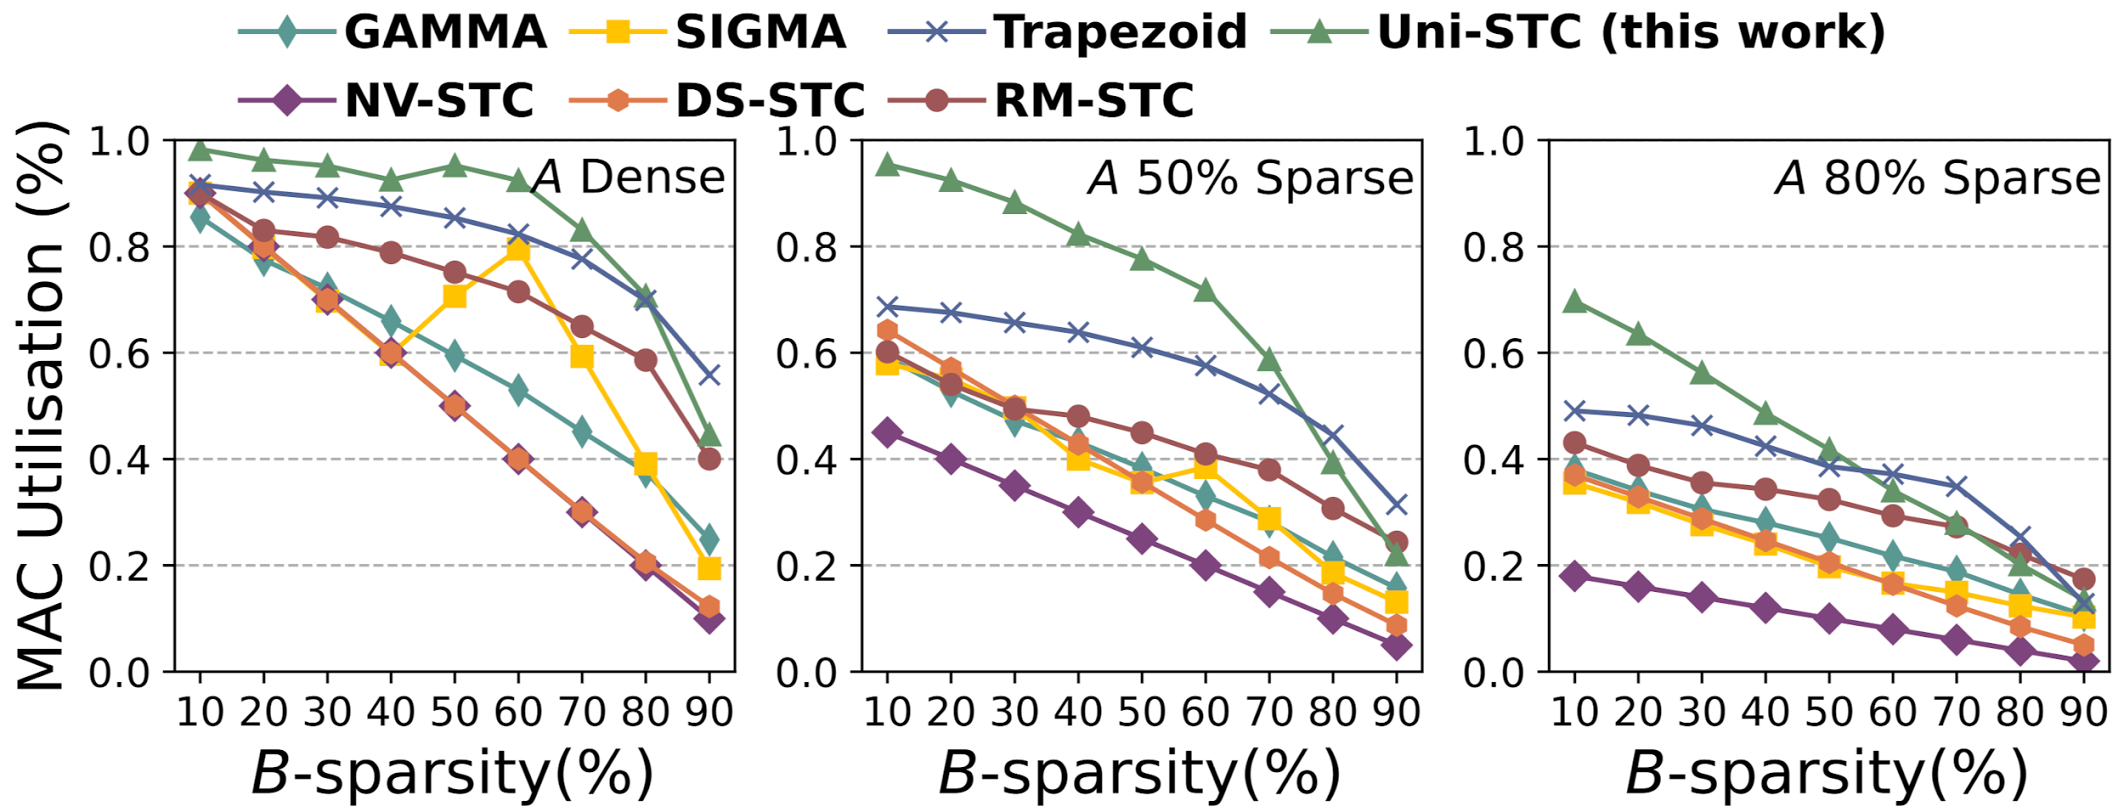
Comparison Using Random Matrices
Uni-STC achieves average speedups of 1.67×, 1.73×, 1.13×, 2.89×, 1.89×, and 1.39× over GAMMA, SIGMA, Trapezoid, NV-DTC, DS-STC, and RM-STC, respectively.
Notes:
In terms of performance, we first compared various works using random matrices of order 8192, and Uni-STC achieved the highest average MAC utilization.

Slide 24
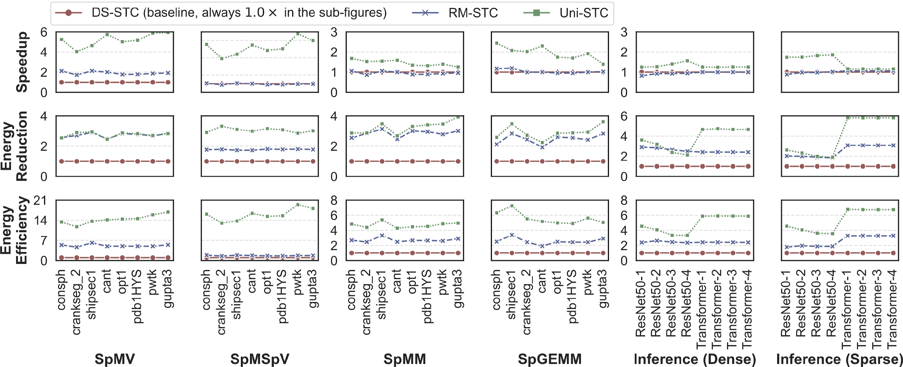
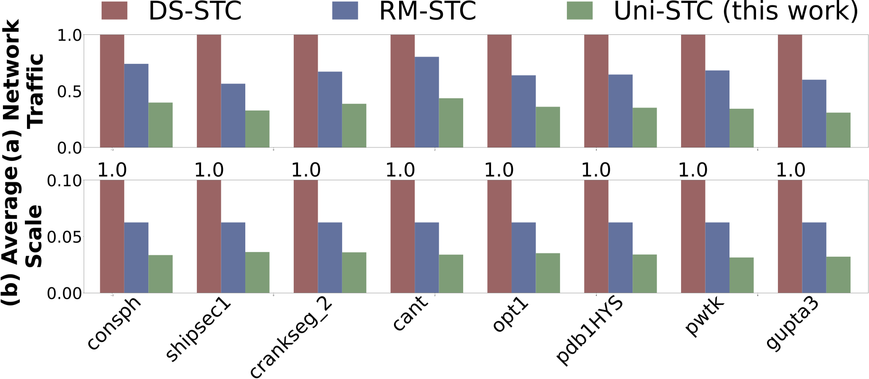
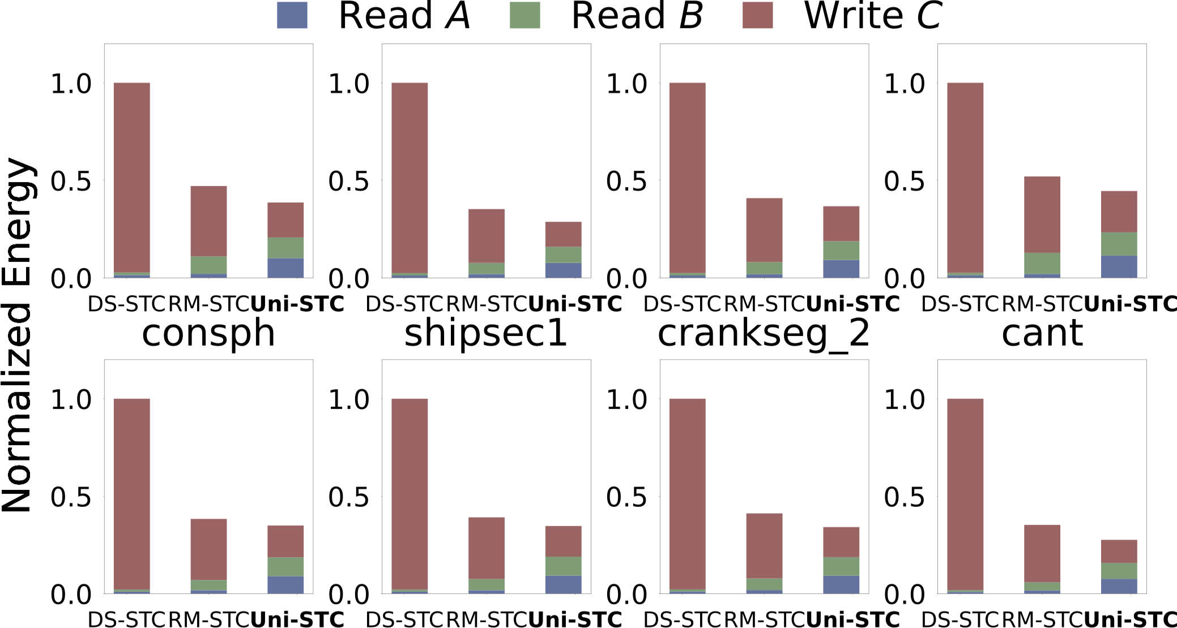
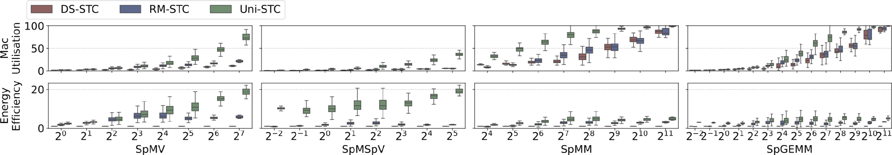
Performance and Energy Efficiency
Energy Reduction Reason 1: SDPU reduce write traffic, and DPG dynamic activation reduce energy per bit traffic.
2.74× speedup & 9.40× energy efficiency over RM-STC.
1.88× speedup & 2.21× energy efficiency over RM-STC.
1.43× speedup & 1.51× energy efficiency over RM-STC.
Energy Reduction Reason 2: Outer product tile task order improves the data reuse rate of matrices A and B.
Speedup Reason: Fine-grained task concatenation improves throughput.
Uni-STC outperforms RM-STC with 2.96x energy efficiency (geomean) across the four operators on 2,893 SuiteSparse matrices.
Notes:
We evaluate four sparse operators and AI inference using eight representative matrices.
1. Uni-STC consistently outperforms RM-STC across all sparse workloads.
2. This speedup reason is ...
1. For the energy efficiency, first, our SDPU and DPG units reduce write traffic and dynamic power consumption.
2. Second, our Outer-product task order optimizes data reuse, lowering the memory access energy.
We also evaluate the four sparse kernels using the all matices of SuiteSparse, 【念PPT】

Slide 25
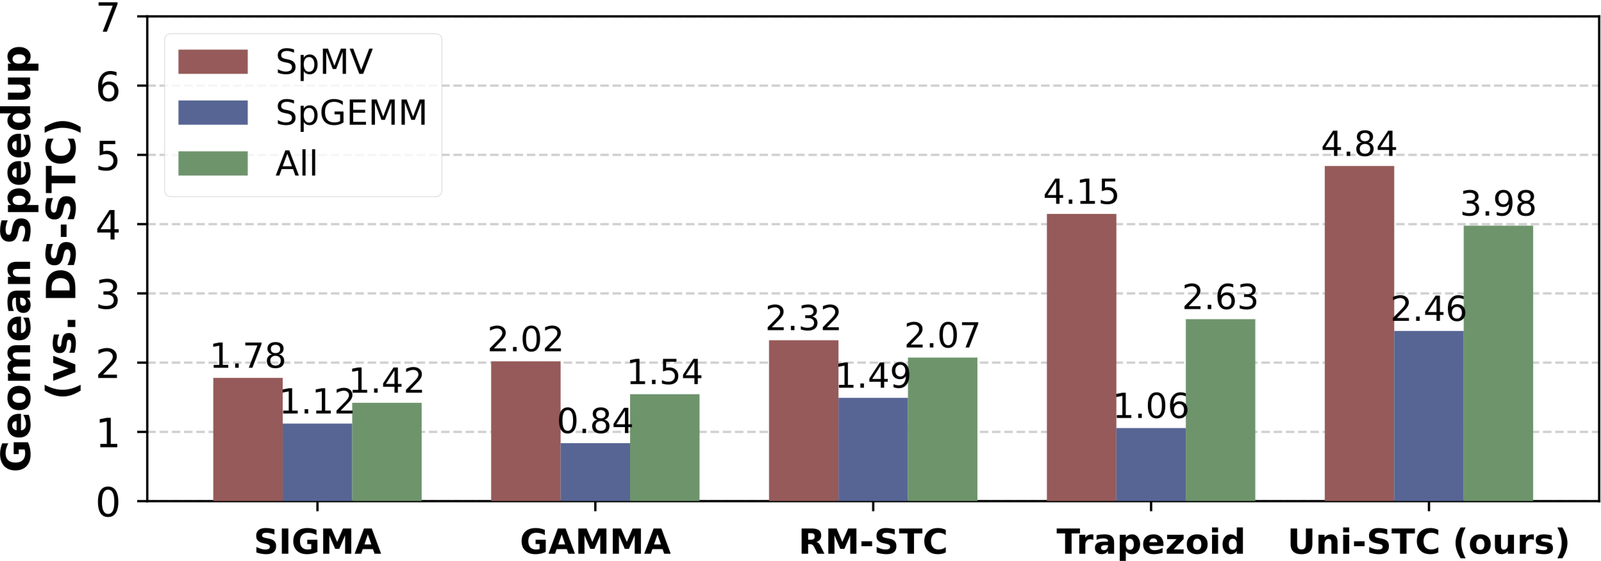
AMG Solver
Uni-STC achieves superior performance on both SpMV and SpGEMM operators:
Consistently best: Outperforms all baselines (SIGMA, GAMMA, RM-STC, Trapezoid).
Balanced acceleration: Unlike Trapezoid which struggles with SpGEMM (1.06×), Uni-STC excels in both SpMV (4.84×) and SpGEMM (2.46×).
Overall speedup: Achieves a geomean speedup of 3.98×.
Notes:
For the AMG Solver, Uni-STC achieves four point eight four times and two point four six times performance improvements over DS-STC on the SpMV and SpGEMM kernels respectively, thus achieving a geometric mean speedup of three point nine eight times.

Slide 26

Sensitivity Analysis
When DPG = 8, SpMM and SpGEMM achieve energy efficiency density (EED, energy efficiency / area) close to the DPG = 16 configuration (1.37× improvement over DPG = 4), while the EED of SpMV and SpMSpV degrades slightly (1.1× lower than DPG = 4). Therefore, Uni-STC adopts the default configuration of DPG = 8.
Notes:
We also conducted a sensitivity analysis on the quantity of DPGs use the EED metric, which present the energy efficiency density.

Slide 27
Area Overhead
Module Name | Area (mm²) | Percentage (%)
Benes & MUX networks | 0.002 | 0.1
TMS & DPG | 0.012 | 0.6
Extra adders in SDPU | 0.018 | 0.94
Meta data buffer (144B) | 0.0005 | 0.03
Accumulate buffer (1KB) | 0.003 | 0.15
Matrix A buffer (2KB) | 0.007 | 0.3
Total Overhead | 0.0425 | 2.12
Use yosys, FreePDK45 and CACTI7 to calculate.
The area overhead compared to the RM-STC's 1.8% is increased by 1.18x, but the average energy efficiency improvement across the four sparse operators is 2.96x.
Notes:
14

Slide 28
1
Background & Motivation
2
Uni-STC’s Architecture
OUTLINE
3
Uni-STC’s Dataflow
4
Evaluation
5
Conclusion
Notes:
In conclusion,

Slide 29


Conclusion
Contribution 1. We propose a unified BBC sparse format, the corresponding implementation of sparse BLAS operators and the Uni-STC integrated within GPU to meet applications' demand for generality.
Contribution 2. To overcome the difficulties in maintaining MAC utilization, we proposed TMS, DPG, and SDPU in the Uni-STC to achieve task aggregation. And we design a supporting data path and pipeline to ensure efficient execution.
Contribution 3. We conduct evaluation covering the performance, energy, and area of Uni-STC. Results demonstrate performance improvement and energy reduction over state-of-the-art designs with acceptable area overhead.
Notes:
We propose Uni-STC, which includes three main contributions:
123

Slide 30
Thank you!
Any Questions?
Notes:
我的汇报到此结束，请各位老师批评指正！

Slide 31



T3 Task Size
1. Symmetric configuration (M=N=K).
1. Support unified data structure for matrices A, B and C.
2. Improve the adaption on real-world matrices.
❶ Long row
❷ Long column
❸ Diagonal
concentration
❸
❶
crankseg_2
❷
2. Hardware cost.
Notes:
Uni-STC架构设计在T3任务尺寸选择对称配置，即M=N=K，可支持矩阵A、B和C使用统一的数据结构，这能大幅提升对现实世界矩阵的适应性。此外，还需考虑硬件设计代价，有三种情况需重点关注：长行情况、长列情况以及对角线集中情况。这些情况综合起来，能帮助我们设计出更合理、高效的架构。

