Slide 1

TileSpGEMM: A Tiled Algorithm for Parallel Sparse General Matrix-Matrix Multiplication on GPUs
Yuyao Niu, Zhengyang Lu, Haonan Ji, Shuhui Song, Zhou Jin, Weifeng Liu
Super Scientific Software Laboratory, China University of Petroleum-Beijing, China
4 Apr 2022
https://github.com/SuperScientificSoftwareLaboratory/TileSpGEMM

Slide 2









Introduction
General Sparse Matrix-Matrix Multiplication (SpGEMM) operation computes 𝐶 =𝐴𝐵, where 𝐴, 𝐵 and 𝐶 are all sparse matrices.
1
2
$$a$$
$$b$$
3
4
5
$$c$$
$$d$$
$$×$$
$$=$$
$$e$$
6
$$f$$
$$g$$
A (4x4)
sparse
6 nonzeros
B (4x4)
sparse
7 nonzeros
C (4x4)
sparse
(to be computed)
Niu et al., TileSpGEMM: A Tiled Algorithm for Parallel Sparse General Matrix-Matrix Multiplication on GPUs, PPoPP ’22

Slide 3


Introduction
General Sparse Matrix-Matrix Multiplication (SpGEMM) operation computes 𝐶 =𝐴𝐵, where 𝐴, 𝐵 and 𝐶 are all sparse matrices.
$$1a$$
$$1b$$
Intermediate product
1
2
$$a$$
$$b$$
3
4
5
$$c$$
$$d$$
$$×$$
$$=$$
$$e$$
6
$$f$$
$$g$$
A (4x4)
sparse
6 nonzeros
B (4x4)
sparse
7 nonzeros
C (4x4)
sparse
(to be computed)
Niu et al., TileSpGEMM: A Tiled Algorithm for Parallel Sparse General Matrix-Matrix Multiplication on GPUs, PPoPP ’22

Slide 4



Introduction
General Sparse Matrix-Matrix Multiplication (SpGEMM) computes 𝐶 =𝐴𝐵, where 𝐴, 𝐵 and 𝐶 are all sparse matrices.
$$1a$$
$1b$+$2e$
$$1b$$
Intermediate product
1
2
$$a$$
$$b$$
3
4
5
$$c$$
$$d$$
$$×$$
$$=$$
$$e$$
6
$$f$$
$$g$$
A (4x4)
sparse
6 nonzeros
B (4x4)
sparse
7 nonzeros
C (4x4)
sparse
(to be computed)
Niu et al., TileSpGEMM: A Tiled Algorithm for Parallel Sparse General Matrix-Matrix Multiplication on GPUs, PPoPP ’22

Slide 5





Introduction
General Sparse Matrix-Matrix Multiplication (SpGEMM) computes 𝐶 =𝐴𝐵, where 𝐴, 𝐵 and 𝐶 are all sparse matrices.
$$1a$$
$$1b$$
Intermediate product
$1b$+$2e$
1
2
$$a$$
$$b$$
$$1a$$
$1b$+$2e$
3
4
5
$$c$$
$$d$$
$$×$$
$$=$$
$$e$$
6
$$f$$
$$g$$
A (4x4)
sparse
6 nonzeros
B (4x4)
sparse
7 nonzeros
C (4x4)
sparse
(to be computed)
Niu et al., TileSpGEMM: A Tiled Algorithm for Parallel Sparse General Matrix-Matrix Multiplication on GPUs, PPoPP ’22

Slide 6


















Introduction
General Sparse Matrix-Matrix Multiplication (SpGEMM) computes 𝐶 =𝐴𝐵, where 𝐴, 𝐵 and 𝐶 are all sparse matrices.
1
2
$$a$$
$$b$$
$$1a$$
$1b$+$2e$
3
4
5
$$c$$
$$d$$
$$4d$$
$$3b$$
$$5g$$
$$3a+4c\text{+}5f$$
$$3b$$
$$×$$
$$=$$
$$e$$
6
$$f$$
$$g$$
$$6a$$
$$6b$$
A (4x4)
sparse
6 nonzeros
B (4x4)
sparse
7 nonzeros
C (4x4)
sparse
(8 nonzeros)
Niu et al., TileSpGEMM: A Tiled Algorithm for Parallel Sparse General Matrix-Matrix Multiplication on GPUs, PPoPP ’22

Slide 7
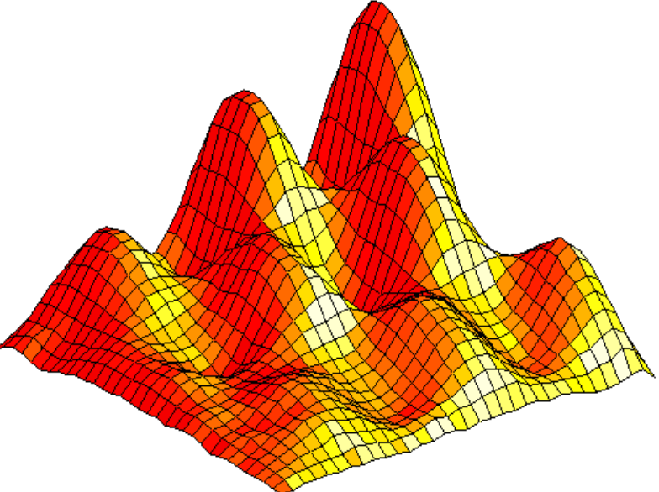
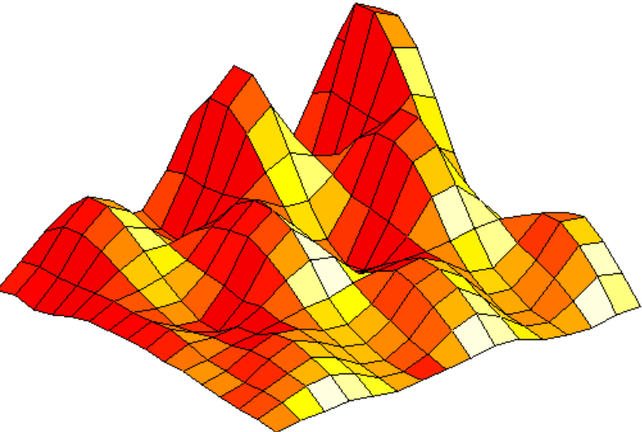
Why important?
Algebraic multigrid methods
Breadth first search
Deep neural network
Niu et al., TileSpGEMM: A Tiled Algorithm for Parallel Sparse General Matrix-Matrix Multiplication on GPUs, PPoPP ’22

Slide 8
Outline
Motivations
Format
Algorithm
Experiment
Load imbalance
Unknown size of 𝐶
Tiled data structure
TileSpGEMM
Performance evaluation
Sparse accumulator selection

Slide 9
Outline
Motivations
Format
Algorithm
Experiment
Load imbalance
Unknown size of 𝐶
Tiled data structure
TileSpGEMM
Performance evaluation
Sparse accumulator selection

Slide 10







Motivation 1: Load imbalance
#intermediate products
of rows of C
1
2
$$a$$
$$b$$
2
+
1
=
3
3
4
5
$$c$$
$$d$$
$$×$$
$$e$$
6
$$f$$
$$g$$
A (4x4)
sparse
6 nonzeros
B (4x4)
sparse
7 nonzeros
Niu et al., TileSpGEMM: A Tiled Algorithm for Parallel Sparse General Matrix-Matrix Multiplication on GPUs, PPoPP ’22

Slide 11
Motivation 1: Load imbalance
#intermediate products
of rows of C
1
2
$$a$$
$$b$$
2
+
1
=
3
3
4
5
$$c$$
$$d$$
2
+
2
+
2
=
6
$$×$$
$$e$$
6
$$f$$
$$g$$
A (4x4)
sparse
6 nonzeros
B (4x4)
sparse
7 nonzeros
Niu et al., TileSpGEMM: A Tiled Algorithm for Parallel Sparse General Matrix-Matrix Multiplication on GPUs, PPoPP ’22

Slide 12
Motivation 1: Load imbalance
#intermediate products
of rows of C
1
2
$$a$$
$$b$$
2
+
1
=
3
3
4
5
$$c$$
$$d$$
2
+
2
+
2
=
6
$$×$$
$$e$$
0
6
$$f$$
$$g$$
A (4x4)
sparse
6 nonzeros
B (4x4)
sparse
7 nonzeros
Niu et al., TileSpGEMM: A Tiled Algorithm for Parallel Sparse General Matrix-Matrix Multiplication on GPUs, PPoPP ’22

Slide 13
Motivation 1: Load imbalance
#intermediate products
of rows of C
1
2
$$a$$
$$b$$
2
+
1
=
3
3
4
5
$$c$$
$$d$$
2
+
2
+
2
=
6
$$×$$
$$e$$
0
6
$$f$$
$$g$$
2
A (4x4)
sparse
6 nonzeros
B (4x4)
sparse
7 nonzeros
Niu et al., TileSpGEMM: A Tiled Algorithm for Parallel Sparse General Matrix-Matrix Multiplication on GPUs, PPoPP ’22

Slide 14
Motivation 1: Load imbalance
#intermediate products
of rows of C
1
2
$$a$$
$$b$$
2
+
1
=
3
3
4
5
$$c$$
$$d$$
2
+
2
+
2
=
6
$$×$$
$$e$$
0
6
$$f$$
$$g$$
2
A (4x4)
sparse
6 nonzeros
B (4x4)
sparse
7 nonzeros
Niu et al., TileSpGEMM: A Tiled Algorithm for Parallel Sparse General Matrix-Matrix Multiplication on GPUs, PPoPP ’22

Slide 15
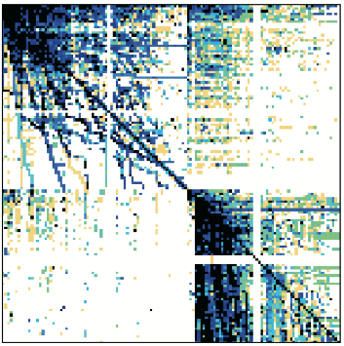
Motivation 1: Load imbalance
When performing A² operation:
The amount of computations for each rows can be very imbalanced, thus it is hard to saturate massively parallel GPUs when a small number of long rows dominate runtime in the row-row style.
#floating point operations | #rows
>100,000 | 3
>10,000 | 190
<100 | 928,730
webbase-1M
(with power-law feature)
n = 1,000,005
nnz = 3,105,536
Niu et al., TileSpGEMM: A Tiled Algorithm for Parallel Sparse General Matrix-Matrix Multiplication on GPUs, PPoPP ’22

Slide 16















Motivation 2: Unknown size of C
1
2
$$a$$
$$b$$
3
4
5
$$c$$
$$d$$
$$×$$
$$=$$
$$e$$
6
$$f$$
$$g$$
A (4x4)
sparse
6 nonzeros
B (4x4)
sparse
7 nonzeros
C (4x4)
Sparse
? nonzeros
(to be computed)
Symbolic SpGEMM
Niu et al., TileSpGEMM: A Tiled Algorithm for Parallel Sparse General Matrix-Matrix Multiplication on GPUs, PPoPP ’22

Slide 17
Motivation 2: Unknown size of C
1
2
$$a$$
$$b$$
3
4
5
$$c$$
$$d$$
$$×$$
$$=$$
$$e$$
6
$$f$$
$$g$$
A (4x4)
sparse
6 nonzeros
B (4x4)
sparse
7 nonzeros
C (4x4)
Sparse
8 nonzeros
(to be computed)
Symbolic SpGEMM
nnzC
Malloc space for C
Numeric SpGEMM
Niu et al., TileSpGEMM: A Tiled Algorithm for Parallel Sparse General Matrix-Matrix Multiplication on GPUs, PPoPP ’22

Slide 18
Motivation 2: Unknown size of C
1
2
$$a$$
$$b$$
$$1a$$
$1b$+$2e$
The size of 𝐶 is unknown in advance and requires a space for storing a possibly large amount of intermediate products, thus it is hard to allocate a proper size at runtime.
3
4
5
$$c$$
$$d$$
$$4d$$
$$3b$$
$$5g$$
$$3a+4c\text{+}5f$$
$$3b$$
$$×$$
$$=$$
$$e$$
6
$$f$$
$$g$$
$$6a$$
$$6b$$
A (4x4)
sparse
6 nonzeros
B (4x4)
sparse
7 nonzeros
C (4x4)
sparse
(8 nonzeros)
Symbolic SpGEMM
nnzC
Malloc space for C
Numeric SpGEMM
Niu et al., TileSpGEMM: A Tiled Algorithm for Parallel Sparse General Matrix-Matrix Multiplication on GPUs, PPoPP ’22

Slide 19
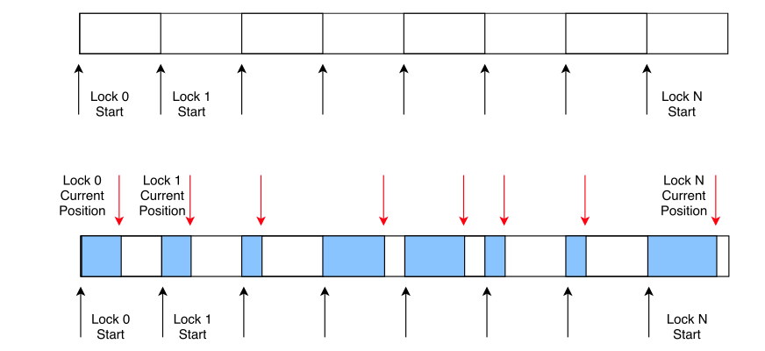
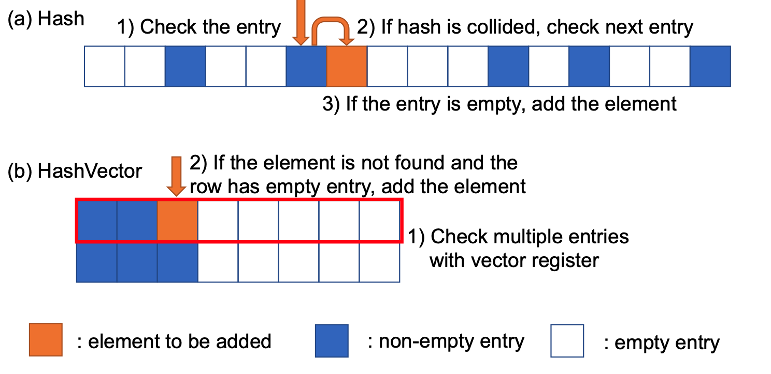
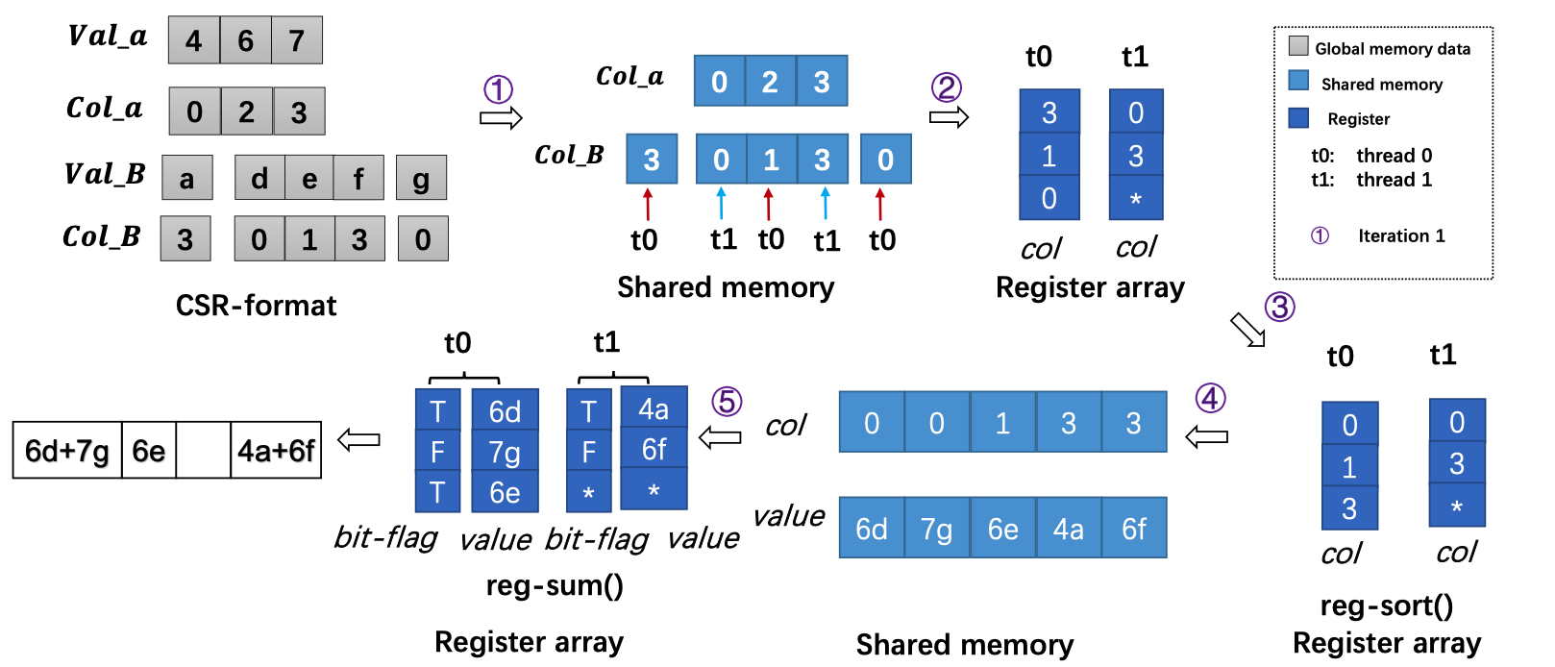
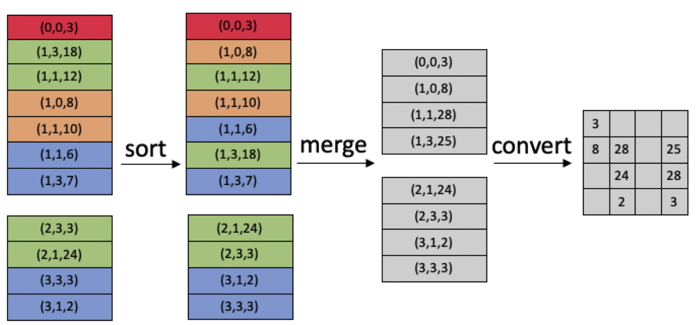
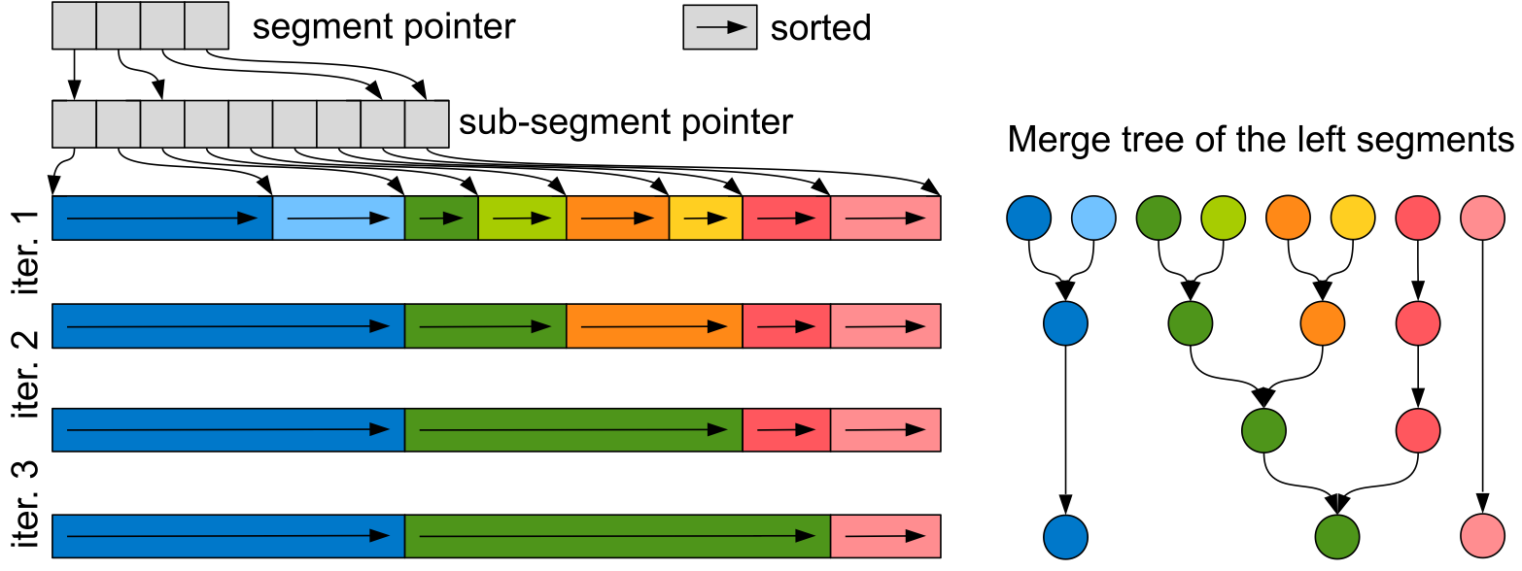
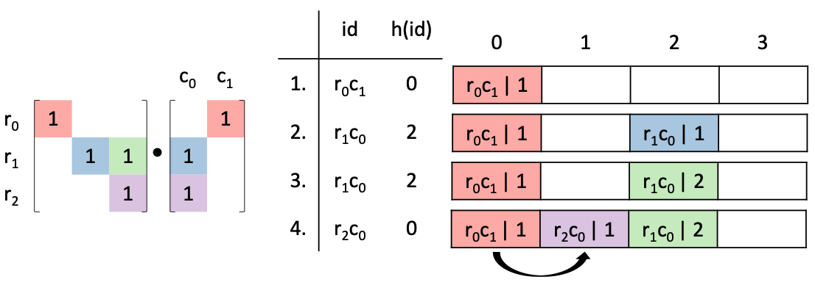
Motivation 3: Sparse accumulator selection
The row-row method inserts nonzeros to random positions in the rows of 𝐶 of unpredictable sparsity, thus it is hard to design a sparse accumulator to efficiently accumulate new entries.
R. Kunchum, A. Chaudhry, A. Sukumaran-Rajam, Q. Niu, I. Nisa, and P. Sadayappan. On improving performance of sparse matrix-matrix multiplication on gpus. In ICS ’17, 2017.
Y. Nagasaka, S. Matsuoka, A. Azad, and A. Buluç. Performance optimization, modeling and analysis of sparse matrix-matrix products on multi-core and many-core processors. Parallel Computing, 90, 2019.
J. Liu, X. He, W. Liu, and G. Tan. Register-aware optimizations for parallel sparse matrix-matrix multiplication. International Journal of Parallel Programming, 2019.
M. Parger, M. Winter, D. Mlakar, and M. Steinberger. Speck: Accelerating gpu sparse matrix-matrix multiplication through lightweight analysis. In PPoPP ’20, pages 362–375, 2020.
Z. Gu, J. Moreira, D. Edelsohn, and A. Azad. Bandwidth optimized parallel algorithms for sparse matrix-matrix multiplication using propagation blocking. In SPAA ’20, 293–303, 2020.
H. Ji, S. Lu, K. Hou, H. Wang, Z. Jin, W. Liu, and B. Vinter. Segmented merge: A new primitive for parallel sparse matrix computations. International Journal of Parallel Programming, 1–13, 2021.
Niu et al., TileSpGEMM: A Tiled Algorithm for Parallel Sparse General Matrix-Matrix Multiplication on GPUs, PPoPP ’22

Slide 20
Outline
Motivations
Format
Algorithm
Experiment
Load imbalance
Unknown intermediate space
Tiled data structure
TileSpGEMM
Performance evaluation
Sparse accumulator selection
Niu et al., TileSpGEMM: A Tiled Algorithm for Parallel Sparse General Matrix-Matrix Multiplication on GPUs, PPoPP ’22

Slide 21
Tiled data structure
Niu et al., TileSpGEMM: A Tiled Algorithm for Parallel Sparse General Matrix-Matrix Multiplication on GPUs, PPoPP ’22

Slide 22
Tiled data structure
higher level
tilePtr
0
2
3
4
6
tileColidx
0
3
1
3
1
3
tileNnz
0
5
9
13
17
23
25
Nnz
5
4
4
4
6
2
Niu et al., TileSpGEMM: A Tiled Algorithm for Parallel Sparse General Matrix-Matrix Multiplication on GPUs, PPoPP ’22

Slide 23
Tiled data structure
higher level
lower level
rowptr
(unsigned char)
0
1
1
3
5
tilePtr
0
2
3
4
6
rowidx
(unsigned char)
0
2
2
3
3
tileColidx
0
3
1
3
1
3
colidx
(unsigned char)
0
1
2
2
3
tileNnz
0
5
9
13
17
23
25
val
mask
(unsigned short)
1
0
0
0
0
0
0
0
0
1
1
0
0
1
0
1
Niu et al., TileSpGEMM: A Tiled Algorithm for Parallel Sparse General Matrix-Matrix Multiplication on GPUs, PPoPP ’22

Slide 24
Tiled data structure
8-bit unsigned char for storing pointers
8-bit unsigned char for storing row and column indices
16-bit unsigned short for bit masks
Niu et al., TileSpGEMM: A Tiled Algorithm for Parallel Sparse General Matrix-Matrix Multiplication on GPUs, PPoPP ’22

Slide 25
Outline
Motivations
Format
Algorithm
Experiment
Load imbalance
Unknown size of 𝐶
Tiled data structure
TileSpGEMM
Performance evaluation
Sparse accumulator selection
step 1: Calculating the number of non-empty tiles in C
step 2: Determining the number of nnz in C
step 3: Computing C

Slide 26
TileSpGEMM
Step 1: Find the possibly non-empty tiles in 𝐶.
tilePtr_C
tileColidx_C
Niu et al., TileSpGEMM: A Tiled Algorithm for Parallel Sparse General Matrix-Matrix Multiplication on GPUs, PPoPP ’22

Slide 27
TileSpGEMM
Step 1: Find the possibly non-empty tiles in 𝐶.
tilePtr_C
tileColidx_C
Step 2: Determine the number of nonzeros and the row pointer array of each tile in 𝐶, and allocate the resulting matrix.
tileNnz_C
mask_C
Niu et al., TileSpGEMM: A Tiled Algorithm for Parallel Sparse General Matrix-Matrix Multiplication on GPUs, PPoPP ’22

Slide 28
TileSpGEMM
Step 1: Find the possibly non-empty tiles in 𝐶.
tilePtr_C
tileColidx_C
Step 2: Determine the number of nonzeros and the row pointer array of each tile in 𝐶, and allocate the resulting matrix.
tileNnz_C
mask_C
Step 3: Calculate the row and column indices and values of the nonzeros in each tile of 𝐶.
rowidx_C colidx_C
val_C
Niu et al., TileSpGEMM: A Tiled Algorithm for Parallel Sparse General Matrix-Matrix Multiplication on GPUs, PPoPP ’22

Slide 29



TileSpGEMM – Step 1
Run a SpGEMM to multiply the high level tile structure of the two input matrices 𝐴 and 𝐵.
The number of nonzeros in the resulting matrix 𝐶’ is the number of non-empty tiles in 𝐶.
Create A’
$$×$$
$$=$$
NSPARSE:
Simpler interface to use
Better performance on small cases
A
6 non-empty tiles
A’
6 nonzeros
B’
6 nonzeros
C’
10 nonzeros
tilePtr
0
2
3
4
6
$$=$$
rowPtr
0
2
3
4
6
Y. Nagasaka, S. Matsuoka, A. Azad, and A. Buluç. High-Performance Sparse Matrix-Matrix Products on Intel KNL and Multicore Architectures. In Proceedings of the 47th International Conference on Parallel Processing Companion (ICPP ’18), 2018, 1–10.
tileColidx
0
3
1
3
1
3
Colidx
0
3
1
3
1
3
Niu et al., TileSpGEMM: A Tiled Algorithm for Parallel Sparse General Matrix-Matrix Multiplication on GPUs, PPoPP ’22

Slide 30
TileSpGEMM – Step 2
Empty tiles in 𝐴 and 𝐵 should not be involved in the computation.
How to find the tile-pairs in 𝐴 and 𝐵 that should be multiplied?
How to generate the row pointer array and the number of nonzeros of each tile of 𝐶?
Niu et al., TileSpGEMM: A Tiled Algorithm for Parallel Sparse General Matrix-Matrix Multiplication on GPUs, PPoPP ’22

Slide 31
TileSpGEMM – Step 2
Search the elements of short array in the long array with binary search operation and then record the index of intersection elements in their own position array.
tilerowidx_B_{*2}
1
3
Binary Search tilerowidx_B_{*2} in tilecolidx_A_{1*}
tilecolidx_A_{1*}
0
1
3
Search:
tilerowidx_B_{*2}
1
3
match
match_pos_B_{*2}
0
L=0
M=1
H=2
match_pos_A_{1*}
1
tilecolidx_A_{1*}
0
1
3
return 1
L=0
M=1
H=2
tilecolidx_A_{1*}
0
1
3
match_pos_B_{*2}
0
1
match
L=M=H=2
0
1
3
return 2
match_pos_A_{1*}
1
2
Niu et al., TileSpGEMM: A Tiled Algorithm for Parallel Sparse General Matrix-Matrix Multiplication on GPUs, PPoPP ’22

Slide 32



TileSpGEMM – Step 2
b1₀
1
1
0
0
Use bit mask of each tile to reduce memory transfer cost of repeatedly loading structure information of tiles in 𝐵.
c1₀
1
1
1
0
b1₂
1
0
1
0
b1₁
0
0
1
0
b1₂
1
0
1
0
c1₁
1
1
1
1
1
1
0
0
0
0
0
1
b2₀
0
0
0
1
1
1
1
0
1
2
a
b
a
0
0
1
0
0
1
0
0
1
1
1
1
3
4
$$×$$
c
$$+$$
1
2
$$×$$
b
b2₃
1
1
0
0
1
0
1
0
1
1
0
0
1
1
0
1
5
d
e
3
4
c
d
0
0
0
1
0
1
0
0
b1₃
0
1
0
1
6
f
5
e
0
0
0
1
A₁₁
B₁₂
A₁₃
maskB₃₂(b2)
maskC₁₂(c1)
maskB₁₂(b1)
B₃₂
b2₀
0
0
0
1
c1₂
1
1
0
1
b2₂
1
1
0
0
perform AtomicOR operation on all the extracted line masks on the scratchpad memory.
b1₃
0
0
0
1
c1₂
0
1
0
1
b2₁
0
1
0
0
Niu et al., TileSpGEMM: A Tiled Algorithm for Parallel Sparse General Matrix-Matrix Multiplication on GPUs, PPoPP ’22

Slide 33

TileSpGEMM – Step 3
An adaptive method for selecting sparse or dense accumulator in on-chip memory
1
1
1
0
0
3
7
10
1
1
1
1
C₁₂_ptr
Dense accumulator
1
1
0
1
C₁₂_nnz
=12
0
1
0
1
Y
maskC₁₂
nnz >= 12 ?
N
1
1
0
0
C₃₂_nnz
=6
Sparse accumulator
0
0
1
0
1
0
1
0
C₃₂_ptr
0
2
3
5
16 $×$75% = 12
0
0
0
1
maskC₃₂
Niu et al., TileSpGEMM: A Tiled Algorithm for Parallel Sparse General Matrix-Matrix Multiplication on GPUs, PPoPP ’22

Slide 34


TileSpGEMM – Step 3
If the tile is relatively dense ($\frac{nnz}{tile−size}$>= 0.75), then we firstly work on a dense full matrix and then save the result into its sparse form.
Dense accumulator
1
2
a
b
a
1
1
1
0
0
3
3
4
$$×$$
c
$$+$$
1
2
$$×$$
b
1
1
1
1
C₁₂_ptr
7
10
5
d
e
3
4
c
d
1
1
0
1
C₁₂_nnz
=12
6
f
5
e
0
1
0
1
A₁₁
B₁₂
A₁₃
B₃₂
maskC₁₂
$$=$$
C₁₂
Niu et al., TileSpGEMM: A Tiled Algorithm for Parallel Sparse General Matrix-Matrix Multiplication on GPUs, PPoPP ’22

Slide 35
TileSpGEMM – Step 3
If the tile is relatively dense ($\frac{nnz}{tile−size}$>= 0.75), then we firstly work on a dense full matrix and then save the result into its sparse form.
Dense accumulator
1
2
a
b
a
1
1
1
0
0
3
3
4
$$×$$
c
$$+$$
1
2
$$×$$
b
1
1
1
1
C₁₂_ptr
7
10
5
d
e
3
4
c
d
1
1
0
1
C₁₂_nnz
=12
6
f
5
e
0
1
0
1
A₁₁
B₁₂
A₁₃
B₃₂
maskC₁₂
$$=$$
Not allocating very large temporary space!
1a
+2d
1b
2e
4d
2e
3c
+4e
1a
4c
4d
3a
+5f
5b
6f
C₁₂
Niu et al., TileSpGEMM: A Tiled Algorithm for Parallel Sparse General Matrix-Matrix Multiplication on GPUs, PPoPP ’22

Slide 36


TileSpGEMM – Step 3
If the tile is relatively sparse ($\frac{nnz}{tile−size}<$ 0.75), then a sparse accumulator working on a sparse tile is selected.
Sparse accumulator
1
1
0
0
C₃₂_nnz
=6
0
0
1
0
1
0
1
0
C₃₂_ptr
0
2
3
5
1
a
b
0
0
0
1
2
$$×$$
c
$$=$$
C₃₂_val
1a
1b
2c
3d
3e
4f
maskC₃₂
3
d
e
Not allocating very large temporary space!
f
C₃₂_colidx
0
1
2
0
2
3
4
A₃₁
B₁₂
C₃₂
Niu et al., TileSpGEMM: A Tiled Algorithm for Parallel Sparse General Matrix-Matrix Multiplication on GPUs, PPoPP ’22

Slide 37
Outline
Motivations
Format
Algorithm
Experiment
Load imbalance
Unknown size of 𝐶
Tiled data structure
TileSpGEMM
Performance evaluation
Sparse accumulator selection

Slide 38
Experiment
Experimental platforms | Six algorithms
RTX 3060(Ampere), 3584 CUDA cores @ 1.78 GHz, 12 GB GDDR6, B/W 360.0 GB/s | cuSPARSE
1.76 | bhSPARSE
4.11 | NSPARSE
RTX 3090(Ampere), 10,496 CUDA cores @ 1.70GHz, 24 GB GDDR6, B/W 936.2 GB/s | spECK
12.78 | tSparse
 | TileSpGEMM (our work)
38
Niu et al., TileSpGEMM: A Tiled Algorithm for Parallel Sparse General Matrix-Matrix Multiplication on GPUs, PPoPP ’22

Slide 39
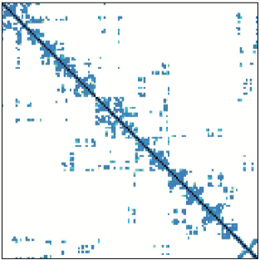
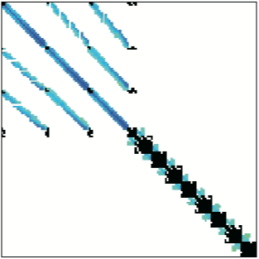
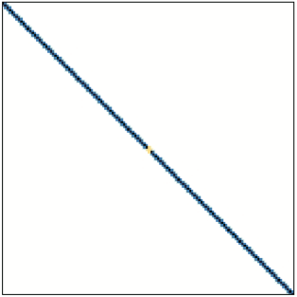
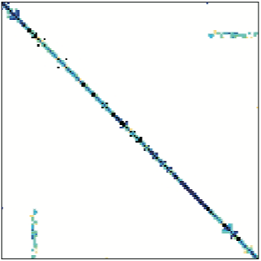
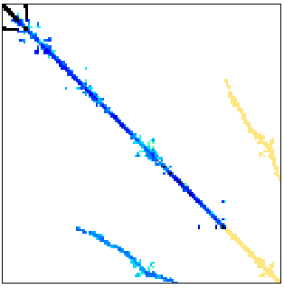
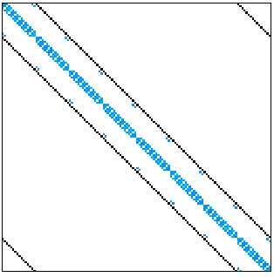
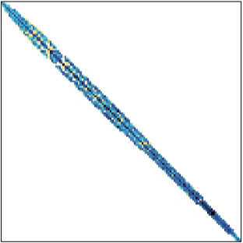
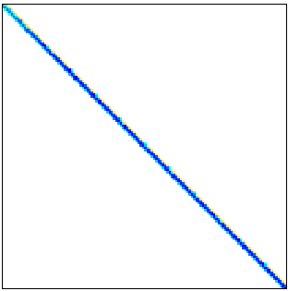
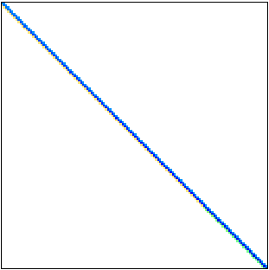
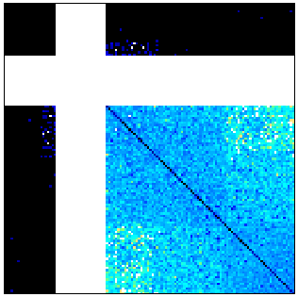
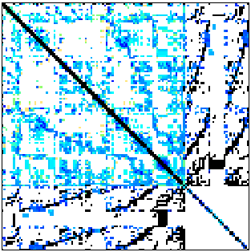
Experiment
142 sparse square matrices in the SuiteSparse Matrix Collection requiring no less than one billion floating point operations when both 𝐶 =𝐴² and 𝐶 =𝐴𝐴^{T} .
pdb1HYS
consph
cant
pwtk
rma10
conf5_4-8x8-05
12 classic matrices in much sparse matrix research.
shipsec1
mac_econ_fwd500
mc2depi
cop20_A
scircuit
webbase-1M
Niu et al., TileSpGEMM: A Tiled Algorithm for Parallel Sparse General Matrix-Matrix Multiplication on GPUs, PPoPP ’22

Slide 40
Experiment
Comparison: 𝐶 =𝐴² and 𝐶 =𝐴𝐴^{T} (double precision)
spECK and TileSpGEMM can finish all 142 matrices.
Niu et al., TileSpGEMM: A Tiled Algorithm for Parallel Sparse General Matrix-Matrix Multiplication on GPUs, PPoPP ’22

Slide 41
Experiment
Comparison: 𝐶 =𝐴² and 𝐶 =𝐴𝐴^{T} (double precision)
spECK and TileSpGEMM can finish all 142 matrices.
TileSpGEMM runs faster than cuSPARSE, bhSPARSE, NSPARSE and spECK on 139, 138, 127 and 94 matrices respectively on RTX 3090, and on 142, 128, 114 and 92 matrices on RTX 3060.
TileSpGEMM is on average 1.77x, 4.73x, 1.45x, 1.16x (geometric mean) and achieve up to 2.78x, 145.35x, 97.86x and 3.70x over cuSPARSE, bhSPARSE, NSPARSE and spECK, respectively.
Niu et al., TileSpGEMM: A Tiled Algorithm for Parallel Sparse General Matrix-Matrix Multiplication on GPUs, PPoPP ’22

Slide 42
Experiment
Comparison: 𝐶 =𝐴² and 𝐶 =𝐴𝐴^{T} (double precision)
bhSPARSE, NSPARSE, spECK and TileSpGEMM achieve on average 2.12x, 2.66x, 2.82x and 2.53x speedups on RTX 3090 over RTX 3060.
Some matrices using TileSpGEMM has more arrays to allocate on GPUs and takes longer time on memory allocation.
Niu et al., TileSpGEMM: A Tiled Algorithm for Parallel Sparse General Matrix-Matrix Multiplication on GPUs, PPoPP ’22

Slide 43
Experiment
Comparison: 𝐶 =𝐴² and 𝐶 =𝐴𝐴^{T} (detailed analysis)
Our method naturally avoids the allocation of temporary products
Niu et al., TileSpGEMM: A Tiled Algorithm for Parallel Sparse General Matrix-Matrix Multiplication on GPUs, PPoPP ’22

Slide 44
Experiment
Comparison: 𝐶 =𝐴² and 𝐶 =𝐴𝐴^{T} (detailed analysis)
Gflops of multiplying Webbase-1M
 | A² | AA^{T}
cuSPARSE | 6.01 | -
bhSPARSE | 1.76 | 6.61
NSPARSE | 4.11 | -
spECK | 6.50 | 18.85
TileSpGEMM | 12.78 | 30.89
Niu et al., TileSpGEMM: A Tiled Algorithm for Parallel Sparse General Matrix-Matrix Multiplication on GPUs, PPoPP ’22

Slide 45
Experiment
Comparison: Runtime peak space cost
In most matrices, bhSPARSE uses the most space, and NSPARSE and spECK are comparable. TileSpGEMM often uses less space than the three methods and finishes earlier.
For some very sparse matrices like `cop20k_A', our method allocates a large amount of sparse tiles for local row pointer and bit masks, and thus may use longer time to allocate and compute.
Niu et al., TileSpGEMM: A Tiled Algorithm for Parallel Sparse General Matrix-Matrix Multiplication on GPUs, PPoPP ’22

Slide 46
Experiment
Comparison: Space costs
Tiled data structure on average takes 31.28 MB less space than CSR, but uses 113.43 and 82.09 MB more space than CSB-M and CSB-I, respectively.
Aydin Buluç, Jeremy T. Fineman, Matteo Frigo, John R. Gilbert, and Charles E. Leiserson. Parallel Sparse Matrix-Vector and Matrix-Transpose-Vector Multiplication Using Compressed Sparse Blocks, SPAA ’09, 2009.
Aydın Buluç and John R Gilbert. The Combinatorial BLAS: design, implementation, and applications. The International Journal of High Performance Computing Applications 25, 4, 2011.
Niu et al., TileSpGEMM: A Tiled Algorithm for Parallel Sparse General Matrix-Matrix Multiplication on GPUs, PPoPP ’22

Slide 47
Experiment
Comparison: Format conversion time
The conversion cost would be acceptable.
The matrix is already stored in the tiled format before running TileSpGEMM. This assumption is pretty reasonable in many applications, such as algebraic multigrid (AMG) solvers using the output matrices from an SpGEMM as the input of another SpGEMM in the next round.
Niu et al., TileSpGEMM: A Tiled Algorithm for Parallel Sparse General Matrix-Matrix Multiplication on GPUs, PPoPP ’22

Slide 48
Experiment
Comparison: 𝐶 =𝐴² (half precision)
tSparse: a relatively new SpGEMM work designed for using half precision and dense tensor cores on modern GPUs.
TileSpGEMM outperforms tSparse on all of the 16 matrices. The average (geometric mean) speedup is 1.98x, and the maximum speedup is 4.04x.
O. Zachariadis, N. Satpute, J. Gómez-Luna, and J. Olivares. Accelerating sparse matrix–matrix multiplication with gpu tensor cores. Computers & Electrical Engineering, 88:106848, 2020.
Niu et al., TileSpGEMM: A Tiled Algorithm for Parallel Sparse General Matrix-Matrix Multiplication on GPUs, PPoPP ’22

Slide 49
Conclusion
Motivations
Format
Algorithm
Experiment
Load imbalance
Unknown size of 𝐶
Tiled data structure
TileSpGEMM
Performance evaluation
Sparse accumulator selection

Slide 50
Thanks for your time!
TileSpGEMM: A Tiled Algorithm for Parallel Sparse General Matrix-Matrix Multiplication on GPUs
Yuyao Niu, Zhengyang Lu, Haonan Ji, Shuhui Song, Zhou Jin, Weifeng Liu
Super Scientific Software Laboratory, China University of Petroleum-Beijing, China
4 Apr 2022
https://github.com/SuperScientificSoftwareLaboratory/TileSpGEMM

