Slide 1



NPC 2020
The 17th Annual IFIP International Conference on Network and Parallel Computing
Zhengzhou, China 2020.09.28 ~ 09.30
Segmented Merge: A New Primitive for Parallel Sparse Matrix Computations
Segmented Merge: A New Primitive for Parallel Sparse Matrix Computations
${\text{Haonan} \text{Ji}}^{1}$, ${\text{Shibo} \text{Lu}}^{1}$, ${\text{Kaixi} \text{Hou}}^{2}$, ${\text{Hao} \text{Wang}}^{3}$, ${\text{Weifeng} \text{Liu}}^{1}$, and ${\text{Brian} \text{Vinter}}^{4}$
Super Scientific Software Laboratory, Department of Computer Science and Technology, China University of Petroleum-Beijing
Department of Computer Science, Virginia Tech
Department of Computer Science and Engineering, The Ohio State University
Faculty of Technical Sciences, Aarhus University

Slide 2
1
Background
2
Parallel segmented merge algorithm
CONTENTS
3
Performance evaluation
4
Conclusion

Slide 3
Part one
Background

Slide 4
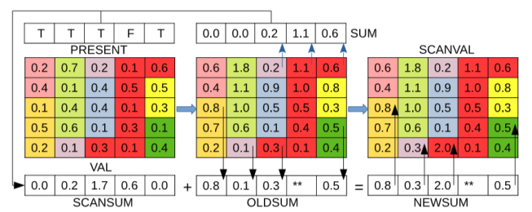
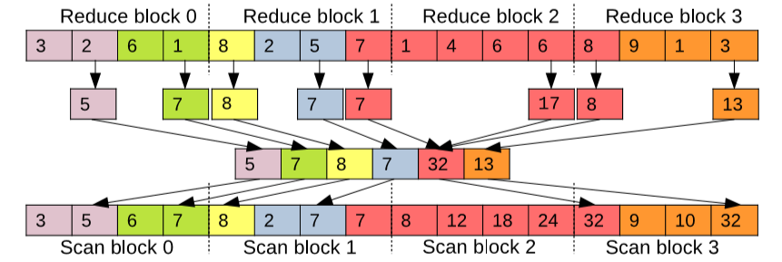
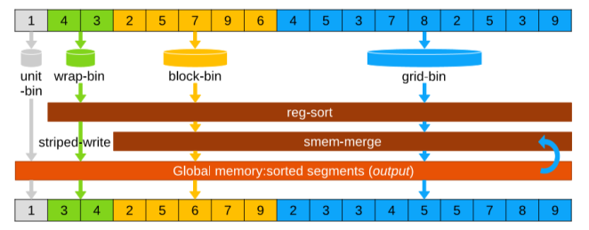



Background
Parallel segmented primitives
(1) ${\text{Parallel} \text{Segmented} \text{Sum}}^{1}$
(2) ${\text{Parallel} \text{Segmented} \text{Scan}}^{2}$
(3) ${\text{Parallel} \text{Segmented} \text{Sort}}^{3}$
1.Blelloch, G.E., Heroux, M.A., Zagha, M.: Segmented Operations for Sparse Matrix Computation on Vector Multiprocessors. Tech. rep ., CMU (1993)
2. Dotsenko, Y., Govindaraju, N.K., Sloan, P.P., Boyd, C., Manferdelli, J.: Fast Scan Algorithms on Graphics Processors. In: Proceedings of the 22nd Annual International Conference on Supercomputing. pp. 205–213 . ICS’08(2008)
3. . Hou, K., Liu, W., Wang, H., Feng, W.c.: Fast Segmented Sort on GPUs. In: Proceedings of the International Conference on Supercomputing . ICS’17(2017)

Slide 5
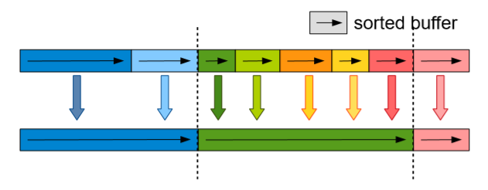




Background
What is segmented merge ?
Assuming a key-value array $S$ includes p segments
$S$ = { $S_{1}$, $S_{2}$, ... , $S_{p}$} (1)
Each segment contains $q_{i}$ sub-segments
$S_{i}$= { $S_{i,1}$, $S_{i,2}$, ... , $S_{i,q_{i}}$} , i ∈ [1,p] (2)
Each sub-segment $S_{i,j}$ includes ${\text{n}}_{i,j}$ key-value pairs already sorted
$S$ = { $S_{1,1}$, $S_{1,2}$, ... , $S_{1,q_{1}}$, $S_{2,1}$, ${\text{S}}_{2,2}$, ... , ${\text{S}}_{2,q_{2}}$ , ... $,{\text{S}}_{p,1}$, ${\text{S}}_{p,2}$, ... , ${\text{S}}_{p,q_{p}}$} (3)
Segment merge: make each segment $S_{i}$ ordered

Slide 6
Background
Two major challenges in segmented merge
core1
core2
core3
core4
Block 0
Block 1
Block 2
core0
Load balancing problem
Vectorizing problem

Slide 7
Parallel segmented
merge algorithm
Part two

Slide 8
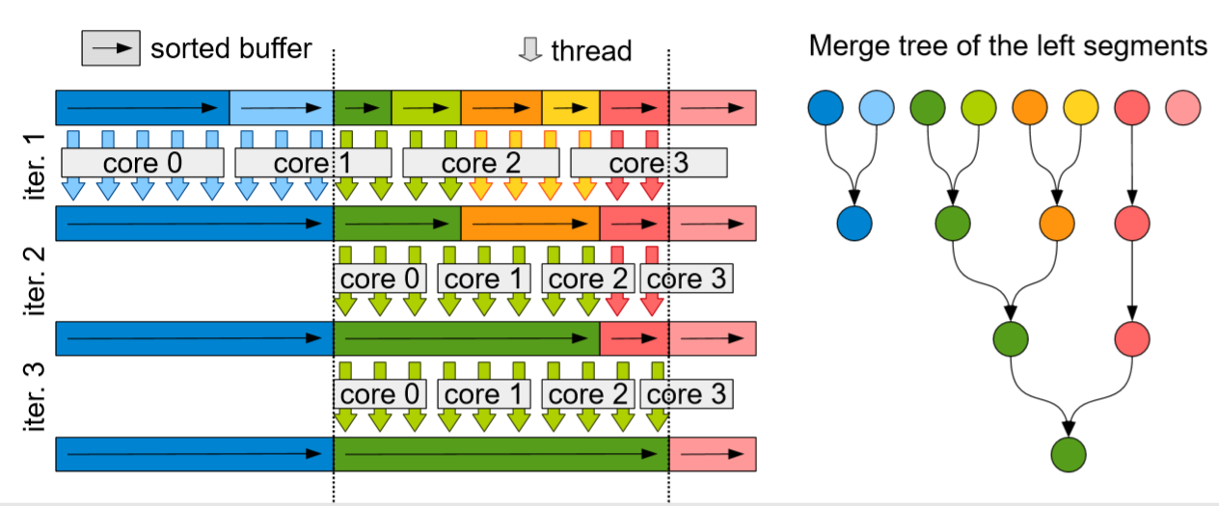
Parallel segmented merge algorithm
1. Each sub-segment of the same segment is regarded as a leaf node of a binary tree and is merged in a bottom-up manner.
2. Fix the number of elements processed by each thread

Slide 9
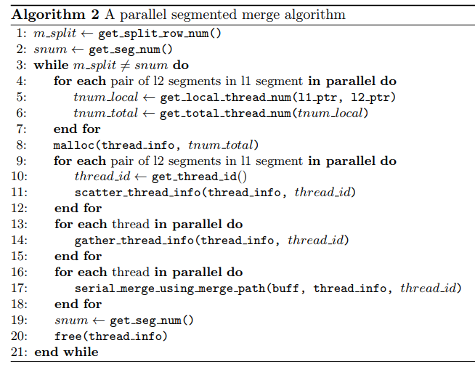
Parallel segmented merge algorithm
1. data preprocessing
Parallel
segmented
merge algorithm
step1

Slide 10
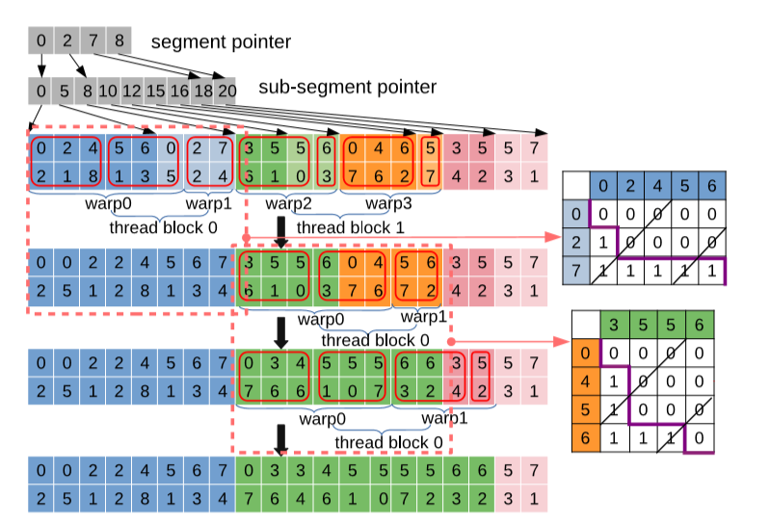
Parallel segmented merge algorithm
Step1. data preprocessing
Firstly, the location of segments and sub-segments is recorded, and then the workload is fixed for each thread. Finally, the partition strategy of the standard merge path algorithm is used to collect the information of the processed data for each thread.

Slide 11
Parallel segmented merge algorithm
1. data preprocessing
Parallel
segmented
merge algorithm
2. merging two sub-segments of each thread
step1
step2

Slide 12
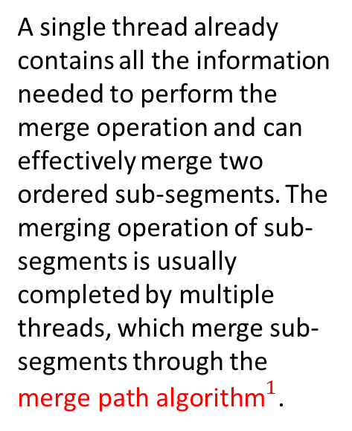
1. Green, O., McColl, R., Bader, D.A.: GPU Merge Path: A GPU Merging Algorithm. In: Proceedings of the 26th ACM International Conference on Supercomputing. pp.331–340. ICS ’12 (2012）
Parallel segmented merge algorithm
Step2. merging two sub-segments of each thread
path
A single thread already contains all the information needed to perform the merge operation and can effectively merge two ordered sub-segments. The merging operation of sub-segments is usually completed by multiple threads, which merge sub-segments through the ${\text{merge} \text{path} \text{algorithm}}^{1}$.

Slide 13
Parallel segmented merge algorithm
1. data preprocessing
Parallel
segmented
merge algorithm
2. merging two sub-segments of each thread
step1
3. merging sub-segments on binary tree in an iterative way
step2
Step3

Slide 14
Parallel segmented merge algorithm
Step3. merging sub-segments on binary tree in an iterative way
Each sub-segment of the same segment can be merged as a leaf node of the binary tree, which may require multiple iterations. When there is only one sub-segment in the segment, the iteration is finished and the segment merging is completed.

Slide 15
Parallel segmented merge algorithm
Step3. merging sub-segments on binary tree in an iterative way
Each sub-segment of the same segment can be merged as a leaf node of the binary tree, which may require multiple iterations. When there is only one sub-segment in the segment, the iteration is finished and the segment merging is completed.

Slide 16
Parallel segmented merge algorithm
Step3. merging sub-segments on binary tree in an iterative way
Each sub-segment of the same segment can be merged as a leaf node of the binary tree, which may require multiple iterations. When there is only one sub-segment in the segment, the iteration is finished and the segment merging is completed.

Slide 17
Performance
evaluation
Part three

Slide 18
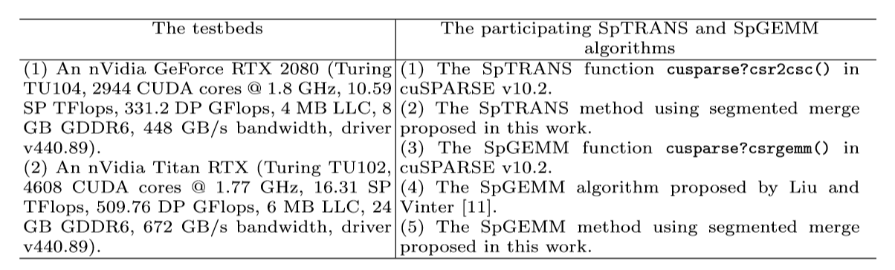
Performance evaluation
Dataset: 956 sparse matrices downloaded from the SuiteSparse Matrix Collection. (We select all 956 relatively large matrices of no less than 100,000 and no more than 200,000,000 nonzero entries for the experiment.)

Slide 19

1. sparse matrix transposition
Performance evaluation
${\text{SpTRANS}}^{1}$ (A=${\text{A}}^{T}\text{)}$
0 | 2 |  | 4
 | 8 |  | 6
 |  | 5 | 3
 | 1 |  | 7
Step1 atomicadd
1 | 3 | 1 | 4
A
prefixsum
0 | 1 | 4 | 5 | 9
Step2 malloc
0
2 | 8 |  | 1
 |  | 5
4 | 6 | 3 | 7
Step3 atomicadd
$$A^{T}$$
random
0 | 8 | 2 | 1 | 5 | 6 | 3 | 4 | 7
sort
0 | 2 | 8 | 1 | 5 | 3 | 6 | 4 | 7
Segmerge
0 | 1 | 2 | 8 | 5 | 3 | 4 | 6 | 7

Slide 20
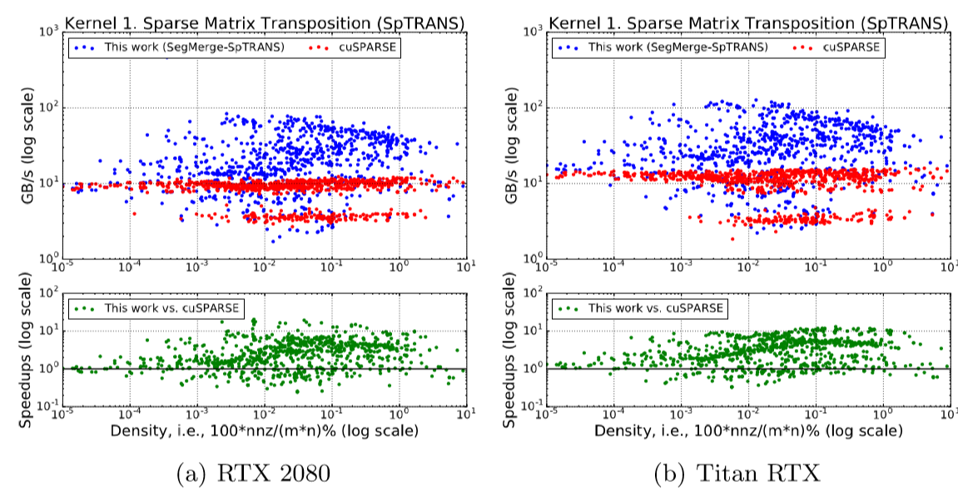
Performance evaluation
SpTRANS using Segmented Merge
The average speedup can reach 3.55x (up to 9.64x) and 3.94x (up to 13.09x)

Slide 21

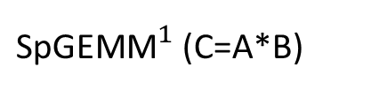
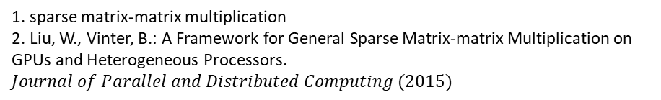
1. sparse matrix-matrix multiplication
2. Liu, W., Vinter, B.: A Framework for General Sparse Matrix-matrix Multiplication on GPUs and Heterogeneous Processors. $Journal of Parallel and Distributed Computing (2015)$
Performance evaluation
${\text{SpGEMM}}^{1}$ (C=A*B)
bin 0-36
Short rows
$${\text{bhSPARSE}}^{2}$$
Calculating bound
Binning
bin 37
Long rows
segmerge
Step 1
Step 2
Step 3

Slide 22
Performance evaluation
${\text{SpGEMM}}^{1}$ (C=A*B)
1b 1c
1b | 1c
 | 1
 | 2 | 3
 | 4
5 | 6 | 7
 |  | a
b |  | c
 | d | e | f
g
5a
5a
*
6b 6c
6b | 6c
7d 7e 7f
7d | 7e | 7f
A
B
1b |  | 1c
2b | 3d | 2c+3e | 3f
4b |  | 4c
6b | 7d | 5a+6c+7e | 7f
C

Slide 23
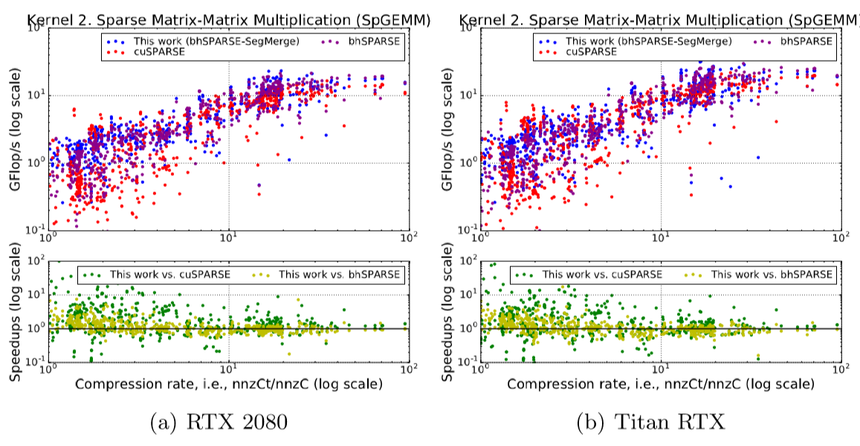
Performance evaluation
SpGEMM using Segmented Merge
2.89x (up to 109.15x) 1.26x (up to 7.5x) 2.53x (up to 81.85x) 1.22x (up to 17.38x)

Slide 24
Part four
Conclusion

Slide 25
Conclusion
1. Deﬁne a new primitive called segmented merge.
2. Present an eﬃcient parallel algorithm achieving good load balancing and SIMD unit utilization on GPUs.
3. Two sparse kernels, SpTRANS and SpGEMM, using our parallel segmented merge are greatly faster than existing methods in cuSPARSE and bhSPARSE.

Slide 26


Thanks for listening

