Slide 1
SMQoS: Improving Utilization and Energy Efficiency with QoS Awareness on GPUs
Qingxiao Sun, Yi Liu, Hailong Yang, Zhongzhi Luan, Depei Qian
School of Computer Science and Engineering
Beihang University, Beijing, China
Notes:
Good afternoon, everyone. I am Qingxiao Sun from Beihang University.
Today, I will introduce our work, SMQoS: Improving Utilization and Energy Efficiency with QoS Awareness on GPUs.

Slide 2
Outline
Background & Motivation
  GPU Execution Model
  Task Consolidation & Characterization
SMQoS Methodology
  Design Overview
  SM Allocation Algorithms
Evaluation
  Experimental Setup
  SMQoS Performance
Related Work
Conclusion
Notes:
The presentation is organized as 4 sections.
Firstly, I will introduce the background.
And then, I will present our method and the experimental results.
After that, I will show some previous works related to our method.
Finally, I will make a conclusion.

Slide 3
GPU Execution Model
Application
Grid Management Unit (GMU)
①
Pending
Kernel Pool
32
Hardware Work Queues
(HWQ)
Host (CPU)
⑤
②
TB Scheduler
④
Runtime APIs
⑥
③
Streaming Queue Management (SQM)
SM
SM
SM
SWQ 0
SWQ 1
SWQ 2
K0
K1
K2
K3
K4
K5
K6
K7
K8
Software Work
Queues
(SWQ)
Interconnect
L2 Cache
Notes:
The GPU task execution model is shown in this page.
To execute on GPU, the task is launched on the CPU host ( 1 )
and the parallel portion of the task namely kernel is offloaded to the GPU through runtime API ( 2 ).
A GPU kernel is tagged with a Software Work Queue (SWQ) ID ( 3 ),
and pushed into Pending Kernel Pool located in Grid Management Unit (GMU) ( 4 ).
Kernels with the same SWQ ID are mapped into the same hardware work queue (HWQ).
The thread blocks from a chosen HWQ’s head-of-the-line kernel are dispatched to SMs by the TB scheduler ( 5 6 ).

Slide 4
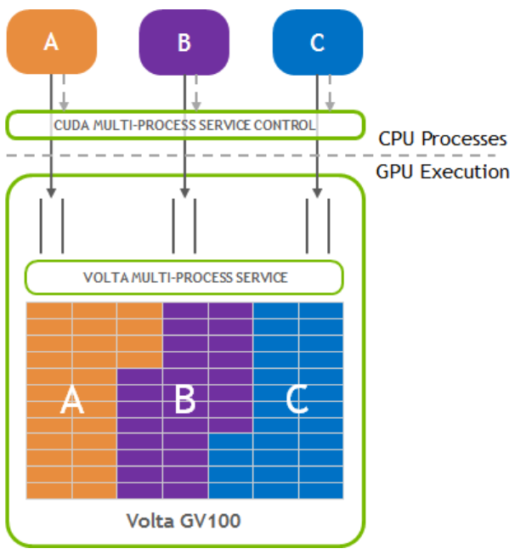
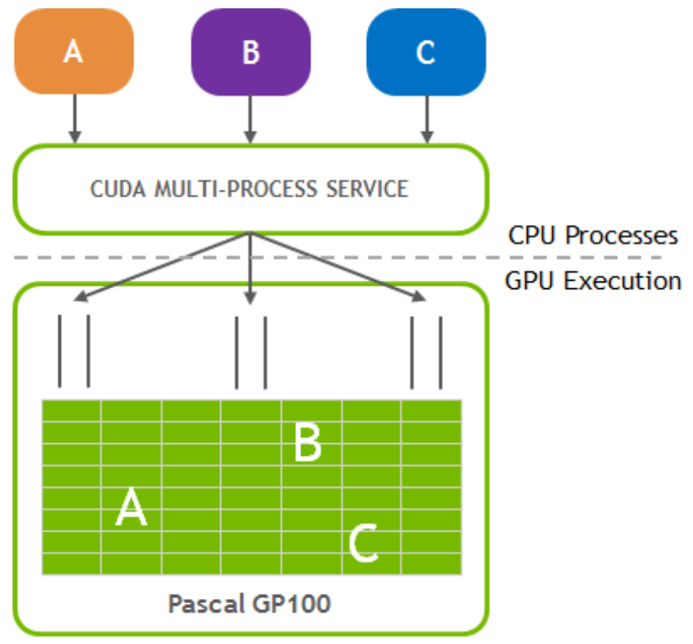
Task Consolidation (Industry)
Software-based MPS
（Pascal）
Hardware-Accelerated MPS
（Volta）
Notes:
Task consolidation on GPUs has received wide attention from both industry and academia.
Multi-Process Server before Volta allows multiple application contexts to be combined into a single application context and run on the GPU.
However, only the GPU resources remained by the current task execution can be utilized to launch a new task. It is meant to be a leftover policy.
Volta MPS improves aggregate GPU utilization by allowing multiple applications to simultaneously share GPU execution resources.
Besides, Volta MPS provides QoS by limiting the percentage of available threads on GPU.
However, it can only be applied before kernel execution, and not support dynamic resource adjustment.

Slide 5










Task Consolidation (Academia)
GPU
GPU
Exclusive
Exclusive
Shared
$SM$₀
$$K1$$
$SM$₁
$$K2$$
$SM$₀
$$K1$$
$$K2$$
$SM$₁
$$K1$$
$$K2$$
Device Memory
Device Memory
Spatial Multitasking
(SMT)
Simultaneous Multitasking
(SMK)
SMK allows multiple tasks to co-run on a single SM simultaneously by switching them with time quota.
SMT divides the SMs on GPU into several disjoint subsets, each of which is assigned to one of the co-running tasks.
Notes:
While in academia, two primary mechanisms are proposed to share GPU resources among co-running GPU tasks
including Spatial Multitasking (SMT) and Simultaneous Multikernel (SMK).
…
QoS for LS tasks is not supported in the original design of the above two mechanisms.

Slide 6





Task Characterization
Latency-sensitive (LS) task
  e.g., pay for bills, watch videos
  Need to react fast on events
  Meet Quality of Service (QoS)
  Focus on latency
Batch task
  e.g., network training, big data
  Group similar jobs together
  Focus on throughput
Latency-sensitive Tasks
throughput
latency
Batch Tasks
Notes:
GPU tasks can be divided into latency-sensitive (LS) tasks and batch tasks based on the requirement for Quality of Service (QoS).
For LS tasks, they need to react fast on events, and focus on latency;
For Batch tasks, they usually group similar jobs together, and focus on throughput.

Slide 7
Task Characterization
Task characterization
  Based on SM sensitivity
  Compute-intensive (CI) tasks
  memory-intensive (MI) tasks
For compute-intensive tasks, their performance increases linearly with the number of SMs allocated.
While for memory-intensive tasks, their performance saturates.
Notes:
Besides, GPU tasks can be classified into memory-intensive (MI) tasks and compute-intensive (CI) tasks depending on their computing characteristics.
As seen in the figure, For CI tasks, their performance increases linearly with the number of SMs allocated; while for MI tasks, their performance saturates.

Slide 8
Outline
Background & Motivation
  GPU Execution Model
  Task Consolidation & Characterization
SMQoS Methodology
  Design Overview
  SM Allocation Algorithms
Evaluation
  Experimental Setup
  SMQoS Performance
Related Work
Conclusion
Notes:
Next, I will present our method.
Firstly, the Design Overview of SMQoS.

Slide 9
Design Overview
Co-running Tasks
②
①
GPU Code
Code Interpretation
LS Tasks
Batch Tasks
LS.cu
Batch.cu
③
Runtime APIs
SMQoS Runtime Framework
SMQoS API
SM Manager
④
Dynamic SM Adjustment
TB Scheduler
Repartition?
Data Collector
Task Pools
⑤
Profiling Data Management
LS
Batch
Send profiling data
$cudaSetQoS$ has two parameters:
$∗kernel$is used to specify the LS task; $IPCtarget$ is used as the QoS target for LS tasks.
Notes:
The GPU kernels from multiple applications are interpreted into co-running GPU tasks through the Code Interpretation module ( 1 and 2).
Here We add a new API call cudaSetQoS. After cudaSetQoS is invoked ( 3 ), the GPU tasks are offloaded to GPU
and pushed into one of the two task pools according to their task types ( 4 ).
To collect the IPC of each task, we extend the TB Scheduler with the Data Collector (DC) module.
The SM Manager manages the task pools through two sub-modules ( 5 ),
the Profiling Data Management (PDM) module and the Dynamic SM Adjustment (DSMA) module,
where the PDM module records the corresponding information,
the DSMA module determines the SM allocation for next epoch using our proposed SM allocation algorithm,
which will be introduced later.
Note that cudaSetQoS has two parameters …

Slide 10
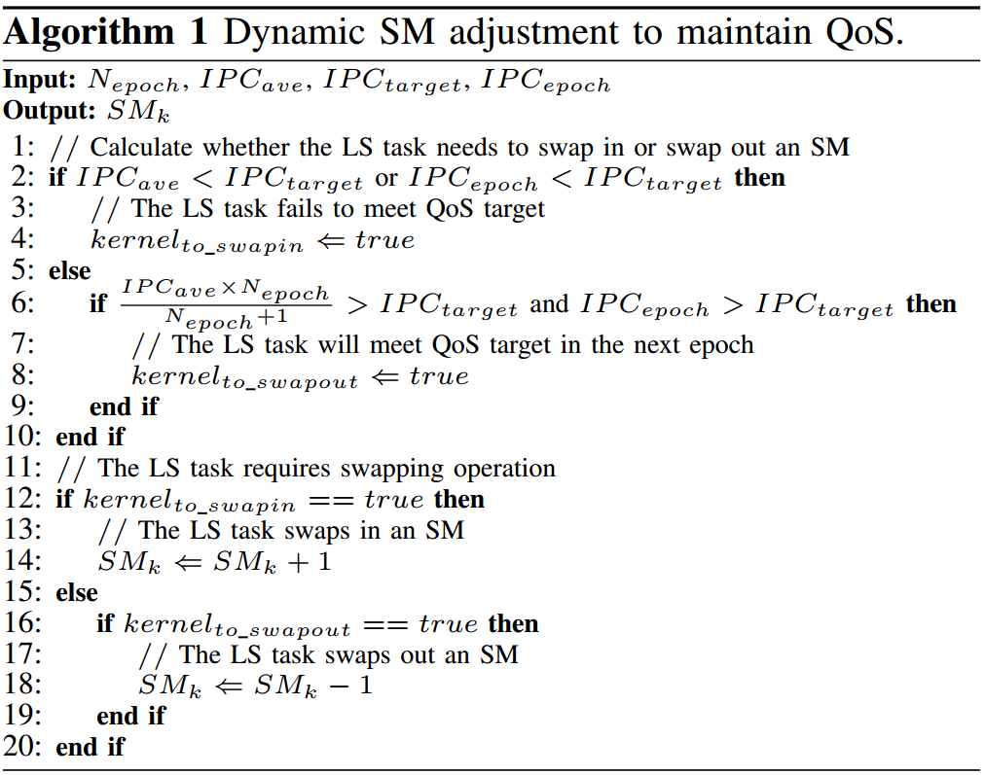
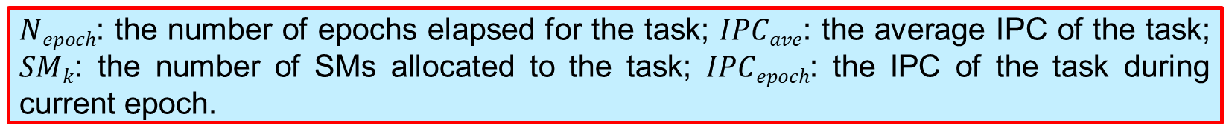
Maintaining QoS for LS Tasks
SMQoS Runtime Framework
SM Manager
Dynamic SM Adjustment
Profiling Data Management
Send
profiling data
Repartition?
TB Scheduler
Data Collector
$Nepoch$: the number of epochs elapsed for the task; $IPCave$: the average IPC of the task; $SMk$: the number of SMs allocated to the task; $IPCepoch$: the IPC of the task during current epoch.
Notes:
Next, I will introduce the SM allocation algorithms.
As shown in this page, Dynamic SM adjustment to maintain QoS.
the inputs of the algorithm includes … , where …
the output of the algorithm is SMk, which …

Slide 11
Maintaining QoS for LS Tasks
SMQoS Runtime Framework
SM Manager
Dynamic SM Adjustment
Profiling Data Management
Send
profiling data
Repartition?
TB Scheduler
Data Collector
When the LS task fails to meet its QoS target, it immediately requires an SM to swap in (line 2-4). To avoid the QoS oscillation, only one SM is swapped at a time.
Notes:
As seen in line 2-4, When the LS task fails to meet its QoS target …

Slide 12
Maintaining QoS for LS Tasks
SMQoS Runtime Framework
SM Manager
Dynamic SM Adjustment
Profiling Data Management
Send
profiling data
Repartition?
TB Scheduler
Data Collector
The conditions for swapping out are more restricted (line 5-10). The SM swapped out by the LS task can be allocated to the batch task to increase GPU utilization, or power gated to reduce power consumption.
Notes:
As seen in line 5-10, The conditions for swapping out are more restricted.
The SM swapped out …

Slide 13
Maintaining QoS for LS Tasks
SMQoS Runtime Framework
SM Manager
Dynamic SM Adjustment
Profiling Data Management
Send
profiling data
Repartition?
TB Scheduler
Data Collector
If the SMs need to be re-allocated, the TB scheduler swaps in/out the TBs on the SM (line 11-20).
Notes:
After that, the SM manager will inform the TB scheduler to re-allocate the SMs.
If the SMs …

Slide 14
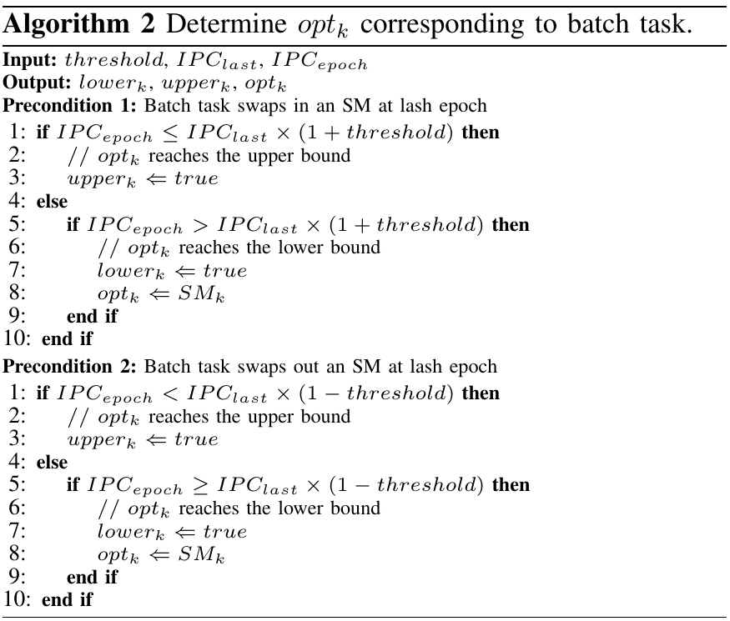
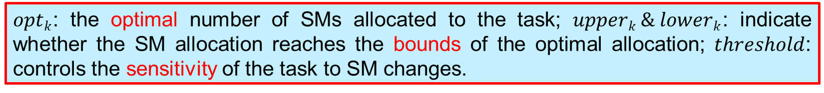
Optimal SM Allocation for Batch Tasks
SMQoS Runtime Framework
SM Manager
Dynamic SM Adjustment
Profiling Data Management
Send
profiling data
Repartition?
TB Scheduler
Data Collector
$optk$: the optimal number of SMs allocated to the task; $upperk \& lowerk$: indicate whether the SM allocation reaches the bounds of the optimal allocation; $threshold$: controls the sensitivity of the task to SM changes.
Notes:
Next, I will introduce the second algorithm, how to determine optk corresponding to batch task, where optk is …
Here we introduce upperk, lowerk and threshold, where …

Slide 15
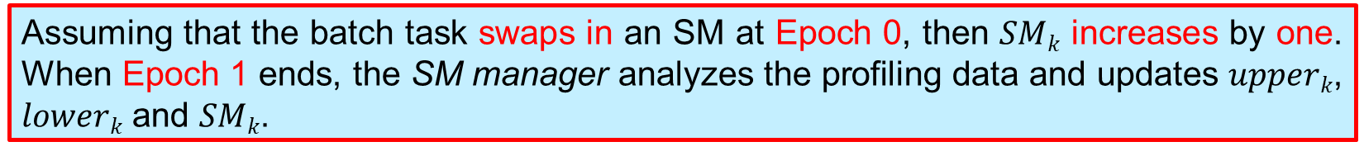
Optimal SM Allocation for Batch Tasks
SMQoS Runtime Framework
SM Manager
Dynamic SM Adjustment
Profiling Data Management
Send
profiling data
Repartition?
TB Scheduler
Data Collector
Assuming that the batch task swaps in an SM at Epoch 0, then $SMk$ increases by one. When Epoch 1 ends, the SM manager analyzes the profiling data and updates $upperk$, $lowerk$ and $SMk$.
Notes:
Now, assuming that …
If optk reaches the upper bound, we set upperk to true;
If optk reaches the lower bound, we set lowerk to true, and set optk to SMk.

Slide 16

Optimal SM Allocation for Batch Tasks
SMQoS Runtime Framework
SM Manager
Dynamic SM Adjustment
Profiling Data Management
Send
profiling data
Repartition?
TB Scheduler
Data Collector
Assuming that the batch task swaps out an SM at Epoch 0, then $SMk$ reduces by one. When Epoch 1 ends, the SM manager analyzes the profiling data and updates $upperk$, $lowerk$ and $SMk$.
Notes:
Similarly, assuming that …
If optk reaches the upper bound, we set upperk to true;
If optk reaches the lower bound, we set lowerk to true, and set optk to SMk.

Slide 17
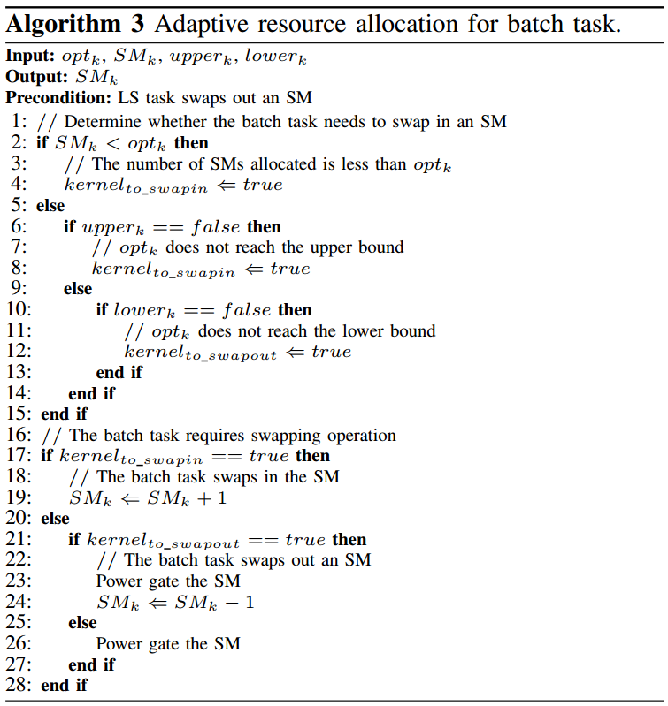
Optimal SM Allocation for Batch Tasks
SMQoS Runtime Framework
SM Manager
Dynamic SM Adjustment
Profiling Data Management
Send
profiling data
Repartition?
TB Scheduler
Data Collector
When the LS task swaps out an SM, whether to allocate the idle SM to the batch task depends on its computing characteristics. The detailed SM allocation strategy for the batch task is illustrated in Algorithm 3.
Notes:
Next, I will introduce the adaptive resource allocation for batch tasks.
When the LS task …

Slide 18
Optimal SM Allocation for Batch Tasks
SMQoS Runtime Framework
SM Manager
Dynamic SM Adjustment
Profiling Data Management
Send
profiling data
Repartition?
TB Scheduler
Data Collector
SMQoS determines whether the batch task needs to swap in the SM according to $SMk$, $optk$, $upperk$ and $lowerk$.
Notes:
As seen in line 1-15, SMQoS determines whether …
if SMk is less than optk, it means the number of SMs allocated to the batch task is less than the optimal number,
we need to swap in an SM;
otherwise, if optk does not reach the upper bound, we need to swap in the SM to determine the upper bound of optk.
If optk reaches the upper bound, and optk does not reach the lower bound, we need to swap out an SM to determine the lower bound of optk.

Slide 19
Optimal SM Allocation for Batch Tasks
SMQoS Runtime Framework
SM Manager
Dynamic SM Adjustment
Profiling Data Management
Send
profiling data
Repartition?
TB Scheduler
Data Collector
If the batch task swaps in the SM (line 17), then the TB scheduler schedules the TBs on the SM (line 19). Otherwise, the SM is power-gated to reduce power consumption (line 21-27).
Notes:
As show in line 17-27, If the batch task requires swapping operation, there are two situations.
If the batch task swaps in …
Otherwise, the SM is …

Slide 20
Outline
Background & Motivation
  GPU Execution Model
  Task Consolidation & Characterization
SMQoS Methodology
  Design Overview
  SM Allocation Algorithms
Evaluation
  Experimental Setup
  SMQoS Performance
Related Work
Conclusion
Notes:
Next, I will introduce the evaluation of our method.

Slide 21
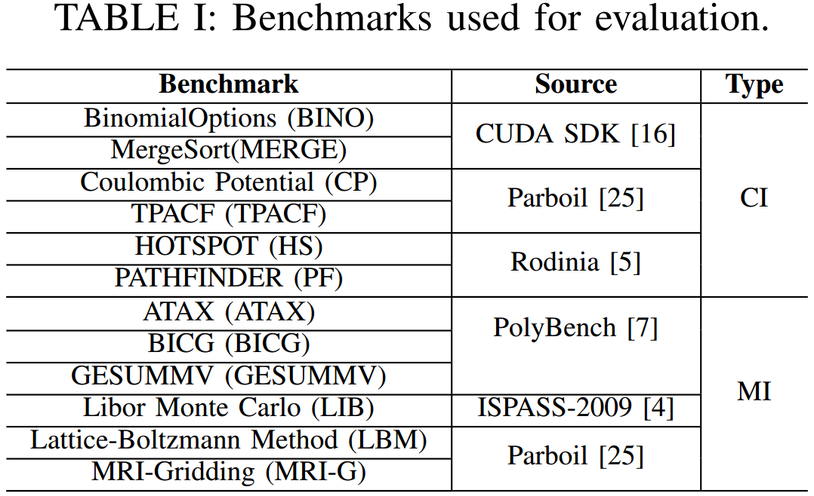
Experimental Setup
We use GPGPU-Sim to evaluate SMQoS. We select two tasks to co-run as a task mix, which consists of one LS task and one batch task.
Notes:
To evaluate SMQoS, we use GPGPU-Sim with the simulation configuration same to the previous paper.
We selete 12 benchmarks from several GPU benchmark suites, including six CI tasks and six MI tasks, as shown in table I.
Among all the benchmarks, we select each two tasks to co-run as a task mix,
which consists of one LS task and one batch task.

Slide 22
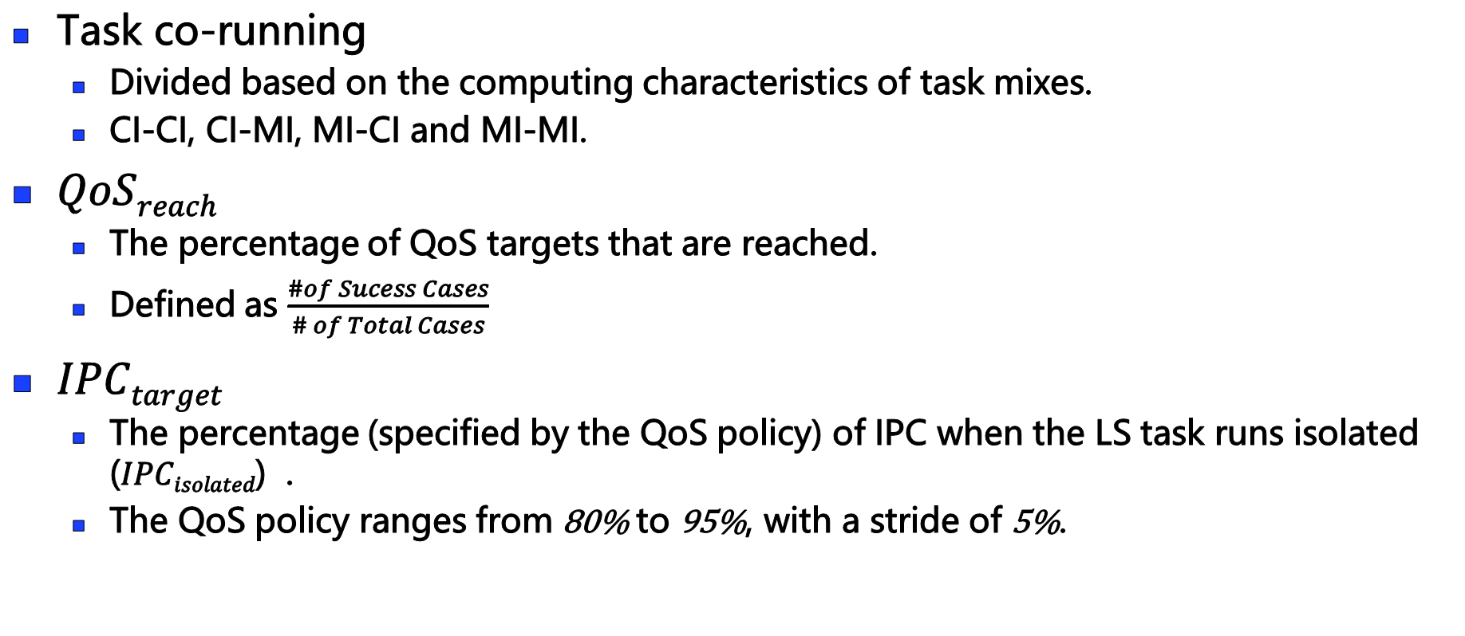
QoS Metrics
Task co-running
  Divided based on the computing characteristics of task mixes.
  CI-CI, CI-MI, MI-CI and MI-MI.
$QoSreach$
  The percentage of QoS targets that are reached.
  Defined as $\frac{\#of Sucess Cases}{\# of Total Cases}$
$IPCtarget$
  The percentage (specified by the QoS policy) of IPC when the LS task runs isolated ($IPCisolated$) .
  The QoS policy ranges from 80% to 95%, with a stride of 5%.
Notes:
We divide the task co-running into four categories based on the computing characteristics of the task mixes.
For instance, CI-MI indicates that the LS task is CI and the batch task is MI.
We use QoSreach to evaluating meeting QoS requirement, which is …
Also, we define the QoS target as the percenteage of IPC when the LS task runs isolated.
the percentage is specified by the QoS policy, the QoS policy ranges from 80% to 95%, with a stride of 5%.

Slide 23
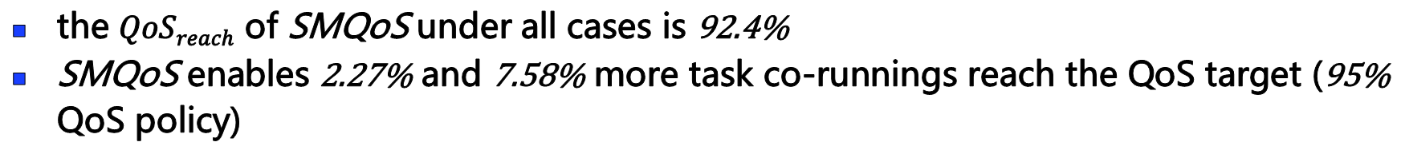
SMQoS Performance
the $QoSreach$ of SMQoS under all cases is 92.4%
SMQoS enables 2.27% and 7.58% more task co-runnings reach the QoS target (95% QoS policy)
Notes:
This figure shows the percentage of task co-runnings with QoS satisfied under different QoS policies.
As seen, SMQoS achieves the highest percentage of task co-runnings with QoS satisfied across all QoS policies.
Especially, when the QoS policy is 95%, SMQoS enables 2.27% and 7.58% more task co-runnings reach the QoS target.
This demonstrates SMQoS is effective even when the QoS policy is tight for the LS task.

Slide 24
SMQoS Performance
CI-CI Mixes
CI-MI Mixes
MI-CI Mixes
MI-MI Mixes
SMQoS achieves the highest throughput in most task mixes
SMQoS achieves 23.9% and 32.3% higher throughput (MI-CI mixes at 80% QoS policy)
Notes:
This figure shows the normalized throughput of batch tasks.
Overall, SMQoS achieves the highest throughput in most task mixes.
For instance, under the MI-CI mixes, when the QoS policy is set to 80%, SMQoS achieves 23.9% and 32.3% higher throughput.
This demonstrates the proposed algorithms in SMQoS ensure that it can allocate more computing resources to the batch task.

Slide 25
SMQoS Performance
MI-MI Mixes
MI-CI Mixes
CI-CI Mixes
CI-MI Mixes
SMQoS consumes less power when both the tasks are MI
SMQoS consumes 25.7% and 10.1% less power (MI-MI mixes at 85% QoS policy)
Notes:
This figure shows power consumption of SMQoS and Spart normalized to Rollover.
As seen, when both the batch task and the LS task are MI, SMQoS consumes less power.
Especially when the QoS policy is set to 85%, SMQoS consumes 25.7% and 10.1% less power
This demonstrates that when the co-running tasks are both memory intensive, SMQoS can efficiently reduce the power consumption.
However, when the batch task is CI, SMQoS achieves comparable power consumption.
This is due to that the design philosophy of SMQoS is to increase GPU utilization whenever possible.

Slide 26
Outline
Background & Motivation
  GPU Execution Model
  Task Consolidation & Characterization
SMQoS Methodology
  Design Overview
  SM Allocation Algorithms
Evaluation
  Experimental Setup
  SMQoS Performance
Related Work
Conclusion
Notes:
Next, I will show some previous works related to our work.

Slide 27
Related Work
GPU Sharing Mechanisms:
  JT. Adriaens et al. HPCA2012
  Z. Wang et al. HPCA2016
  J. Park et al. ASPLOS2017
  X. Zhao et al. ICS2018
QoS Management on GPU:
  P. Aguilera et al. ASP-DAC2014
  Q. Chen et al. ASPLOS2016
  C. Yu et al. TPDS2017
  Z. Wang et al. ISCA2017
GPU Power Saving Techniques:
  J. Zhao et al. TACO2013
  J. Lee et al. ToC2015
  A. Tabbakh et al. IPDPS2017
Notes:
Including:
GPU sharing mechanism, QoS management on GPU and GPU power saving techniques.

Slide 28
Outline
Background & Motivation
  GPU Execution Model
  Task Consolidation & Characterization
SMQoS Methodology
  Design Overview
  SM Allocation Algorithms
Evaluation
  Experimental Setup
  SMQoS Performance
Related Work
Conclusion
Notes:
Next, I will make the conclusion.

Slide 29
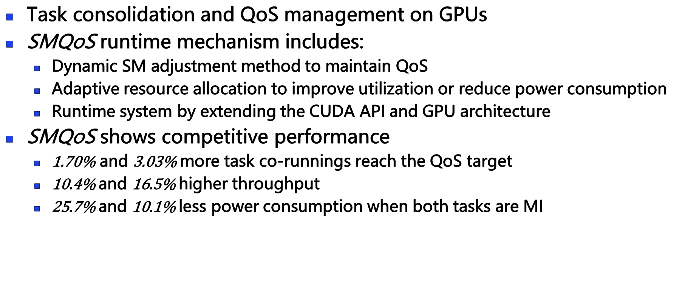
Conclusion
Task consolidation and QoS management on GPUs
SMQoS runtime mechanism includes:
  Dynamic SM adjustment method to maintain QoS
  Adaptive resource allocation to improve utilization or reduce power consumption
  Runtime system by extending the CUDA API and GPU architecture
SMQoS shows competitive performance
  $\text{1}\text{.}\text{70}\text{\%}$ and 3.03% more task co-runnings reach the QoS target
  10.4% and 16.5% higher throughput
  25.7% and 10.1% less power consumption when both tasks are MI
Notes:
Firstly, we introduce the task ….
Then, we introduce SMQoS runtime mechanism, which includes …
Finally, the experimental results shows that SMQoS achieves competitive performance ..
On average, …

Slide 30
Thanks!
Notes:
That’s all, thanks.

