Slide 1




An Efficient GPU General
Sparse Matrix-Matrix Multiplication for Irregular Data
Weifeng Liu, Brian Vinter
Niels Bohr Institute,
University of Copenhagen, Denmark

Slide 2
Overview
Faculty of Science
Sparse GEMM (SpGEMM) and its applications
Three challenges
Our SpGEMM algorithm
  Stage 1: calculating upper bound of nnzC
  Stage 2: binning and allocating C of “reasonable” size
  Stage 3: computing C using three different methods
  Stage 4: arranging data
Experimental results
Conclusion

Slide 3
Overview
Faculty of Science
Sparse GEMM (SpGEMM) and its applications
Three challenges
Our SpGEMM algorithm
  Stage 1: calculating upper bound of nnzC
  Stage 2: binning and allocating C of “reasonable” size
  Stage 3: computing C using three different methods
  Stage 4: arranging data
Experimental results
Conclusion

Slide 4
Sparse GEMM (SpGEMM) - Basics
Multiply a sparse matrix A by a sparse matrix B, obtain a result sparse matrix C.
0
1
x
0
a
=
0
1d
1e
0
2
0
3
0
b
0
c
0
3b
0
3c
2a
0
d
0
e
0
4
0
5
0
6
0
f
0
5d
0
6f
4a+5e
A
(4x4)
nnzA = 6
B
(4x4)
nnzB = 6
C
(4x4)
nnzC = 8

Slide 5
SpGEMM - Data Storage Format
  We assume all three matrices are stored in Compressed Sparse Row (CSR) format that contains three arrays: (1) row pointer, (2) column index, and (3) value.
0
1
row_pointer =
0
1
3
3
6
0
2
0
3
column_index =
2
0
1
0
2
3
0
value =
1
2
3
4
5
6
4
0
5
0
6
A
A in CSR-format

Slide 6

SpGEMM - Applications
Algebraic multigrid method
Breadth first search
Shortest path
Colored intersection
Sub-graghs
…

Slide 7
Overview
Faculty of Science
SpGEMM and its applications
Three challenges
Our SpGEMM algorithm
  Stage 1: calculating upper bound of nnzC
  Stage 2: binning and allocating C of “reasonable” size
  Stage 3: computing C using three different methods
  Stage 4: arranging data
Experimental results
Conclusion

Slide 8
SpGEMM Challenge 1 - Unknown nnzC
The number of nonzeros in C is unknown in advance. Thus it’s not possible to pre-allocate C precisely.
One method is to compute boolean SpGEMM in the same pattern, get nnzC, allocate memory and run the “real” SpGEMM.
0
1
x
0
a
=
?
0
2
0
3
0
b
0
c
0
d
0
e
0
4
0
5
0
6
0
f
A, nnzA = 6
B, nnzB = 6
nnzC = ?
C,
One SpGEMM for Two!
Expensive
T
x
T
=
T
T
Allocate
space of size nnzC
1
x
a
T
T
T
T
T
T
T
2
3
b
c
T
T
d
e
T
T
T
T
T
T
T
4
5
6
f

Slide 9
SpGEMM Challenge 2 - Parallel Insert
Because of the compressed sparse format, the result nonzeros are “inserted” into C, but not “added” to predictable locations of C.
0
4a
insert to column 3
0
4a
0
5d
0
=
4a
0
1
0
a
insert to column 1
x
0
5d
0
2
0
3
0
b
0
c
0
5d
0
4a
=
insert to column 3
4a+5e
0
5e
0
=
d
0
e
0
5d
4a+5e
0
x
insert to column 2
6f
0
6f
0
4
0
5
0
6
0
f
=
x
0
1d
1e
A
B
x
0
3b
0
3c
2a
Parallel hash tables?
Not truly fast
0
5d
0
6f
4a+5e
C

Slide 10

SpGEMM Challenge 3 - Load balancing
p1
0
1
x
0
a
p1
0
1
0
2
0
3
0
b
0
c
p2
0
2
0
3
p2
0
d
0
e
p3
0
4
0
5
0
6
0
f
p4
0
4
0
5
0
6
A
B
A
1D partition
on A
p1
p2
0
even partition
on A
Accessing
on B
1
Imbalanced
0
2
0
3
Balanced
Imbalanced
p3
p4
2D partition
on A
Overall - imbalanced
0
4
0
5
0
6
Imbalanced
A

Slide 11
Overview
Faculty of Science
SpGEMM and its applications
Three challenges
Our SpGEMM algorithm
  Stage 1: calculating upper bound of nnzC
  Stage 2: binning and allocating C of “reasonable” size
  Stage 3: computing C using three different methods
  Stage 4: arranging data
Experimental results
Conclusion

Slide 12
Overview
Faculty of Science
SpGEMM and its applications
Three challenges
Our SpGEMM algorithm
  Stage 1: calculating upper bound of nnzC
  Stage 2: binning and allocating C of “reasonable” size
  Stage 3: computing C using three different methods
  Stage 4: arranging data
Experimental results
Conclusion

Slide 13
Stage 1. Upper bound of nnzC
To calculate the upper bound of nnz of each row of C, for each nonzero in the row of A, sum up nnz of corresponding rows (with the same column ids of the nonzero of A) of B.
0
1
x
0
a
nnz(c_{0*})_{ub} = 2
0
2
0
3
0
b
0
c
nnz(c_{1*})_{ub} = 1
+ 2 = 3
0
d
0
e
nnz(c_{2*})_{ub} = 0
0
4
0
5
0
6
0
f
nnz(c_{3*})_{ub} = 1
+ 2
+ 1 = 4
A
B
Q: Should we pre-allocate a C of the upper bound size?
A: No. NnzC_{ub} may be very large,
so we do not pre-allocate it in this stage.

Slide 14
Overview
Faculty of Science
SpGEMM and its applications
Three challenges
Our SpGEMM algorithm
  Stage 1: calculating upper bound of nnzC
  Stage 2: binning and allocating C of “reasonable” size
  Stage 3: computing C using three different methods
  Stage 4: arranging data
Experimental results
Conclusion

Slide 15
Stage 2. Binning
According to nnz_{ub} of each row of C, we group (permutate) all rows of C to 38 bins (in 5 bin groups).
nnz(c_{0*})_{ub} = 2
nnz(c_{1*})_{ub} = 3
nnz(c_{2*})_{ub} = 0
nnz(c_{3*})_{ub} = 4
…
2
0
1
3
nnz(c_{i*})_{ub} = 0
nnz(c_{i*})_{ub} = 2
nnz(c_{i*})_{ub} = 4
nnz(c_{i*})_{ub} = 3
nnz(c_{i*})_{ub} = 32
nnz(c_{i*})_{ub} = 33-64
nnz(c_{i*})_{ub} = 65-128
nnz(c_{i*})_{ub} = 129-256
nnz(c_{i*})_{ub} = 257-512
nnz(c_{i*})_{ub} = 1
nnz(c_{i*})_{ub} > 512
b1
b2
b3
b4
b5
b33
b34
b35
b36
b37
b38

Slide 16
Stage 2. Memory pre-allocation
In this case, we
pre-allocate C of
size 3+512+2048.
We calculate an initial size for C.
For bins 1-33, nnz = # of rows * binsize
  e.g., bin 4 collectes 1 row, nnz = 1 * 3 = 3
For bins 34-37, nnz = # of rows * binsize_{ub}
  e.g., bin 35 collectes 4 rows, nnz = 4 * 128 = 512
For bin 38, nnz = # of rows * 256
  e.g. bin 38 collectes 8 rows, nnz = 8 * 256 = 2048
…
nnz(c_{i*})_{ub} = 0
nnz(c_{i*})_{ub} = 2
nnz(c_{i*})_{ub} = 4
nnz(c_{i*})_{ub} = 3
nnz(c_{i*})_{ub} = 32
nnz(c_{i*})_{ub} = 33-64
nnz(c_{i*})_{ub} = 65-128
nnz(c_{i*})_{ub} = 129-256
nnz(c_{i*})_{ub} = 257-512
nnz(c_{i*})_{ub} = 1
nnz(c_{i*})_{ub} > 512
b₁
b₂
b₃
b₄
b₅
b₃₃
b₃₄
b₃₅
b₃₆
b₃₇
b₃₈

Slide 17
Stage 2. Memory pre-allocation (cont.)
Q: Why we pre-allocate 256 entries for bin 38 that contains rows longer than 512 entries?
A: Some old entries will “eat” new entries. Thus we set a guessed “shrink” factor (< 0.5).
nnz(c_{i*})_{ub} > 512
b₃₈
0
1
x
0
a
=
0
1d
1e
0
2
0
3
0
b
0
c
0
3b
0
3c
2a
0
d
0
e
0
4
0
5
0
6
0
f
0
5d
0
6f
4a+5e
A
B
C

Slide 18
Overview
Faculty of Science
SpGEMM and its applications
Three challenges
Our SpGEMM algorithm
  Stage 1: calculating upper bound of nnzC
  Stage 2: binning and allocating C of “reasonable” size
  Stage 3: computing C using three different methods
  Stage 4: arranging data
Experimental results
Conclusion

Slide 19
Stage 3. C is the goal!
1d
1e
3b
3c
2a
5d
6f
4a+5e
For bin 1 or bin 2, no computation is required.
For bins 3-33, a heap-based method is used. Each bin has a dedicated GPU kernel call.
For each GPU thread:
  (1) collects all candidate nonzeros,
  (2) establishs a binary max-heap on column indices,
  (3) executes a heapsort-like operation to sort and fuse entries at a duplicate location.
Example. Row 3
column_index =
3
1
3
2
value =
0
4a
0
5d
0
5e
0
6f
Load balancing
is guaranteed,
since each GPU
thread has the
same amount of
work.
idx=3
val=4a
idx=3
val=5e
idx=2
val=6f
idx=1
val=5d
idx=2
val=6f
idx=3
val=5e
idx=2
val=6f
idx=1
val=5d
idx=1
val=5d
idx=1
val=5d
-
idx=3
val=4a
idx=3
val=4a+5e
idx=2
val=6f
idx=3
val=4a+5e
idx=1
val=5d
idx=2
val=6f
idx=3
val=4a+5e

Slide 20
Stage 3. C is the goal! (cont.)
1d
1e
3b
3c
2a
5d
6f
4a+5e
For bins 34-37, a bitonic sort based method is used. Each bin has a dedicated GPU kernel call.
For each GPU thread-group:
column_index =
3
1
3
2
  (1) collects all candidate nonzeros,
  (2) sorts them according to the column indices,
  (3) identifies duplicate nonzeros, and scans to obtain final positions,
  (4) compacts nonzeros at the same column location,
  (5) obtains final nonzeros of the row.
value =
0
4a
0
5d
0
5e
0
6f
column_index =
1
2
3
Example. Row 3
3
value =
0
5d
0
6f
0
4a
0
5e
Load balancing
is naturally
guaranteed,
although each GPU
thread-group has
different amount
of work.
flag =
1
1
1
0
flag (scan) =
0
1
2
3
column_index =
1
2
3
3
value =
0
5d
0
6f
4a+5e
0
5e
column_index =
1
2
3
value =
0
5d
0
6f
4a+5e

Slide 21
Stage 3. C is the goal! (cont.)
1d
1e
3b
3c
2a
5d
6f
4a+5e
For bin 38, a merge-based method is used.
For each GPU thread-group:
  (1) looks for duplicate locations through binary search,
  (2) fuses values at the same position,
  (3) copies the input sequence without duplicate entries to the result sequence,
  (4) merge the two sequences through Merge Path algorithm and gets the new result sequence.
input sequence =
1
2
3
1
3
0
5d
0
6f
0
4a
0
5d
0
5e
Example. Row 3
result sequence =
3
4a+5e
Load balancing is naturally guaranteed.
If the pre-allocated space is not enough,
2x memory is allocated.
The old values are copied to new space.
The same merge operations continue.

Slide 22
Overview
Faculty of Science
SpGEMM and its applications
Three challenges
Our SpGEMM algorithm
  Stage 1: calculating upper bound of nnzC
  Stage 2: binning and allocating C of “reasonable” size
  Stage 3: computing C using three different methods
  Stage 4: arranging data
Experimental results
Conclusion

Slide 23
Stage 4. Arranging data
Now we know the precise size of nnzC, and can allocate a “real” C and copy nonzeros from the pre-allocated space to the final space.
pre-allocated C
final C

Slide 24
Overview
Faculty of Science
SpGEMM and its applications
Three challenges
Our SpGEMM algorithm
  Stage 1: calculating upper bound of nnzC
  Stage 2: binning and allocating C of “reasonable” size
  Stage 3: computing C using three different methods
  Stage 4: arranging data
Experimental results
Conclusion

Slide 25

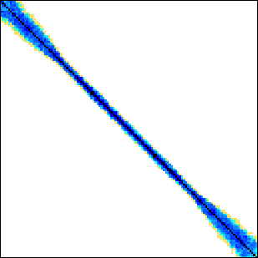
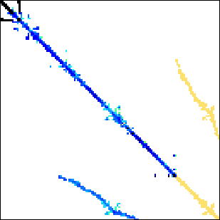



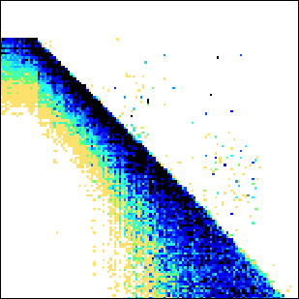


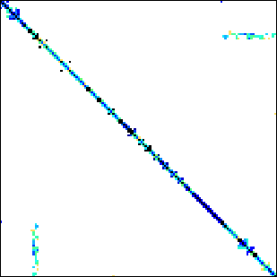
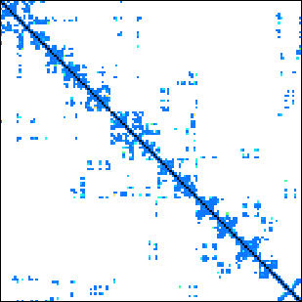
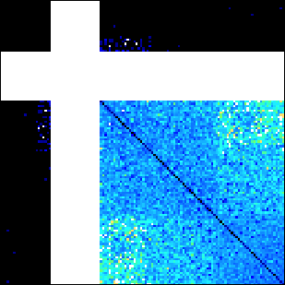

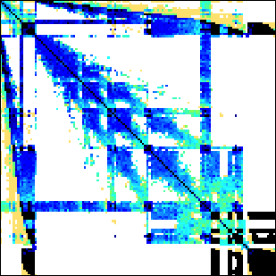
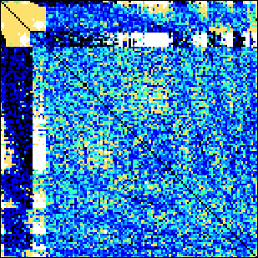


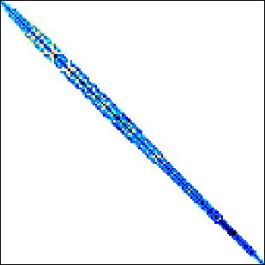
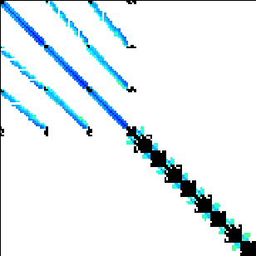
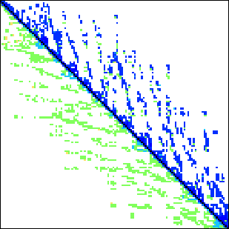
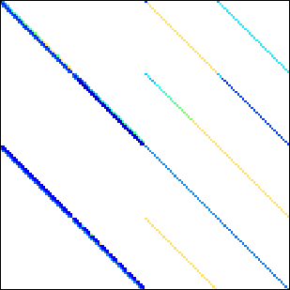
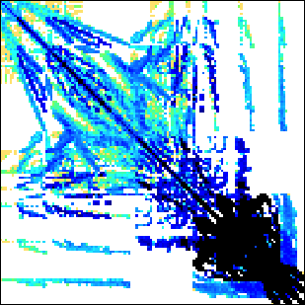
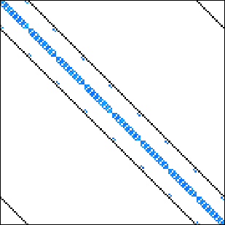
Benchmark suite
23 matrices downloadable from the University of Florida sparse matrix collection.
cant
filter3D
harbor
2cubes_sphere
hood
mario002
patents_main
scircuit
economics
pwtk
protein
accelerator
m133-b3
mono_500Hz
poisson3Da
webbase-1M
epidemiology
ship
spheres
cage12
majorbasis
offshore
QCD
Regular matrices
Irregular matrices with diverse structures

Slide 26
Experiment platforms
Intel Xeon E5-2630, six Sandy Bridge cores @ 2.3 GHz, 15 MB LL$, 4-channel memory, 42.6 GB/s Bandwidth. MKL v11.0.
nVidia GeForce GTX Titan, 2688 CUDA cores @ 876 MHz, 672 KB scratchpad memory, 288 GB/s bandwidth. CUSPARSE v2, CUSP v0.4.0 and BHSPARSE_CUDA.
AMD Radeon HD 7970, 2048 Radeon cores @ 1 GHz, 2048 KB scratchpad memory, 288 GB/s bandwidth. BHSPARSE_OCL.

Slide 27
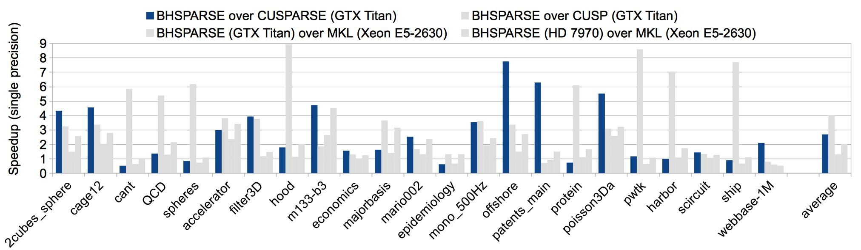
Comparison: C = A² (single percision)
Compared to CUSPARSE v2 in CUDA SDK v5.5 on nVidia Geforce GTX Titan GPU, our method obtains up to 7.7x and on average 2.6x speedup.

Slide 28
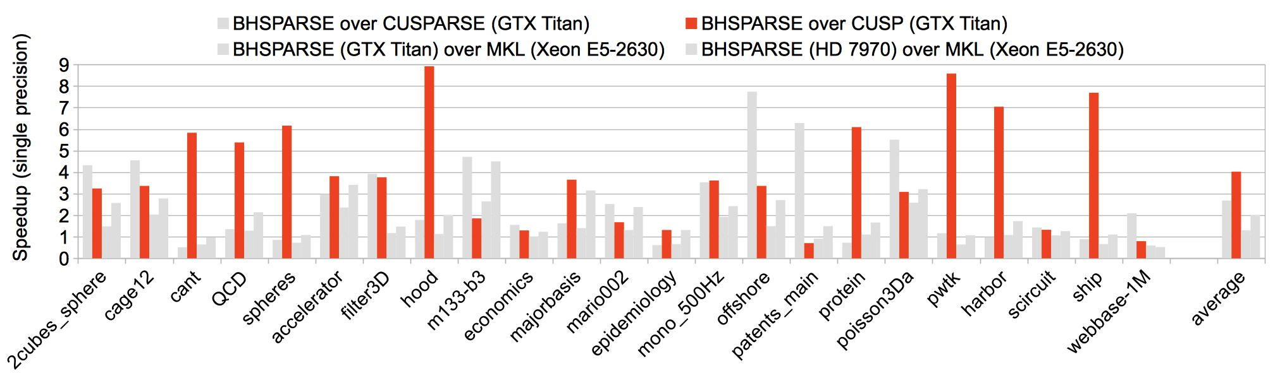
Comparison: C = A² (single percision)
Compared to CUSP v0.4.0 on nVidia Geforce GTX Titan GPU, our method obtains up to 8.9x and on average 4x speedup.

Slide 29
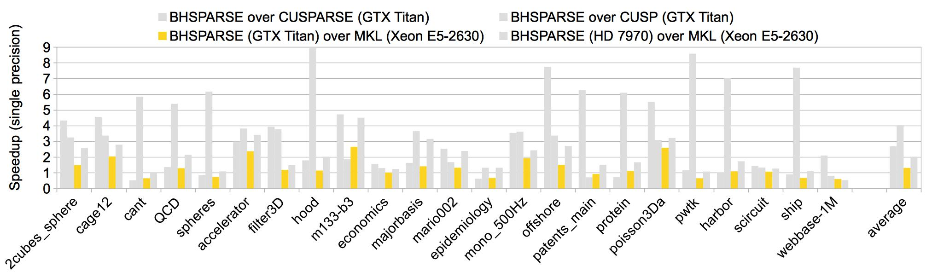
Comparison: C = A² (single percision)
Compared to MKL v11.0 on Intel Xeon E5-2630 CPU, our method on nVidia Geforce GTX Titan GPU obtains up to 2.6x and on average 1.3x speedup.

Slide 30
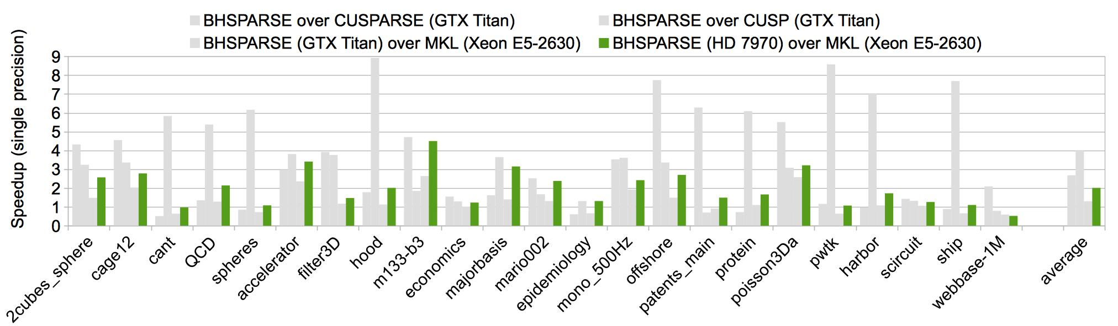
Comparison: C = A² (single percision)
Compared to MKL v11.0 on Intel Xeon E5-2630 CPU, our method on AMD Radeon HD 7970 GPU obtains up to 4.5x and on average 2x speedup.

Slide 31
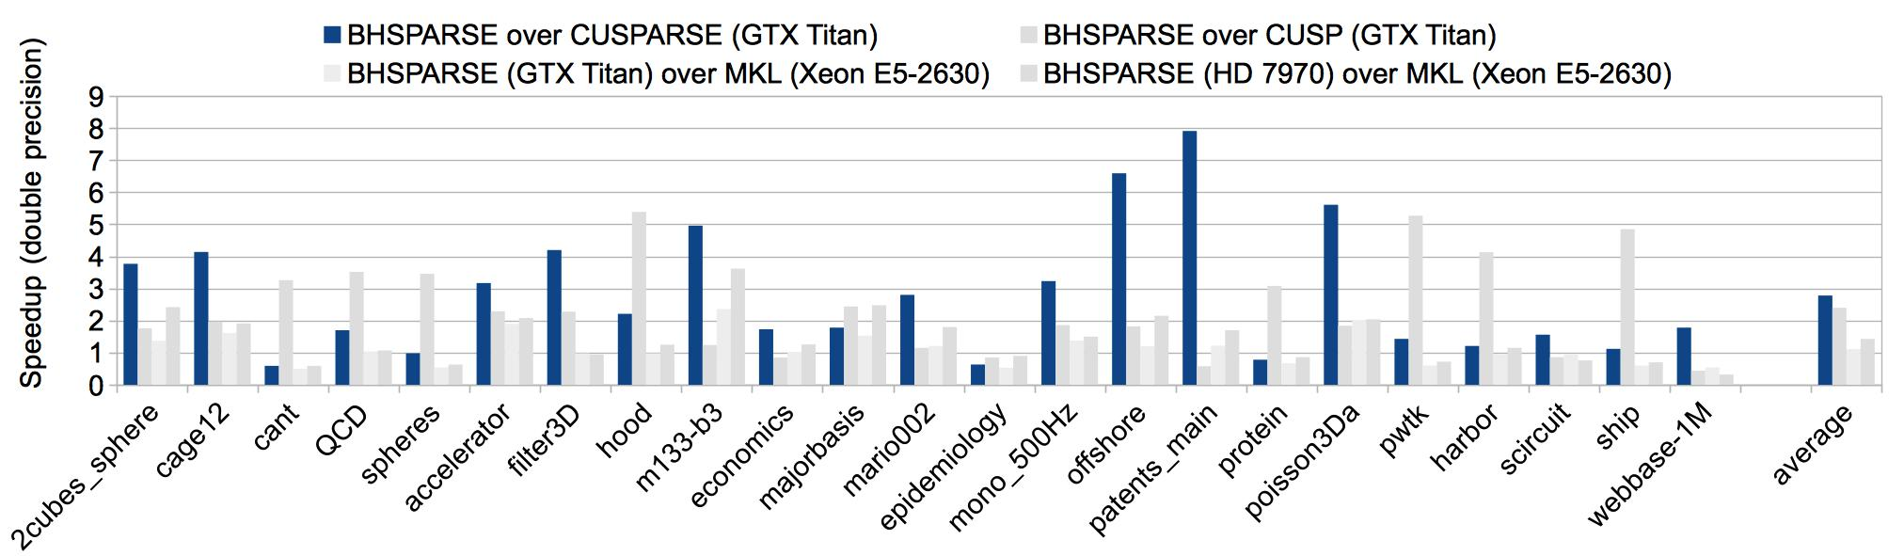
Comparison: C = A² (double percision)
Compared to CUSPARSE v2 in CUDA SDK v5.5 on nVidia Geforce GTX Titan GPU, our method obtains up to 7.9x and on average 2.7x speedup.

Slide 32
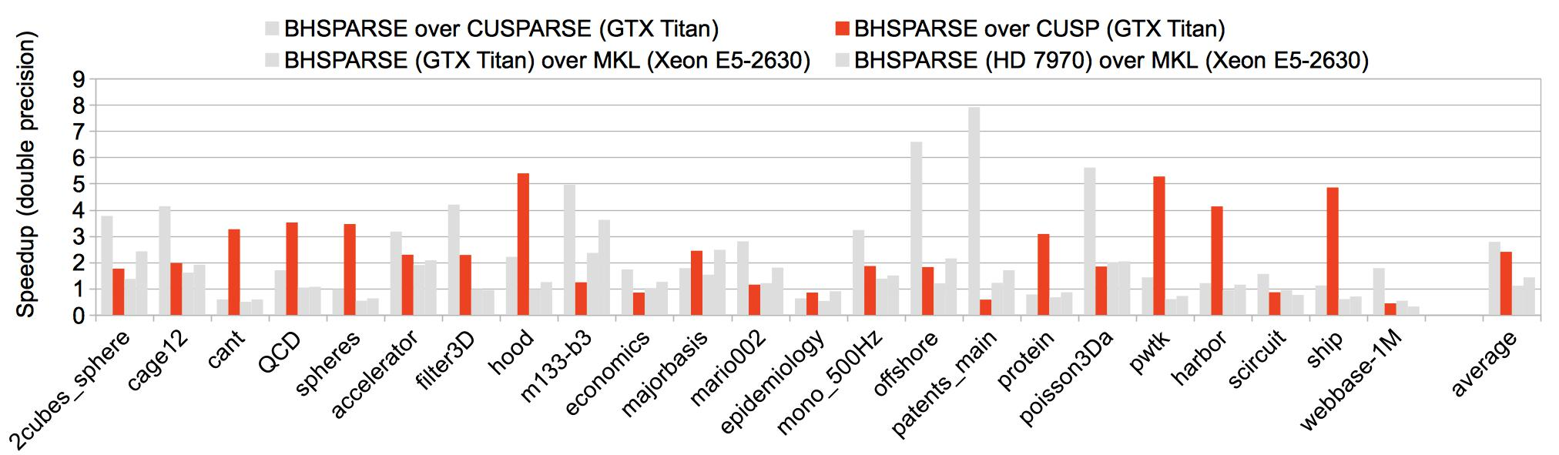
Comparison: C = A² (double percision)
Compared to CUSP v0.4.0 on nVidia Geforce GTX Titan GPU, our method obtains up to 5.4x and on average 2.4x speedup.

Slide 33
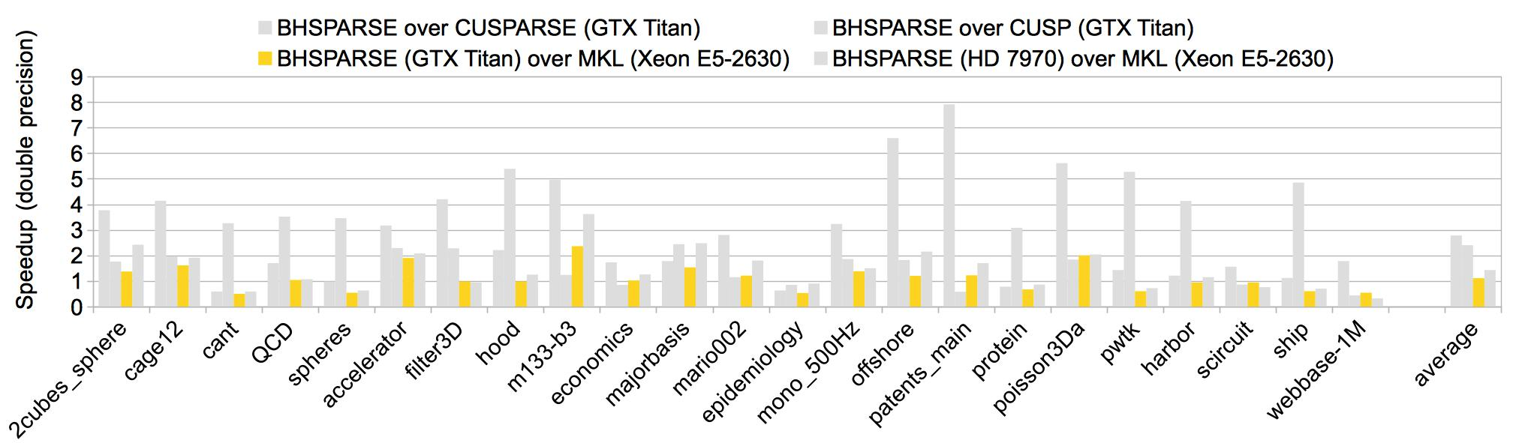
Comparison: C = A² (double percision)
Compared to MKL v11.0 on Intel Xeon E5-2630 CPU, our method on nVidia Geforce GTX Titan GPU obtains up to 1.9x and on average 1.1x speedup.

Slide 34
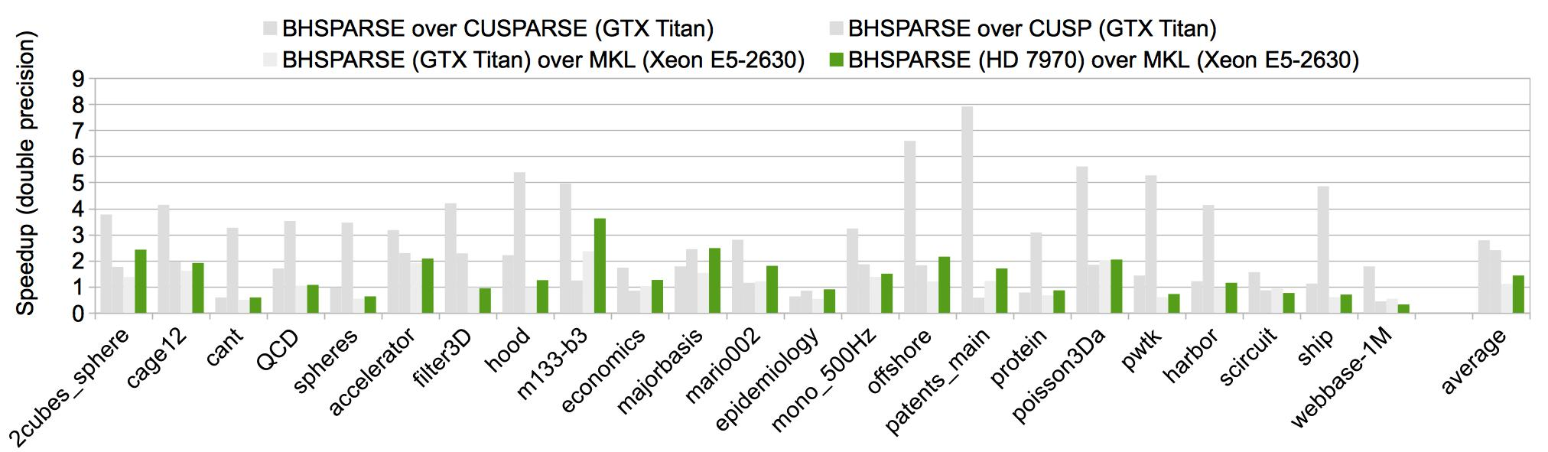
Comparison: C = A² (double percision)
Compared to MKL v11.0 on Intel Xeon E5-2630 CPU, our method on AMD Radeon HD 7970 GPU obtains up to 2.4x and on average 1.4x speedup.

Slide 35
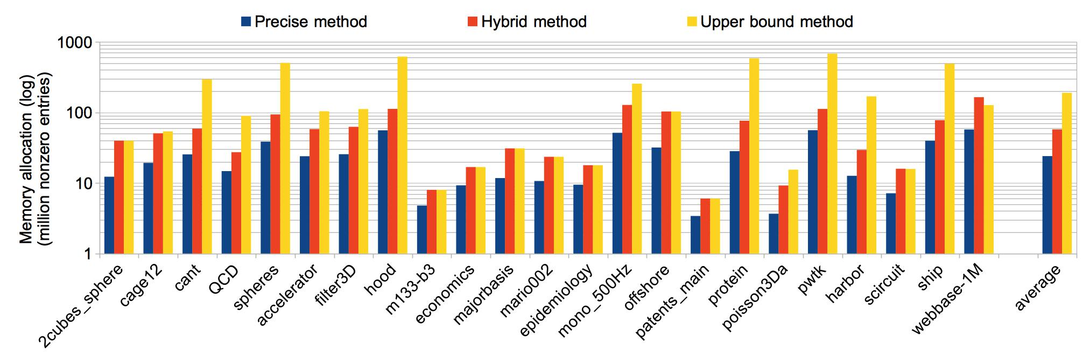
Comparison: C = A² (allocated space)
For matrices with short rows (upper bound size), our hybrid method completely converts to the upper bound method.
For matrices with long rows (upper bound size), our hybrid method allocates much less space than the upper bound method, and be very close to precise method.
In the worst case, our hybrid method needs the largest space, but would not be too bad.

Slide 36
Overview
Faculty of Science
SpGEMM and its applications
Three challenges
Our SpGEMM algorithm
  Stage 1: calculating upper bound of nnzC
  Stage 2: binning and allocating C of “reasonable” size
  Stage 3: computing C using three different methods
  Stage 4: arranging data
Experimental results
Conclusion

Slide 37
Conclusion
We identified three performance bottlenecks of SpGEMM, and proposed effcient approaches on GPUs.
Our GPU SpGEMM method is much faster than state-of-the-art approaches in the CUSPARSE and CUSP.
We can see that the capacity of on-chip scratchpad memory is important for SpGEMM. (Kepler vs. GCN)
For the first time, GPU SpGEMM outperforms CPU counterparts.

Slide 38
T k u !
A y Q s n s ?
0
4
8
9
0
2
4
7
11
12
13

