Slide 1



﻿Machine Learning and GPU
Accelerated Sparse Linear Solvers for
Transistor-Level Circuit Simulation:
A Perspective Survey
ASP-DAC 2024
Zhou Jin, Wenhao Li, Yinuo Bai, Tengcheng Wang, Yicheng Lu, Weifeng Liu
Super Scientific Software Laboratory,
China University of Petroleum-Beijing, China
Email: jinzhou@cup.edu.cn

Slide 2
Contents
Background
Sparse Linear Solvers for Circuit Simulation
  SFLU: Synchronization-Free Sparse LU Factorization for Fast Circuit Simulation on GPUs
  Accelerating Sparse LU Factorization with Density-Aware Adaptive Matrix Multiplication for Circuit Simulation
  PanguLU: A Scalable Regular Two-Dimensional Block-Cyclic Sparse Direct Solver on Distributed Heterogeneous Systems
Conclusions

Slide 3
Contents
Background
Sparse Linear Solvers for Circuit Simulation
  SFLU: Synchronization-Free Sparse LU Factorization for Fast Circuit Simulation on GPUs
  Accelerating Sparse LU Factorization with Density-Aware Adaptive Matrix Multiplication for Circuit Simulation
  PanguLU: A Scalable Regular Two-Dimensional Block-Cyclic Sparse Direct Solver on Distributed Heterogeneous Systems
Conclusions

Slide 4
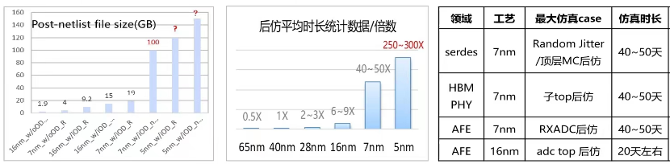
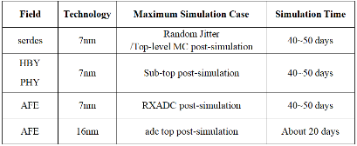
Transistor-Level Circuit Simulation
Transistor-level circuit simulation (SPICE simulation) plays a crucial role in verifying circuit performance, and serving as the basis of timing, yield and reliability analysis, etc.
needs to be iteratively verified in the design process
Circuit design
Pre-simulation
Layoutdesign
RC extraction
Post-simulation
Chip fabrication
Verification
Design process of analog circuits
Challenges in SPICE simulation: the continuous expansion of scale, making it extremely time-consuming during the IC design process.
Average duration of post-simulation ( times )

Slide 5
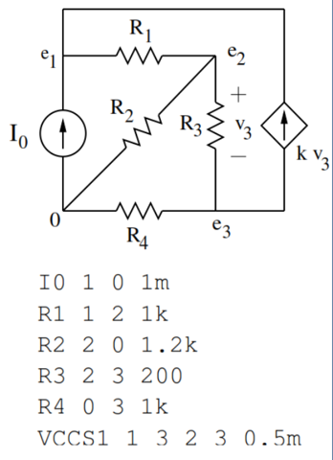
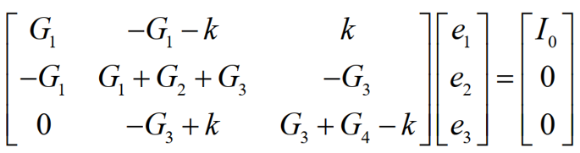
Transistor-Level Circuit Simulation
SPICE workflow example
The most time-consuming step in SPICE simulation is solving linear equations Ax = b.
In post-layout simulation that takes parasitic effects into account, the linear direct solution typically takes 60-90% of the time.
Read the netlist and establish the circuit equation
DC analysis
Solve Ordinary Differential Equations （ODE）
offer initial parameter
Transient iteration
numerical integration
Model evaluation
Newton-Raphson iteration
Sparse LU factorization
（A=LU）
N
NR Converge
Y
N
Triangle solution(Ly=b，Ux=y)
transient converge
or reach end time
Y
Waveform output

Slide 6
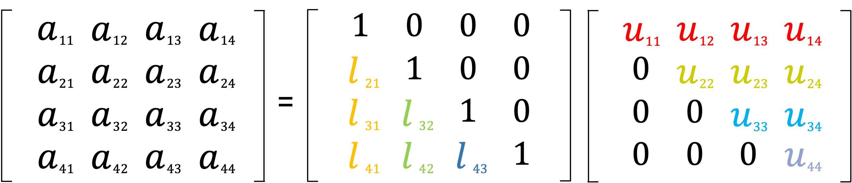
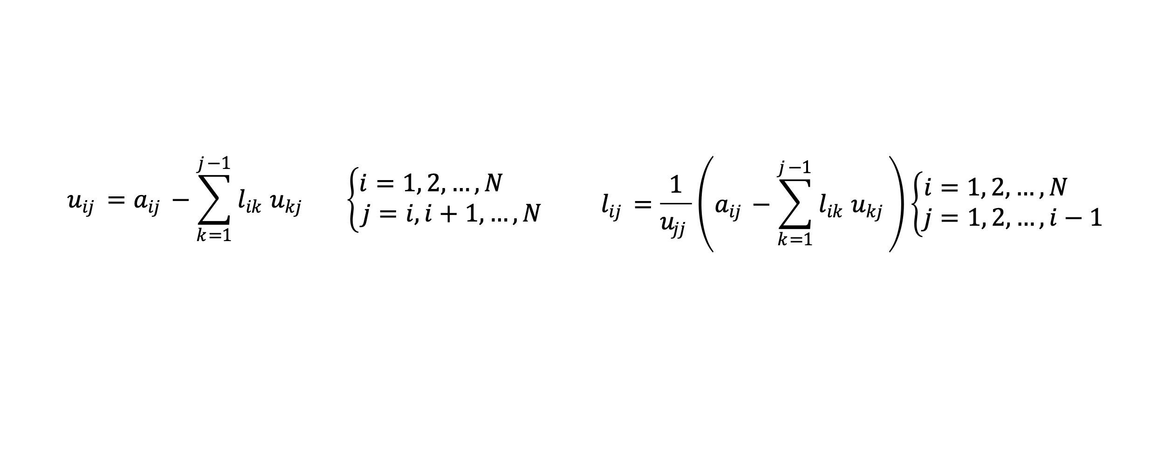
LU Factorization
LU factorization is part of the direct method to solve the linear equations and is also one of the most important tasks in many scientific computing applications. The following figure shows an example of LU factorization:
The elements of L and U are calculated from the following two equations:

Slide 7
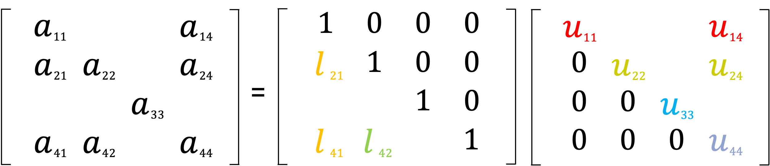
Sparse LU Factorization
When the input matrix is sparse, the sparse LU factorization can be used to reduce unnecessary computation and storage, which is called sparse LU factorization.
Unlike LU factorization, sparse LU factorization is divided into the following three phases:
usually only performed once
often performed multiple times
Pre-processing
Symbolic factorization
Numeric factorization
reduce fill-in nonzeros and maintain numerical stability
determine the structure of the matrices L and U
perform floating-point operations
The most time-consuming

Slide 8
Development of Direct Sparse Solver
Only on share memory CPUs
MUMPS is a distributed direct solver using the multifrontal method. It was developed by Patrick and Duff et al. (PARA00)
SuperLU using supernodal method is developed by Li and Demmel et al. SuperLU_DIST is a distributed version. (TOMS03)
On Single GPU
On share memory CPUs and single GPU
SuperLU_DIST has been continuously updated and added versions for GPU.(JPDC19)
On distributed systems
2000
2001
2003
2004
2010
2013
2015
2019
2020
2022
PARDISO is developed by Schenk et al. It uses a combination of left- and right-looking Level-3 BLAS to exploit parallelism. (FGCS01)
Davis developed UMFPACK which combines pre-ordering and multifrontal method. (TOMS04)
Davis et al also developed KLU, which is a sparse solver for circuit simulation. (TOMS10)
GLU is a sparse direct solver on GPU developed by Tan et al. (D&T20)
FLU is developed by Yan et al. It introduces a register-level method. (DATE22)
NICSLU is a sparse solver using level-set and supernode. Developed by Chen and Wang et al. (TCAD13)

Slide 9
Development of Direct Sparse Solver
MUMPS is a distributed direct solver using the multifrontal method. It was developed by Patrick and Duff et al. (PARA00)
SuperLU using supernodal method is developed by Li and Demmel et al. SuperLU_DIST is a distributed version. (TOMS03)
Dedicated to circuit matrix
SuperLU_DIST has been continuously updated and added versions for GPU.(JPDC19)
2000
2001
2003
2004
2010
2013
2015
2019
2020
2022
PARDISO is developed by Schenk et al. It uses a combination of left- and right-looking Level-3 BLAS to exploit parallelism. (FGCS01)
Davis developed UMFPACK which combines pre-ordering and multifrontal method. (TOMS04)
Davis et al also developed KLU, which is a sparse solver for circuit simulation. (TOMS10)
GLU is a sparse direct solver on GPU developed by Tan et al. (D&T20)
FLU is developed by Yan et al. It introduces a register-level method. (DATE22)
NICSLU is a sparse solver using level-set and supernode. Developed by Chen and Wang et al. (TCAD13)

Slide 10
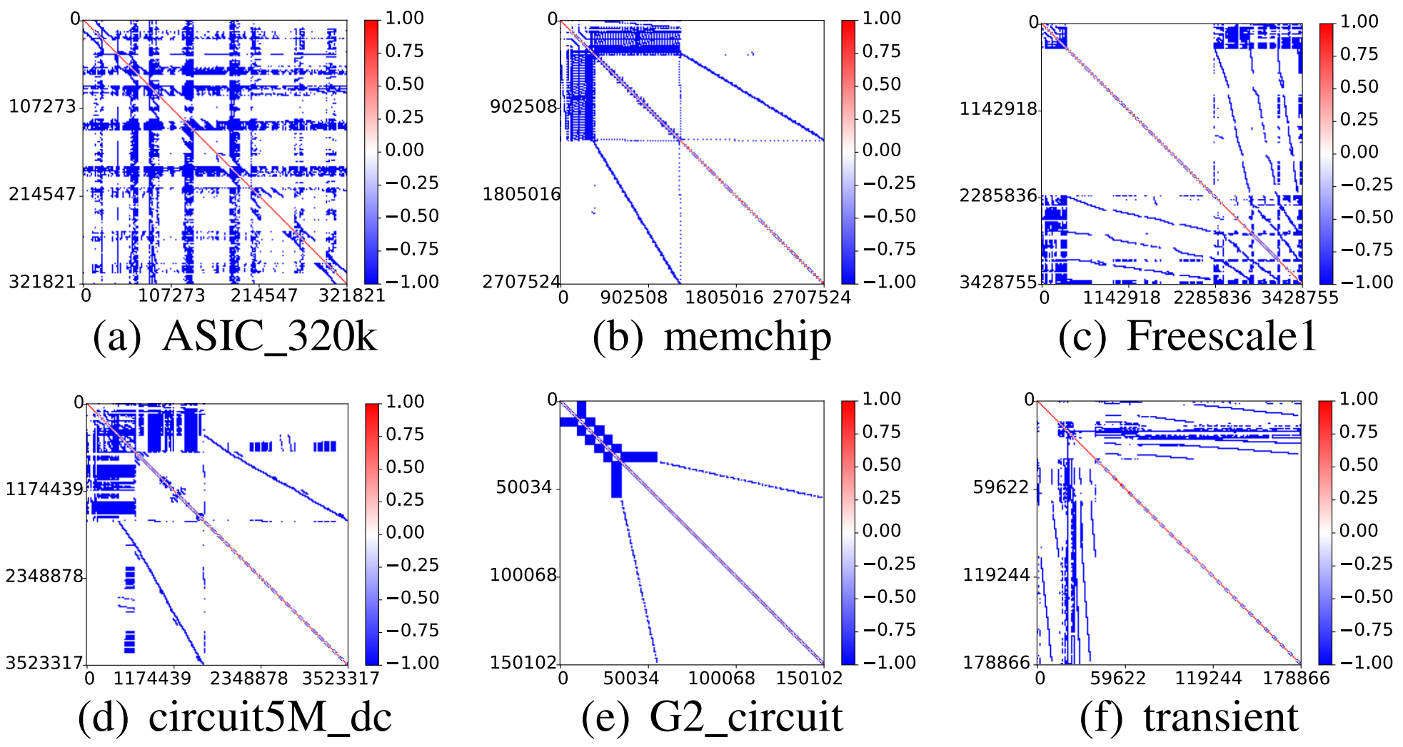
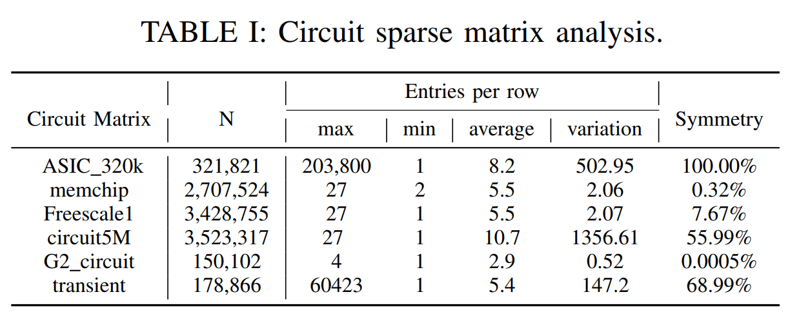

Circuit Matrix Properties
In circuit simulation, the matrix usually has the following properties:
(1) The value and position of nonzeros in circuit matrix are usually unsymmetric
(2) Circuit matrices are often very sparse
(3) The distribution of non-zero elements in circuit matrix is extremely irregular, leading to some dense rows and columns (e.g., power supplies are usually connected to a larger number of devices).
﻿The structure of some circuit sparse matrices.
﻿Circuit sparse matrix properties.

Slide 11
Development of Direct Sparse Solver
MUMPS is a distributed direct solver using the multifrontal method. It was developed by Patrick and Duff et al. (PARA00)
SuperLU using supernodal method is developed by Li and Demmel et al. SuperLU_DIST is a distributed version. (TOMS03)
PanguLU is developed by SSSLab. It uses strategies such as regular two-dimensional blocking, synchronization-free and sparse kernels on distributed heterogeneous platform. (SC23 Best paper)
On single GPU
On CPU with AI assisted
SuperLU_DIST has been continuously updated and added versions for GPU.(JPDC19)
On distributed heterogeneous system
2000
2001
2003
2004
2010
2013
2015
2019
2020
2021
2022
2023
PARDISO is developed by Schenk et al. It uses a combination of left- and right-looking Level-3 BLAS to exploit parallelism. (FGCS01)
Davis developed UMFPACK which combines pre-ordering and multifrontal method. (TOMS04)
Davis et al also developed KLU, which is a sparse solver for circuit simulation. (TOMS10)
NICSLU is a sparse solver using level-set and supernode. Developed by Chen and Wang et al. (TCAD13)
GLU is a sparse direct solver on GPU developed by Tan et al. (D&T20)
SFLU is developed by SSSLab. It uses synchronization-free strategy on GPU. (DAC21)
FLU is developed by Yan et al. It introduces a register-level method. (DATE22)
DALU is developed by SSSLab. It proposed a density-aware adaptive method. (DAC23)

Slide 12
Contents
Background
Sparse Linear Solvers for Circuit Simulation
  SFLU: Synchronization-Free Sparse LU Factorization for Fast Circuit Simulation on GPUs
  Accelerating Sparse LU Factorization with Density-Aware Adaptive Matrix Multiplication for Circuit Simulation
  PanguLU: A Scalable Regular Two-Dimensional Block-Cyclic Sparse Direct Solver on Distributed Heterogeneous Systems
Conclusions

Slide 13
SFLU: Synchronization-Free Sparse LU Factorization on GPUs (DAC21)
Using GPU for general computing has become a research hotspot.
TABLE I: There are two ways to utilize GPUs for sparse LU.
Name | Strategy | Characteristic
SuperLU^{[1]} | Running GPU-version dense matrix-matrix multiplication on (often small) matrices generated from supernodal pattern. | Can not use GPU for scheduling to save the cost for kernel relaunching and cache data flushing.
GLU^{[2]} | Finding dependencies between columns, generating levels, and using level scheduling method for running multiple columns in the same level on GPUs concurrently.
? | ？ | Can use GPU for scheduling.
We need to design a method that can use GPU for scheduling.
[1] Demmel, James W , Eisenstat, et al, A supernodal approach to sparse partial pivoting. SIAM Journal on Matrix Analysis & Applications, 1999.
[2] Wai-Kong L , Ramachandra A , Nakhla M S, Dynamic GPU Parallel Sparse LU Factorization for Fast Circuit Simulation, IEEE Transactions on Very Large Scale Integration (VLSI) Systems, 2018

Slide 14


SFLU: Synchronization-Free Sparse LU Factorization on GPUs (DAC21)
: to do
: busy waiting
Thread block 1
Thread block 3
Global memory
Thread block 2
Thread block 4
Due to the logic between symbolic and numeric factorization are similar. we only use the symbolic factorization to introduce our algorithm.

Slide 15
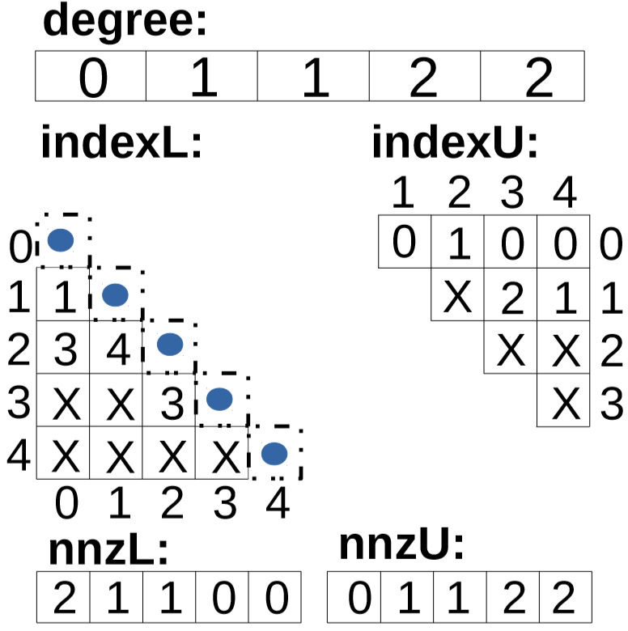
SFLU: Synchronization-Free Sparse LU Factorization on GPUs (DAC21)
Specifically:
Elements above the diagonal line of the row k can be eliminated.
Degree represents the number of uneliminated elements in each column.
0 | 1 | 1 | 2 | 2
: to do
: busy waiting
: new fill-in
0
1
2
3
4
0 1 2 3 4
All the elements above the diagonal of column k are eliminated.
The index represents the row index of each element.
NnzL and nnzU represents the number of elements in each column of L and U.

Slide 16
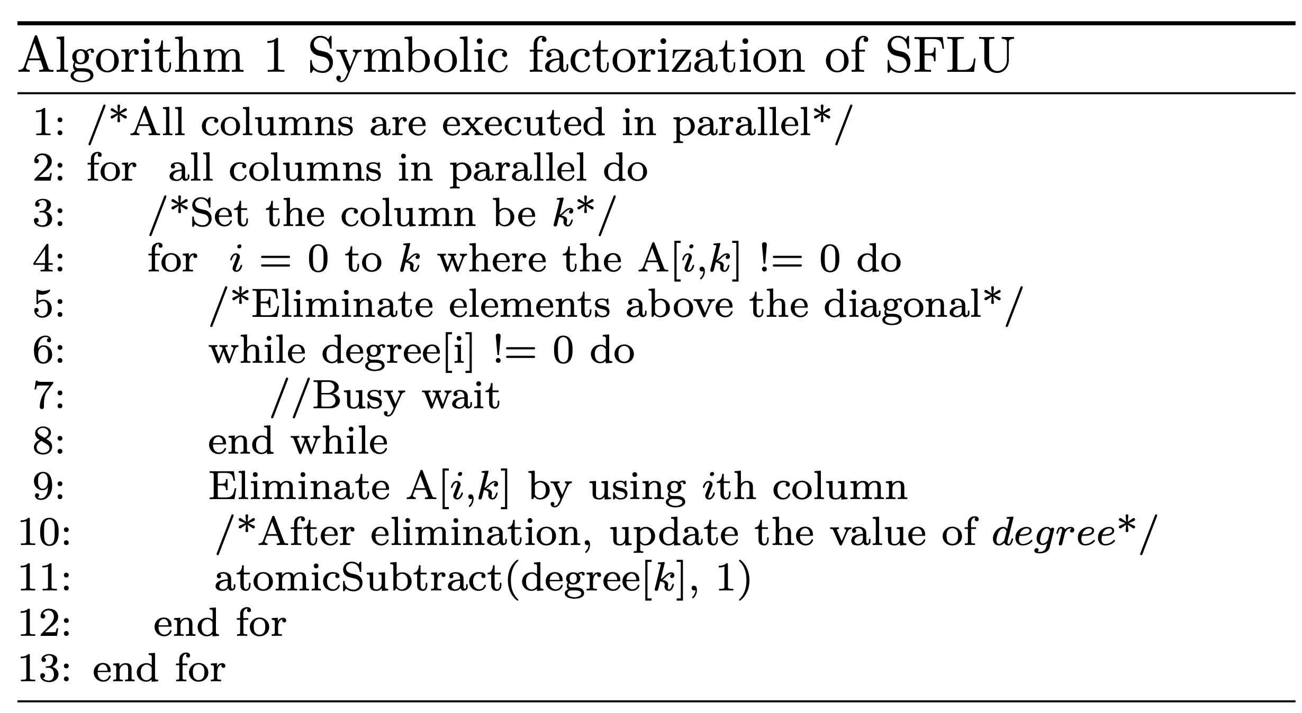
SFLU: Synchronization-Free Sparse LU Factorization on GPUs (DAC21)
: to do
: busy waiting
: new fill-in
0
1
2
3
4
0 1 2 3 4
Three warps are working
We use the storage order of indexU to determine the decomposition object of each thread block.
Each unfinished thread block should have an object.
Four objects.

Slide 17
SFLU: Synchronization-Free Sparse LU Factorization on GPUs (DAC21)
: to do
: busy waiting
: new fill-in
0
1
2
3
4
0 1 2 3 4
Three warps are working
One element will be busy waiting.

Slide 18
SFLU: Synchronization-Free Sparse LU Factorization on GPUs (DAC21)
: to do
: busy waiting
: new fill-in
0
1
2
3
4
0 1 2 3 4
Three warps are working
One element will be busy waiting.
Three elements will be eliminated.

Slide 19
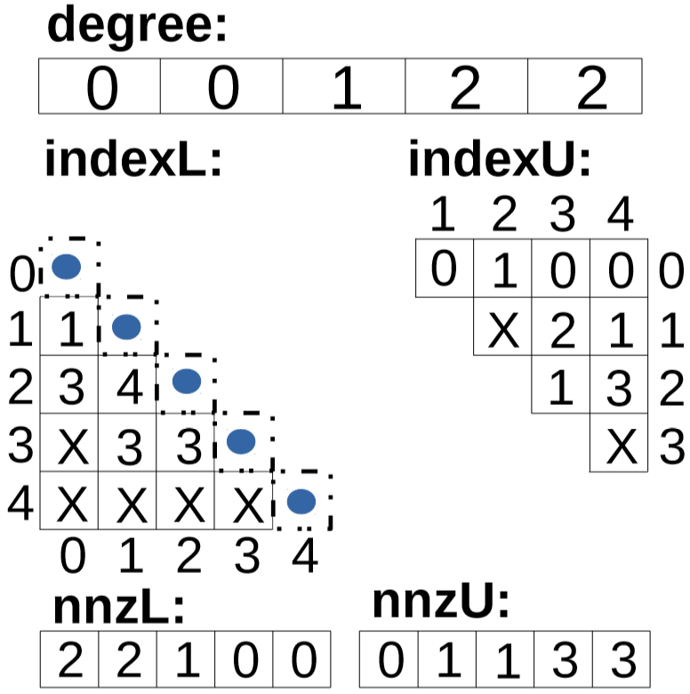
SFLU: Synchronization-Free Sparse LU Factorization on GPUs (DAC21)
: to do
: busy waiting
: new fill-in
0
1
2
3
4
0 1 2 3 4
Three nonzero elements were filled in.
Degree Changed.

Slide 20
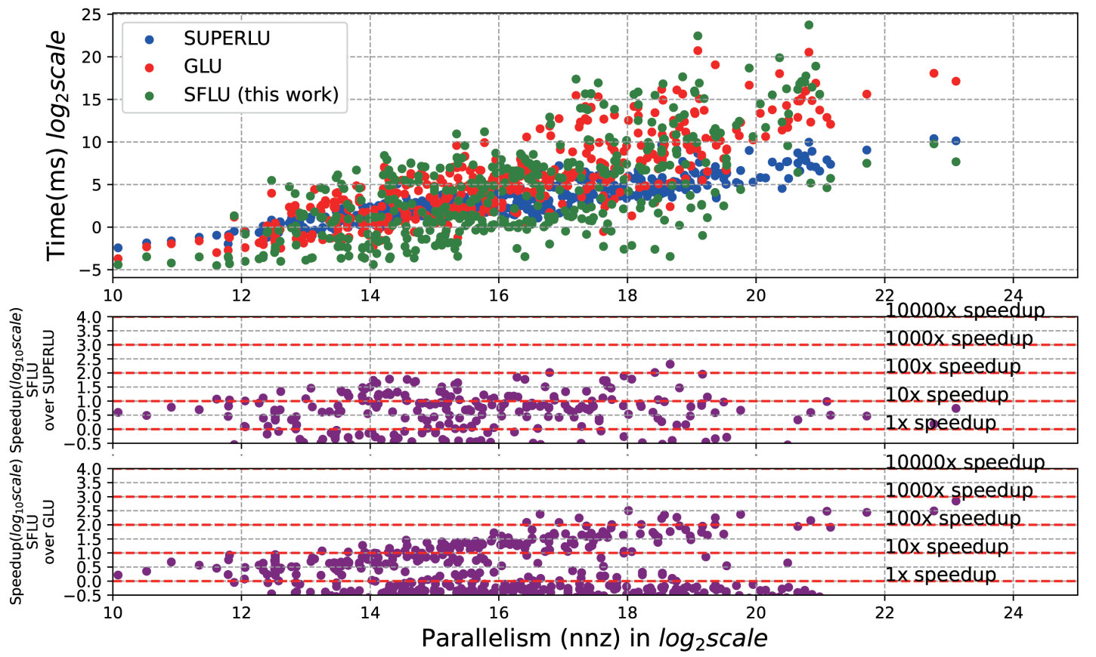
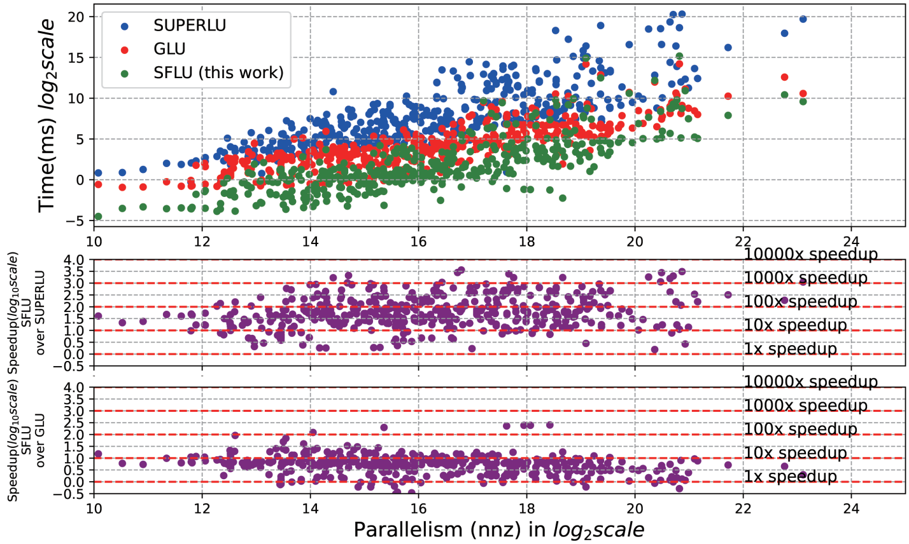
Experimental Result
We test 1309 matrices from the SuiteSparse matrix set on Titan RTX (Turing) GPUs, Intel 20-core CPUs, comparing the performance of SFLU with SuperLU and GLU.
Figure 1. Symbolic factorization comparison.
Figure 2. Numeric factorization comparison.
In the symbolic factorization, the acceleration is up to 205.14x and 701x compared to SuperLU and GLU, respectively.
In the numeric factorization, the acceleration is up to 3585.2x and 252.2x compared to SuperLU and GLU, respectively.

Slide 21
Contents
Background
Sparse Linear Solvers for Circuit Simulation
  SFLU: Synchronization-Free Sparse LU Factorization for Fast Circuit Simulation on GPUs
  Accelerating Sparse LU Factorization with Density-Aware Adaptive Matrix Multiplication for Circuit Simulation
  PanguLU: A Scalable Regular Two-Dimensional Block-Cyclic Sparse Direct Solver on Distributed Heterogeneous Systems
Conclusions

Slide 22
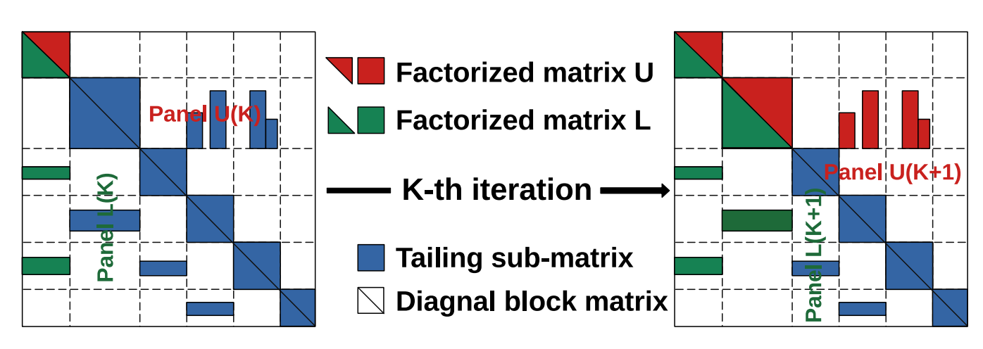
Sparse LU with Density-Aware Adaptive Matrix Multiplication (DAC23)
The numeric factorization in supernodal LU factorization follows four steps，where K signifies the K-th iteration and N denotes the number of matrix blocks on the diagonal.
The Schur-complement phase contains a large number of GEMM operations.
Factorize the diagonal block.
Factorize the sub-matrices in L panel: L(K : N, K)
Factorize the sub-matrices in U panel: U(K, K +1 : N)
Perform the Schur-complement for all the tailing sub-matrices by using A = A−L×U.

Slide 23
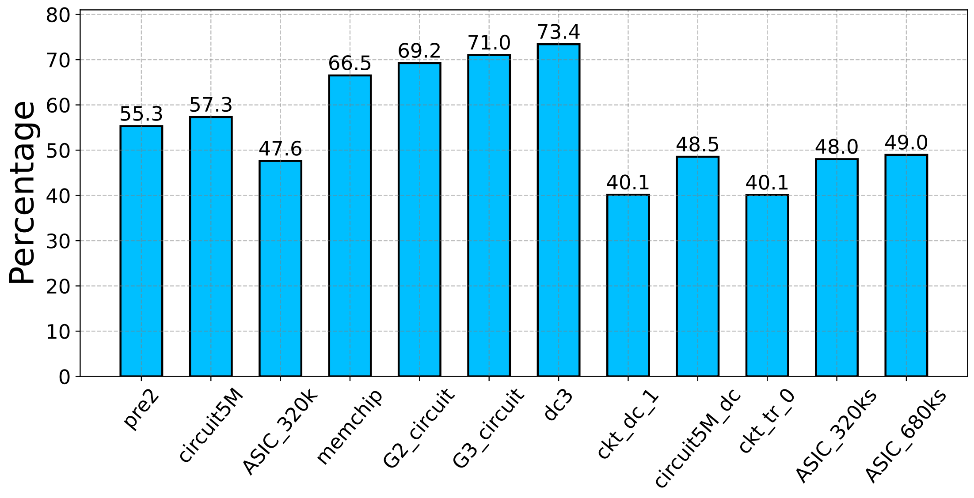
Sparse LU with Density-Aware Adaptive Matrix Multiplication (DAC23)
GEMM takes up much of the time for numeric factoriztaion.
Accelerating GEMM is of great significance for numeric factorization performance improvement.
We tested some circuit matrices, such as the G3_circuit matrix in the figure, which accounts for as much as 73.4% of the time, and most of the other matrices tend to account for 40%-60% of the GEMM time.

Slide 24
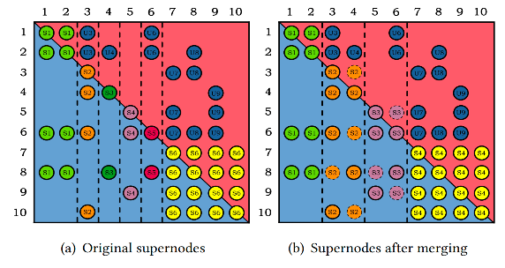

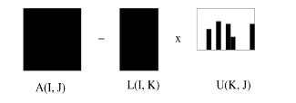
Sparse LU with Density-Aware Adaptive Matrix Multiplication (DAC23)
In order to better utilize the dense GEMM of Level-3 BLAS, the traditional approach is to form dense blocks using supernodal (shown in Figure 1) or multifrontal methods. However, for matrices without a regular sparse structure, supernodes formed through relaxation may not always be dense (shown in Figure 2).
Schur-complement
Figure 2. Example of Schur- complement computation.
Figure 1. How to form supernodes.

Slide 25
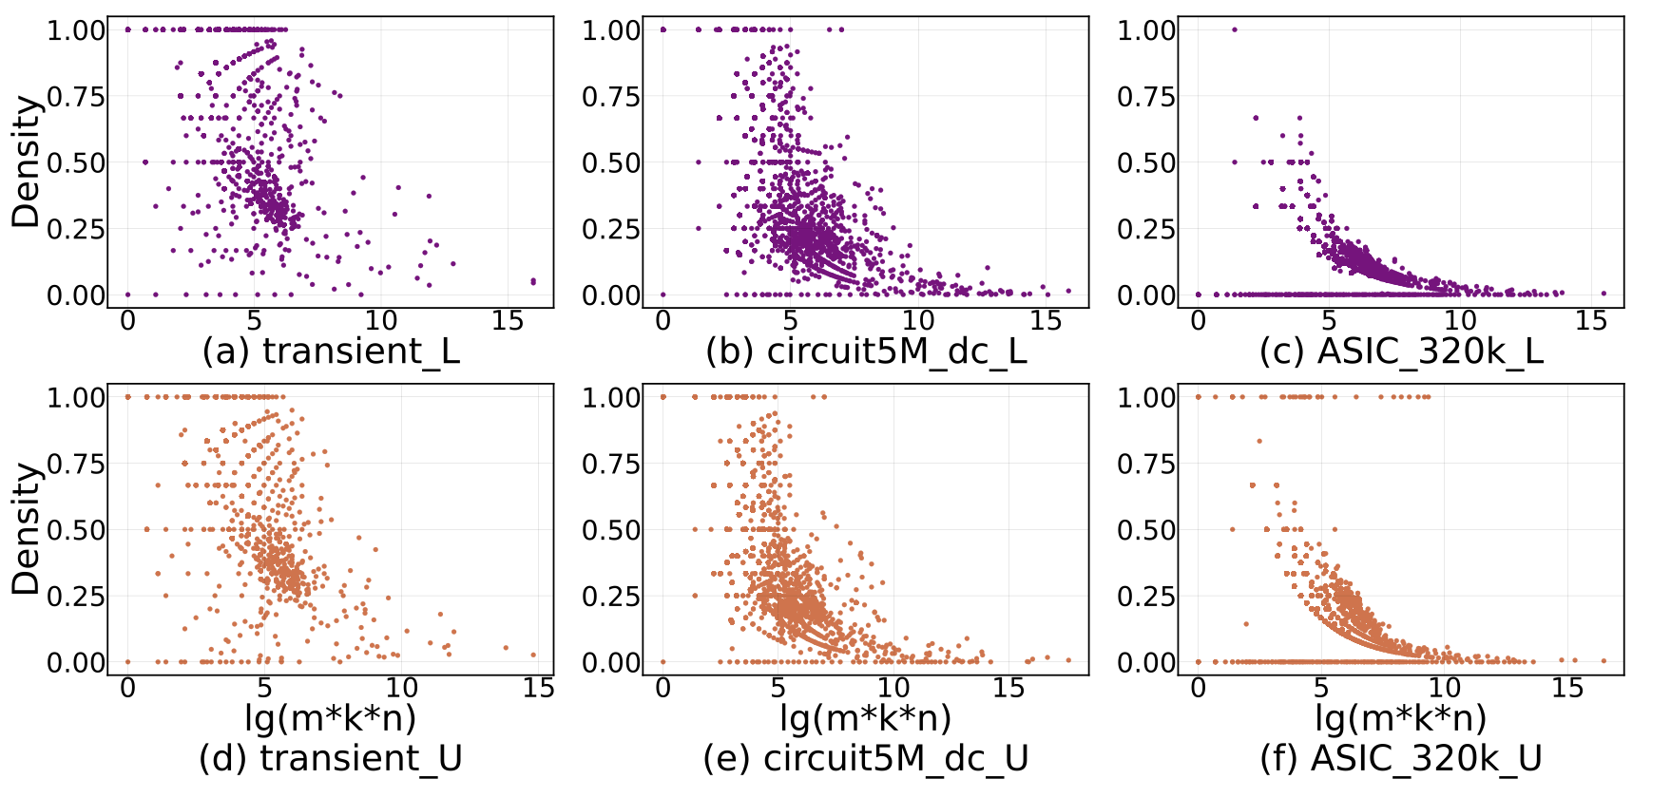
Sparse LU with Density-Aware Adaptive Matrix Multiplication (DAC23)
We select three representative circuit matrices and can see that the input matrix (L and U blocks) involved in GEMM are not always dense.
Figure 1. Density distribution of matrix factors (L and U blocks) participating in GEMM.
The introduction of sparse matrix multiplication (SpMM) shows great potential for further accelerating the LU factorization.

Slide 26
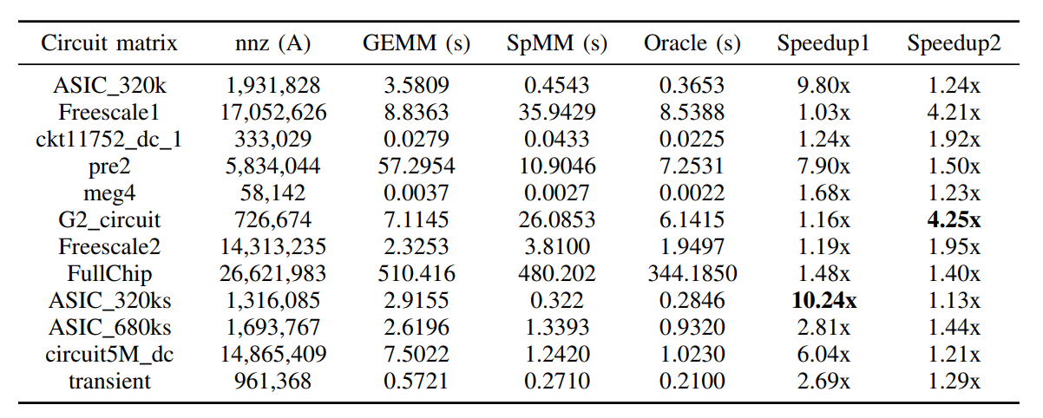
Sparse LU with Density-Aware Adaptive Matrix Multiplication (DAC23)
After introducing SpMM, we test the data in Table 1. The "Oracle" in the table indicates the optimal total time computed by picking the optimal kernel in SpMM and GEMM for each matrix multiplication in the ideal case.
TABLE I: Analysis of the performance improvement space of matrix multiplication.
Which method is best？GEMM？SpMM？
Compared with GEMM and SpMM, the performance improvement potential of "Oracle" is 1.03x-10.24x and 1.13x-4.25x, respectively.
We need to pick the optimal kernel for each execution of matrix multiplication!

Slide 27
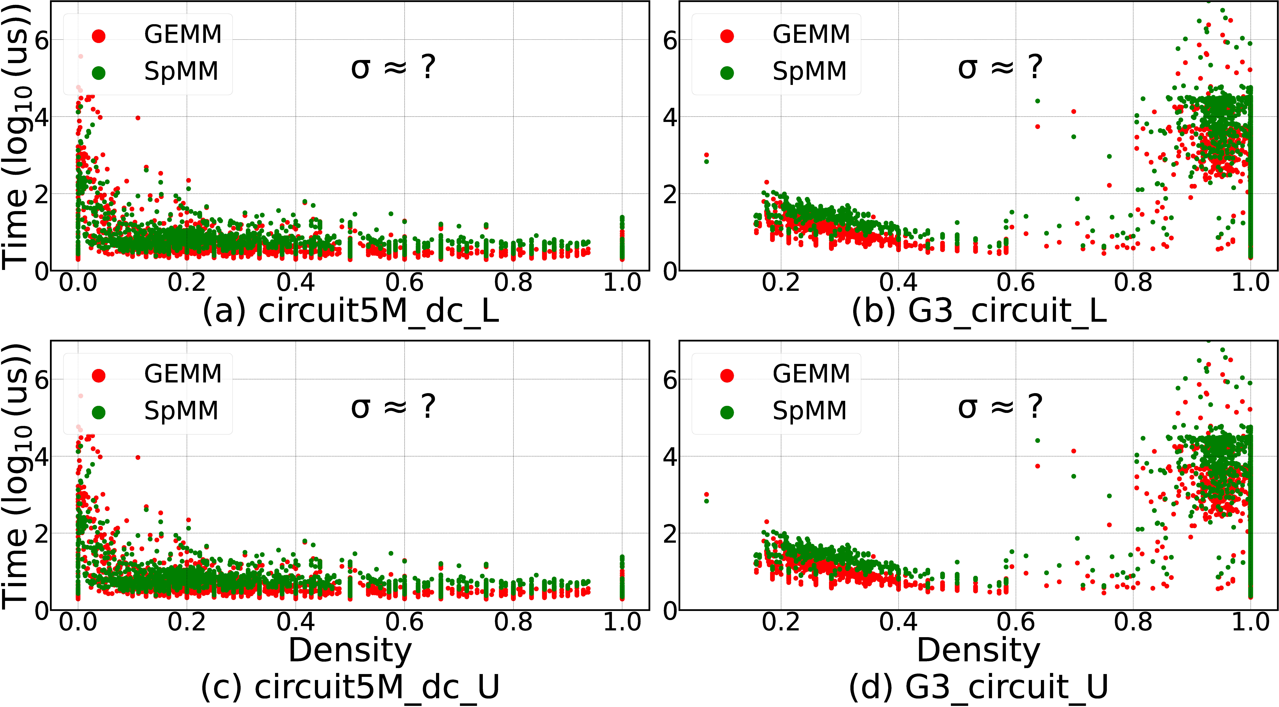
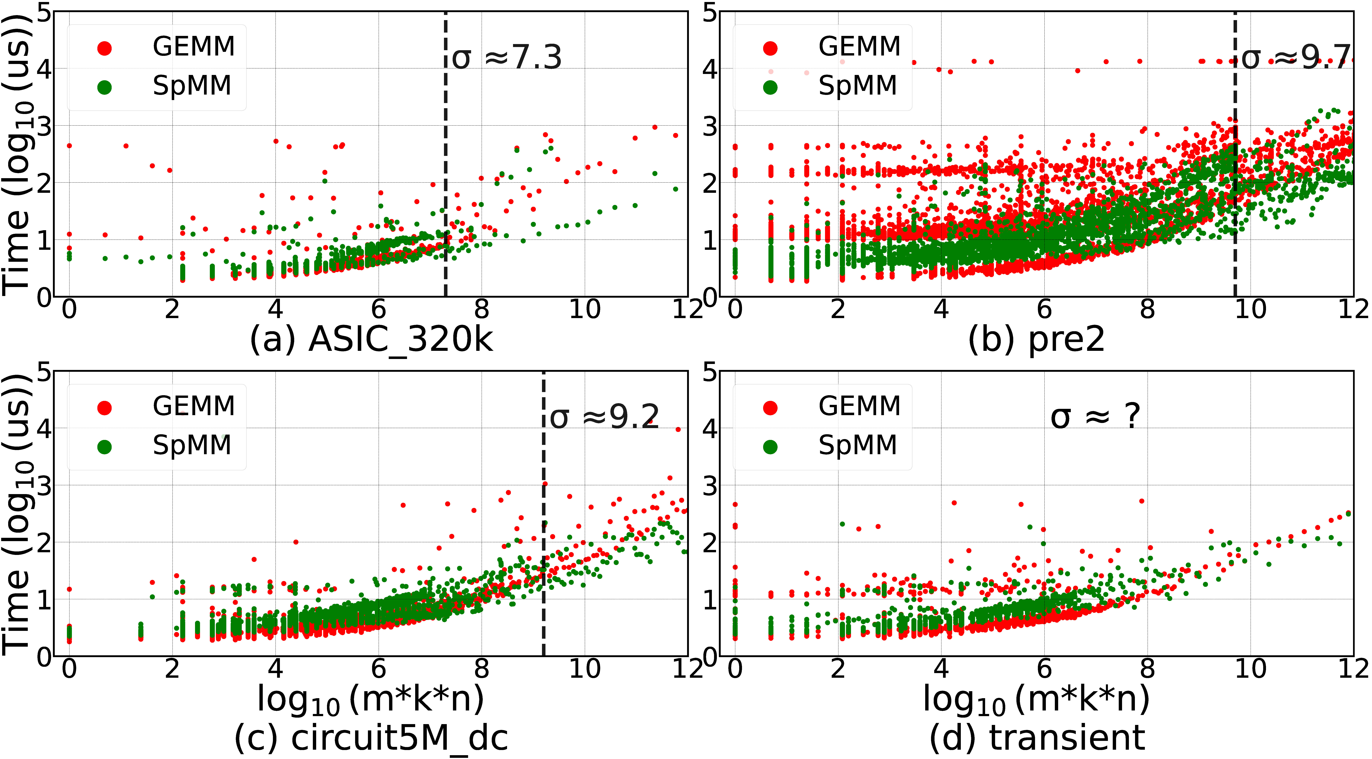
Sparse LU with Density-Aware Adaptive Matrix Multiplication (DAC23)
Figure 1. Performance comparison based on density and matrix size.
It is difficult to define thresholds for either density or matrix size. The use of density-aware adaptive matrix multiplication equipped with random forest^{[1]} provides an effective solution to the issues mentioned above.
Figure 2. Density-aware LU factorization.

Slide 28
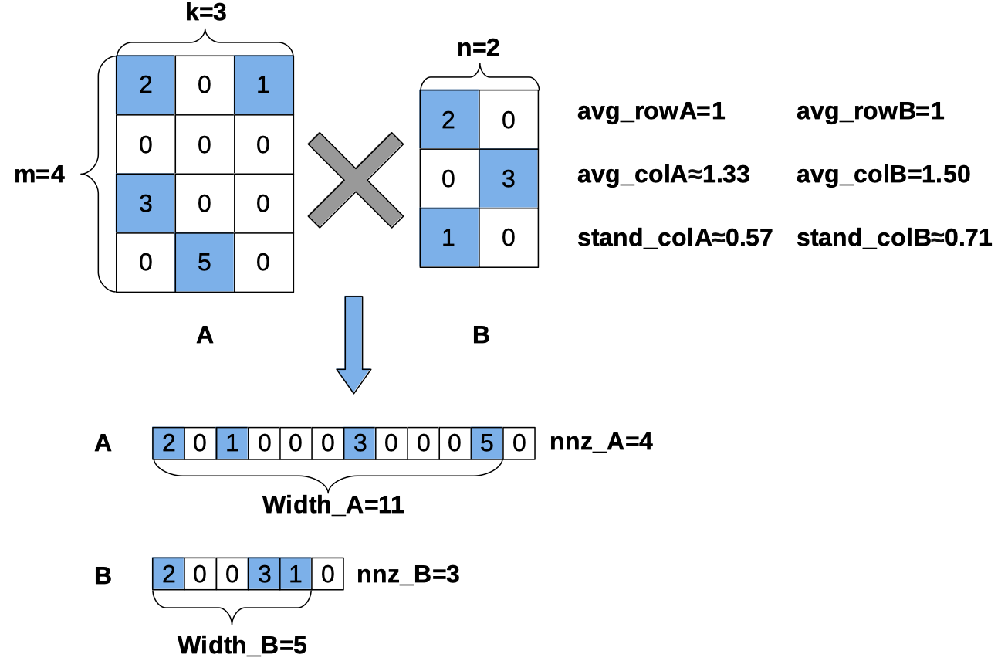
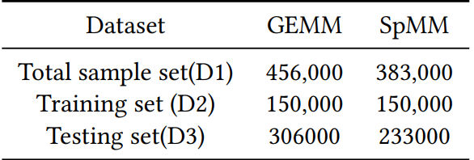

Experimental Result
Dataset Source: The large-scale circuit matrices in SuiteSparse and exported by SuperLU_DIST 8.0.0.
Samples in the dataset: Each sample contains 15 matrix features (F1-F15) and a label P, where P=1 indicates that using GEMM is better than that of SpMM, and P=0 is vice versa.
Data preprocessing:
  Z-score normalization
  Sample equalization
Number of samples in the dataset ：
An example of 15 matrix features (F1-F15).

Slide 29
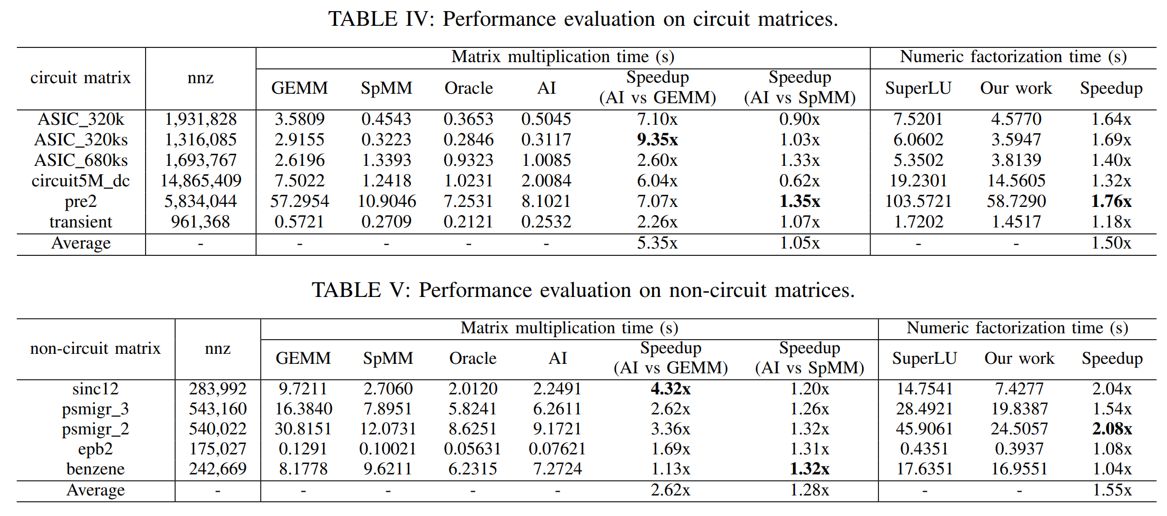
Experimental Result
We test several matrix in a 2 * Intel Xeon Silver 4210 CPU @ 2.20GHz, 512GB DDR4 platform configuration. We test 11 test matrix from the SuiteSparse, including 6 circuit matrix and 5 non-circuit matrix.
For circuit matrix, up to 9.35x acceleration for matrix mutiplication and 1.76x for LU factorization;
For other irregular matrix, up to 4.32x and 2.08x, respectively.
Figure 1. Model accuracy

Slide 30
Contents
Background
Sparse Linear Solvers for Circuit Simulation
  SFLU: Synchronization-Free Sparse LU Factorization for Fast Circuit Simulation on GPUs
  Accelerating Sparse LU Factorization with Density-Aware Adaptive Matrix Multiplication for Circuit Simulation
  PanguLU: A Scalable Regular Two-Dimensional Block-Cyclic Sparse Direct Solver on Distributed Heterogeneous Systems
Conclusions

Slide 31
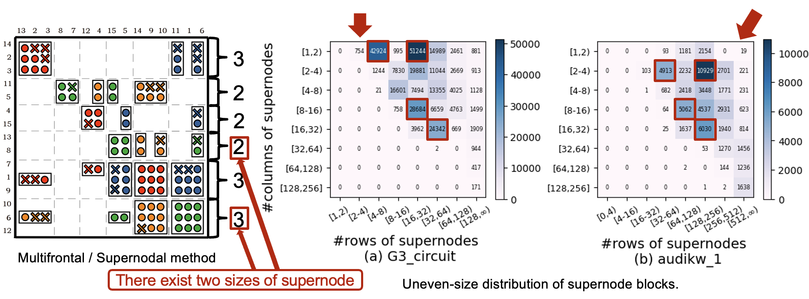

PanguLU: Sparse Solver on Distributed Heterogeneous Systems (SC23)
Motivation 1: Uneven Block Sizes
When the supernodal method aggregates columns of the same structure, there are different sizes of supernodes.
It can be seen that the matrix blocks generated by the supernodes can be very irregular, which often affects the computational efficiency, and their irregular structure makes it difficult to optimise the performance at the kernel level.

Slide 32
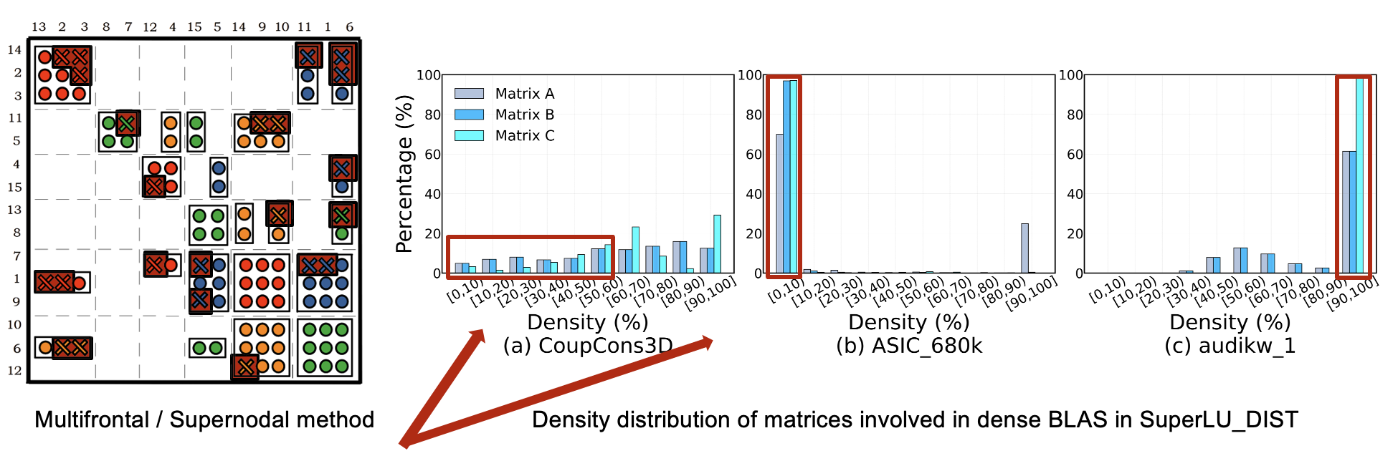
PanguLU: Sparse Solver on Distributed Heterogeneous Systems (SC23)
Motivation 2: Redundant Zero Fill-ins
The supernodal method divides the matrix into uneven dense blocks to be computed with dense BLAS, which may cause two questions.
1. Redundant zero fill-ins can occur when forming dense blocks that add extra floating-point operations.
2. The local sparsity of the matrix cannot be exploited during GEMM calculations.
This matrix has an overall even distribution but a significant portion is less than 50%
concentrated
at [90,100)%
concentrated at [0,10)%
As a result, for the two matrices there is a chance that sparse BLAS is faster compared with dense BLAS.

Slide 33
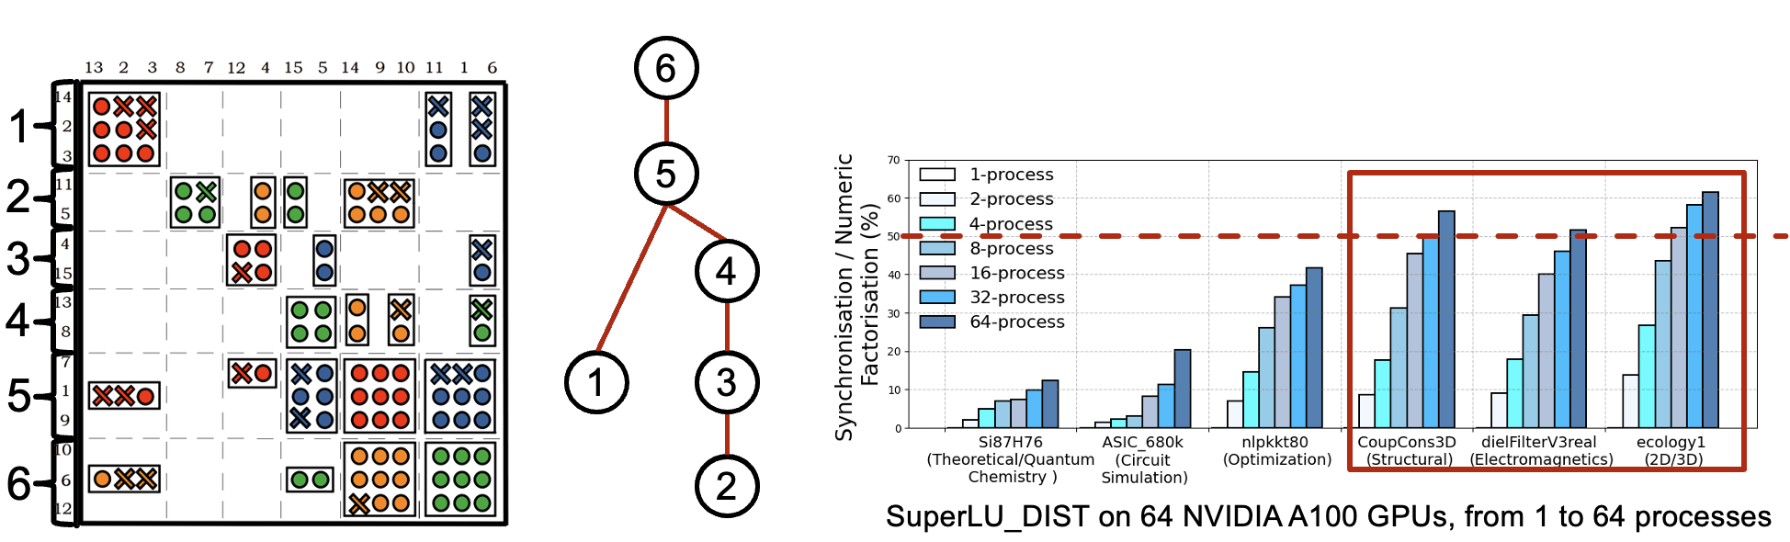
PanguLU: Sparse Solver on Distributed Heterogeneous Systems (SC23)
Motivation 3: High Synchronisation Costs
SuperLU_DIST uses the level-set method to generate an elimination tree with tree nodes as the minimum scheduling unit in distributed systems, which can lead to high synchronization costs.
Tree nodes consist of multiple dense BLAS and there are dependencies between each tree node that need to be synchronized, resulting in additional synchronization overhead.
We test six real-world matrices from SuiteSparse Matrix Collection on 64 NVIDIA A100 GPUs.
The synchronization cost would be more than 50% at 64 processes on irregular matrices.
We need a new method to reduce synchronization costs.

Slide 34
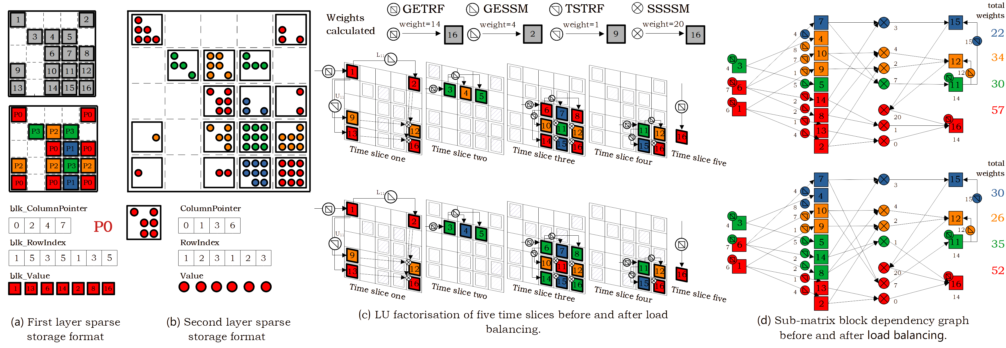
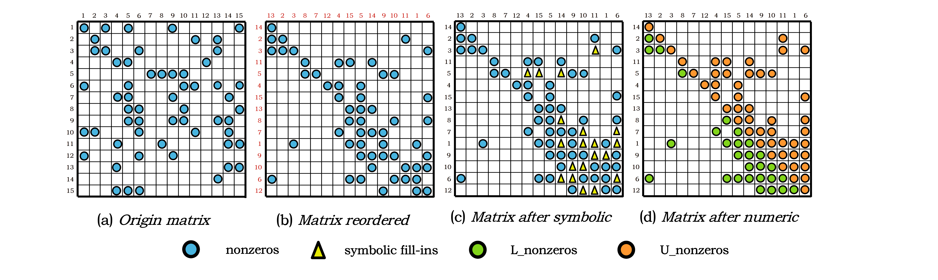
Data Layout of PanguLU
Our approach is completely different from the classic supernodal method.
PanguLU splits the matrix into multiple blocks of equal size and uses sparse kernel to calculate.
Each process uses a two-layer sparse structure to store the matrix.
First layer sparse structure stores the positional information of sparse matrix blocks. We will get the position of sub-matrix in this layer sparse format.
Second layer sparse structure stores the non-zero elements of sub-matrix block with sparse format. We will get internal information about the block, including rows, non-zeros, and sub-matrix structure.
34

Slide 35
Sparse Kernels of PanguLU
In the numeric factorization of PanguLU, since the matrix blocks are sparse, we develop four dedicated sparse kernels: sparse general triangular factorization (GETRF), sparse upper triangular solve (TSTRF), sparse lower triangular solve (GESSM), and Schur complement with sparse-sparse matrix multiplication (SSSSM).
A = L * U
X * U = A
L * X = A
- L * U + C = C
All four sparse kernels use sparse sub-matrix blocks as inputs and outputs.

Slide 36
Sparse Kernels of PanguLU
There are several critical factors for the performance of numeric factorzation, such as density, structure and size of the matrix. To exploit the best performance, we implement 17 sparse kernels in PanguLU.
Kernel | Version | Addressing Method | Paralleling Method | Dense Mapping
GETRF | C_V1 | Direct | Row | ✓
 | G_V1 | Bin-search | Un-sync SFLU | -
 | G_V2 | Direct | Un-sync SFLU | ✓
TSTRF/ GESSM | C_V1 | Merge | Column | -
 | C_V2 | Direct | Column | ✓
 | G_V1 | Bin-search | Warp-level column | -
 | G_V2 | Bin-search | Un-sync warp-level row | -
 | G_V3 | Direct | Warp-level column | ✓
SSSSM | C_V1 | Direct | Approximate equal load column block | ✓
 | C_V2 | Bin-search | Adaptive split-bin type | -
 | G_V1 | Bin-search | Adaptive multi-level | -
 | G_V2 | Direct | Warp-level column | ✓
The “Addressing Method” indicates how the calculation value is located and updated. In addition, the “Dense Mapping” represents that the sparse structure is mapped to a dense space.
Different sparse kernels have different
How to select one of these sparse kernels at runtime?

Slide 37
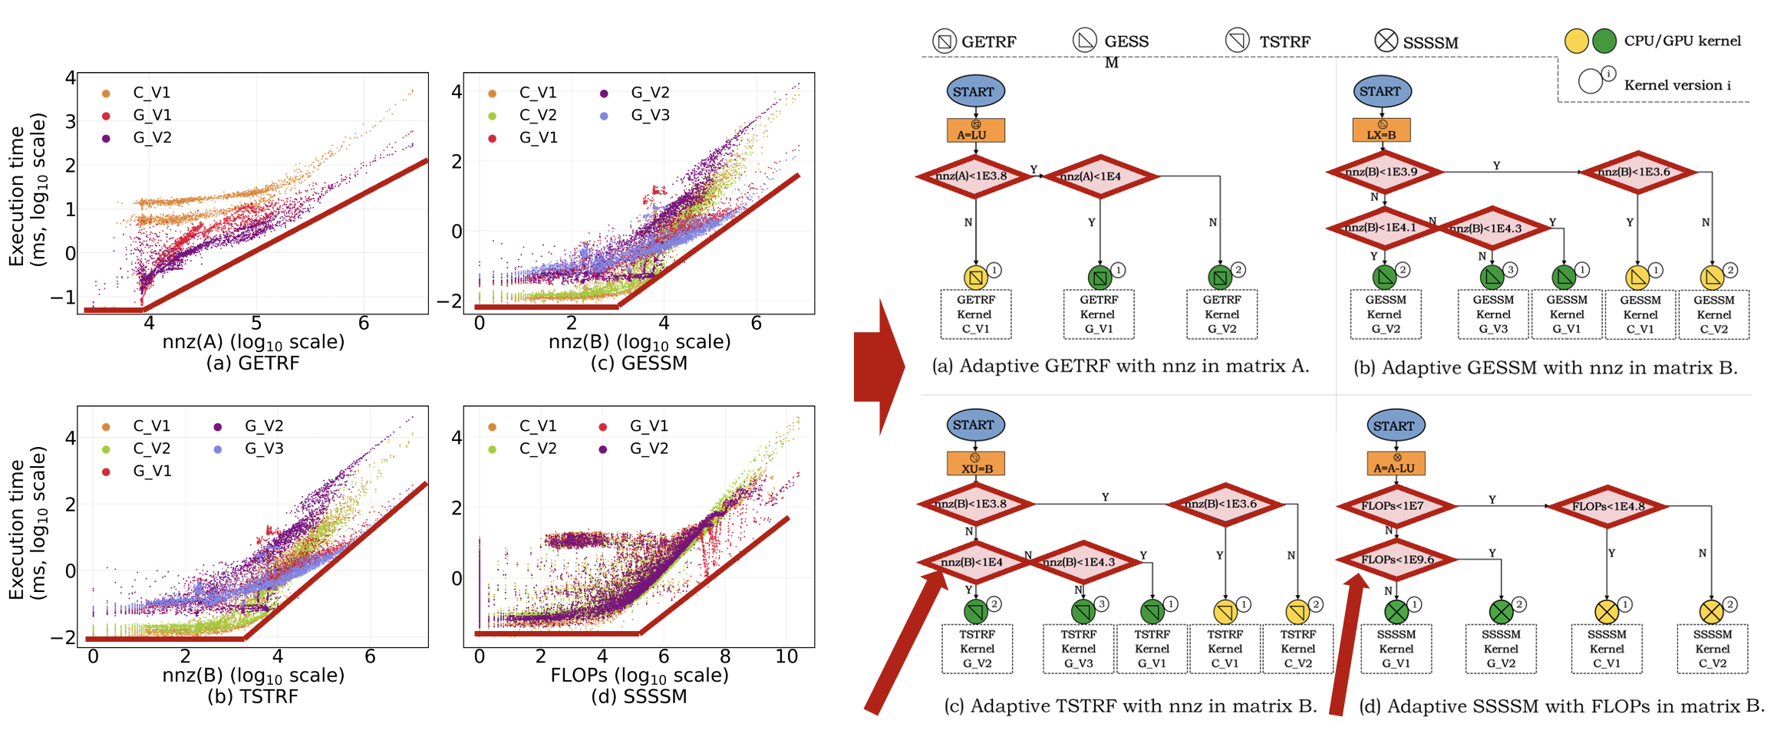
Sparse Kernels of PanguLU
We propose an algorithm selection strategy for constructing sparse kernels based on large amounts of performance data to select better sparse kernels.
We develop four decision trees according to #non-zeros of matrix A/B and the FLOPs involved in the computation from the performance of 17 sparse kernels to guide our algorithm selection.

Slide 38
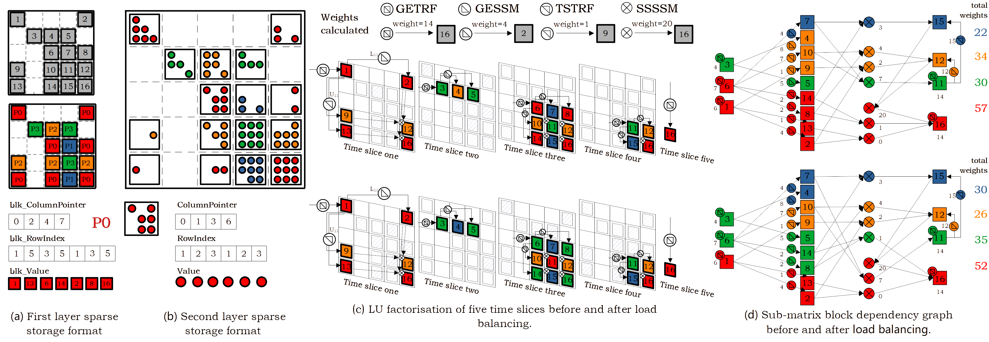
Mapping of PanguLU
PanguLU develops a mapping method and redistributes the computational load between processes. We map sparse block of heavy-load process to less-load process according to kernel types and time slices.
Calculate the total weights of the LU factorisation by preprocessing
Each block presents a sparse kernel
Migrate heavy-load sparse kernels for load-balancing
Exchange load from orange process to blue process
Exchange from red process to green process

Slide 39
Synchronisation-Free Scheduling
PanguLU are computed sequentially in the order of time slices, to maintain the correctness of the sparse LU factorisation as show in figure.
Executive direction

Slide 40
Synchronisation-Free Scheduling
PanguLU are computed sequentially in the order of time slices, to maintain the correctness of the sparse LU factorisation as show in figure.
But obviously these time slices can be computed in parallel on different processes.
Executive direction
Mainly because synchronisation reduces parallelism in distributed systems.
For the blocks 1, 2 and 6, if we do the calculations in time-slice order, these blocks will be executed sequentially.
The synchronisation between each time slice is required to ensure that the correctness of the calculations.
Is there another method of calculation that can guarantee correctness while keeping the processes in a working state as much as possible?

Slide 41
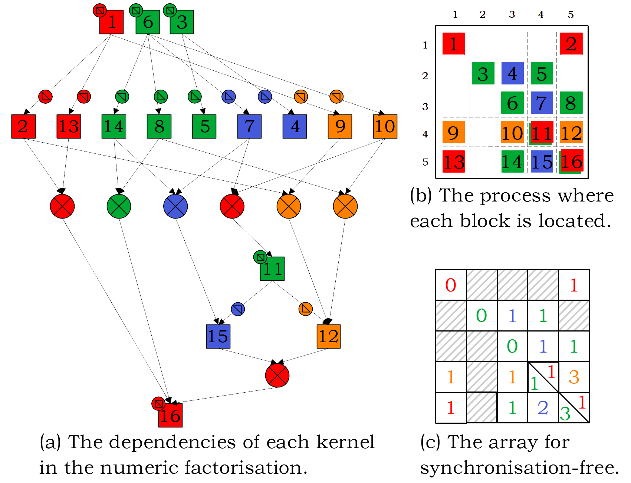
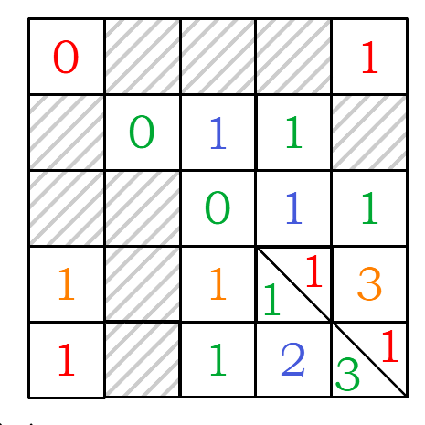
Synchronisation-Free Scheduling
So we researched the order of computation of sparse LU factorisation using sparse kernels.
We find all kernels need to calculate according to the dependencies shown in the figure.
Therefore, we can use a synchronisation-free array to keep the number of sparse kernels that still need to be calculated for each block to ensure the correctness of the computation.
The computation of all sparse kernels (GETRF, TSTRF, GESSM and SSSSM) can only be started after computation of the kernel pointed to by the previous arrow has been completed, which is like the relationship between 0 and non-zero.
For blocks 1, block 2, and block 6, the synchronisation-free array is 0 because there are no arrows.
For block 12, the synchronisation-free array is 3 because there are three arrows.
In particular, we do not use any synchronisation in here.

Slide 42



Experimental Result
Experimental Setup
Two experimental platforms | Two heterogeneous distributed Solvers
4 * NVIDIA A100 GPUs (40 GB, B/W 1555GB/s) 2 * Intel Xeon 8180 CPUs @ 2.5 GHz (512GB DDR4) | SuperLU_DIST 8.1.2 PanguLU 3.5
4 * AMD MI50 GPUs (16 GB, B/W 1024GB/s) 1 * AMD Epyc 7601 CPU @ 2.2 GHz (128GB DDR4) | SuperLU_DIST 8.1.2 PanguLU 3.5

Slide 43
Experimental Result
Compared with SuperLU_DIST, PanguLU achieves an average speedup of 2.53x and 2.79x on the NVIDIA GPU platform and the AMD GPU platform, with speedups ranging from 1.10x - 11.70x and 1.12x - 17.97x, respectively.
Especially, PanguLU achieves significant performance advantages for irregular matrices such as ASIC_680k (circuit matrix) with speedups of up to 11.70x and 17.97x on the two GPU platforms, respectively.
In this figure, the red lines and blue lines indicate the performance of SuperLU_DIST and PanguLU, respectively, while the solid lines and dotted lines indicate the performance on the A100 GPU and MI50 GPU platforms, respectively.

Slide 44
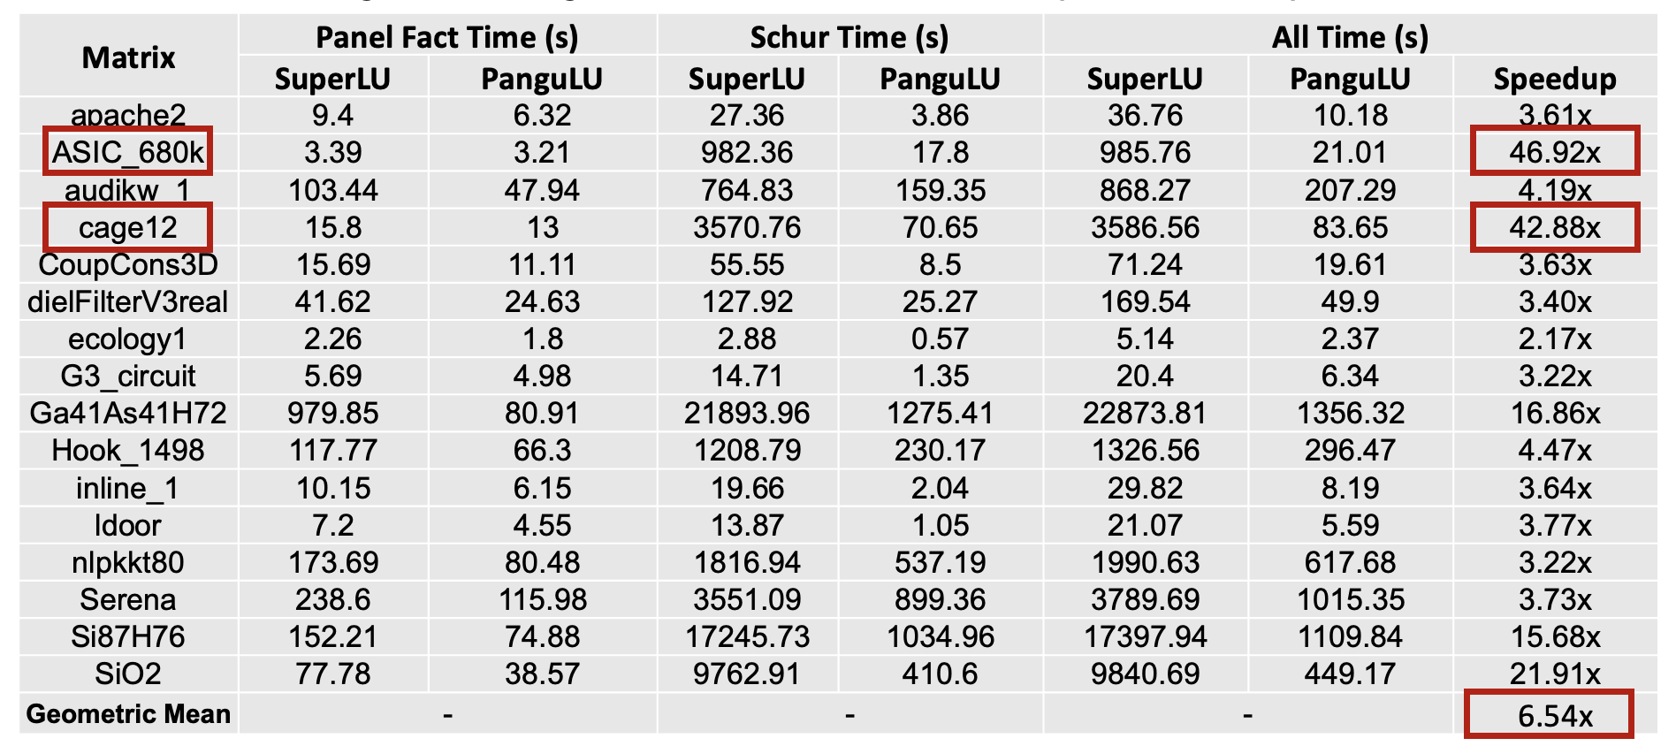
Experimental Result
PanguLU achieves better performance by using sparse kernel on a single GPU.
In the 16 matrices, PanguLU has a geometric mean of 6.54x compared with SuperLU.
Kernel time comparison of SuperLU_DIST and PanguLU for 16 test matrices on a signle A100 GPU.

Slide 45
Contents
Background
Sparse Linear Solvers for Circuit Simulation
  SFLU: Synchronization-Free Sparse LU Factorization for Fast Circuit Simulation on GPUs
  Accelerating Sparse LU Factorization with Density-Aware Adaptive Matrix Multiplication for Circuit Simulation
  PanguLU: A Scalable Regular Two-Dimensional Block-Cyclic Sparse Direct Solver on Distributed Heterogeneous Systems
Conclusions

Slide 46
Sparse Linear Solvers for Circuit Simulation
Machine Learning and GPU Accelerated Sparse Linear Solver (on CPU, GPU and Distributed Heterogeneous Systems):
Jianqi Zhao, Yao Wen, Yuchen Luo, Zhou Jin, Weifeng Liu, Zhenya Zhou. SFLU: Synchronization-Free Sparse LU Factorization for Fast Circuit Simulation on GPUs. The 58th ACM/IEEE Design Automation Conference (DAC' 21). 2021.
https://gitee.com/ssslab/sflu
Tengcheng Wang, Wenhao Li, Haojie Pei, Yuying Sun, Zhou Jin, Weifeng Liu. Accelerating Sparse LU Factorization with Density-Aware Adaptive Matrix Multiplication for Circuit Simulation. The 60th ACM/IEEE Design Automation Conference (DAC' 23). 2023
https://github.com/SuperScientificSoftwareLaboratory/DALU
Xu Fu, Bingbin Zhang, Tengcheng Wang, Wenhao Li, Yuechen Lu, Enxin Yi, Jianqi Zhao, Xiaohan Geng, Fangying Li, Jingwen Zhang, Zhou Jin, Weifeng Liu. PanguLU: A Scalable Regular Two-Dimensional BlockCyclic Sparse Direct Solver on Distributed Heterogeneous Systems. 36th ACM/IEEE International Conference for High Performance Computing, Networking, Storage, and Analysis (SC' 23). 2023. (Best paper award)
https://www.ssslab.cn/software.html

Slide 47
An overview of surveyed sparse direct solver
 | Solver | Left/Right looking | Blocking method | Kernel | Parallelism | 的
 |  |  |  |  | Level | Method | Distributed | Multi-thread | GPU
Gene- ral | MUMPS | Left | Multifrontal | Level-3 BLAS | Tree/Node | Level-set | √ | √ | —
 | UMFPACK | Left | Multifrontal | Level-3 BLAS | — | — | — | — | —
 | SuperLU_DIST | Right | Supernode | Level-3 BLAS | Supernode | Level-set | √ | √ | √
 | PARDISO | Left & Right | Supernode | Level-3 BLAS | Supernode | Pipeline | √ | √ | —
 | PanguLU | Right | Regular 2D block | Adaptive sparse kernel | 2D block | Synchronization-free | √ | √ | √
Dedi-cated to circuit matrix | KLU | Left | Block diagonal | — | — | — | — | — | —
 | NICSLU | Left | Supernode | Level-3 BLAS | Supernode | Level-set | — | √ | √
 | FLU | Left | Supernode | Level-3 BLAS | Supernode | Register Level | — | √ | —
 | GLU | Left & Right | — | — | Element | Level-set | — | — | √
 | SFLU | Left & Right | — | — | Element | Synchronization-free | — | — | √
 | Density-aware LU | Right | Supernode | Adaptive kernel | Supernode | Level-set | √ | √ | —

Slide 48
Some Observations for Future
﻿The future opportunities in this evolving landscape:
Taking into account various factors such as the matrix and hardware platform characteristics in algorithm design.
  How to introduce sparse computations and strike a trade-off between dense and sparse kernels for different computational tasks remains a pivotal challenge.
  Better task scheduling strategies and computational kernels need to be designed on GPUs to improve the parallel computing performance.

Slide 49

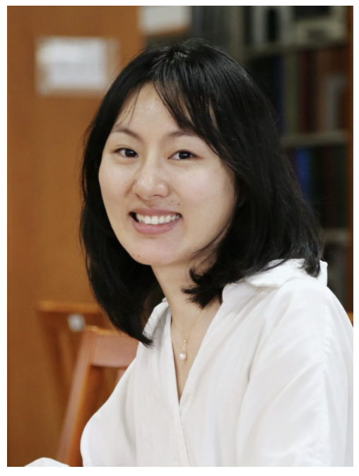

Welcome to collaborate with us!
Thanks!
jinzhou@cup.edu.cn

