Slide 1
StencilMART: Predicting Optimization Selection for Stencil Computations across GPUs
Qingxiao Sun^{1,2}, Yi Liu², Hailong Yang^{1,2}, Zhonghui Jiang²,
Zhongzhi Luan², Depei Qian²
State Key Laboratory of Software Development Environment¹
School of Computer Science and Engineering²
Beihang University, Beijing, China
Notes:
Hello, everyone. I am Qingxiao Sun from Beihang University. Now, I will introduce our work, StencilMART: Predicting Optimization Selection for Stencil Computations across GPUs.

Slide 2
Outline
Background & Motivation
Stencil Computation & Optimization
Stencil Auto-tuning Mechanisms
Observations on Stencil Optimizations
Design & Methods
Random Stencil Generator & Stencil Representation
Optimization Selection & Performance Prediction
Evaluation
Experiment Setup
Performance Analysis
Related Work
Conclusion
Notes:
The presentation is organized as 5 sections. Firstly, I will introduce the background and motivation. And then, I will present our design and methods. After that, I will present the evaluation results. Finally, I will show some related works and make a conclusion.

Slide 3
Outline
Background & Motivation
Stencil Computation & Optimization
Stencil Auto-tuning Mechanisms
Observations on Stencil Optimizations
Design & Methods
Random Stencil Generator & Stencil Representation
Optimization Selection & Performance Prediction
Evaluation
Experiment Setup
Performance Analysis
Related Work
Conclusion
Notes:
Next, I will present the background and motivation, including introduction to stencil computation and optimization, stencil auto-tuning Mechanisms, also the observations on stencil optimizations.

Slide 4
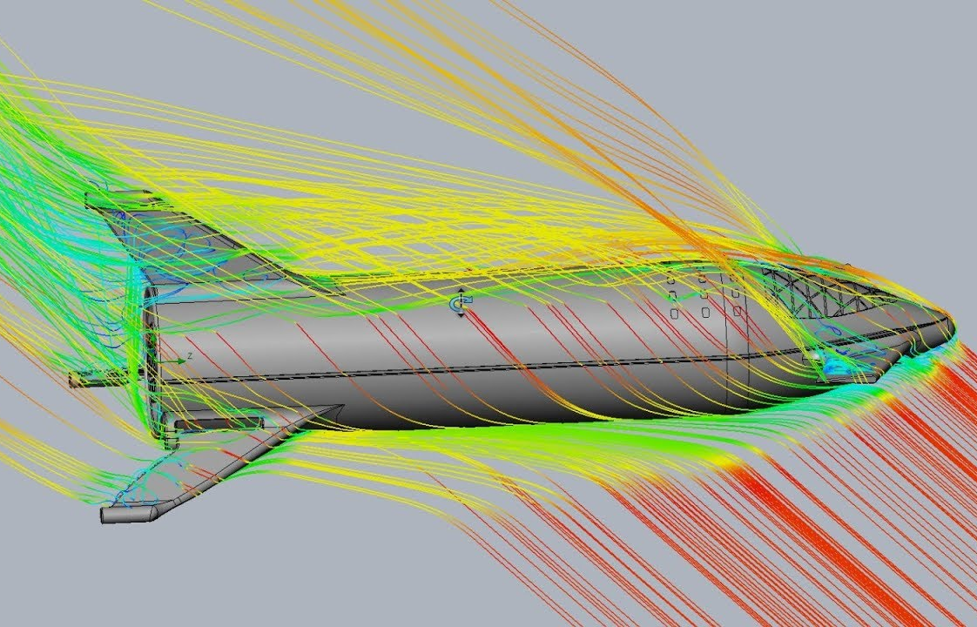
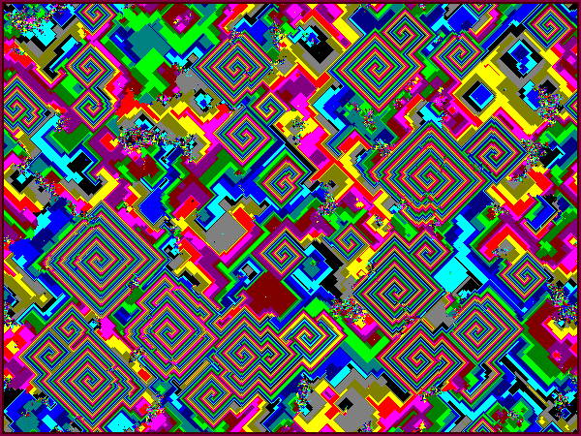
Stencil Computation
Image Processing
Physical Simulation
Cellular Automata
Quantum Mechanics
Stencil Computation
0
$$i$$
$x$-1
0
$$i$$
$x$-1
0
$$i$$
$x$-1
0
0
0
// iteration for T time steps
for (t=0; t<T; t++) {
// traverse of 2-D grid
for (j=0; j<y; j++) {
for (i=0; i<x; i++) {
v(t+1,i,j) =: F(v(t,i,j) in S(i, j));
}}}
$$S_{i,j}$$
$$v_{i,j}$$
$$v_{i,j}$$
$$S_{i,j}$$
$$v_{i,j}$$
$$S_{i,j}$$
$$j$$
$$j$$
$$j$$
$y$-1
$y$-1
$y$-1
Order-1 Star
Order-2 Box
Order-3 Cross
Pseudo Code of Order-$N$ Stencil
A stencil computation sweeps a grid and processes the fixed neighbors around each point
The extent of the neighbors along each dimension is referred as the stencil order
Notes:
The stencil computation is one of the most adopted computation patterns in scientific computing applications. Stencil computations appear in many domains such as image processing, physical simulation, cellular automata and Quantum Mechanics.
A stencil computation sweeps a computational grid and processes the fixed neighbors around each point to update its value, where the extent of the neighbors along each dimension is referred to as the stencil order.
Here are some examples of 2-D stencils from various shapes, including order-1 star, order-2 box and order-3 cross. The pseudo code of Order-N stencil is illustrated on the right side.

Slide 5
Stencil Optimization on GPUs
$$x$$
$$x$$
$$x$$
Streaming: the computation of 2-D tiles is streamed over one dimension, and the data of each tile is reused for updating the next tiles
Block/Cyclic merging: each GPU thread works on the computation of several adjacent / spaced points
Retiming: the stencil computation is decomposed into several subsets along with accumulations
…
$$y$$
$$y$$
$$y$$
$$z$$
$$z$$
$$z$$
Streaming ($z$-Dim)
Block Merging ($y$-Dim)
Cyclic Merging ($x$-Dim)
$$x$$
$z$ plane
$z$-1 plane
$$y$$
Retiming
$$z$$
shared memory
registers
The above optimizations can be combined under certain constraints to further improve stencil performance. However, the optimization combination (OC) should be carefully selected to adapt to the target stencil and hardware architecture.
Notes:
Here we briefly discuss the existing GPU optimization techniques for stencil computation.
For 3-D input grids, an effective implementation of streaming is 2.5-D spatial blocking. The computation of 2-D tiles is streamed over one dimension, and the data of each tile is reused for updating the next tiles.
For block merging, a number of adjacent output points are merged. Whereas for cyclic merging, every two points are merged with a fixed distance.
Retiming can balance the resource usage between memory and registers by decomposing a stencil computation into a set of sub-computations along with accumulations.
The above optimizations can be combined under certain constraints to improve performance further. However, the optimization combination (OC) should be carefully selected to adapt to the target stencil and hardware architecture.

Slide 6
Stencil Auto-tuning Mechanisms
Existing Stencil DSLs expose performance-related parameters to auto-tuning mechanisms
Stochastic search by Halide [PLDI’13], hierarchical auto-tuning by Artemis [IPDPS’19], etc.
Limitations: 1) rely on expert knowledge; 2) large search cost; 3) pool scalability.
Stencil auto-tuning frameworks reduce the search cost through grouping and sampling
csTuner [CLUSTER’21] leverages statistics and ML methods to generate the sampled space.
Limitation: not supporting optimization adaptation and performance prediction.
Performance prediction is used to study the impact of optimizations on stencil computation
Cosenza et al. [IPDPS’17] utilized ordinal regression to predict the ranking of stencil code variants.
Limitation: only implemented on CPUs and not consider cross-architecture predictions.
To address the above drawbacks, we propose an automatic optimization selection framework StencilMART, which predicts the best OC or the performance under a specific parameter setting for stencil computation across GPUs.
Notes:
Due to the diversity of stencil patterns, any optimization has to be fine-tuned to maximize its performance.
Stencil DSLs expose performance-related parameters to auto-tuning mechanisms integrated in their frameworks. However, they heavily rely on expert knowledge and have large cost and pool scalability.
Stencil auto-tuning frameworks reduce the search cost through grouping and sampling. However, they do not support optimization adaptation and performance prediction.
On the other hand, performance prediction is used to study the impact of optimizations on stencil computation. However, they are only implemented on CPUs and not consider cross-architecture predictions.
To address the above drawbacks, we propose an automatic optimization selection framework StencilMART, which predicts the best OC or the performance under a specific parameter setting for stencils across GPUs.

Slide 7
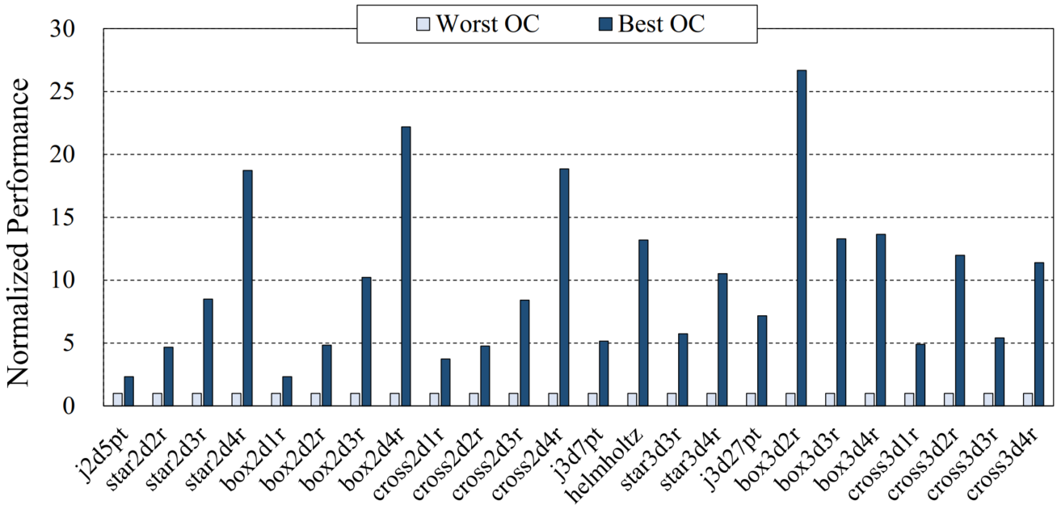
Performance Gap among OCs
Performance of the best OC of each stencil (normalized to its worst OC)
The OC should be carefully selected to ensure successful execution while improving performance, especially for complex stencils (high-order and high-dimensional).
The best OC achieves an average speedup of 9.95× over the worst OC
For the same shape, a higher dimension or order usually means a larger performance gap
Notes:
We make four main observations by comparing the performance of optimizations.
This figure shows the performance of the best OC of each stencil normalized to its worst OC. As seen, the performance gap among OCs is significant, where the best OC achieves an average speedup of 9.95× over the worst OC. In addition, for stencils of the same shape, a higher dimension or order usually means a larger performance gap. This indicates that the OC should be carefully selected to ensure successful execution while improving performance, especially for high-order and high-dimensional complex stencils.

Slide 8
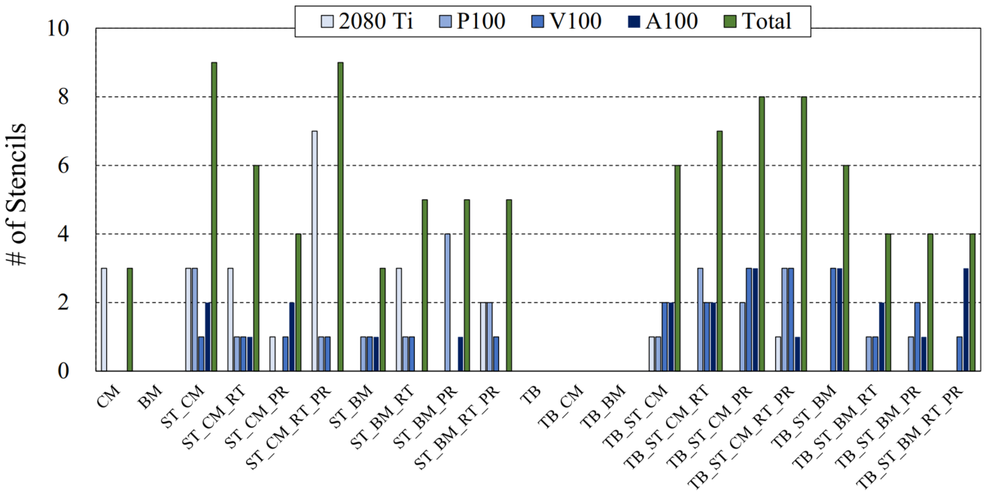
Distribution of Best OCs for Stencils
The number of stencils that each OC achieves the best performance
Optimization | Abbr.
Streaming | ST
Block Merging | BM
Retiming | RT
Prefetching | PR
Temporal Blocking | TB
The missing bars indicate that the OC does not achieve the best performance for any stencil
The distribution of the best OCs is relatively even, there is no single OC fits for all stencils
The computation pattern of stencils has a significant impact on the effectiveness of optimizations.
Notes:
This figure shows the number of stencils that each OC achieves the best performance.
The missing bars indicate that the OC does not achieve the best performance for any stencil, such as temporal blocking without streaming. It can be observed that the distribution of the best OCs is relatively even, there is no single OC fits for all.
The reason is that the computation pattern of stencils has a significant impact on the effectiveness of optimizations.

Slide 9
Pairwise Correlation of OCs
The value distribution of top-100 PCCs achieved by pairwise OCs
The Pearson correlation coefficient (PCC) is used to quantify the correlation between pairwise OCs
The intersection of pairwise OCs under all architectures accounts for 28% of the total
The performance impact of certain OCs on stencil computation is general among architectures, thus the OC pairs can be grouped to reduce the classes to be predicted.
Notes:
This figure shows the value distribution of top-100 PCCs achieved by pairwise OCs.
The Pearson correlation coefficient is used to quantify the correlation between pairwise OCs. As seen, the intersection of pairwise OCs under all architectures accounts for 28% of the total. This indicates that the influence of certain OCs on stencil computation is general among architectures. Therefore, if the selection of the best OC is analogous to a classification problem, the OC pairs in the intersection can be grouped to reduce the classes to be predicted.

Slide 10
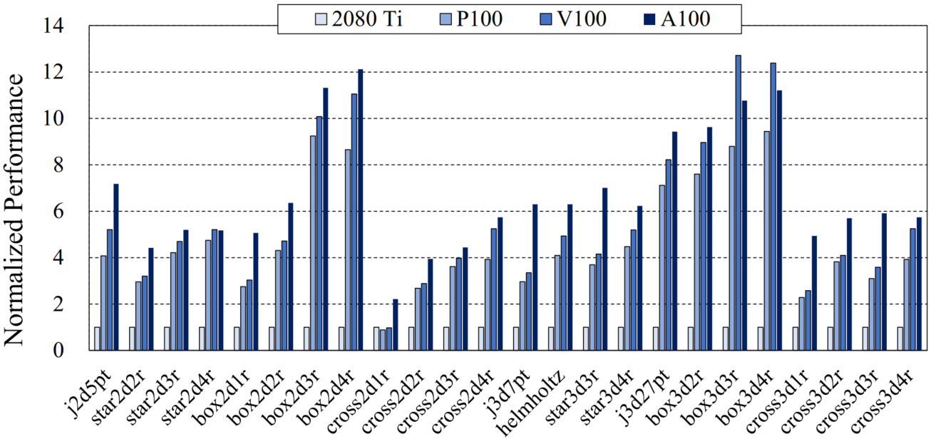
Performance Comparison across GPU Architectures
The best performance of stencils under each GPU architecture (normalized to 2080 Ti)
The performance of each stencil is taken from the best OC obtained on the target architecture
The most “powerful” GPU (A100) is not always the best for stencil computations (e.g., box3d3r)
Cost-efficiency requires for selecting an appropriate GPU for stencil computation, and thus it is necessary to know the performance in advance before purchasing GPUs.
Notes:
This figure shows the best performance of stencils under each GPU architecture normalized to 2080 Ti.
The performance of each stencil is taken from the best OC obtained on the target architecture. As seen, the A100 GPU is not always the best for stencil computations.
In addition, cost-efficiency leads to selecting an appropriate GPU for stencil computation. It is necessary to know the performance in advance before purchasing GPUs.

Slide 11
Outline
Background & Motivation
Stencil Computation & Optimization
Stencil Auto-tuning Mechanisms
Observations on Stencil Optimizations
Design & Methods
Random Stencil Generator & Stencil Representation
Optimization Selection & Performance Prediction
Evaluation
Experiment Setup
Performance Analysis
Related Work
Conclusion
Notes:
Next, I will present our design and methods.

Slide 12
Design Overview
③
②
①
④
The StencilMART consists of four important components:
① Random stencil generator: outputs a variety of stencil programs for training data collection
② Stencil representation: transforms the patterns into assigned tensors and neighboring features
Machine-learning based ③ classification mechanisms & ④ regression mechanisms: determine the best OC & predict the cross-architecture performance
The StencilMART implements various mechanisms based on both machine learning (e.g., GBDT) and deep learning (e.g., ConvMLP) methods for different needs.
Notes:
Here is the design overview of StencilMART. The StencilMART consists of four important components, including random stencil generator, stencil representation, classification mechanisms for OC selection and regression mechanisms for performance prediction. The random stencil generator outputs a variety of stencil programs for training data collection. The stencil representation transforms the access patterns of stencils into assigned tensors and neighboring features. Machine learning-based classification and regression mechanisms effectively determine the best OC and predict the cross-architecture performance.
Note that the StencilMART implements various mechanisms based on both machine learning (e.g., GBDT) and deep learning (e.g., ConvMLP) for different needs.

Slide 13
Random Stencil Generation
Order-1 sampling
Order-2 sampling
Order-3 sampling
Order-4 sampling
Stencil generated
The access pattern of a stencil with any dimension or shape is represented as a binary sparse tensor. Regarding the stencil characteristics, we iteratively sample access points in the tensor space to generate stencils for model training.
Access points are iteratively sampled from low-order neighbors to high-order neighbors:
1) randomly sample the higher-order neighbors of the selected points in the previous iteration
2) store the non-redundant neighbor points in the list and advance to the next iteration
Notes:
We represent the access pattern of a stencil with any dimension or shape as a binary sparse tensor. Regarding the stencil characteristics, we iteratively sample access points in the tensor space to generate stencils for model training. Specifically, we iteratively sample access points from low-order neighbors to high-order neighbors. In each iteration, we randomly sample the higher-order neighbors of the selected points in the previous iteration. After that, we store the non-redundant neighbor points in the list and advance to the next iteration. The higher dimensional stencils can be analogized in the same way.

Slide 14
Stencil Representation
Transforming a 2-D stencil with a maximum order of 4 into a sparse tensor:
1
1
1
1
1
1
1
Order-4 neighbors
1
1
1
1
1
1
1
1
1
1
1
Order-2 neighbors
1
1
1
1
1
1
1
1
1
1
1
1
1
1
1
1
1
1
1
1
1
1
1
1
1
1
1
1
1
1
1
1
1
1
1
1
1
1
1
1
1
1
1
1
1
1
1
1
1
1
1
Order-1 neighbors
1
1
1
1
1
1
1
1
1
1
1
1
1
1
1
1
1
1
1
1
1
1
1
1
1
1
1
1
1
1
1
1
1
Order-3 neighbors
1
1
1
1
1
1
1
1
1
1
1
1
1
1
1
1
1
1
Order-1 star
Order-2 box
Order-3 cross
Order-4 no-corner
Any-order any-shape stencils
The random stencils generated in this way cover the popular stencil shapes (e.g., star and box) and conform to the neighbor access patterns of stencil computation.
The offset of the neighbor points is converted into the location of the non-zero elements:
The representation of a sparse tensor captures the distribution of neighbors accessed and the Euclidean distance among each other. This type of information largely dominates the latency of memory operations, which in turn significantly impacts the performance of stencil computation.
Notes:
This figure shows an example of transforming a 2-D stencil with a maximum order of 4 into a sparse tensor with a size of 9×9. As seen, the random stencils generated in this way cover the popular stencil shapes such as star and box and conform to the neighbor access patterns of stencil computation.
We convert the offset of the neighbor points into the location of the non-zero elements. The representation of a sparse tensor captures the distribution of neighbors accessed and the Euclidean distance among each other. This type of information largely dominates the latency of memory operations, which in turn significantly impacts the performance of stencil computation.

Slide 15
Classification Mechanisms for OC Selection
The candidate feature set of a stencil
The candidate features extracted focus on the distance between neighbor points and central point instead of the sparsity distribution in the entire tensor space.
ConvNet structure using tensor representation
GBDT & FcNet: take the stencil feature set as input and output the probability of the stencil belonging to each OC
ConvNet: takes the assigned tensor as input, exploits the hidden features of the tensor input through convolutional layers and fully connected layers
Notes:
This table shows the candidate feature set of a stencil, which focus on the distance between neighbor points and central point instead of the sparsity distribution in the entire tensor space.
We implement three classification mechanisms for OC selection including GBDT, FcNet and ConvNet. The GBDT and FcNet take the stencil feature set as input and output the probability of the stencil belonging to each OC. This figure shows the ConvNet structure, which takes the assigned tensor as input, digs the hidden features of the tensor input through convolutional layers and fully connected layers.

Slide 16
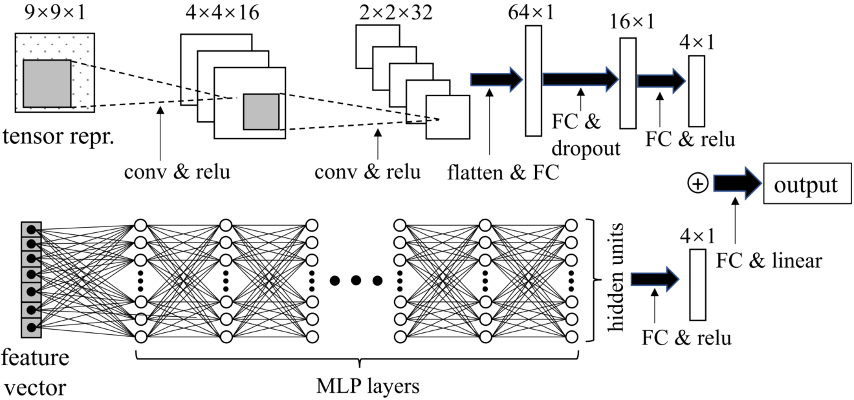
Regression Mechanisms for Performance Prediction
The optimizations of stencils on GPUs
The input features include three parts: candidate feature set (or assigned tensor) of a stencil, parameter setting
under a specific OC and GPU hardware characteristics (memory capacity and bandwidth, number of SMs, peak FLOPS).
ConvMLP using tensor representation
GBRegressor: utilizes gradient boosting to produce a prediction model for regression tasks
MLP: comprises an input layer, multiple hidden layers and an output layer that produces the predicted execution time for stencil instances
ConvMLP: combines CNN and MLP, where the CNN input is the assigned tensor
Notes:
This table shows the optimizations of stencils, also the constraints among the optimizations. We implement three regression mechanisms for performance prediction, including GBRegressor, MLP and ConvMLP. The input features include candidate feature set or assigned tensor of a stencil, parameter setting under a specific OC and GPU hardware characteristics. The GPU characteristics include memory capacity and bandwidth, number of SMs, peak FLOPS.
GBRegressor utilizes gradient boosting to produce a prediction model for regression tasks. MLP comprises an input layer, multiple hidden layers and an output layer that produces the predicted execution time for stencil instances. This figure shows the ConvMLP structure using tensor representation, which combines CNN and MLP, where the CNN input is the assigned tensor.

Slide 17
Outline
Background & Motivation
Stencil Computation & Optimization
Stencil Auto-tuning Mechanisms
Observations on Stencil Optimizations
Design & Methods
Random Stencil Generator & Stencil Representation
Optimization Selection & Performance Prediction
Evaluation
Experiment Setup
Performance Analysis
Related Work
Conclusion
Notes:
Next, I will introduce the evaluation of our methods.

Slide 18
Experiment Setup
Hardware and Software Platforms
Ubuntu 16.04 with CUDA v10.0 and cuDNN v7
TensorFlow v1.15, XGBoost v1.4.2
Randomly Generated Stencils
500 2-D and 500 3-D FP64 stencil programs
64,927 2-D and 76,240 3-D stencil instances
5-fold Cross Validation
Adam optimizer, convolution filter size (3×3)
Learning rate (0.0001, 0.0005), batch size (50, 256)
Comparison Metric
OC selection: prediction accuracy, performance speedup
Performance prediction: absolute percentage error (MAPE)
Methods for Comparison
Artemis [Rawat et al., IPDPS’19], AN5D [Matsumura et al., CGO’20]
The rental cost is taken from Google Cloud
Notes:
The GPUs used for evaluation are shown in Table 3. The rental cost of GPUs is taken from Google Cloud. We randomly generate 500 2-D and 500 3-D double-precision stencil programs using StencilMART, where the maximum stencil order is set to 4.
We use the 5-fold cross validation method to evaluate the accuracy of the models. For OC selection, we compare the predicted best OC with SOTA stencil frameworks including Artemis and AN5D, where the number of randomly selected parameter settings remains the same to ensure a fair comparison. For performance prediction, we use the mean absolute percentage error (MAPE) as the comparison metric.

Slide 19
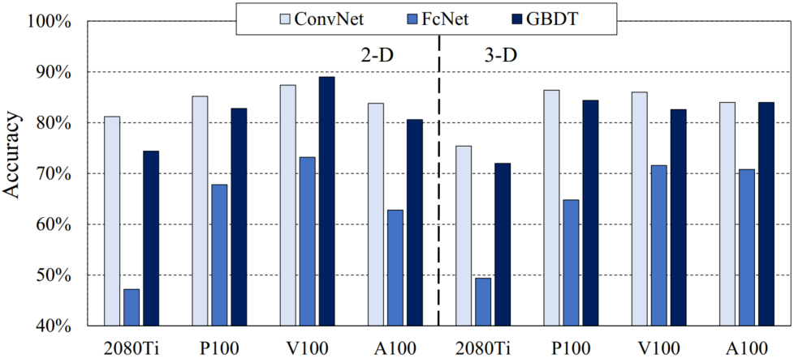
Results for OC Selection
Prediction accuracy of different classification mechanisms
ConvNet achieves the highest accuracy in general, with 84.4% and 83.0% for 2-D and 3-D stencils
GBDT performs slightly worse than ConvNet, achieving an average accuracy of 81.7% and 80.8%
The results indicate that the StencilMART quickly learns the stencil features and maintains convergence on all GPU generations.
Notes:
This figure shows the prediction accuracy of different classification mechanisms. As seen, ConvNet achieves the highest prediction accuracy in general, with 84.4% and 83.0% for 2-D and 3-D stencils. GBDT performs slightly worse than ConvNet, achieving an average accuracy of 81.7% and 80.8%. The results indicate that the StencilMART quickly learns the stencil features and maintains convergence on all GPU generations.

Slide 20
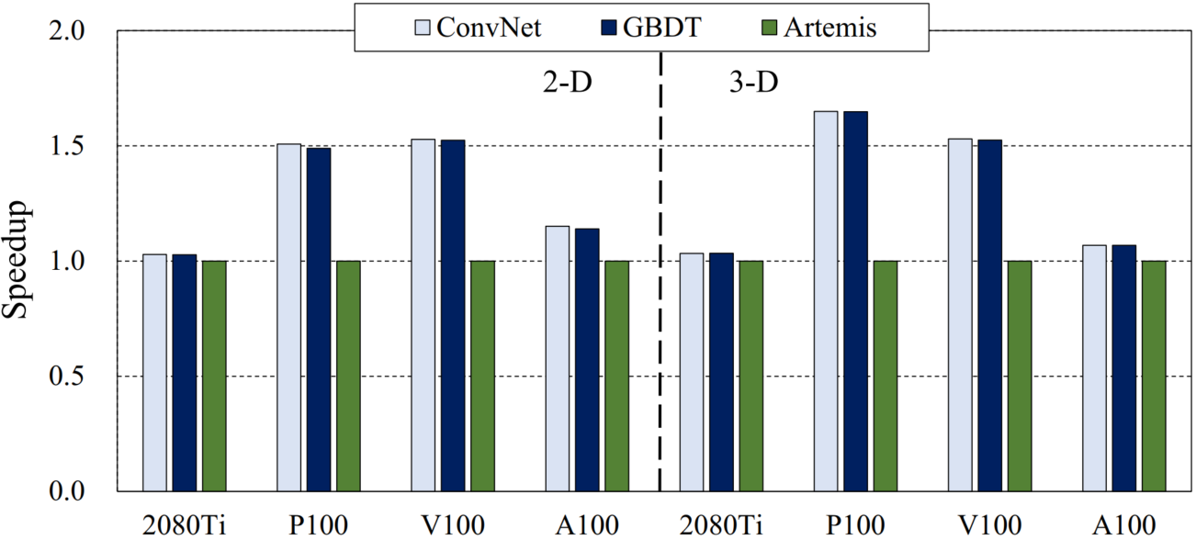
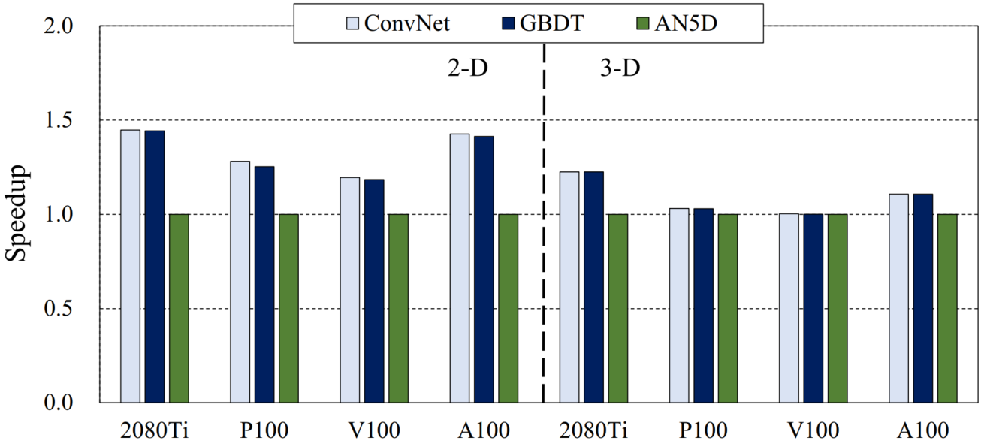
Results for OC Selection
Performance speedup of ConvNet and GBDT over Artemis and AN5D
The results indicate that no single OC fits all stencil programs, thus selecting the right OC is critical to achieving the high performance of stencil computations.
Both ConvNet and GBDT achieve higher performance than Artemis and AN5D on all GPU generations
ConvNet achieves an average speedup of 1.30× and 1.32× over Artemis, 1.33× and 1.09× over AN5D
Notes:
This figure shows the Performance Speedup of StencilMART over Artemis and AN5D. As seen, both ConvNet and GBDT achieve higher performance on all GPU generations. Specifically, ConvNet achieves an average speedup of 1.30× and 1.32× over Artemis, 1.33× and 1.09× over AN5D. The results indicate that no single OC fits all stencil programs, thus selecting the right OC is critical to achieving the high performance of stencil computations.

Slide 21
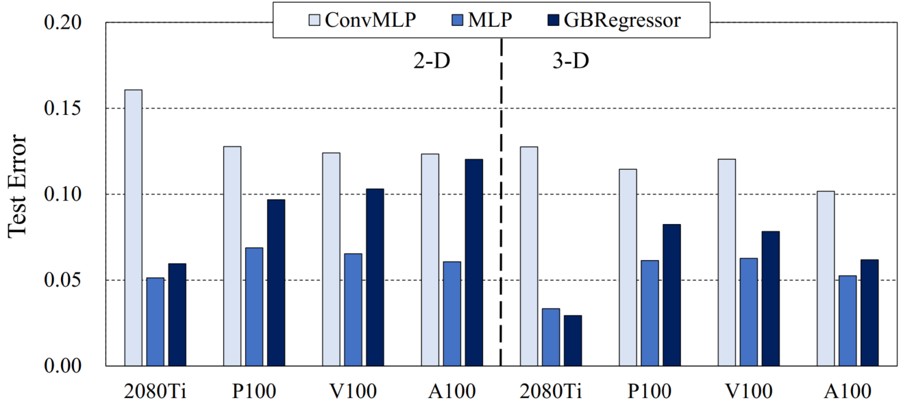
Results for Performance Prediction
Test error of different regression mechanisms
The results indicate that the StencilMART effectively extracts the features of stencil instances and GPU architectures that contribute to execution time.
All three mechanisms accurately predict the execution time of stencil computations
MLP outperforms others, with an average test error of 6.2% and 5.3% for 2-D and 3-D stencils
Notes:
This figure shows the test error of different regression mechanisms. As seen, all three mechanisms accurately predict the execution time of stencil computations. MLP outperforms others, with an average test error of 6.2% and 5.3% for 2-D and 3-D stencils. The results indicate that the StencilMART effectively extracts the features of stencil instances and GPU architectures that contribute to execution time.

Slide 22
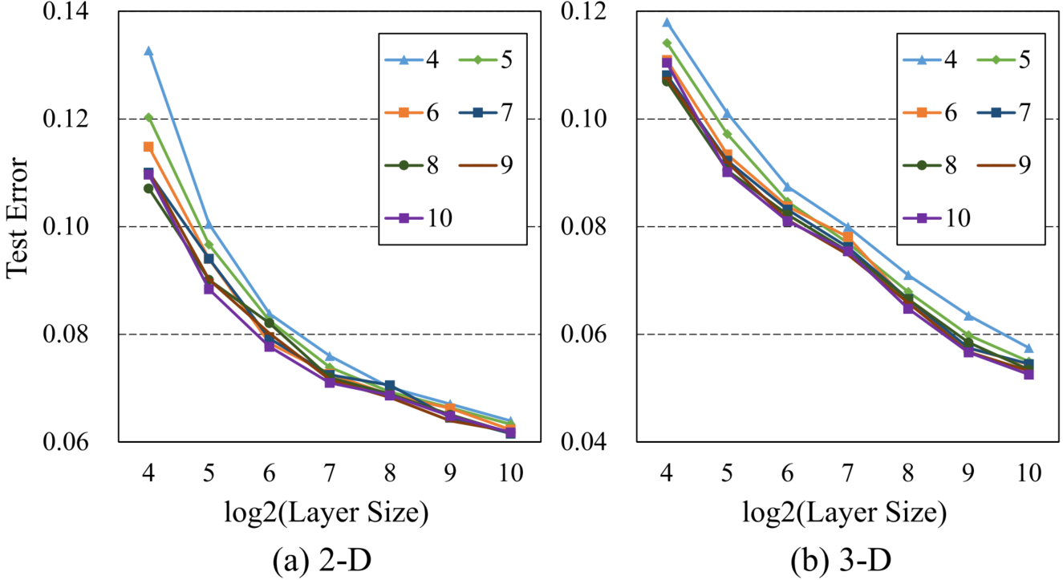
Results for Performance Prediction
Test error of MLP with varying layer numbers and layer sizes
In general, increasing the number of layers and their sizes leads to lower test errors for stencils
Increasing the number of layers beyond seven leads to diminishing returns on stencil computations
Notes:
This figure shows the test error of MLP with varying layer numbers and layer sizes. As seen, increasing the number of layers and their sizes leads to lower test errors. However, increasing the number of layers beyond seven leads to diminishing returns on stencil computations. Therefore, we can conclude that using seven layers for MLP is a reasonable choice.

Slide 23
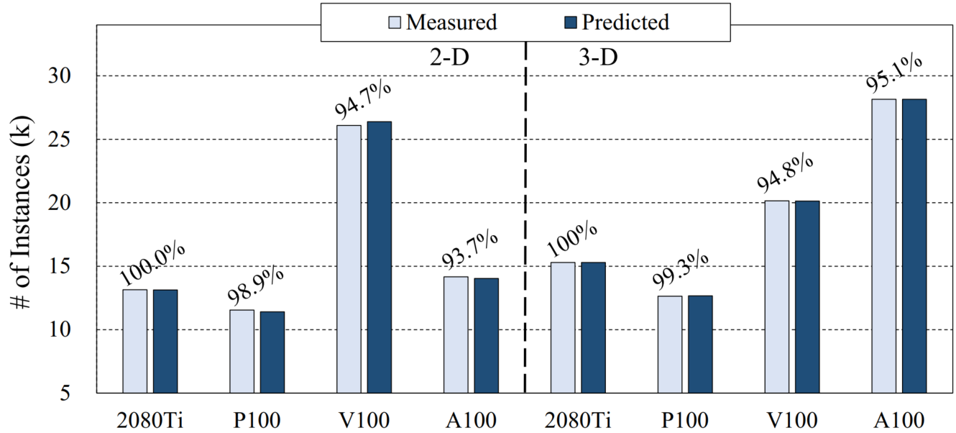
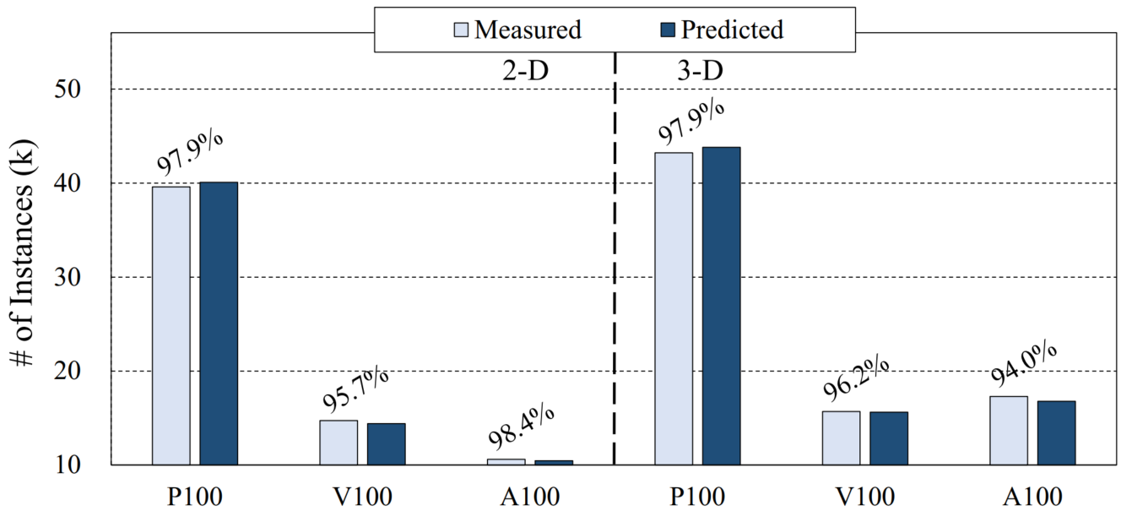
Case Study: To Rent or Not to Rent a Cloud GPU
The ground truth on stencil instances considering raw performance and cost efficiency
raw performance
cost efficiency
A100 GPU only accounts for 21.8% and 36.9% of 2-D and 3-D instances with the best performance
P100 GPU is the most cost-efficient to rent for most stencil instances (accounting for 61.0% and 56.7%)
The average prediction accuracies for raw performance and cost efficiency reach 97.0% and 96.7%
The results indicate that the StencilMART can correctly predict the most
performant or cost-efficient GPU, which in turn allows researchers to make the rental decision in an informed way.
Notes:
The figures show the ground truth on stencil instances considering raw performance and cost efficiency. The prediction accuracy is shown above each bar. As seen, A100 does not always achieve better performance, whereas P100 is the most cost-efficient to rent for most stencil instances. In addition, the prediction results indicate that the StencilMART can correctly predict the most performant or cost-efficient GPU, which in turn allows researchers to make the rental decision in an informed way.

Slide 24
Outline
Background & Motivation
Stencil Computation & Optimization
Stencil Auto-tuning Mechanisms
Observations on Stencil Optimizations
Design & Methods
Random Stencil Generator & Stencil Representation
Optimization Selection & Performance Prediction
Evaluation
Experiment Setup
Performance Analysis
Related Work
Conclusion
Notes:
Next, I will show some related works.

Slide 25
Related Work
Stencil DSLs and Optimizations
Research works exploit the integration of optimization schemes into Domain-Specific Languages (DSLs) to achieve automatic code transformation and optimization, such as [Maruyama et al., SC’11], [Zheng et al., MICRO’17], [Hagedorn et al., CGO’18], [Oh et al., PACT’20], etc.
None of the above DSLs support the optimization selection for stencil computation. The StencilMART can be integrated into these DSLs and quickly determine the best optimization combination for target stencils.
Performance Prediction on GPUs
Since it’s non-trivial to characterize the execution behavior of GPU kernels for efficient task scheduling, research works focus on performance prediction on GPUs, such as [Ardalani et al., MICRO’15], [Konstantinidis et al., JPDC’17], [Zhu et al., ATC’20], [Yu et al., ATC’21], etc.
To the best of our knowledge, this is the first work that targets the cross-architecture performance prediction for stencil computation.
Notes:
Stencil DSLs have been proposed to achieve automatic code transformation and optimization. However, none of the DSLs support the optimization selection for stencil computation. The StencilMART can be integrated into these DSLs and quickly determine the best optimization combination for target stencils.
Since it’s non-trivial to characterize the execution behavior of GPU kernels for efficient task scheduling, research works focus on performance prediction on GPUs. To the best of our knowledge, this is the first work that targets the cross-architecture performance prediction for stencil computation.

Slide 26
Outline
Background & Motivation
Stencil Computation & Optimization
Stencil Auto-tuning Mechanisms
Observations on Stencil Optimizations
Design & Methods
Random Stencil Generator & Stencil Representation
Optimization Selection & Performance Prediction
Evaluation
Experiment Setup
Performance Analysis
Related Work
Conclusion
Notes:
Finally, I will make the conclusion.

Slide 27
Conclusion
Optimization Prediction for Stencil Computation
Random stencil generator
Iteratively sample from low-order to high-order
Stencil representation
Tensor assignment & feature extraction
Optimization selection
Classification mechanisms: GBDT, ConvNet, FcNet
Performance prediction
Regression mechanisms: GBRegressor, ConvMLP, MLP
Experiment Results
Prediction comparison
Higher accuracy for optimization selection and performance prediction
Performance speedup
Predicted OC outperforms Artemis and AN5D
Notes:
In this work, we propose an automatic optimization selection framework that predicts the best OC and execution time for stencils on GPU. Our framework consists of random stencil generator, stencil representation, classification mechanisms for optimization selection and regression mechanisms for performance prediction. The experiment results show that the StencilMART can achieve accurate optimization selection and performance prediction, thus performance speedup over SOTA works.

Slide 28
Thanks! Q&A
Notes:
This concludes the presentation and I am available for questions.

