Slide 1
SFLU: Synchronization-Free Sparse LU
Factorization for Fast Circuit Simulation on GPUs
Jianqi Zhao¹ , Yao Wen¹ , Yuchen Luo¹ , Zhou Jin¹ , Weifeng Liu¹ and Zhenya Zhou²
1. Super Scientific Software Laboratory, Department of Computer Science and Technology, China University of Petroleum-Beijing, Beijing, China 2. Huada Empyrean Software Co. Ltd Beijing, China
Notes:
Hello everyone, I am so pleased to introduce our new method of Synchronization-Free Sparse LU Factorization for Fast Circuit Simulation on GPUs, named SFLU. Our co-authors are Yao Wen, Yuchen Luo, Dr Zhou Jin, Dr Weifeng Liu from Super Scientific Software Laboratory, China University of Petroleum-Beijing and Zhenya Zhou from Huada Empyrean Software Company. Limited Beijing, China.
My report is consist of this four parts。

Slide 2
Background & Motivation
SFLU
Experimental Results
Conclusion

Slide 3
Background & Motivation
SFLU
Experimental Results
Conclusion

Slide 4
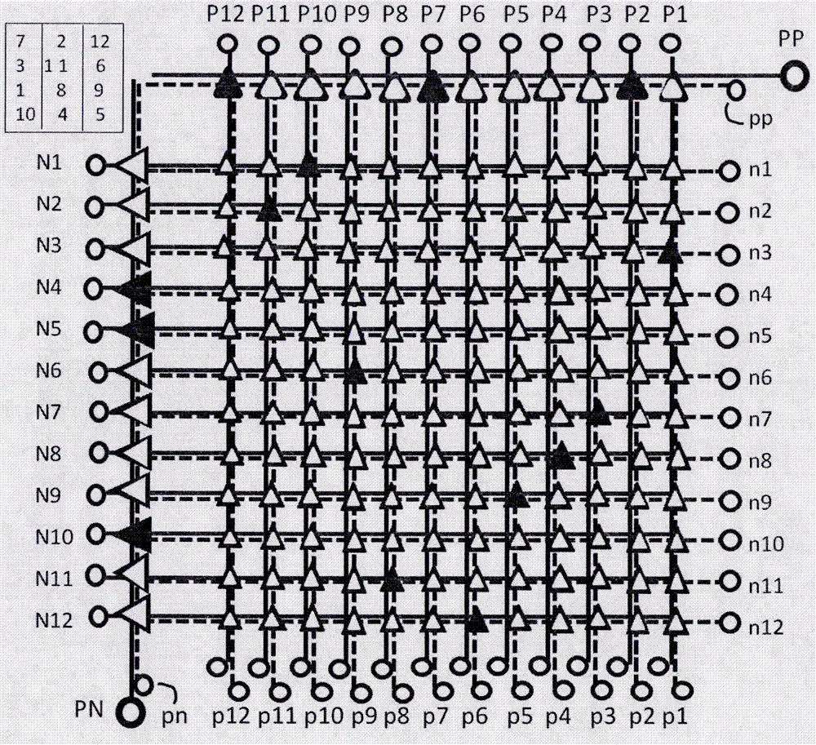
Circuit Simulation
With the rapid development of the IC and computer technologies, EDA has become an important subject in the electronics area.
As one of the core parts of EDA techniques, SPICE-like circuit simulation is an essential step.
In the SPICE-like circuit simulation flow, the sparse LU factorization is usually very time-consuming.
Notes:
First, let’s talk about the circuit simulation.
With the rapid development of the IC and computer technologies, EDA has become an important subject in the electronics area. As one of the core parts of EDA techniques, SPICE-like circuit simulation is an essential step. In the SPICE-like circuit simulation flow, the sparse LU factorization is usually very time-consuming. So it is necessary to do something to optimize LU factorization.

Slide 5
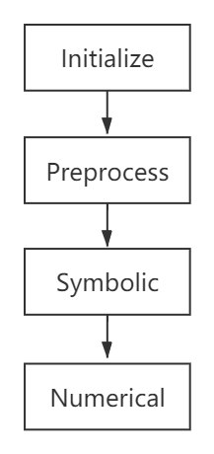
Sparse LU Factorization
LU factorization is the direct method of choice for solving unsymmetric linear systems.
The matrix is sparse (there are a large number of zero elements)
Non-zero elements will be added during the solution process
Notes:
The sparse LU factorization is the direct method of choice for solving unsymmetric linear systems.
decomposes a sparse matrix A into the product of a unit lower triangular sparse matrix L and an upper triangular sparse matrix U. Non-zero elements will be added during the solution process. The process of LU Factorization can be divided into this four steps.

Slide 6
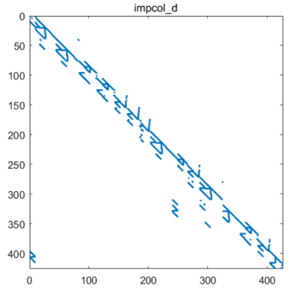
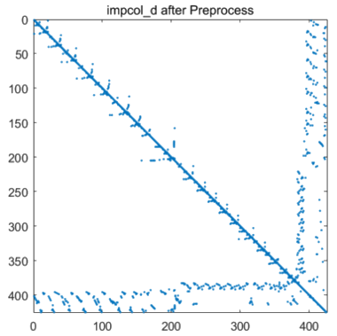
Preprocessing
We use two reordering algorithms^{[1]} to get a new nonzero structure form of the matrix.
MC64 algorithm^{[2]}： confirm static principal elements
AMD algorithm^{[3]}： reduce non-zero element padding
Preprocess
[1]. Chen X, Wang Y, Yang H, “Parallel Sparse Direct Solver for Integrated Circuit Simulation,”
[M]. Springer International Publishing, 2017.
[2]. Duff, I.S., Koster, J., “The design and use of algorithms for permuting large entries to the
diagonal of sparse matrices,” SIAM J. Matrix Anal, 1999.
[3]. Amestoy,P.R.,Davis,T.A.,Duff,I.S., “Algorithm837:AMD,an approximate minimum degree
ordering algorithm,” ACM Trans. Math, 2004.
Notes:
The preprocessing part,
We use two sorting algorithms to get a new matrix form just like the picture shows. We will use this new matrix form to do Symbolic Factorization.

Slide 7
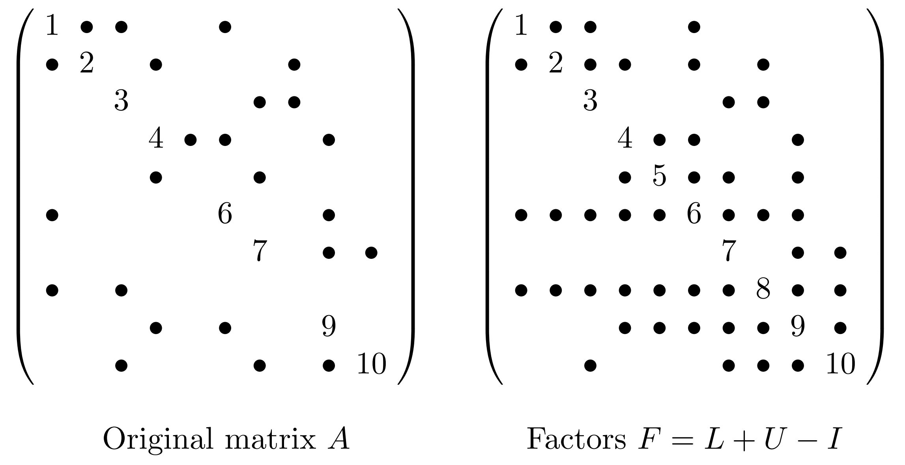
Symbolic Factorization
The symbolic factorization is to predict the nonzero structure of matrix L and U.
[4]. Demmel, James W , Eisenstat, et al, “A supernodal approach to sparse partial pivoting,” [J].
SIAM Journal on Matrix Analysis & Applications, 1999.
Notes:
The symbolic factorization
is to forecast the nonzero structure of the Cholesky factor. Just like I say just now, due to the matrix is sparse, non-zero elements will be added during the solution process. The symbolic factorization will allocate memory for numeric factorization based on the nonzero structure.

Slide 8
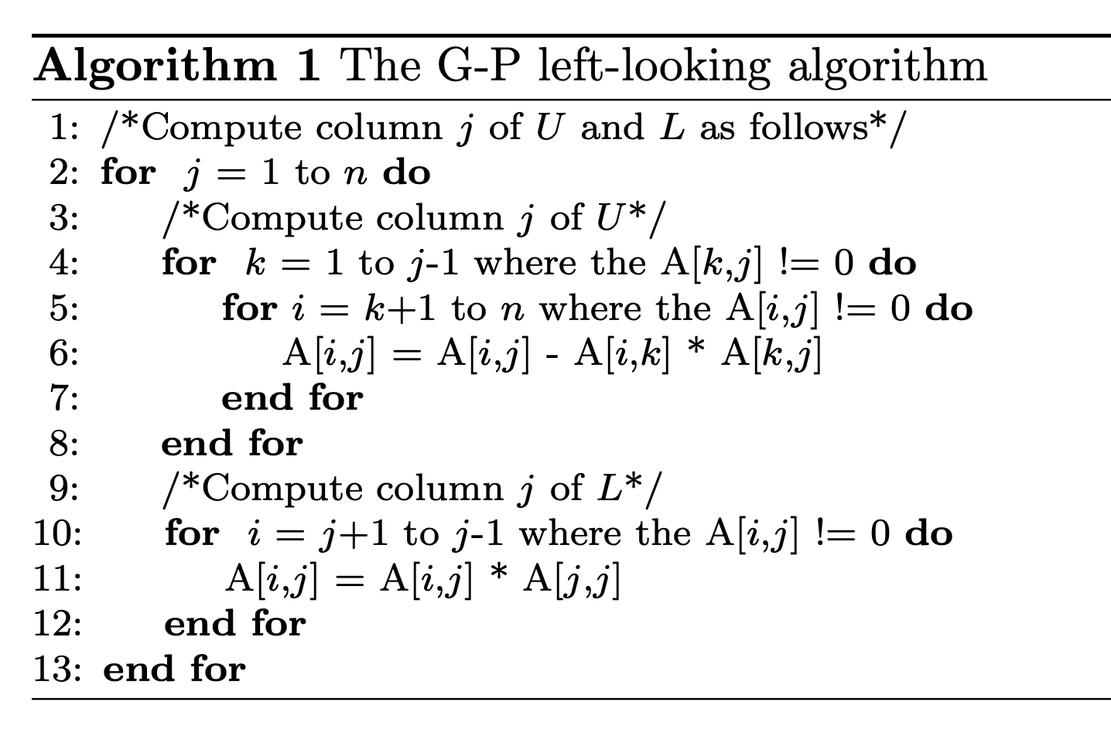
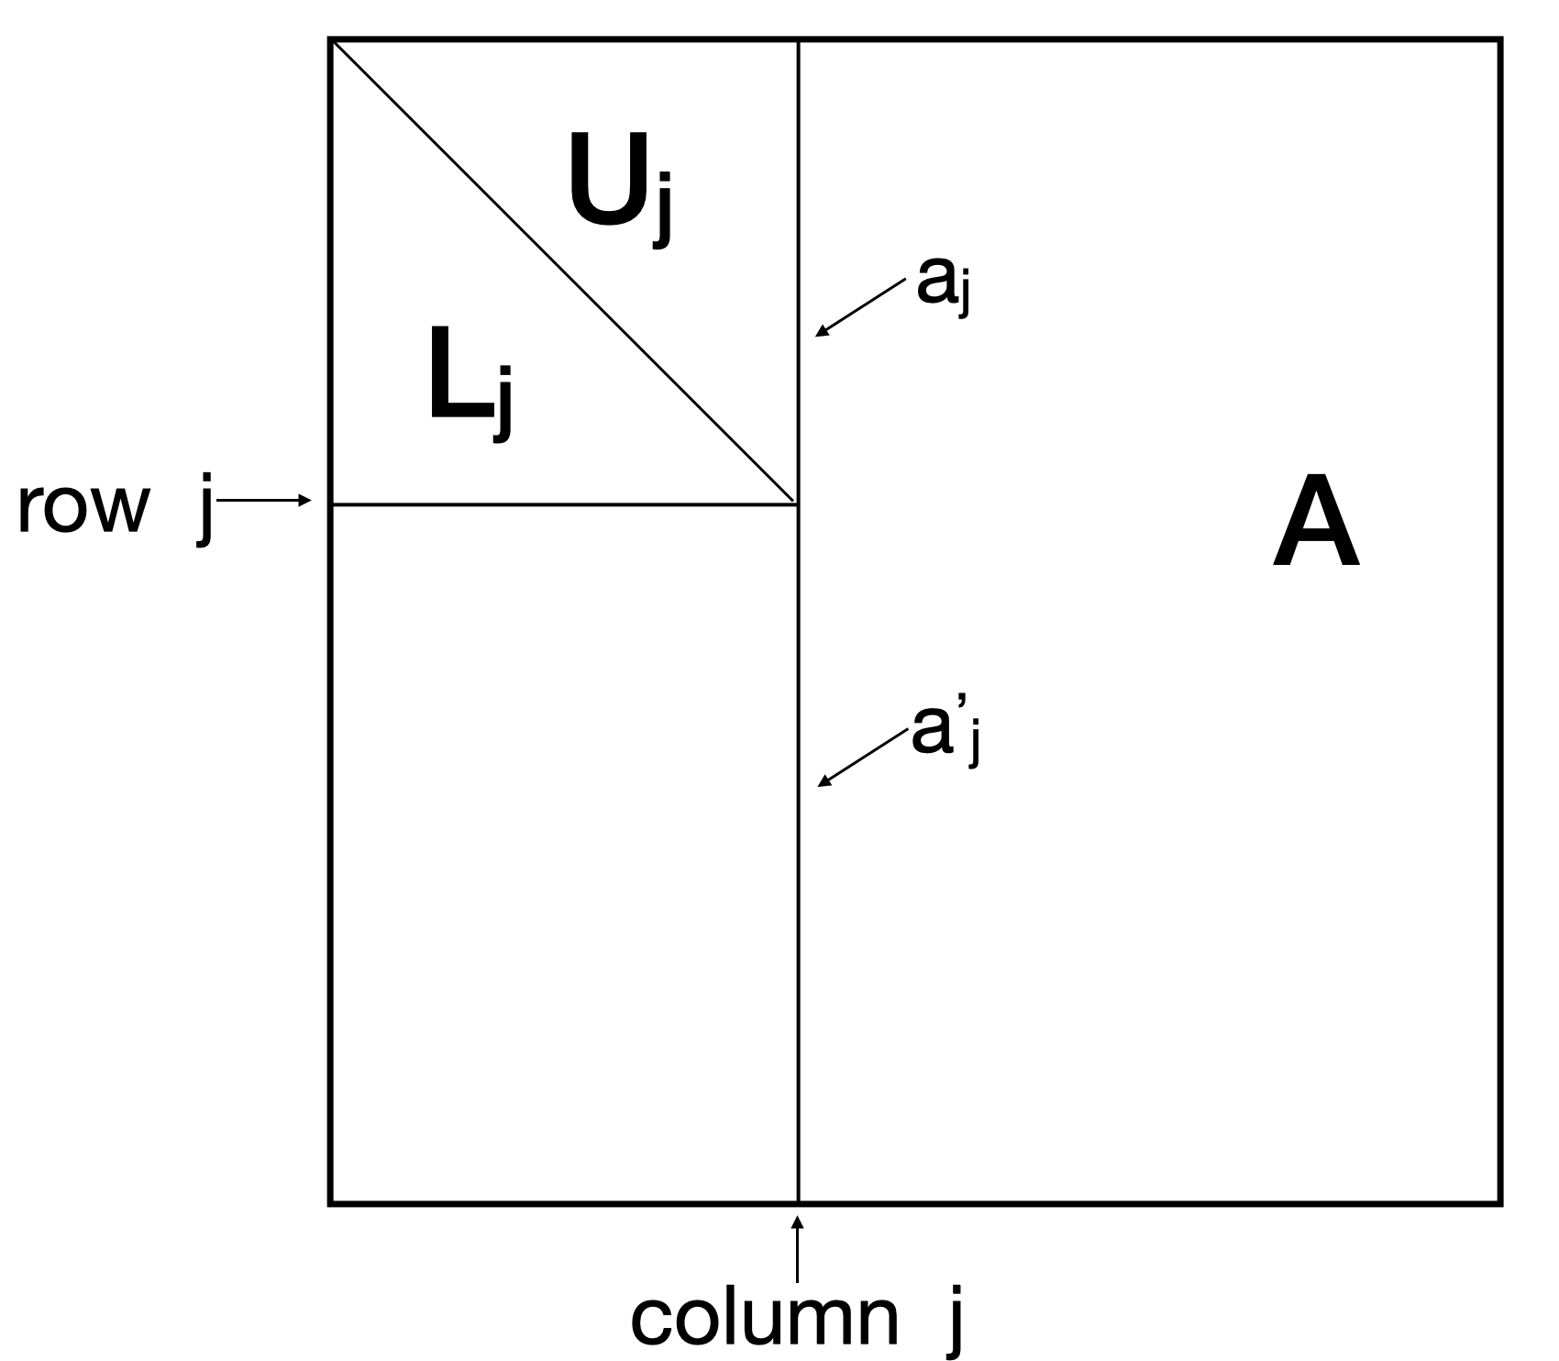
Numeric Factorization ( left-looking )
The numeric factorization is to compute the value of all the elements.
[5]. Gilbert, J.R., Peierls, T., “Sparse partial pivoting in time proportional to arithmetic operations,”
SIAM J. Sci. Statist. Comput., pages 862–874, 1988.
Notes:
The numeric factorization is to compute the value of all the elements.
This slide show the G-P left-looking algorithm. Its features is that completing the solution of one column in each loop. It has strict data dependence which the premise of decomposing one column is that all the column before this one is ready.

Slide 9
Motivation
Using GPU for general computing has become a research hotspot in recent years.
There are two ways to utilize GPUs for sparse LU.
Name | Strategy | Characteristic
SuperLU^{[4]} | Running GPU-version dense matrix-matrix multiplication on (often small) matrices generated from supernodal pattern. | Can not use GPU for scheduling to save the cost for kernel relaunching and cache data flushing.
GLU^{[6]} | Finding dependencies between columns, generating levels, and using level scheduling method for running multiple columns in the same level on GPUs concurrently.
? | ? | Can use GPU for scheduling.
[4]. Demmel, James W , Eisenstat, et al, “A supernodal approach to sparse partial pivoting,” [J]. SIAM
Journal on Matrix Analysis & Applications, 1999.
[6]. Wai-Kong L , Ramachandra A , Nakhla M S, “Dynamic GPU Parallel Sparse LU Factorization for
Fast Circuit Simulation,“ IEEE Transactions on Very Large Scale Integration (VLSI) Systems, 2018
Notes:
So as we know,
Sparse LU factorization is very difficult to parallelize it on GPU. GLU is one of them, has only implemented numerical decomposition on the GPU, while the symbol decomposition is still on the CPU. On the other hand, the strategy GLU used called level-set has its disadvantage. A level has to wait until its previous levels are completed. It thus may cause much useless waiting time. Especially for some matrices with a large amount of level-sets. This motivates us to design a new method that can avoid the synchronization costs.

Slide 10
SFLU
Experimental Results
Conclusion
Notes:
We propose SFLU algorithm to do that.

Slide 11
Basic Idea of Synchronization-Free Method
: to do
: busy waiting
Thread block 1
Thread block 3
Global memory
Thread block 2
Thread block 4
Due to the logic between symbolic and numeric factorization are similar. we only use the symbolic factorization to introduce our algorithm.
Notes:
First, let’s see what the Basic Idea of Synchronization-Free Method is.
In this method, a global memory space is allocated in advance, and the working state of a CUDA thread block is determined by a value in this global memory space. During the running of the program, all thread blocks can access this global memory space. The value will also change as the thread block’s task is completed, which in turn changes the working states of other thread blocks until the whole task is finished. So the thread blocks are self scheduled, higher parallelism can be obtained.

Slide 12
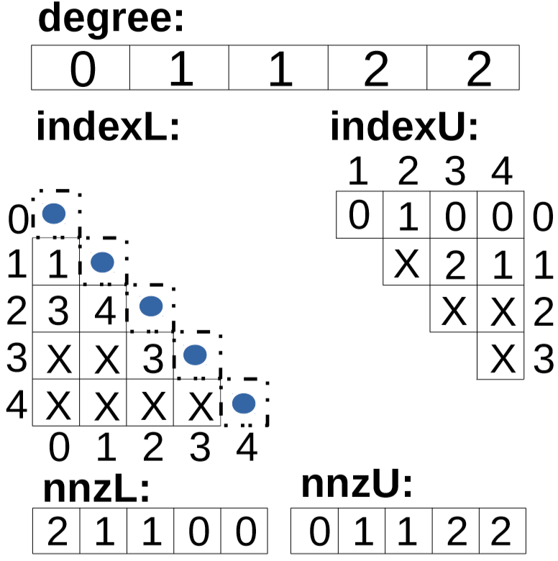
Initial state
SFLU
Elements above the diagonal line of the row k can be eliminated.
0 | 1 | 1 | 2 | 2
0
1
2
3
4
: to do
: busy waiting
: new fill-in
Degree represents the number of uneliminated elements in each column.
0 1 2 3 4
The index represents the row index of each element.
All the elements above the diagonal of column k are eliminated.
NnzL and nnzU represents the number of elements in each column of L and U.
Notes:
In Initial state, we Introduce some Array to make it easy to understand.
NnzL and nnzU represents the number of elements in each column of L and U. Index represents the row index of each element. We introduce a global array degree, which is of length n, where n is the order of the matrix A. The values in degree corresponds to the number of elements not deleted above the diagonal of each column. From the data dependence, we can know that when all the elements above the diagonal of a column k are eliminated (at this time, degree[k] = 0), the elements above the diagonal line of the row k can be eliminated based on this column

Slide 13
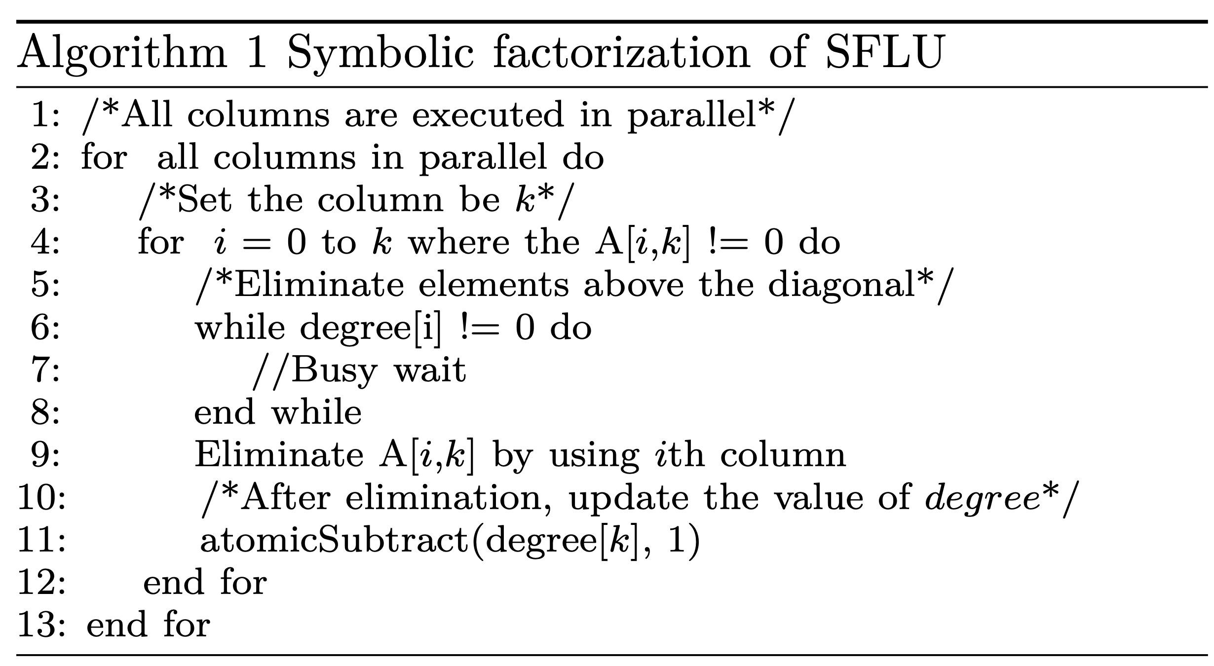
SFLU
: to do
: busy waiting
: new fill-in
0
1
2
3
4
0 1 2 3 4
Three warps are working
We use the storage order of indexU to determine the decomposition object of each thread block.
Each unfinished thread block should have an object.
Four objects.
Notes:
We use a 5x5 matrix example to introduce the processing logic of the symbolic factorization. We can see from this pseudo code, that all columns are executed in parallel. Each thread block is responsible for decomposition of a colum. We use the storage order of indexU to determine the decomposition object of each thread block. Each unfinished thread block should have an object. There are 4 objects.

Slide 14
SFLU
: to do
: busy waiting
: new fill-in
0
1
2
3
4
0 1 2 3 4
Three warps are working
One element will be busy waiting.
Notes:
Well, the degree[1] is not equal to 0, so there is one element will be busy waiting.

Slide 15
SFLU
: to do
: busy waiting
: new fill-in
0
1
2
3
4
0 1 2 3 4
Three warps are working
One element will be busy waiting.
Three elements will be eliminated.
Notes:
And the other three elements will be eliminated.

Slide 16
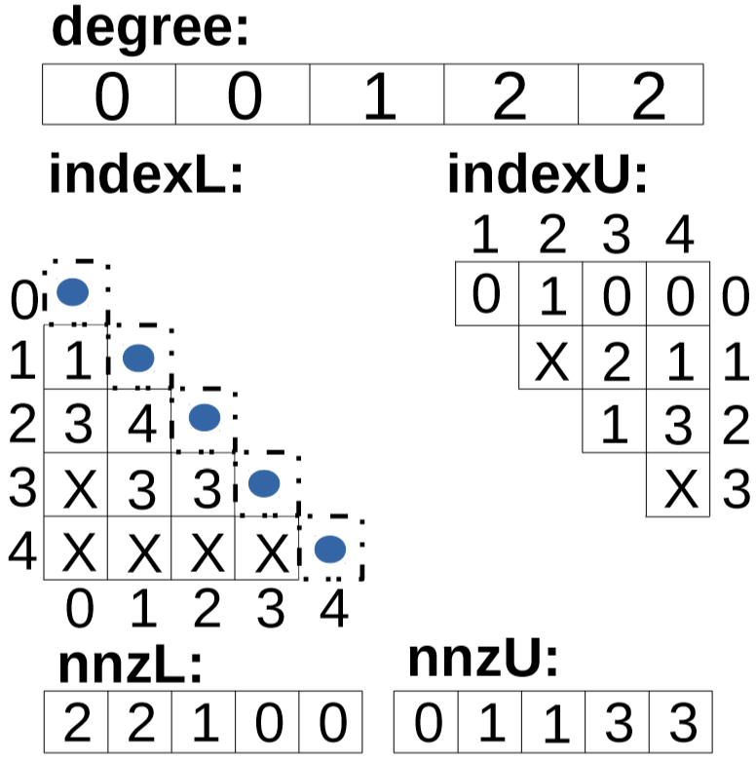
SFLU
: to do
: busy waiting
: new fill-in
0
1
2
3
4
0 1 2 3 4
Three nonzero elements were filled in.
Degree[1] Changed.
Notes:
After eliminating, three nonzero elements were filled in. Degree[1] changed. By the way, other array such as indexL and indexU ,nnzL and nnzU is updated too.

Slide 17
SFLU
: to do
: busy waiting
: new fill-in
0
1
2
3
4
0 1 2 3 4
Three objects.
Notes:
Next loop, there are thread block unfinshed, so there are three objects. By the way, we can see the location of storage the fill-ins is the end of the indexU. So due to the order of the indexU, the object of the column 3 is in row 2 rather than row 1.

Slide 18
SFLU
: to do
: busy waiting
: new fill-in
0
1
2
3
4
0 1 2 3 4
One element will be busy waiting.
Notes:
Well, the degree[2] is not equal to 0, so there is one element will be busy waiting.

Slide 19
SFLU
: to do
: busy waiting
: new fill-in
0
1
2
3
4
0 1 2 3 4
Two warps are working
One element will be busy waiting.
Two elements will be eliminated.
Notes:
The other two elements will be eliminated.

Slide 20
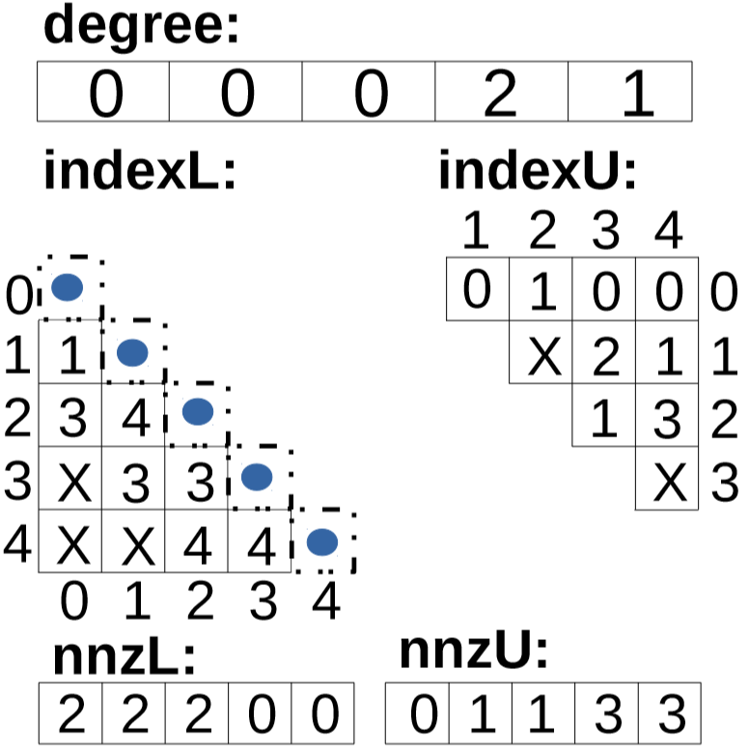
SFLU
: to do
: busy waiting
: new fill-in
0
1
2
3
4
0 1 2 3 4
One nonzero element was filled in.
Degree[2] Changed.
Degree[4] Changed.
Notes:
One nonzero element was filled in.
Degree[2] Changed.
Degree[4] Changed.

Slide 21
SFLU
: to do
: busy waiting
: new fill-in
0
1
2
3
4
0 1 2 3 4
Two objects.
Notes:
there are two thread blocks unfinished, so there are two objects.

Slide 22
SFLU
: to do
: busy waiting
: new fill-in
0
1
2
3
4
0 1 2 3 4
One element will be busy waiting.
Notes:
Due to the degree[4] is not 0, One element will be busy waiting.

Slide 23
SFLU
: to do
: busy waiting
: new fill-in
0
1
2
3
4
0 1 2 3 4
One warp is working
One element will be busy waiting.
One element will be eliminated.
Notes:
One element will be eliminated.

Slide 24
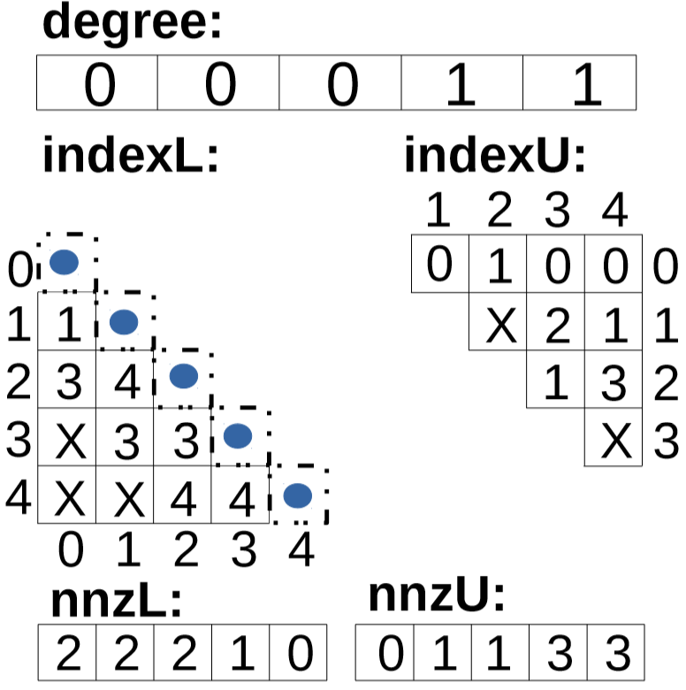
SFLU
: to do
: busy waiting
: new fill-in
0
1
2
3
4
0 1 2 3 4
One nonzero element was filled in.
Degree[3] Changed.
Notes:
One nonzero element was filled in.
Degree[3] Changed.

Slide 25
SFLU
: to do
: busy waiting
: new fill-in
0
1
2
3
4
0 1 2 3 4
Two objects.
Notes:
Two objects.

Slide 26
SFLU
: to do
: busy waiting
: new fill-in
0
1
2
3
4
0 1 2 3 4
One element will be busy waiting.
Notes:
One element will be busy waiting.

Slide 27
SFLU
: to do
: busy waiting
: new fill-in
0
1
2
3
4
0 1 2 3 4
One warp is working
One element will be busy waiting.
One element will be eliminated.
Notes:
One element will be busy waiting.
One element will be eliminated.

Slide 28
SFLU
: to do
: busy waiting
: new fill-in
0
1
2
3
4
0 1 2 3 4
No nonzero element was filled in.
Degree[3] Changed.
Notes:
No nonzero element was filled in.
Degree[3] Changed.

Slide 29
SFLU
: to do
: busy waiting
: new fill-in
0
1
2
3
4
0 1 2 3 4
One object.
Notes:
One object.

Slide 30
SFLU
: to do
: busy waiting
: new fill-in
0
1
2
3
4
0 1 2 3 4
One warp is working
One element will be eliminated.
Notes:
One element will be eliminated.

Slide 31
SFLU
: to do
: busy waiting
: new fill-in
0
1
2
3
4
0 1 2 3 4
No nonzero element was filled in.
Degree[4] Changed.
Notes:
No nonzero element was filled in.
Degree[4] Changed.

Slide 32
SFLU
: to do
: busy waiting
: new fill-in
0
1
2
3
4
0 1 2 3 4
All the work is done!!!
Notes:
All the work is done!!!

Slide 33
Background & Motivation
SFLU
Experimental Results
Conclusion

Slide 34
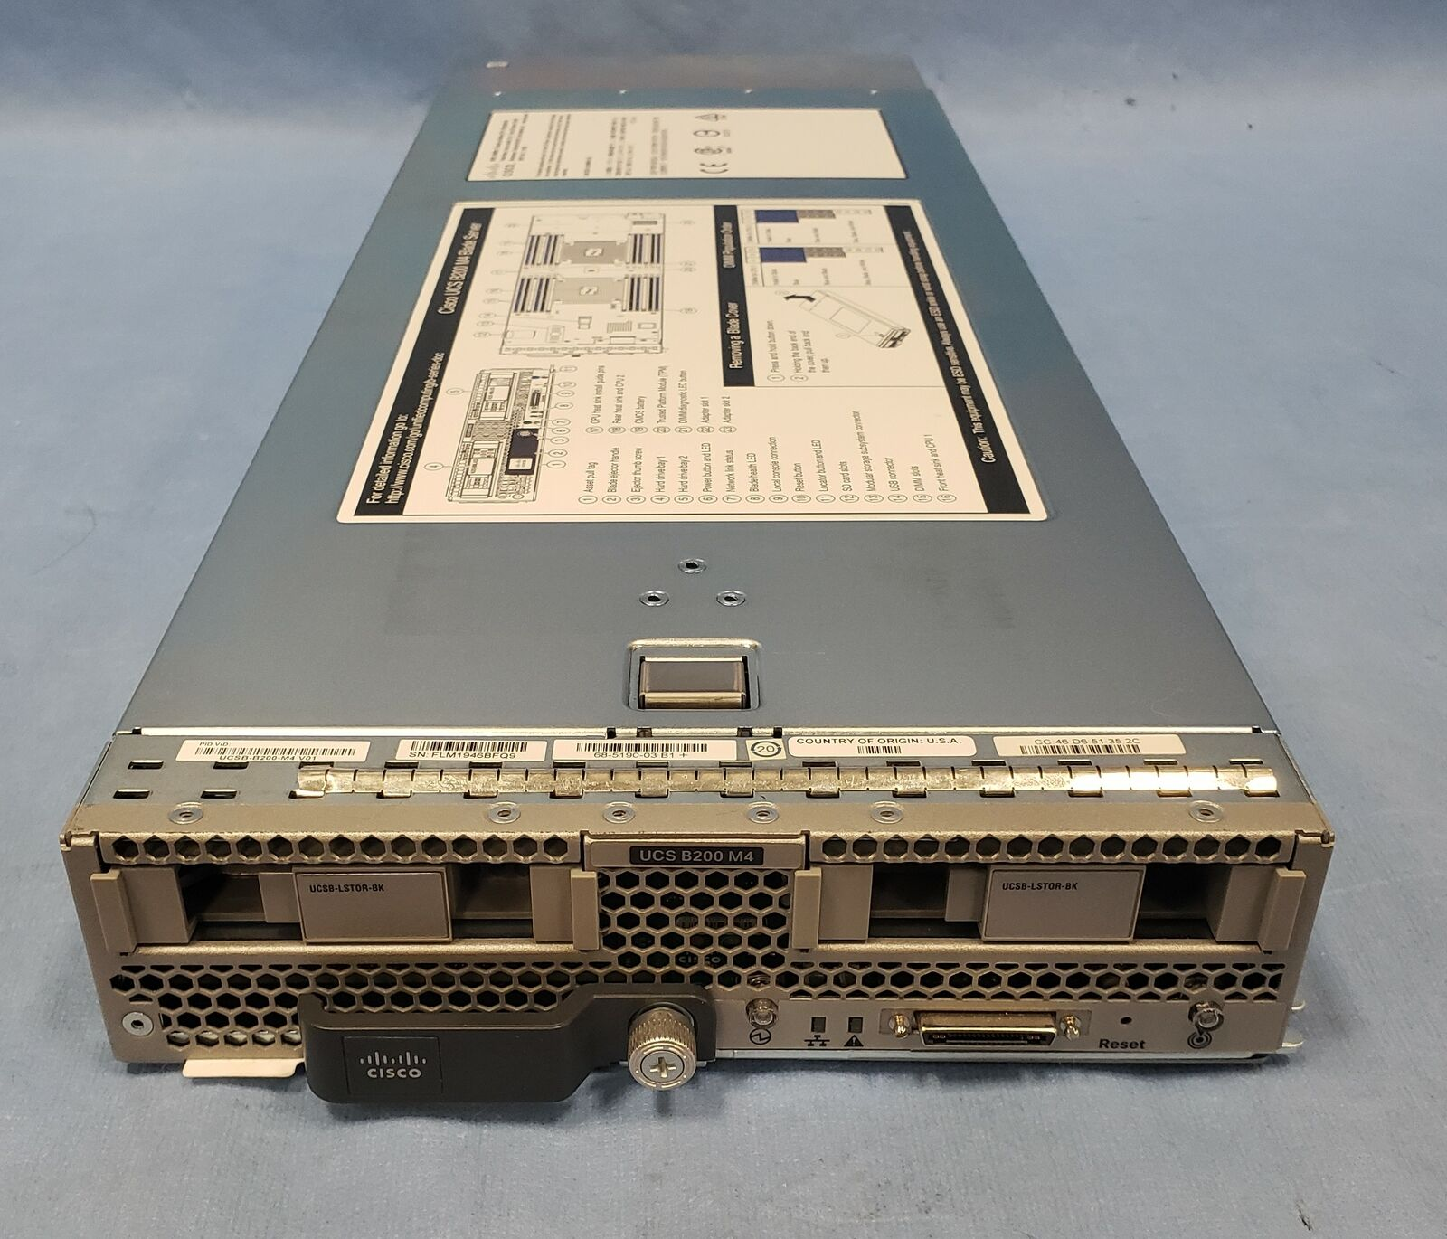
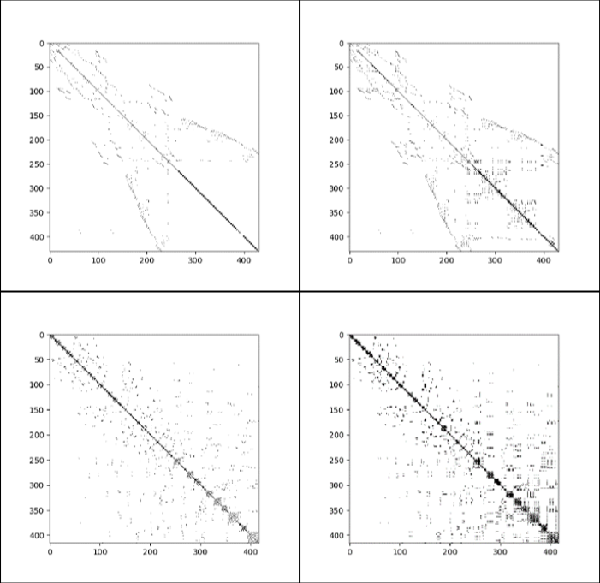
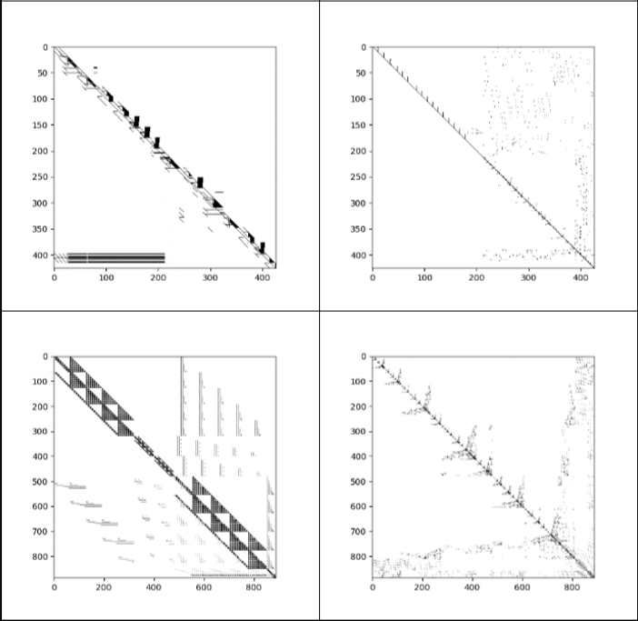
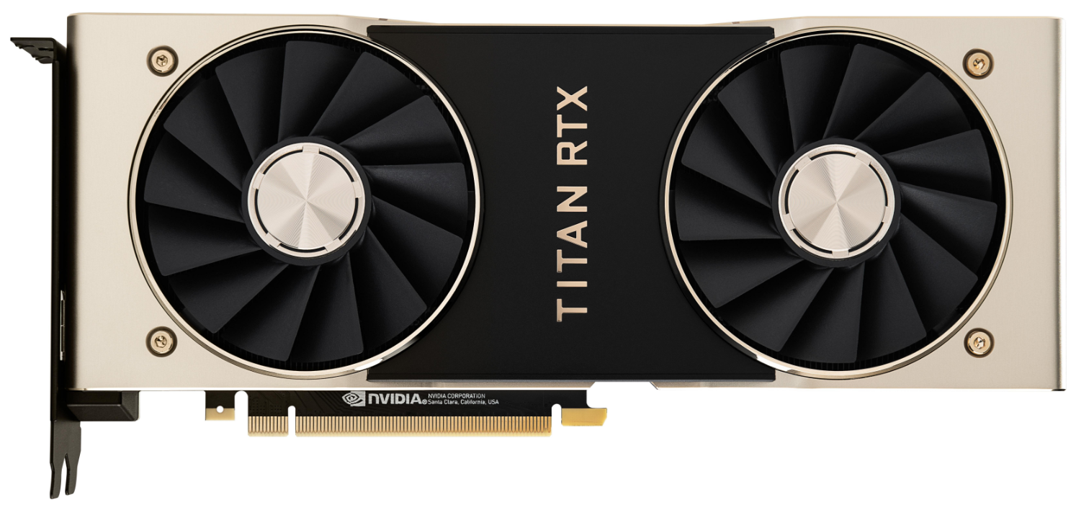
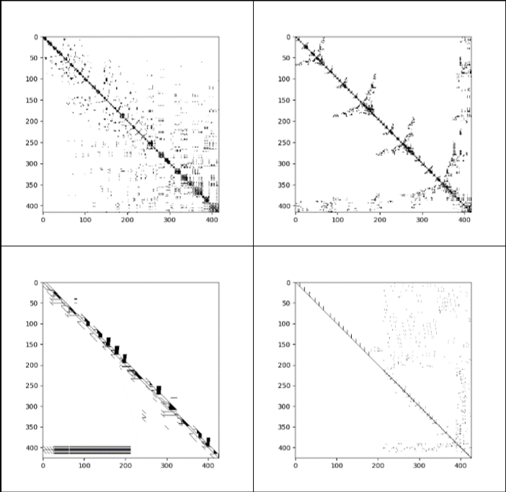
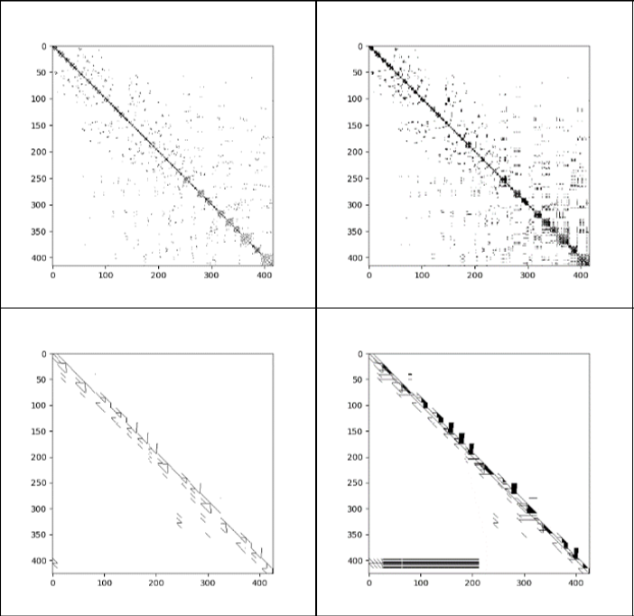
Experimental Setup
Titan RTX (Turing)
4608 CUDA cores
@1770MHz，24GB, B/W 672GB/S
Intel 20-core machine
2x Intel Xeon 10-Core
E5-2660v3 @ 2.6GHz
Test matrix
1309 sparse matrices downloaded from the SuiteSparse Matrix Collection

Slide 35
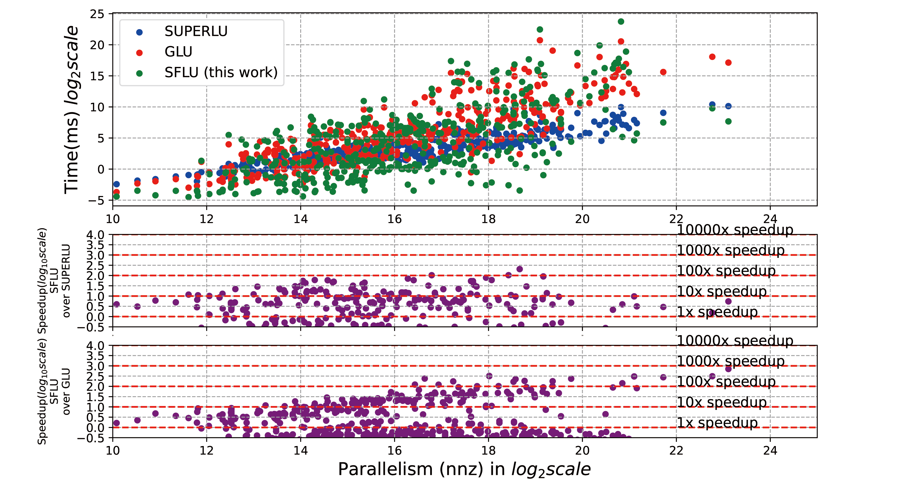
Experimental Results (Symbolic)
Our SFLU algorithm has obvious performance gain.
For some matrices originally with limited parallelism and many fill-ins, the serial method which SuperLU and GLU used, can give the best performance.
Compared with SuperLU and GLU, the highest speedup is 205.14 and 701.

Slide 36
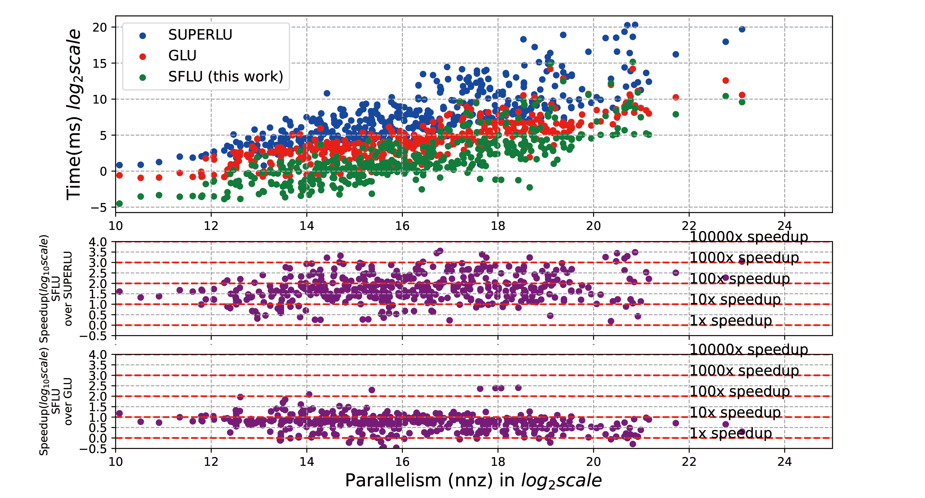
Experimental Results (Numeric)
In this part, the performance level of the three algorithms is very obvious, and SFLU is the best.
Compared with SuperLU and GLU, the highest speedup is 3585.2 and 252.2.

Slide 37
Experimental Results (Circuit Matrix Performance)
First, in the symbolic factorization part, SFLU has a good performance. Compared with GLU and SuperLU, the highest speedup is 37.73 and 1.97.
Second, in the numeric factorization part, SFLU is mostly better than the other two algorithms. Compared with GLU and SuperLU, the highest speedup is 6.09 and 287.61.
We can conclude that our SFLU gives state-of-the-art performance for circuit matrices.

Slide 38
Background & Motivation
SFLU
Experimental Results
Conclusion

Slide 39
Conclusion
SFLU deals with synchronizations through communicating on global memory with atomic operations on GPUs.
SFLU avoided the global synchronizations and increased the amount of parallelizable work for GPUs.
The experimental results demonstrated that SFLU is on average 155.7 and 8.21 (up to 3585.2 and 252.5) faster than SuperLU and GLU packages, respectively.

Slide 40
Background & Motivation
SFLU
Experimental Results
Conclusion

