Slide 1
NPC 2020
The 17th Annual IFIP International Conference on Network and Parallel Computing
Online, September 28-30, 2020
NUMA-Aware Optimization of
Sparse Matrix-Vector Multiplication on
ARMv8-based Many-core Architectures
Authors ：Xiaosong Yu ¹, Huihui Ma ¹, Zhengyu Qu ¹, Jianbin Fang ², Weifeng Liu ¹
¹ Super Scientific Software Laboratory, Department of Computer Science and
Technology, China University of Petroleum-Beijing
² Institute for Computer Systems, College of Computer, National University of
Defense Technology
2019215847@student.cup.edu.cn, 2019211254@student.cup.edu.cn,
2019215846@student.cup.edu.cn, j.fang@nudt.edu.cn, weifeng.liu@cup.edu.cn

Slide 2
Sparse Matrix-Vector Multiplication
Part 1
Sparse Matrix-Vector Multiplication
NUMA
Part 2
Contents
Part 3
Hypergraph Partitioning
NUMA-Aware SpMV Alogrithm
Part 4
Part 5
Performance and Analysis

Slide 3
Part 1
Sparse Matrix-Vector Multiplication

Slide 4
Part 1. Sparse Matrix-Vector Multiplication
 | 5 | 2
6 |  | 8 | 3
 |  | 4
 | 7 | 1
1
2
3
4
16
42
12
17
x
=
A
（4x4）
x
（4x1）
y
（4x1）
The sparse matrix-vector multiplication (SpMV) operation multiples a sparse matrix A with a dense vector x and gives a resulting dense vector y.

Slide 5
Part 2
NUMA

Slide 6
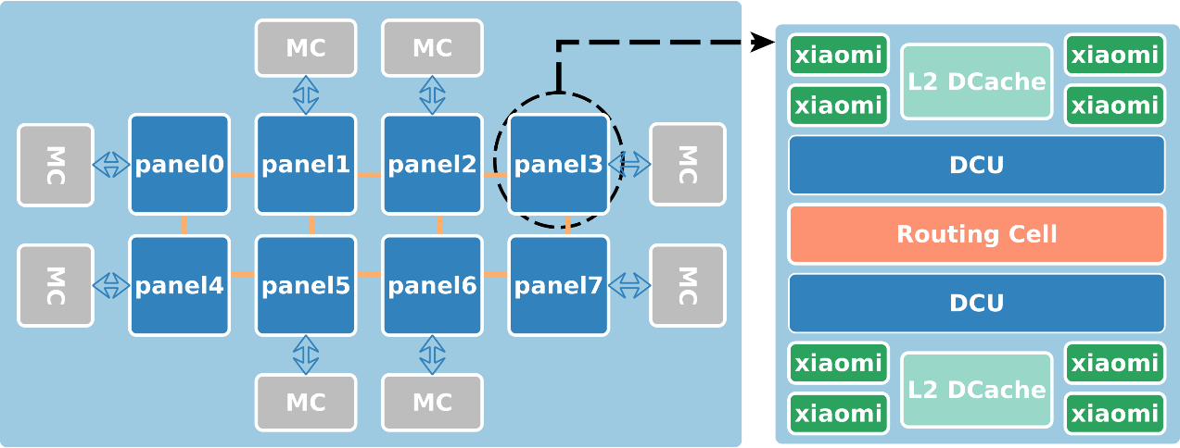
Part 2. NUMA
NUMA architectures can obtain scale-out benefits on modern multi-core and many-core processors. Most modern x86 processors and ARM processors utilize NUMA architecture for building a processor with tens of cores.
NUMA

Slide 7
Part 2. NUMA
Fig. 1. Architecture of the Phytium 2000+ processor
It uses the Mars II ^{[1]} architecture, and features 64 high-performance ARMv8 xiaomi cores running at 2.2GHz. The 64 hardware cores are organized into 8 panels, where each panel connects a memory control unit. The entire chip offers a peak performance of 563.2 Gflops for double-precision operations.
[1]Phytium: Mars ii - microarchitectures. https://en.wikichip.org/wiki/phytium/microarchitectures/mars_ii.

Slide 8
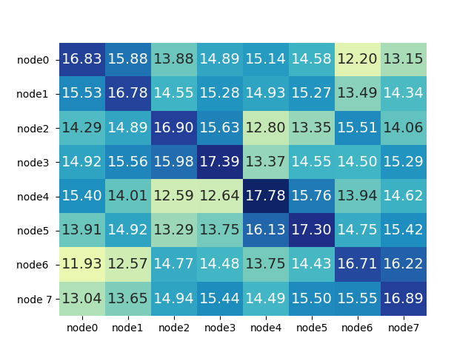
Part 2. NUMA
We measure NUMA-Aware bandwidth of Phytium 2000+ by running a Pthread version of the STREAM bandwidth code. The results show that
(1) The bandwidth results inside the same NUMA node are the highest.
(2) The bandwidth results between difference nodes are much lower.
Fig. 2. STREAM triad bandwidth microbenchmark on Phytium 2000+, the heatmap values are in GB/s

Slide 9
Part 2. NUMA
 | 5 | 2
6 |  | 8 | 3
 |  | 4
 | 7 | 1
1
2
3
4
Node0
x
A
（4x4）
x
（4x1）
The character of NUMA architecture brings problems: the data locality of accessing x is poor.

Slide 10
Part 3
Hypergraph Partitioning

Slide 11
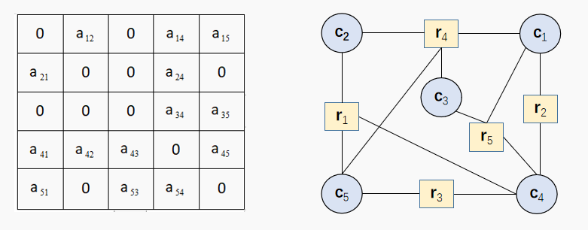
Part 3. Hypergraph Partitioning
Hypergraph can be seen as a general form of graph. A hypergraph is often denoted by H = (V, E), where V is a vertex set, and E is a hyperedge set. A hyperedge can link more than two vertices, which is different to an edge in a graph. A hypergraph can also correspond to a sparse matrix through the row-net model ^{[2]} (columns and rows are vertices and hyperedges, respectively).
Fig. 3. Correspondence between sparse matrix (left) and hypergraph (right)
[2] Kucar, Dorothy, Shawki Areibi, and Anthony Vannelli. "Hypergraph partitioning techniques." DYNAMICS OF CONTINUOUS DISCRETE AND IMPULSIVE SYSTEMS SERIES A 11 (2004).

Slide 12
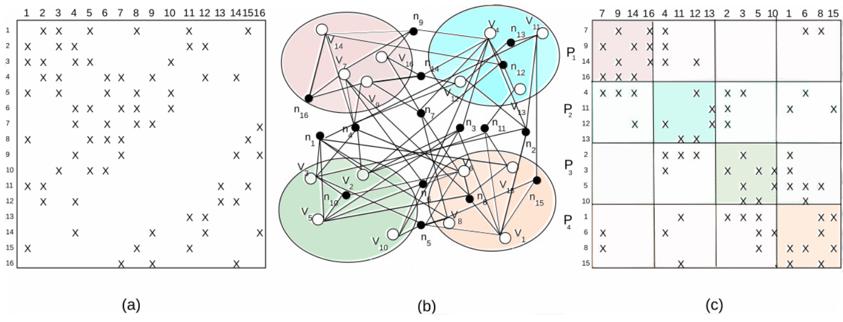
Part 3. Hypergraph Partitioning
Fig. 4. Hypergraph partitioning
(a) An original sparse matrix A of size 16x16.
(b) A row-net representation of hypergraph H of matrix A, and a four-way partitioning of H.
(c) The matrix A reordered according to the hypergraph partitioning.

Slide 13
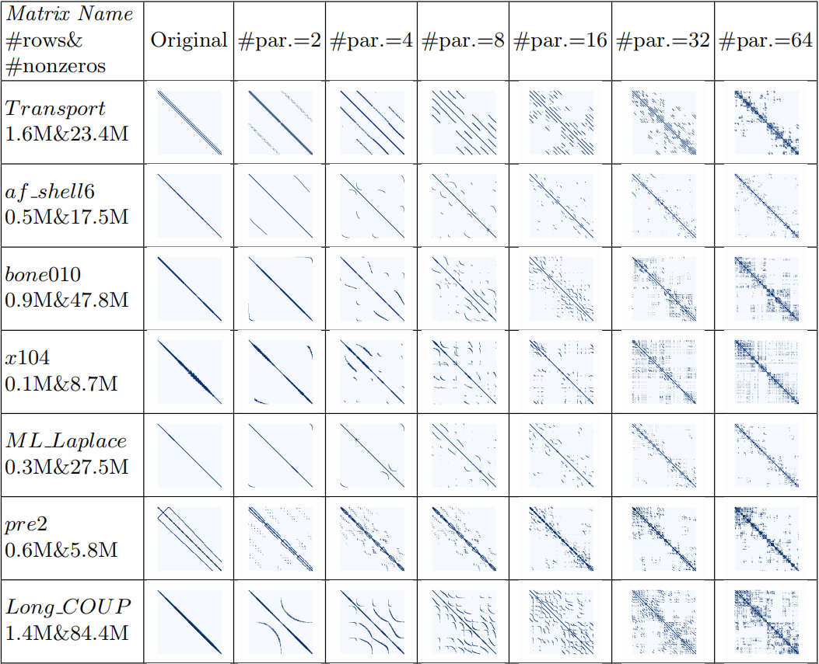
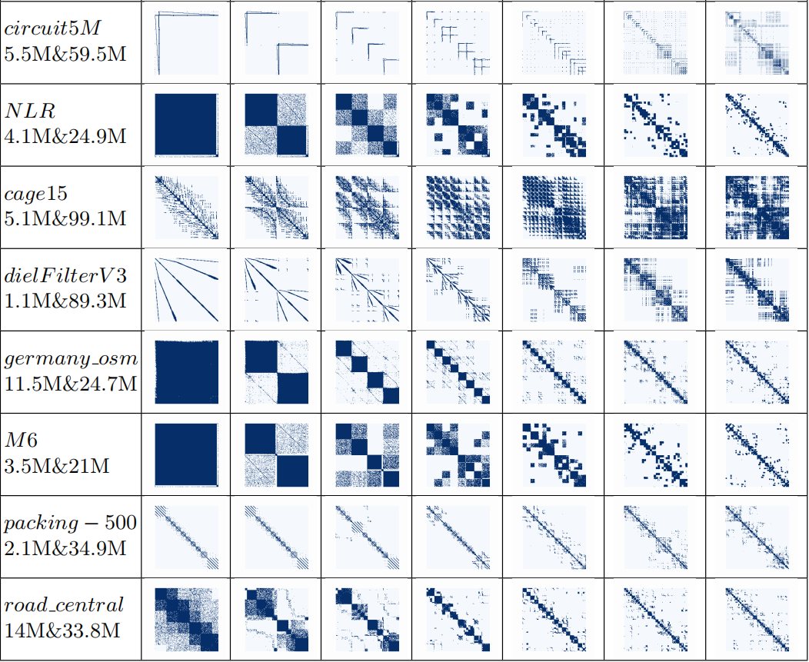
Part 3. Hypergraph Partitioning
Each matrix is divided into 2, 4, 8, 16, 32 and 64 partitions, and reordered according to the partitions. In terms of the sparsity structures of these matrices, as the number of partitions increases, the non-zero elements will move towards the diagonal blocks.

Slide 14
Part 4
NUMA-Aware SpMV Algorithm

Slide 15
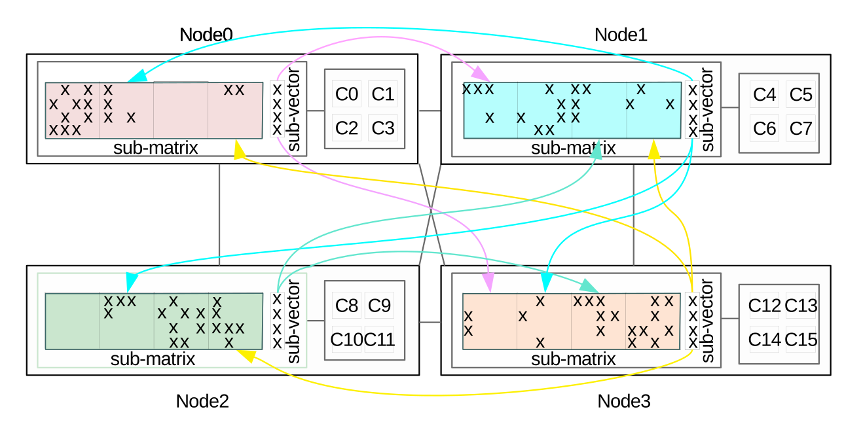
Part 4. NUMA-Aware SpMV Algorithm
Fig. 5. The computational process of the NUMA-Aware SpMV algorithm on a 16-core four-node NUMA system.
The four row blocks of the sparse matrix in Fig. 4.(c) are allocated onto the four nodes, and the four sub-vectors are also evenly distributed. When computing SpMV, the cross-node memory accesses for remote x are visualized by using lines with arrows.

Slide 16
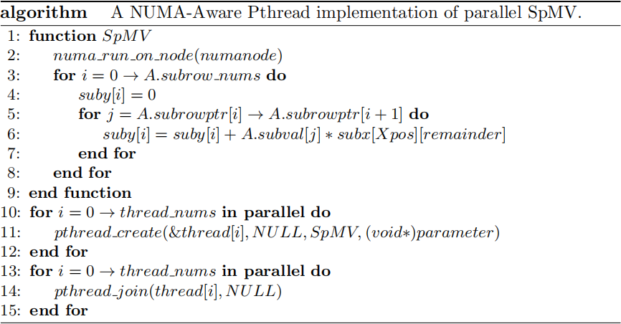
Part 4. NUMA-Aware SpMV Algorithm
We design and implement NUMA-Aware SpMV algorithm.

Slide 17
Part 5
Performance and Analysis

Slide 18
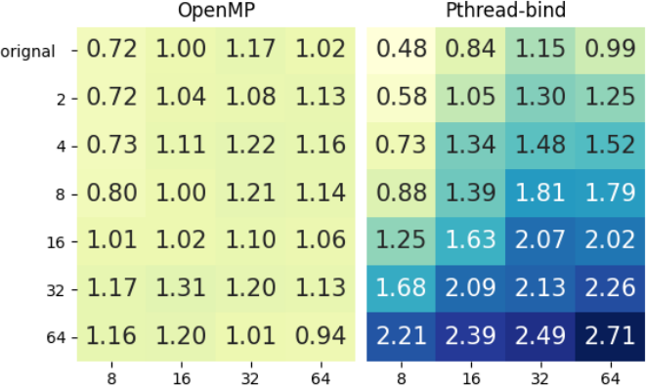
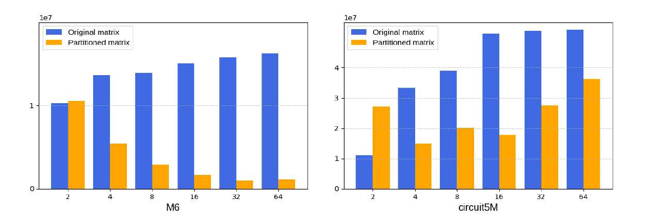
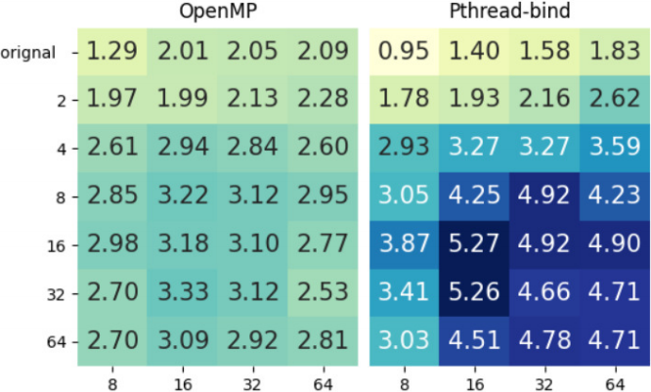
Part 5. Performance and Analysis
Hypergraph partitioning can improve data locality, reduce cross node traffic, and improve performance.
M6
Fig. 6. Comparison of communication volume before and after partitioning under different number of blocks (the x-axis is the number of partitioned blocks, the y-axis is the communication volume).
circuit5M

Slide 19
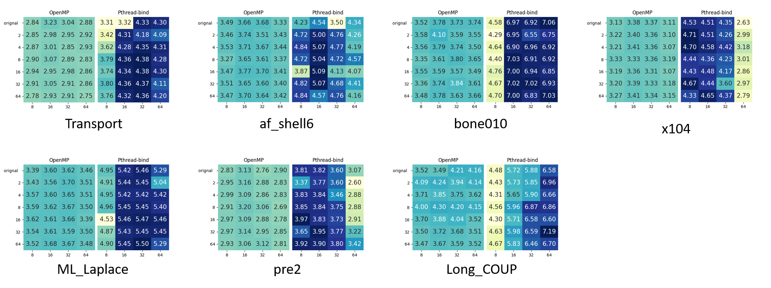
Part 5. Performance and Analysis
Performance of OpenMP SpMV (left) and NUMA-Aware SpMV (right) on Phytium 2000+. In each subfigure, x-axis and y-axis refer to the number of threads and partitions, respectively. The heatmap values are in single precision GFlop/s.

Slide 20
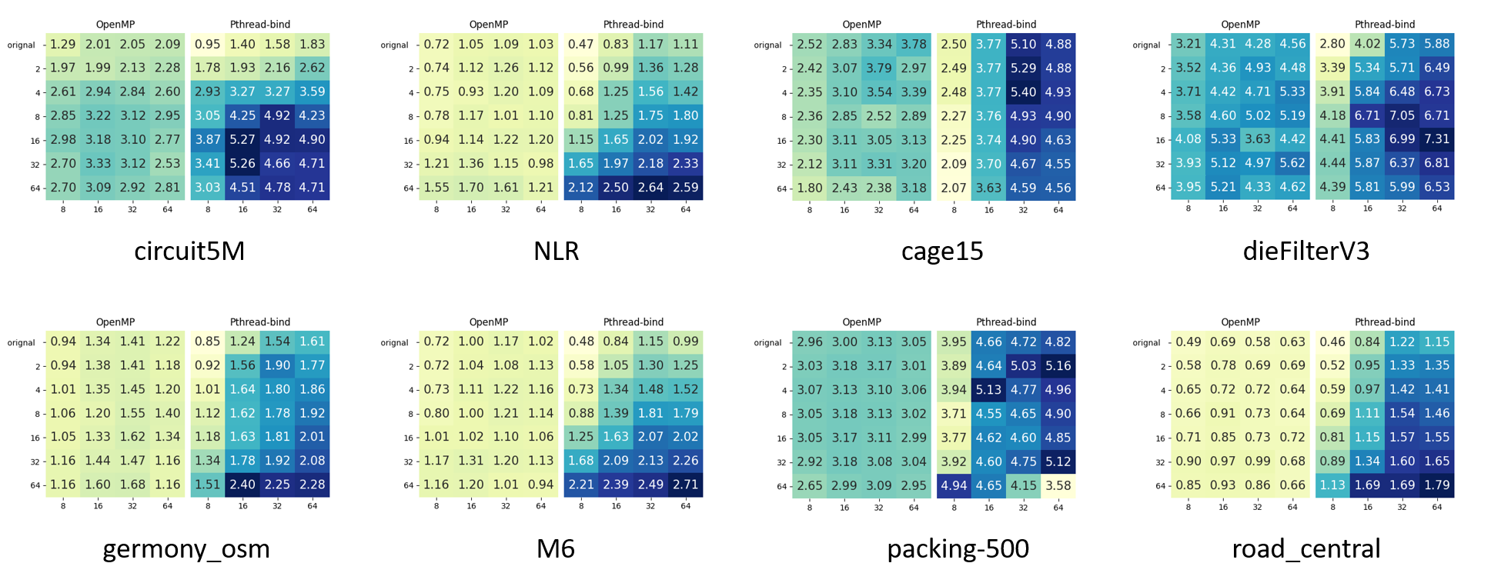
Part 5. Performance and Analysis
Performance of OpenMP SpMV (left) and NUMA-Aware SpMV (right) on Phytium 2000+. In each subfigure, x-axis and y-axis refer to the number of threads and partitions, respectively. The heatmap values are in single precision GFlop/s.

Slide 21
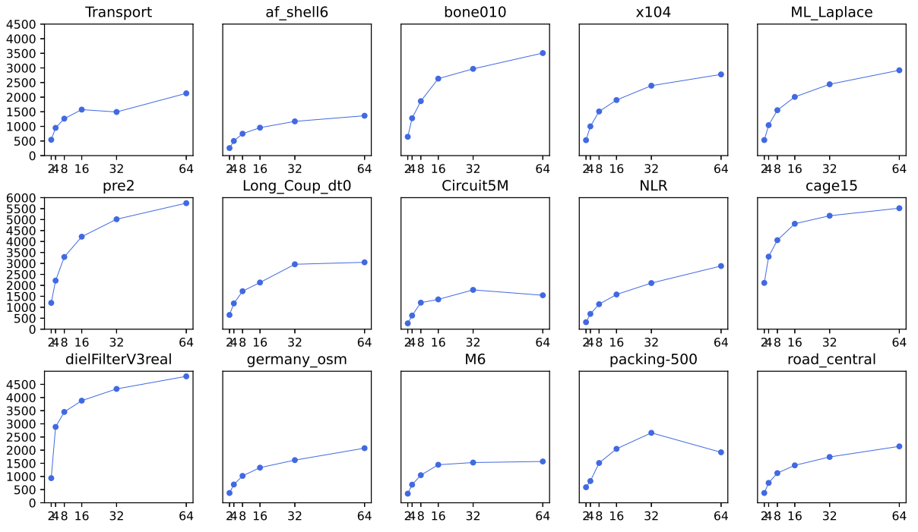
Part 5. Performance and Analysis
In general, the optimal performance of NUMA-Aware SpMV mainly concentrates on 16 and 32 partitions due to the different distribution of non-zero elements in the matrix. It can be seen that the proportion increases with the increase of the number of zones.
Fig. 7. The ratio of hypergraph time to a single NUMA-Aware SpMV time

Slide 22
NPC 2020
The 17th Annual IFIP International Conference on Network and Parallel Computing
Online, September 28-30, 2020
Thank you for attention
Authors ：Xiaosong Yu ¹, Huihui Ma ¹, Zhengyu Qu ¹, Jianbin Fang ², Weifeng Liu ¹
¹ Super Scientific Software Laboratory, Department of Computer Science and
Technology, China University of Petroleum-Beijing
² Institute for Computer Systems, College of Computer, National University of
Defense Technology
2019215847@student.cup.edu.cn, 2019211254@student.cup.edu.cn,
2019215846@student.cup.edu.cn, j.fang@nudt.edu.cn, weifeng.liu@cup.edu.cn

