Slide 1
SpTFS: Sparse Tensor Format Selection for MTTKRP via Deep Learning
Qingxiao Sun¹, Yi Liu¹, Ming Dun¹, Hailong Yang¹, Zhongzhi Luan¹, Lin Gan², Guangwen Yang² , Depei Qian¹
School of Computer Science and Engineering
Beihang University¹, Beijing, China
Tsinghua University², Beijing, China
Notes:
Hello, everyone. I am Qingxiao Sun from Beihang University. Now, I will introduce our work, SpTFS: Sparse Tensor Format Selection for MTTKRP via Deep Learning. This is a joint work with Tsinghua university.

Slide 2
Outline
Background & Motivation
Tensor Decomposition & MTTKRP
Sparse Tensor Formats
Design & Methods
Tensor Transformation & Feature Extraction
TnsNet Structure
Evaluation
Experiment Setup
Performance Analysis
Related Work
Conclusion
Notes:
The presentation is organized as 5 sections. Firstly, I will introduce the background and motivation. And then, I will present our design and methods. After that, I will present the evaluation results. Finally, I will show some related works and make a conclusion.

Slide 3
Outline
Background & Motivation
Tensor Decomposition & MTTKRP
Sparse Tensor Formats
Design & Methods
Tensor Transformation & Feature Extraction
TnsNet Structure
Evaluation
Experiment Setup
Performance Analysis
Related Work
Conclusion
Notes:
Next, I will present the background and motivation, including introduction to tensor decomposition and MTTKRP, also the sparse tensor formats proposed by previous works.

Slide 4
Tensor Decomposition
Neuroscience
Computer Vision
machine learning
Recommendation System
Tensor Decomposition
decompose
3-D Tensor
Factor Matrices
Tensor denotes the array with multiple dimensions and is the generalization of matrix and vector
Tensor decomposition is used to understand the relationship of data across multiple dimensions
Notes:
Tensor denotes the array with multiple dimensions and is the generalization of matrix and vector. Tensor decomposition is widely used to understand the relationship of data across multiple dimensions. In recent years, tensor decomposition has become popular in broader areas such as neuroscience, computer vision, recommendation systems, and machine learning.
Here is an example of tensor decomposition. A third-order tensor has been decomposed into three factor matrices (A, B and C).

Slide 5
Tensor Decomposition
$$C_{1}$$
$$C_{2}$$
$$C_{F}$$
$$≈$$
$$+$$
$$+…+$$
$$x$$
$$B_{1}$$
$$B_{2}$$
$$B_{F}$$
$$A_{1}$$
$$A_{2}$$
$$A_{F}$$
Canonical Polyadic Decomposition (CPD)
Alternating Least Squares (CPD-ALS)
decompose
MTTKRP
ALS solves a least square problem for each factor matrix iteratively with others fixed
Matricized tensor times Khatri-Rao product (MTTKRP) is the main bottleneck of CPD-ALS
Notes:
Canonical polyadic decomposition is one of the most widely-applied tensor operations, which decomposes a tensor with rank F into the summation of F rank-one tensors, and the rank-one tensors can be represented as the outer products of vectors. To solve the CPD, one of the most popular approaches is to utilize Alternating Least Squares, where a least square problem for each factor matrix is solved iteratively with others fixed. The update process for factor matrix A is shown in the equation. The main bottleneck of CPD-ALS is Matricized tensor times Khatri-Rao product, abbreviated as MTTKRP.

Slide 6
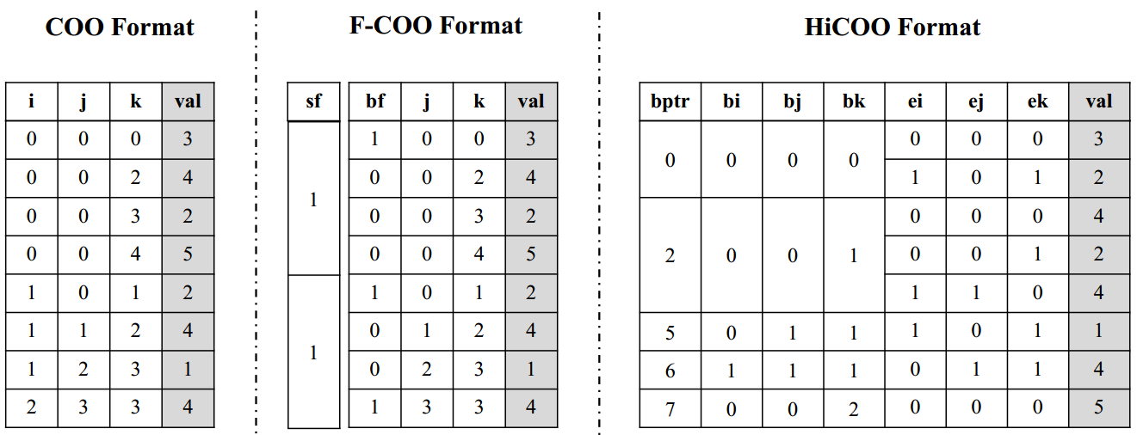
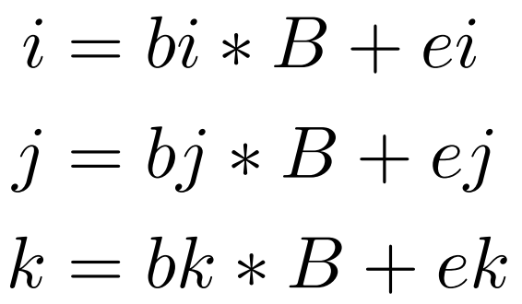
Sparse Tensor Formats
Index Calculation (HiCOO):
F-COO adds two flag arrays named start-flag and bit-flag, which are used to guide segment scan for avoiding atomic operations in MTTKRP on GPU [Liu et al., CLUSTER’17]
HiCOO 1) partitions each dimension into chunks with size $B$ and 2) groups blocks into a large logical superblock with size $L$ [Li et al., SC’18]
Notes:
Multiple sparse tensor storage formats have been proposed to improve the computation performance that adapts to the sparsity and hardware. Here we divide the sparse tensor storage format into COO-based formats and CSF-based formats. Here is an example of COO-based formats. Coordinate format is an intuitive format for storing sparse tensor. COO consists of tuples, and each tuple stores the indices and value for every nonzero element in the tensor. F-COO adds two flag arrays named start-flag and bit-flag, which indicate whether the indices of slices vary at the beginning of a block and at an element, respectively. HiCOO partitions each dimension into chunks with size B and compresses the nonzero tuples with fewer bits. Moreover, HiCOO groups blocks into a large logical superblock with size L. The index calculation of HiCOO is shown in the equation.

Slide 7
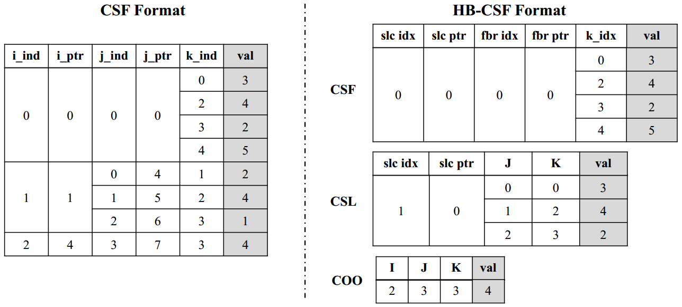
Sparse Tensor Formats
Tree-based Structure (CSF):
0
1
2
0
0
1
2
3
0
2
3
4
1
2
3
3
Compressed Sparse Fiber (CSF) extends the Compress Sparse Row (CSR) format that maintains a tree-based structure and consists of six arrays [Smith et al., IPDPS’15]
HB-CSF is a mixture of COO, Compressed Slice (CSL), and CSF for better adaption on GPU [Nisa et al., IPDPS’19]
Notes:
Here is an example of CSF-based formats, including CSF and HB-CSF. Compressed Sparse Fiber extends the Compress Sparse Row format that maintains a tree-based structure and consists of six arrays. Moreover, tiling can be used along the second mode to partition matrix factors, which are distributed among threads to eliminate the need for locks. HB-CSF extends CSF for better adaption on GPU. As shown, HB-CSF is a mixture of COO, Compressed Slice, and CSF. The COO is used when the slice only contains one element, whereas the CSL is applied when the slice contains multiple fibers, and each fiber contains a single element. Except for the above cases, the CSF format is adopted.

Slide 8
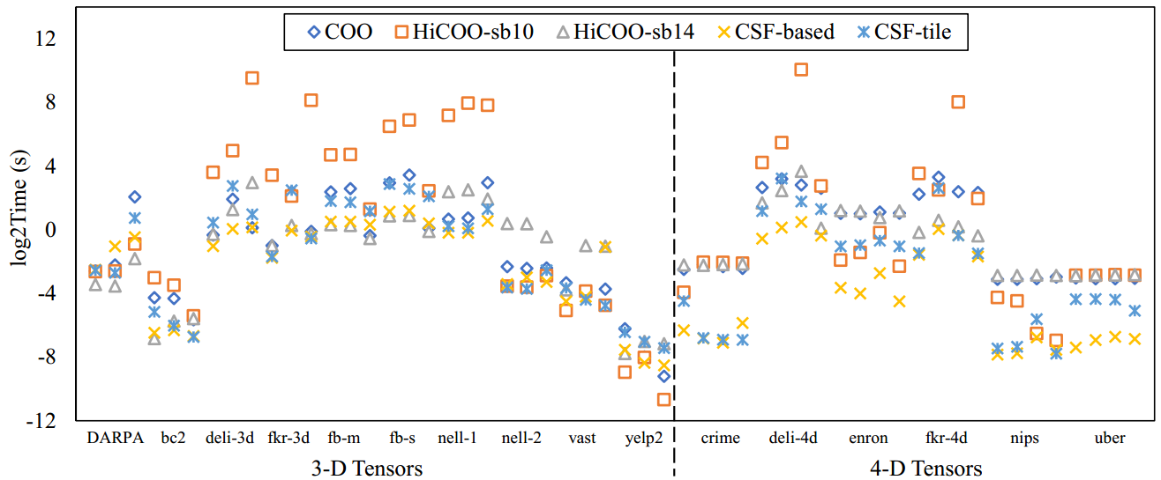
Motivation
The execution time of MTTKRP on real-world sparse tensors across all modes on CPU:
The sparsity distribution of tensors is difficult to be described by traditional machine learning methods. This motivates us to predict the optimal storage format through deep learning methods automatically.
The execution time of the same tensor in different formats varies significantly
The optimal storage format changes across tensors, there is no single format fits for all
The selection of sub-optimal format may exponentially increase the execution time
Notes:
Now I will introduce the motivation of our paper. This figure presents the performance comparison of real-world sparse tensors using different storage formats for MTTKRP. Two observations can be drawn. Firstly, the execution time of the same tensor in different formats varies significantly. Secondly, the optimal storage format changes across tensors, there is no single format fits for all. What’s worse, the selection of sub-optimal format may exponentially increase the execution time of MTTKRP. The sparsity distribution of high-dimensional tensors is difficult to be described by traditional machine learning methods. This motivates us to predict the optimal storage format for tensors through deep learning methods automatically.

Slide 9
Outline
Background & Motivation
Tensor Decomposition & MTTKRP
Sparse Tensor Formats
Design & Methods
Tensor Transformation & Feature Extraction
TnsNet Structure
Evaluation
Experiment Setup
Performance Analysis
Related Work
Conclusion
Notes:
Next, I will present our design and methods.

Slide 10
Design Overview
SpTFS consists three important components:
Tensor transformation: converts the sparse tensors into fix-sized matrices through tensor lowering and matrix representation
Feature extraction: captures lost tensor features during tensor transformation
TnsNet: a re-designed CNN network to predict the optimal storage format for a tensor
As tensors of any order can be transformed into matrices through tensor transformation, SpTFS can support the format selection of higher-order tensors. In addition to MTTKRP, the SpTFS can also support more tensor computations such as Tensor Times Matrix (TTM).
Notes:
Here is the design overview of SpTFS. We randomly select sparse matrices from the SuiteSparse and combine them to generate more datasets of sparse tensors. The SpTFS consists of three important components including tensor transformation, feature extraction and TnsNet, which is a re-designed CNN network. The tensor transformation component converts the sparse tensors into fix-sized matrices through tensor lowering and matrix representation. Feature extraction is used to capture lost tensor features during tensor transformation. The tensor dataset is used to train the TnsNet, which predicts the optimal format for a tensor on the target hardware platform.
As tensors of any order can be transformed into matrices through tensor transformation, SpTFS can support the format selection of higher-order tensors. In addition to MTTKRP, the SpTFS can also support more tensor computations such as Tensor Times Matrix (TTM).

Slide 11
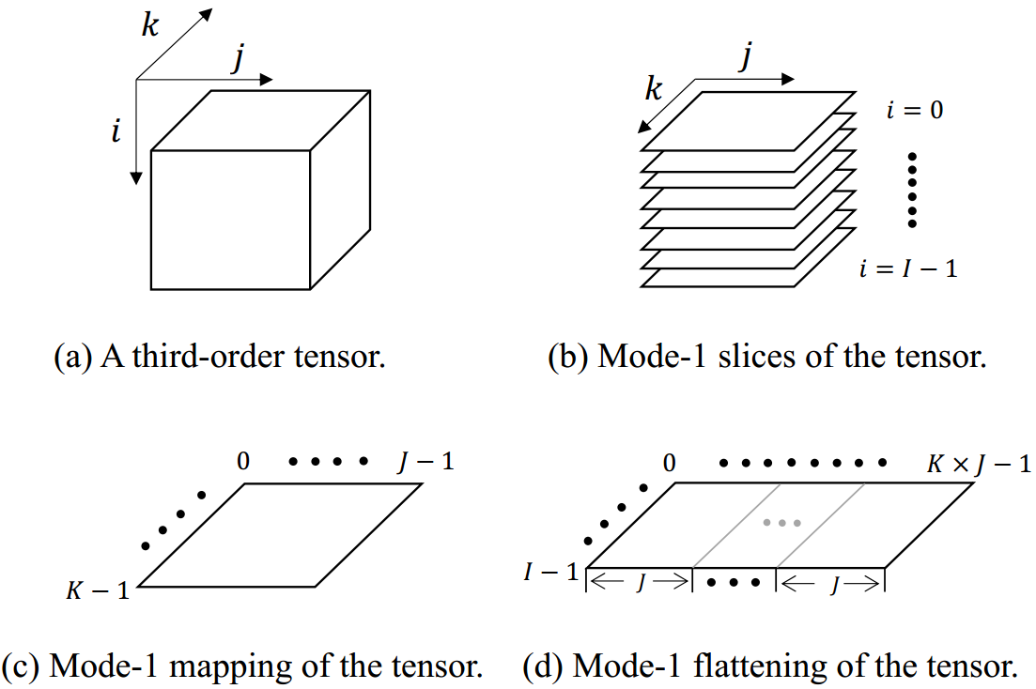
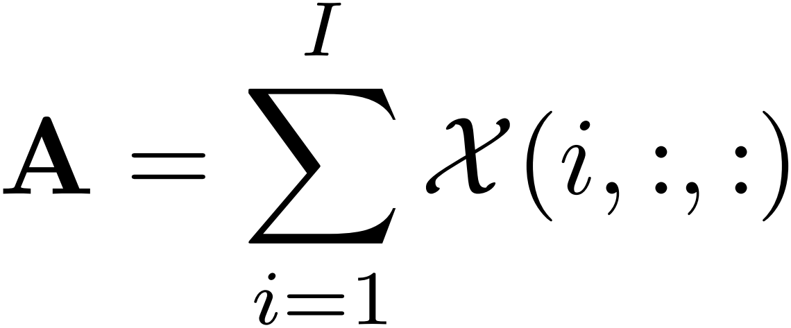
Tensor Lowering
Mode-1 Mapping (3-D Tensor):
Mode-1 Flattening (3-D Tensor):
Mapping: the non-zero values of the same position are accumulated to obtain the density of slices
Flattening: unfold the tensor using matricization
Note: flattening and mapping can be applied independently or together
Notes:
Tensor lowering is based on flattening and mapping techniques, both of which are able to capture the sparsity distribution of tensors. Here is an example of mode-1 mapping and flattening of third-order tensors. The process of mapping and flattening are formulated in the equations. For mapping, we map the non-zero values of all slices to a slice, and the non-zero values of the same position are accumulated to obtain the density of slices. For flattening, we unfold the tensor using matricization. Flattening and mapping are two separate methods of tensor lowering that can be applied independently or together.

Slide 12
Tensor Lowering
Mode-1 Mapping (3-D Tensor):
Mode-1 Mapping (N-D Tensor):
generalize
Mode-1 Flattening (3-D Tensor):
generalize
Mode-1 Flattening (N-D Tensor):
Mapping: map the non-zeros to a slice with $N−2$indices fixed and generate $C_{N}^{N−1}$ matrices
Flattening: each tensor element $\left(i_{1},i_{2},…,i_{N}\right)$ maps to matrix element $\left(i_{n},j \right)$
Note: mapping reflects the vertical distribution of the non-mode indices, and flattening reflects the horizontal distribution of the mode index
The reason for not using the high-dimensional convolution is that the irregularity of tensor data deteriorates the computation efficiency of convolution operations, which leads to unacceptable training overhead.
Notes:
Now we generalize the method of tensor lowering regarding a Nth-order tensor. For mapping, we map the non-zeros to a slice with N-2 slices fixed each time and eventually generate C_N^(N-1) matrices. For flattening, each tensor element maps to matrix element, as formulated in the equation. As seen, mapping reflects the vertical distribution of the non-mode indices, and flattening reflects the horizontal distribution of the mode index. Therefore, they can be combined to retain the sparsity distribution of a tensor. The reason for not using the high-dimensional convolution is that the irregularity of tensor data deteriorates the computation efficiency of convolution operations, which leads to unacceptable training overhead.

Slide 13
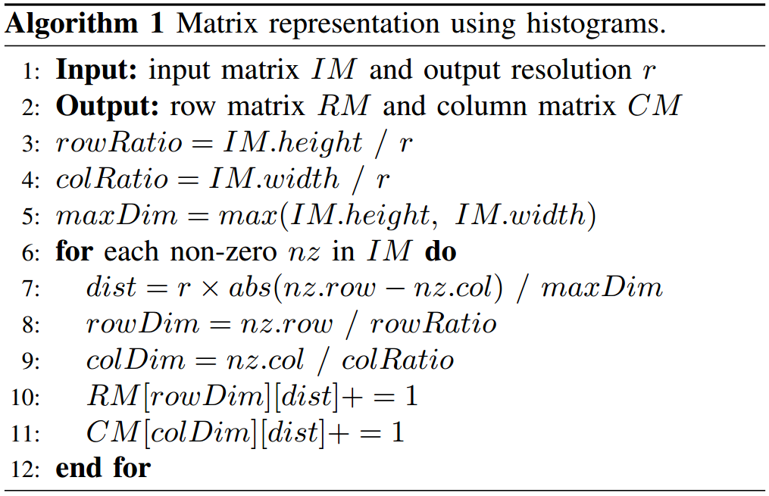
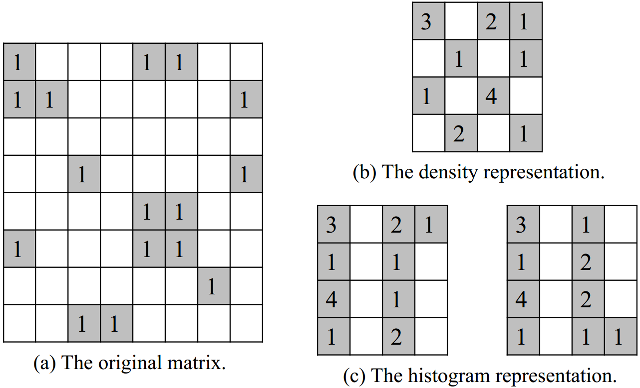
Matrix Representation
Mapping the $8×8$ matrix to $4×4$ matrices:
diagonal
Density: each block counts non-zero elements and fills into the new matrix
Histogram: row and column histograms express the diagonal information
Note: the values are normalized to the range of [0,1] by dividing by the maximum value
The matrices generated through tensor lowering are irregular in size, and we need to scale the matrices into fix-sized input for the network.
Notes:
The matrices generated through tensor lowering are irregular in size, and we need to scale the matrices into fix-sized input for the network. Inspired by previous works, we consider two ways for matrix scaling, including density representation and histogram representation. Here is an example of mapping the 8*8 matrix to 4*4 matrices. For density, each block counts non-zero elements and fills into the new matrix. For histogram, row and column histograms are used to express the diagonal information of the original matrix. As shown in Algorithm 1, the rowDim and the colDim are the row and column indices of the elements mapped to the new matrix. The dist reflects the distance between the element and the diagonal. Finally, the values of the new matrices are normalized to the range of [0,1] by dividing by the maximum value.

Slide 14
Network Structure
late-merging structure
When porting the TnsNet to a different hardware platform, new training data needs to be collected. Also, when adding new tensor data to the training dataset, the same tensor transformation procedures are applied to re-train TnsNet.
TnsNet: combines CNN and feedforward neural network (FFNN) to predict the optimal format
BaseNet: includes all convolution and pooling layers of TnsNet (provide better portability)
Feature layer: supplements the missing sparsity features of the original tensor
Notes:
Now I will introduce the structure of TnsNet. Inspired by previous works, we combine convolutional neural network and feedforward neural network to predict the optimal storage format for a tensor. Here we take the density representation as an example, where the BaseNet includes all convolution and pooling layers. The advantage of using BaseNet is to provide better portability when handling higher-order tensors. In such a case, the design and hyper-parameters of the BaseNet can be re-used without any modification. We use the matrices as inputs to the BaseNets separately and concatenate the outputs at the fully connected layer. After that, the output is concatenated with the feature layer. The feature layer can supplement the missing sparsity features of the original tensor. When porting the TnsNet to a different hardware platform, new training data needs to be collected. Also, when adding new tensor data to the training dataset, the same tensor transformation procedures are applied to re-train TnsNet.

Slide 15
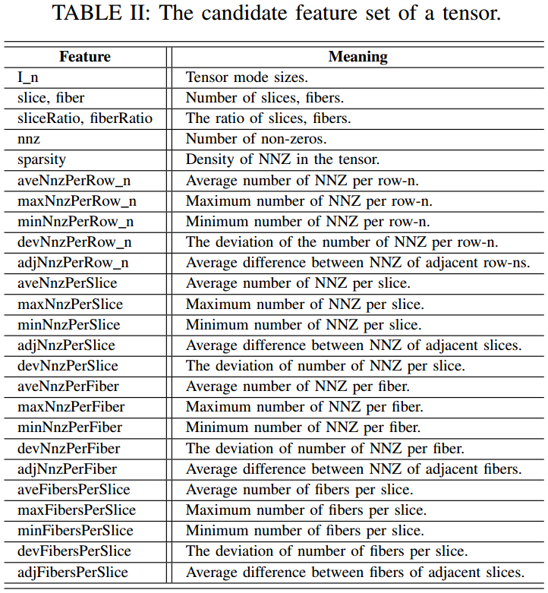
Network Structure
The feature layer reflects the memory layout and computation characteristics
Global features: include the tensor’s mode sizes, nnz, sparsity, and features related to nnz per row-n
Local features: features related to slices and fibers (e.g., nnz per slice)
Note: local features can significantly affect the performance of CSF-based tensor formats
Notes:
Now I will introduce the features contained in the feature layer. The feature layer reflects the memory layout and computation characteristics using the specific tensor storage format. As shown in Table 2, the sparsity features include the global features and local features. The global features include the tensor’s mode sizes, number of non-zeros, sparsity and features related to nnz per row-n, while the local features are related to slices and fibers. The local features can significantly affect the performance of CSF-based tensor formats.

Slide 16
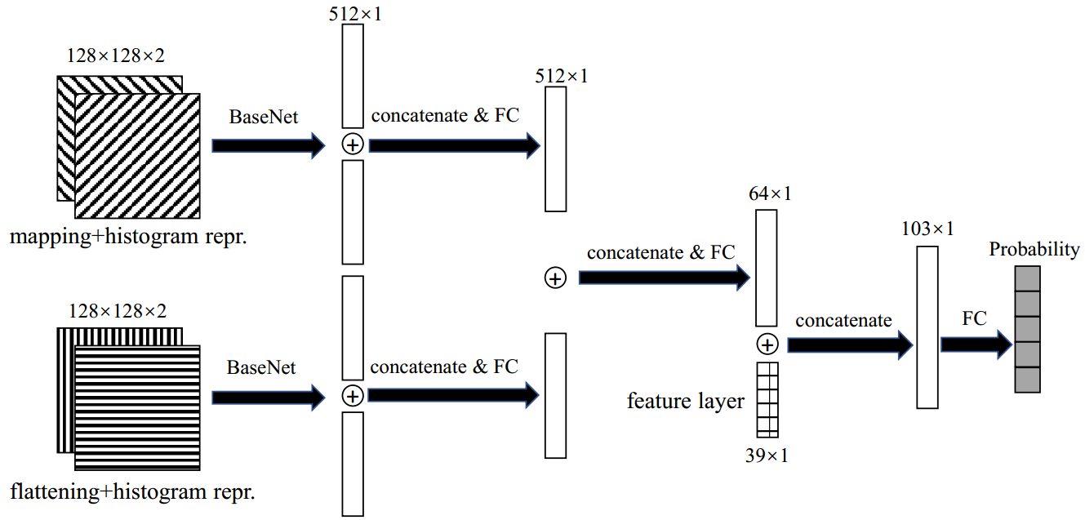
Network Structure
unchanged structure
TnsNet using histograms:
TnsNet replaces each input matrix with a row matrix and a column matrix
Each matrix is used as the input of BaseNet and then merged into the fully connected layer (similar to handling higher-order tensors)
The tensor storage format with the highest probability is predicted to be optimal
Notes:
Here is an example of TnsNet using histograms. The network structure is similar to handling higher-order tensors. The input matrix is replaced with a row matrix and column matrix, which can be seen as different channels of an image. In this case, each matrix is used as the input of BaseNet, and then the output features are merged into the fully connected layer. After merging, the remaining network structure stays unchanged. After inference, the tensor storage format with the highest probability is predicted to be optimal.

Slide 17
Outline
Background & Motivation
Tensor Decomposition & MTTKRP
Sparse Tensor Formats
Design & Methods
Tensor Transformation & Feature Extraction
TnsNet Structure
Evaluation
Experiment Setup
Performance Analysis
Related Work
Conclusion
Notes:
Next, I will introduce the evaluation of our methods.

Slide 18
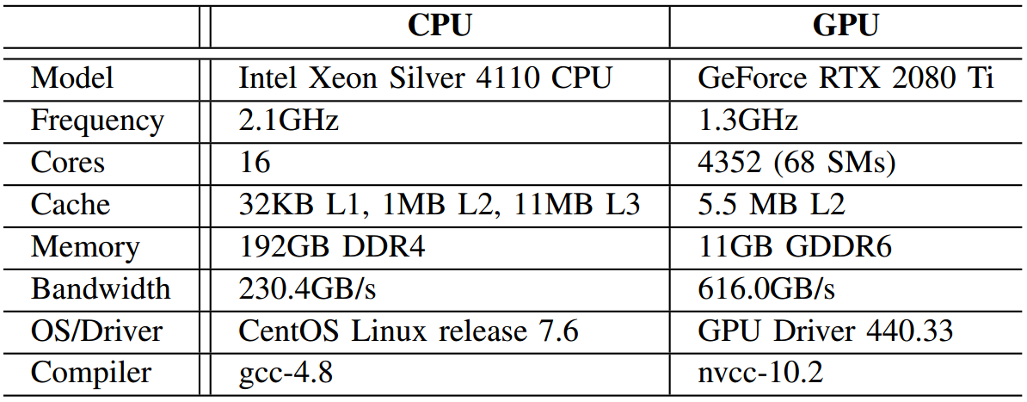
Experiment Setup
Hardware and software
TensorFlow v1.15
Library
CPU: SPLATT (CSF), ParTI! (COO, HiCOO)
GPU: B-CSF (COO, CSF, HB-CSF)
Sparse tensor formats
CPU: COO, CSF-(based, tile), HiCOO-(sb10, sb14)
GPU: COO, F-COO, CSF, HB-CSF
Tensor datasets
Real-world: FROSTT, HaTen2
Generated: SuiteSparse Matrix Collection
Training data collection
Rank size (16), CPU threads (16), TB size (256)
Compile option (-O3)
NOTE: F-COO only accounts for 0.4% of the cases with the best performance because of load imbalance [Nisa et al., IPDPS’19]
Notes:
We evaluate the effectiveness of our methods on two hardware platforms. The GPU is also utilized to speedup the process of training and prediction. For training data collection, we select three open-source tensor libraries. Specifically, we compare five tensor formats on CPU and four tensor formats on GPU. Since there is no public F-COO implementation available, we develop our F-COO implementation in the existing library. However, F-COO only accounts for 0.4% of the cases with the best performance, the similar results are also shown in the previous work. Therefore, we do not consider FCOO for tensor format selection on GPU. To ensure fairness, we use the best parameter configurations reported in each implementation and compile with the “O3” option. The tensor datasets are mostly generated from SuiteSparse, but we also add the real-word tensors we collected to the evaluation dataset.

Slide 19
Experiment Setup
Methods for comparison
XGBoost (GBDT, GBLinear), with input features same to the feature layer of TnsNet
Various designs of TnsNet
Cross validation
5-fold cross validation
Hyperparameters
Batch size (100), Filter size ($3×3$)
Adam stochastic optimizer with 0.0001 learning rate
Metrics
Prediction accuracy
Performance speedup
Notes:
We compare the various designs of TnsNet with the XGBoost machine learning methods, including GBDT and GBLinear. The input features of GBDT and GBLinear are the same to the feature layer of TnsNet. We use the 5-fold cross validation method to evaluate the accuracy of the models. For TnsNet, we set the batch size to 100 and the convolution filter size to 3*3. We select the Adam stochastic optimizer with 0.0001 learning rate. The main metrics in the evaluation are prediction accuracy and performance speedup.

Slide 20
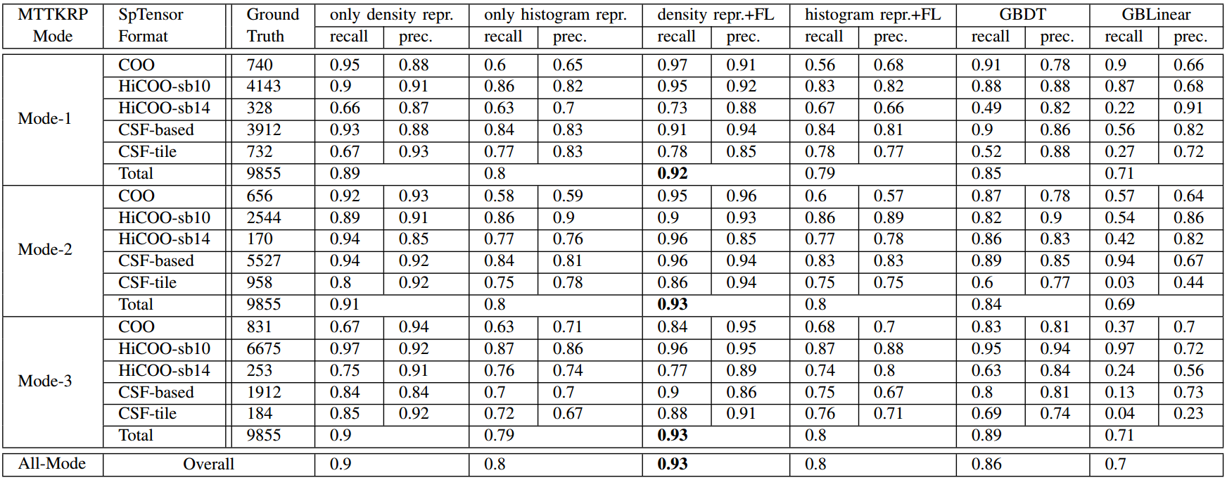
Accuracy Comparison for 3-D Tensors on CPU
Due to page limit, we only present the evaluation results of TnsNet (density repr.+FL) and GBDT in the rest of the paper.
The overall prediction accuracy of TnsNet (density repr.+FL) and GBDT is 93% and 86%, respectively
The histogram repr. suffers from overfitting (with high training accuracy and low prediction accuracy)
Notes:
This table reports the prediction accuracy of the four designs of TnsNet (including density or histogram representation with or without feature layer) and two machine learning methods (including GBDT and GBLinear) on CPU. As seen, the overall prediction accuracy of TnsNet with density representation and feature layer and GBDT is 93% and 86%， respectively. For the histogram representation, the training accuracy is high whereas the prediction accuracy is low, which indicates it suffers from overfitting. We only present the evaluation results of TnsNet with density and feature layer and GBDT in the rest of the paper.

Slide 21
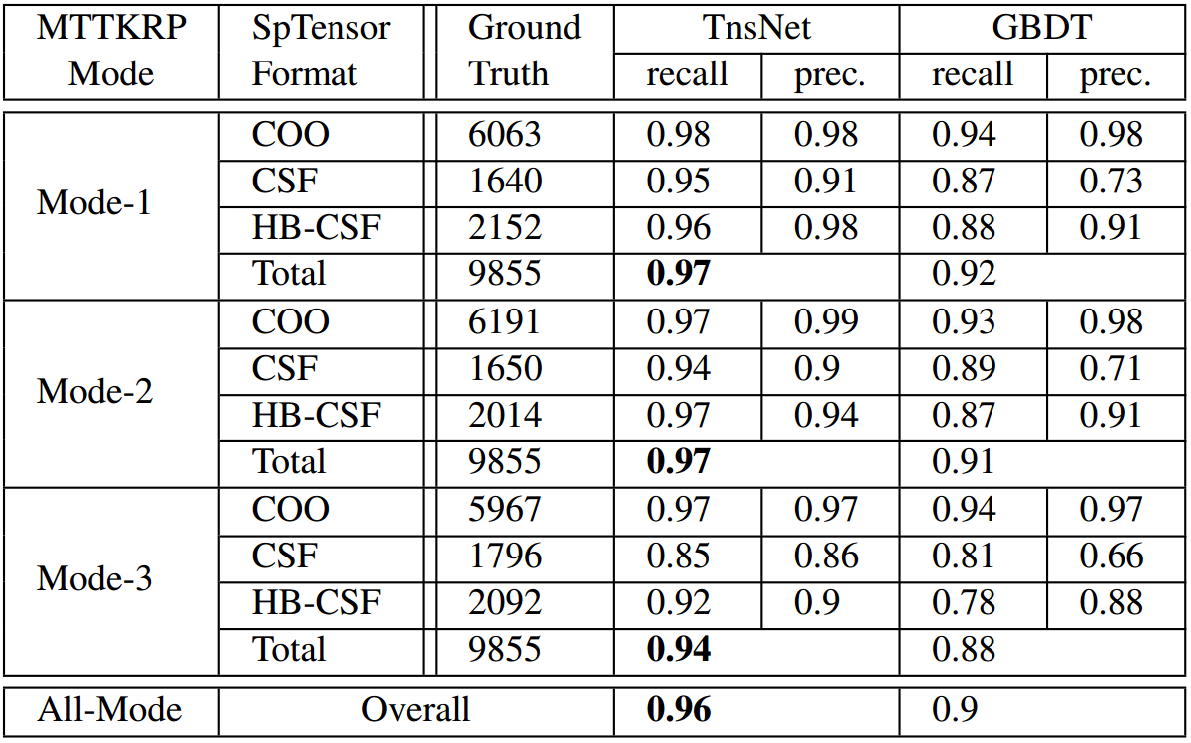
Accuracy Comparison for 3-D Tensors on GPU
TnsNet achieves better prediction accuracy compared to GBDT across all tensor formats
The overall accuracy of TnsNet and GBDT is 96% and 90%, respectively
Notes:
This table reports the prediction accuracy on GPU. Similarly, TnsNet achieves better prediction accuracy compared to GBDT in all modes across all tensor formats. The overall accuracy of TnsNet and GBDT is 96% and 90%, respectively.

Slide 22
Loss and Accuracy during Training/Testing on CPU/GPU
CPU (above)
GPU (below)
The loss curve during training is more oscillating than during testing, but the overall trend is similar
The training on GPU converges faster than that on CPU due to fewer tensor formats
Notes:
The loss is used to indicate the degree of prediction deviation from the true value. This figure compares the losses and accuracies during training and testing on CPU and GPU. As seen, the loss curve during training is more oscillating than during testing, but the overall trend is similar. Compared to CPU, the training on GPU converges faster due to fewer tensor formats.

Slide 23
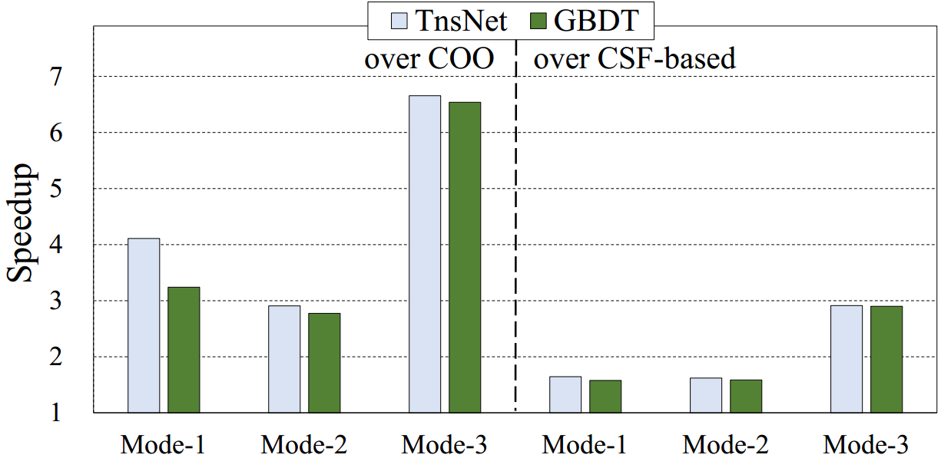
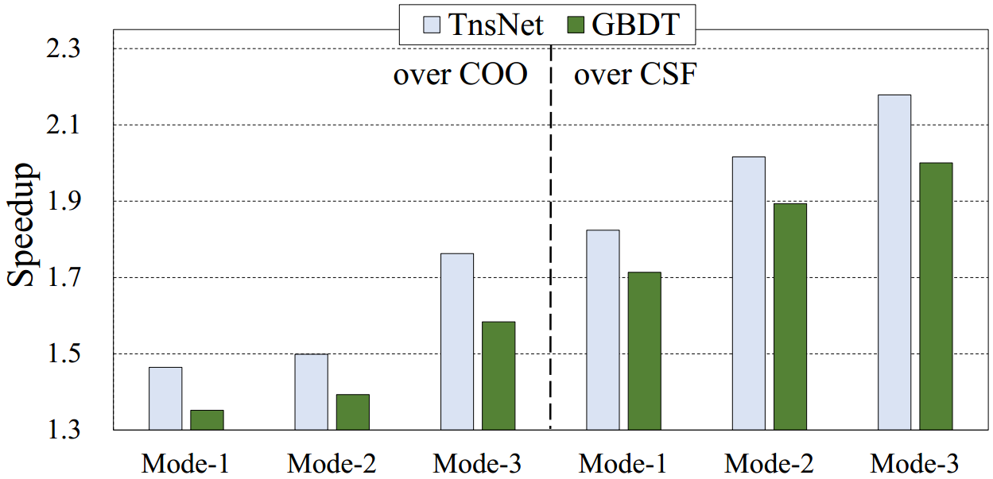
Speedup Comparison for 3-D Tensors on CPU/GPU
CPU
GPU
TnsNet achieves higher performance speedup than GBDT in all modes on both platforms
CPU: TnsNet achieves 4.56× and 2.06× speedup on average over COO and CSF-based, respectively
GPU: TnsNet achieves an average speedup of 1.58× and 2.08× over COO and CSF, respectively
Notes:
The figures show the speedup comparison between TnsNet and GBDT for third-order tensors on CPU and GPU. As seen, TnsNet achieves higher performance speedup than GBDT on both platforms. On CPU, TnsNet achieves 4.56× and 2.06× speedup on average over COO and CSF-based, respectively. On GPU, TnsNet achieves an average speedup of 1.58× and 2.08× over COO and CSF, respectively.

Slide 24
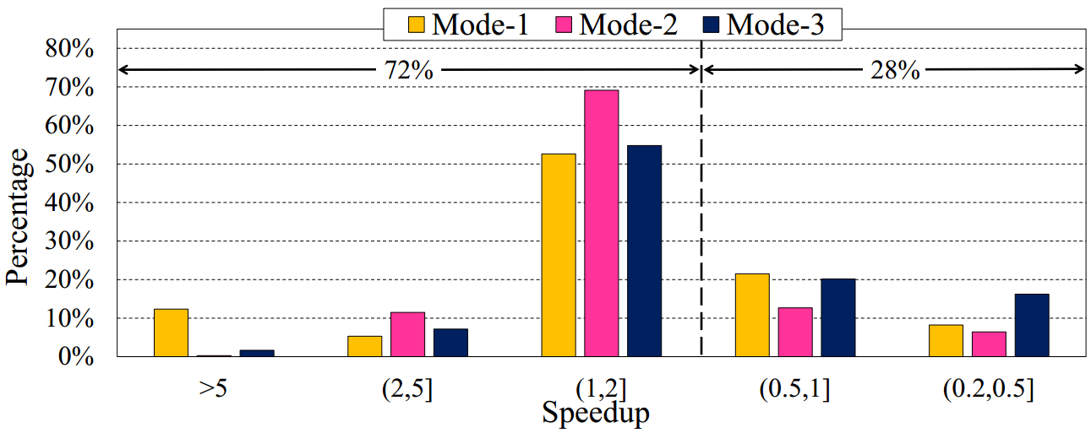
Speedup Distribution of TnsNet over GBDT on CPU
For 72% of then tensors, TnsNet achieves better performance than GBDT
For 4.8% of the tensors, TnsNet achieves 5× speedup over GBDT
The speedup can reach up to 420×, 341× and 557× in mode-1, mode-2, and mode-3, respectively
Notes:
This figure shows the speedup distribution of TnsNet over GBDT on CPU, with the cases where the two models give different results. As seen, TnsNet is able to improve the performance for 72% of the tensors. For 4.8% of the tensors, TnsNet achieves 5* speedup over GBDT. Moreover, the speedup of TnsNet can reach up to 420×, 341× and 557× in mode-1, mode-2, and mode-3, respectively.

Slide 25
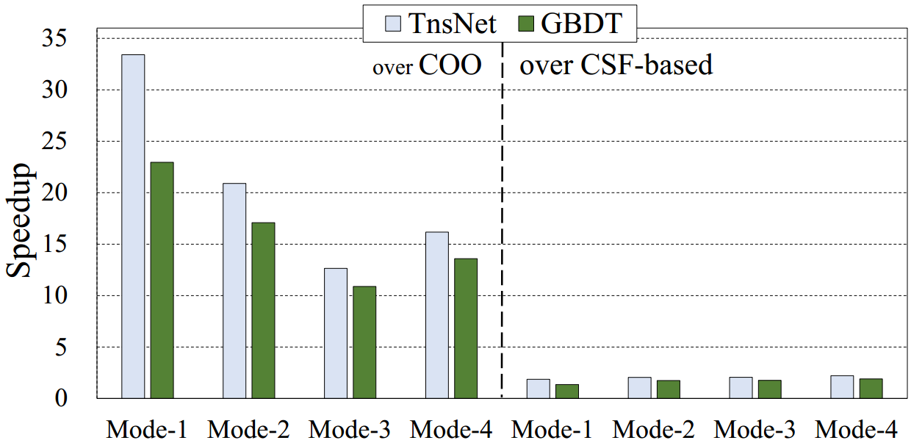
Accuracy/Speedup Comparison for 4-D Tensors on CPU
TnsNet achieves an average accuracy of 88% across all modes, whereas GBDT only achieves 58%
TnsNet achieves 20.8× and 2.05× speedup over COO and CSF-based, respectively
Notes:
We also apply our approach to fourth-order tensors. TnsNet achieves an average accuracy of 88% across all modes, whereas GBDT only achieves 58%. Also, TnsNet achieves higher speedup than GBDT in all modes. As seen, TnsNet achieves 20.8× and 2.05× speedup over COO and CSF-based, respectively.

Slide 26
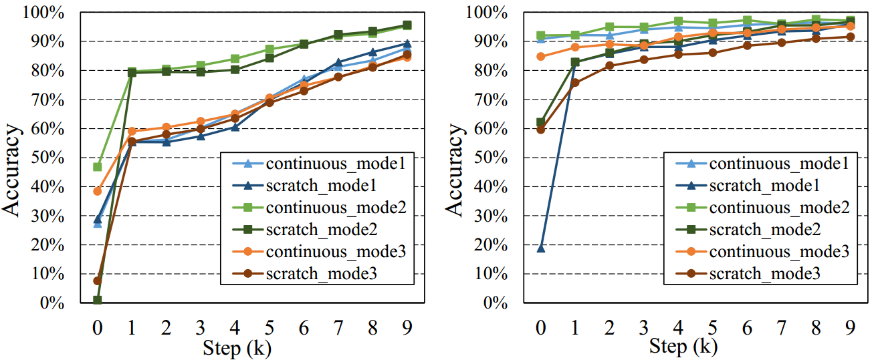
Accuracy Comparison of Re-training on New Hardware Platforms
CPU: Intel Xeon E5-2650v4
GPU: Nvidia Tesla V100
CPU
GPU
Scratch and continuous mean training the model from scratch and from a pre-trained model
Both methods eventually achieve similar prediction accuracy of around 90%
For continuous training on GPU, the accuracy already reaches over 85% when re-training starts
On CPU, the continuous training has no significant advantage over training from scratch
Notes:
We evaluate our methods on two new hardware platforms. Here we utilized two methods for re-training, Scratch means training the model from scratch, continuous means re-training the models based on pre-trained ones. As seen, both methods eventually achieve similar prediction accuracy of around 90%. For continuous training on GPU, the accuracy already reaches over 85% when re-training starts. However, on CPU, the continuous training has no significant advantage over training from scratch. The reason can be attributed to the different similarity of the training data collected on the platforms.

Slide 27
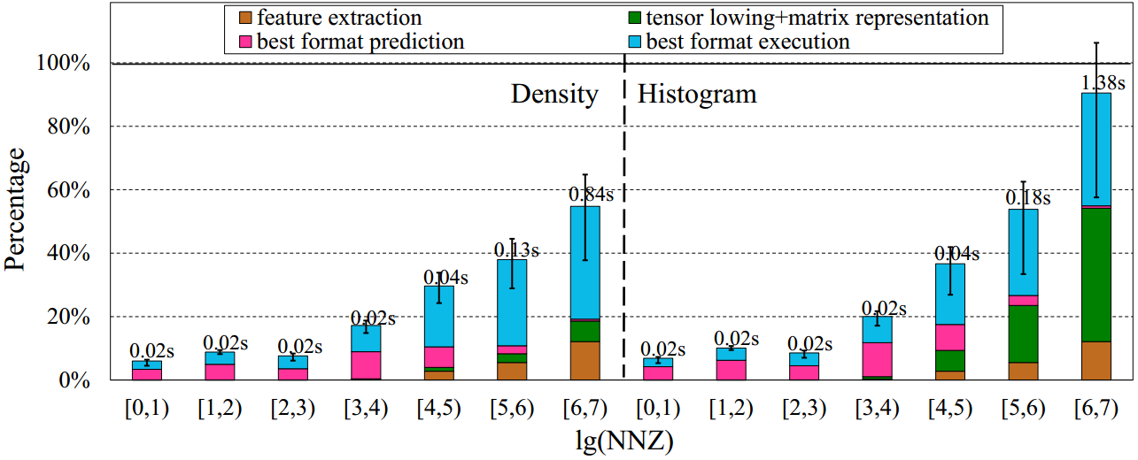
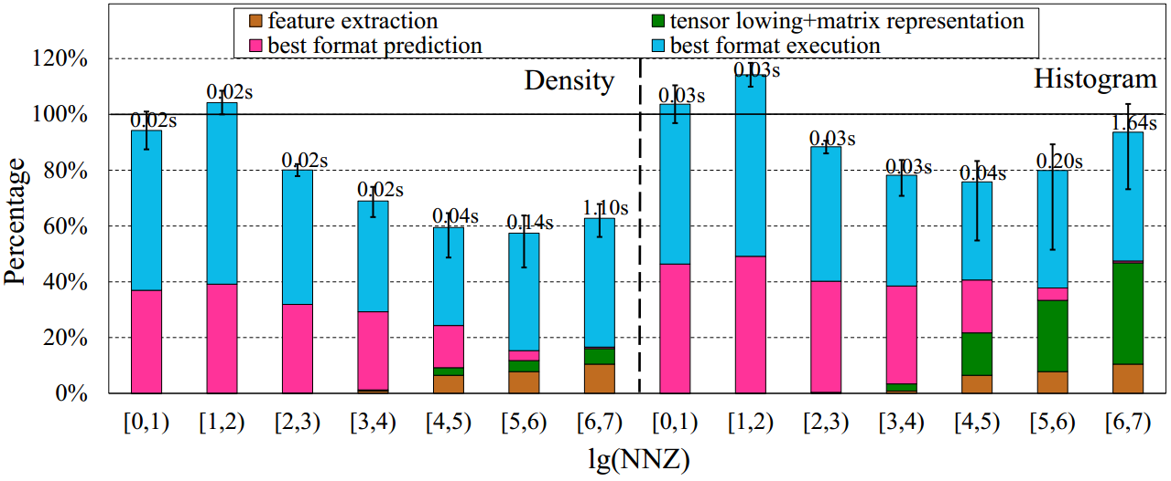
Overhead Analysis of SpTFS on CPU/GPU
Performance breakdown normalized to the baseline COO format on CPU/GPU：
CPU
GPU
For training, it takes about 7 minutes to train TnsNet with 7,886 input tensors
The prediction overhead of SpTFS is amortized to 15 iterations of CPD-ALS (based on empirical study)
For prediction, the results of most groups are below 100% (SpTFS achieving better performance with overhead taken into account)
The prediction overhead using histogram repr. is 2.1× higher on average than using density repr.
Notes:
We discuss the overhead of SpTFS form both training and prediction aspects. For training, it takes about 7 minutes to train TnsNet with 7,886 input tensors. Since the training is only performed once, the training overhead is negligible. Based on our empirical study, we analyze the prediction overhead of SpTFS amortized to 15 iterations of CPD-ALS. This figure shows the performance breakdown normalized to the baseline COO format on CPU and GPU. The average performance is presented for 7 groups (the number of non-zeros ranges from ${10}^{0}$ to ${10}^{7}$). The results less than 100% mean SpTFS achieve better performance even with prediction overhead taken into account. As seen, the results of most groups are below 100%. Also, the prediction overhead using histogram representation is 2.1× higher on average than using density representation.

Slide 28
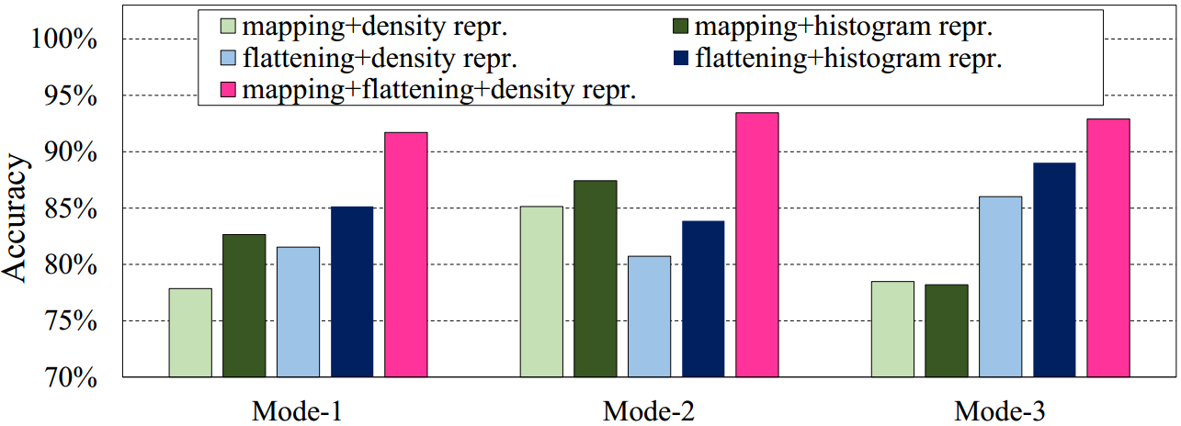
Analysis of Network Designs
Mapping/Flattening: the average accuracy when using mapping or flattening alone is 82% and 84%
Density/Histogram: the accuracy with histogram is 3.4% higher than the density on average
CNN Ablation Study: TnsNet achieves 54% prediction accuracy on average without CNN
Input Resolution: the accuracies of 64×64, 128×128, and 256×256 are 83.5%, 92.7%, and 93.3%
Notes:
We also provide detailed analysis of various designs of TnsNet. For tensor lowering methods, the accuracy when using mapping or flattening alone is only 82% and 84%. Therefore, it is necessary to combine mapping and flattening in order to capture more tensor patterns. For matrix scaling methods, the accuracy with histograms is 3.4% higher than the density on average. This indicates that the low number of weights and biases avoids the overfitting problem. We also perform CNN ablation study, TnsNet achieves 54% prediction accuracy on average without CNN, which proves the necessity of CNN in TnsNet. Finally, we change the input resolution form 64*64 to 256*256, the accuracies are 83.5%, 92.7%, and 93.3%, respectively. To balance the prediction accuracy and tensor transformation overhead, we choose the input resolution of 128 × 128 for TnsNet.

Slide 29
Outline
Background & Motivation
Tensor Decomposition & MTTKRP
Sparse Tensor Formats
Design & Methods
Tensor Transformation & Feature Extraction
TnsNet Structure
Evaluation
Experiment Setup
Performance Analysis
Related Work
Conclusion
Notes:
Next, I will show some previous works related to our work.

Slide 30
Related Work
Optimization for CPD Algorithm
Multiple sparse tensor formats have been proposed to improve the computation performance considering the sparsity and hardware, such as [Smith et al., IPDPS’15], [Liu et al., CLUSTER’17], [Li et al., SC’18], [Nisa et al., IPDPS’19], etc.
Many works improve the CPD performance by optimizing the MTTKRP process, such as [Kang et al., SIGKDD’12], [Choi et al., NIPS’14], [Vervliet et al, J-STSP’15], [Cheng et al., NIPS’16], etc.
Sparse Matrix Format Selection
Traditional machine learning methods train classifiers or regression models based on sparsity features, such as [Sedaghati et al., ICS’15], [Benatia et al., ICPP’16], [Zhao et al., IPDPS’18], etc.
Deep learning methods convert irregular sparse matrices into fixed-size matrices and feed them to CNNs, such as [Zhao et al., PPoPP’18], [Xie et al., ICS’19], [Barreda et al., TJSC’20], etc.
To the best of our knowledge, this is the first work to automatically select the optimal sparse storage format for tensor computation.
Notes:
We divide the related works into optimization for CPD algorithm and sparse matrix format selection. For optimization for CPD algorithms, multiple sparse tensor formats are proposed to improve the computation. Also, many works improve the CPD performance by optimizing the MTTKRP process. Methods for handling sparse matrix format selection can be divided into traditional machine learning methods and deep learning methods. To the best of our knowledge, this is the first work to automatically select the optimal sparse storage format for tensor computation.

Slide 31
Outline
Background & Motivation
Tensor Decomposition & MTTKRP
Sparse Tensor Formats
Design & Methods
Tensor Transformation & Feature Extraction
TnsNet Structure
Evaluation
Experiment Setup
Performance Analysis
Related Work
Conclusion
Notes:
Finally, I will make the conclusion.

Slide 32
Conclusion
Sparse tensor format selection via deep learning
Tensor transformation
Tensor lowering (mapping / flattening)
Matrix representation (density / histogram)
Feature extraction
Global and local features
TnsNet structure
Combing CNN and FFNN
BaseNet / Feature layer
Experiment Results
Prediction Accuracy
Intel CPU (93%) / NVIDIA GPU (96%)
Performance Speedup
Intel CPU (4.56×) / NVIDIA GPU (1.58×)
Notes:
In this work, we propose an automatic tensor format selection framework that can predict the optimal sparse tensor storage format. Our framework consists of tensor transformation methods, feature extraction methods, and a re-designed CNN network. The experiment works show that our methods achieve high prediction accuracy on both CPU and GPU platforms, which in turn leads to significant performance speedup.

Slide 33
Thanks! Q&A
Notes:
This concludes the presentation and I am available for questions.

