Slide 1
Locality-Aware CTA Clustering for Modern GPUs
ASPLOS’17,
Xi’An, China
Ang Li, Shuaiwen Leon Song
Pacific Northwest National Laboratory (PNNL)
Weifeng Liu (University of Copenhagen),
Xu Liu (William&Mary),
Akash Kumar (TU Dresden)
Henk Corporaal (TU Eindhoven)

Slide 2
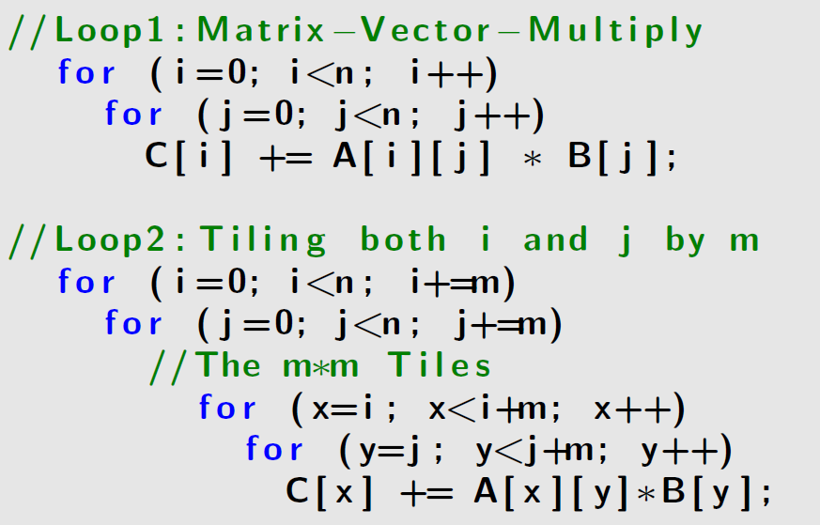
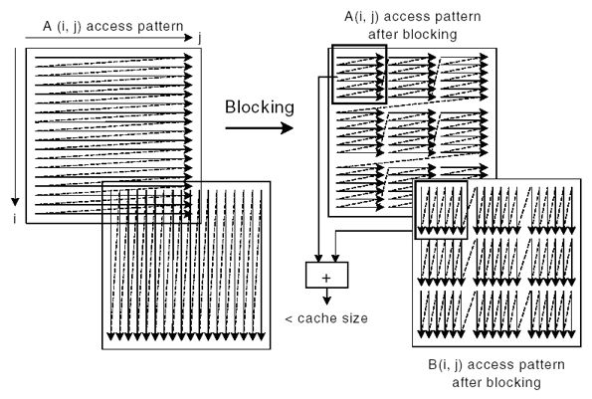
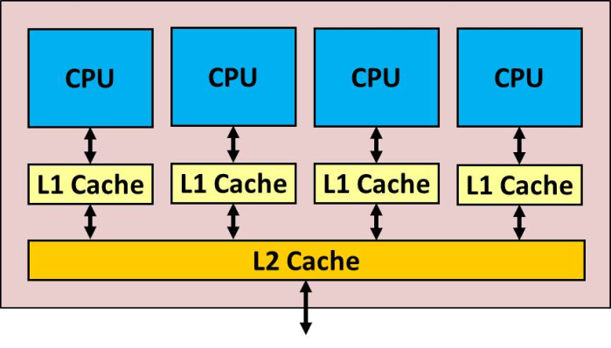
CPU Loop Tiling => Thread Clustering
X
Y
X
Y
Data Sharing: X & Y
A Tile => A Thread
Data Sharing => Thread Clustering
Notes:
Traidiotanlly, cpu uses tiling to reude reuse-distance and exploit locality for small L1 cache. X and Y are two threads correpsoding to two tiles. With the rising of hyperthreading on multicore, people proposed the idea of thread clustering which map two threads with inter-tile locality onto the same core to exploit on-core locality for the threads.
Traditionally, CPU use tiling to reduces reuse-distance and exploit locality for small L1 cache: each tile can be put into L1.
Later, with multithreading, and each tile maps to a thread, people use thread clustering to map tiles with inter-tile locality onto the same core, in hoping that inter-tile locality can be exploited on-core, from core-shared cache to core-private cache For example, …

Slide 3
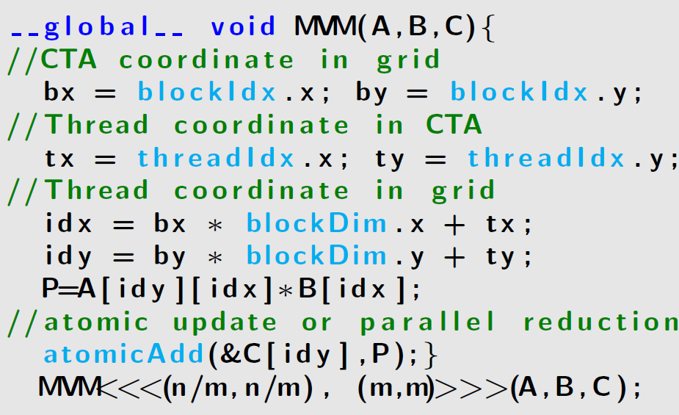
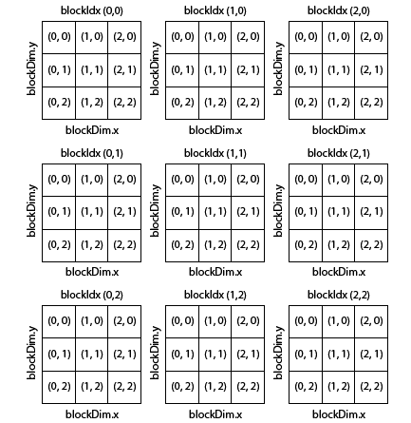
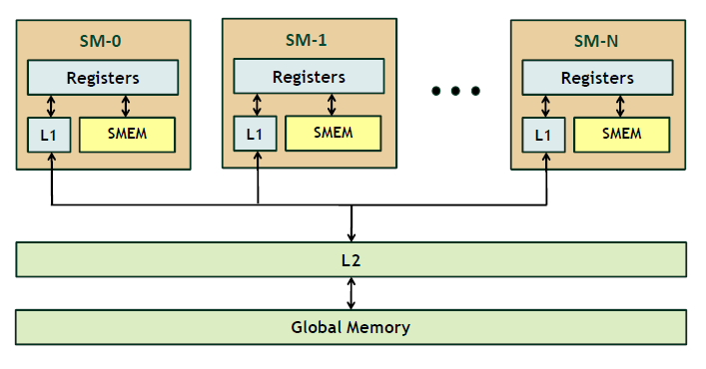
GPU Thread Block => CTA Clustering
X
Y
Data Sharing: X & Y
A Tile => A CTA
Data Sharing => CTA Clustering
Notes:
* A kernel should still obtain correct result with arbitrary dispatching and execution of CTAs. This feature remains applications remain unchanged with sm hardware is modified or CTA scheudlers are changed across architectures.
Moving the concept of inter-tile locality to GPU.
CTA definition: Cooperative-Thread-Array(CTA),whichencapsulates all thethreadsynchronization and barrier operations. CTA is the basic unit for delivering jobs to SMs.
For GPUs, the whole grid is separated into CTAs – each CTA maps to a tile, so it is possible to cluster CTA together on the same SM to exploit inter-tile (or inter-CTA) locality on the SM-private L1 cache rather than SM-shared L2 cache?
Fromthehardwareperspective, there should be no dependency among CTAs — a kernel should always obtain correct result in arbitrary dispatching/execution order of CTAs. This feature ensures that applications remain unchanged when the CTA scheduling policy and/or the SM architecture is modiﬁed. Such an “orderless”propertyisalsocriticalforthispaper:CTAscheduling can be manipulated without jeopardizing consistency.

Slide 4
Obstacles for CTA Clustering in Reality
Y
X
Y
X
Y
X
Unclear hardware feasibility: exploitable on L1?
[ASPLOS’13] [TC’15]
Unknown and Inaccessible CTA scheduler (not RR/GTO, imbalanced dispatching)
[DAC’16][HPCA’14]
Small capacity for L1 and L1/Tex unified cache.
[HPCA’15][ICS’15][SC’15]
Notes:
UnclearHardwareFeasibility.ExistingGPUdocumentation and programming guides suffer from signiﬁcant omissions and ambiguities on the subject of inter-CTA locality. No existing works have demonstrated if interCTAlocalityisexploitableonL1orL1/Texuniﬁedcache on real hardware, forcing performance optimization to be guided by folklore assumptions or research simulators [21]. For instance, common belief suggests that the lifetime and accessibility of data in L1 are restricted within the CTA boundary, similar to shared memory usage; while inter-CTA locality, if exists, is to be exploited at L2 level [11, 22]. • Unknown CTA-Scheduler. The default CTA scheduler, known as GigaThread Engine [23], is hardware implemented [24]. It is unknown and inaccessible [25]. Since no software approaches can tune or inﬂuence it directly [26], inter-CTA locality has been largely ignored by application developers due to lack of knowledge on how CTAsareassignedtoSMs.Itisalsowhythefewexisting CTA scheduling techniques are mostly hardware-based [8, 27].
Not sure the L1 data lifetime is at CTA level or kernel level. For example, like shared memory, the lifetime of data is within a CTA. But data in L2 wont be invidated until the kernel completes.
However, three obstacles prevent people from doing that…
GigaThread Engine
Is a hardware managed process by gigathread engine and cannot be intervened by software approaches. Cannot modify the dispatching.
* Additionally,once aCTA isassigned to an SM,it cannot be preempted or reassigned to another SM

Slide 5
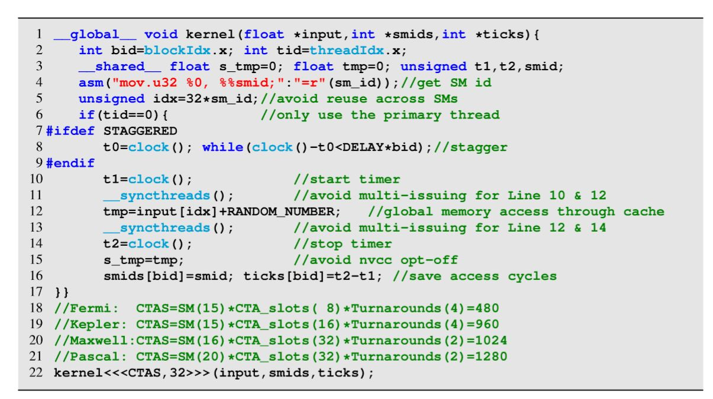
Microbenchmarking
Figure. Microbenchmark for verifying spatial and temporal inter-CTA locality.
Notes:
We designed a microbenchmark (shown in Listing 3) to verify if the GPU L1 cache is capable of exploiting data reuse among CTAs that are dispatched onto the same SM, either simultaneously (spatial locality) or subsequently (temporal locality).
Each CTA contains one warp and only the primary thread is essentially utilized to avoid intra-warp coalescing and inter-warp conﬂicting effects within the CTA boundary

Slide 6
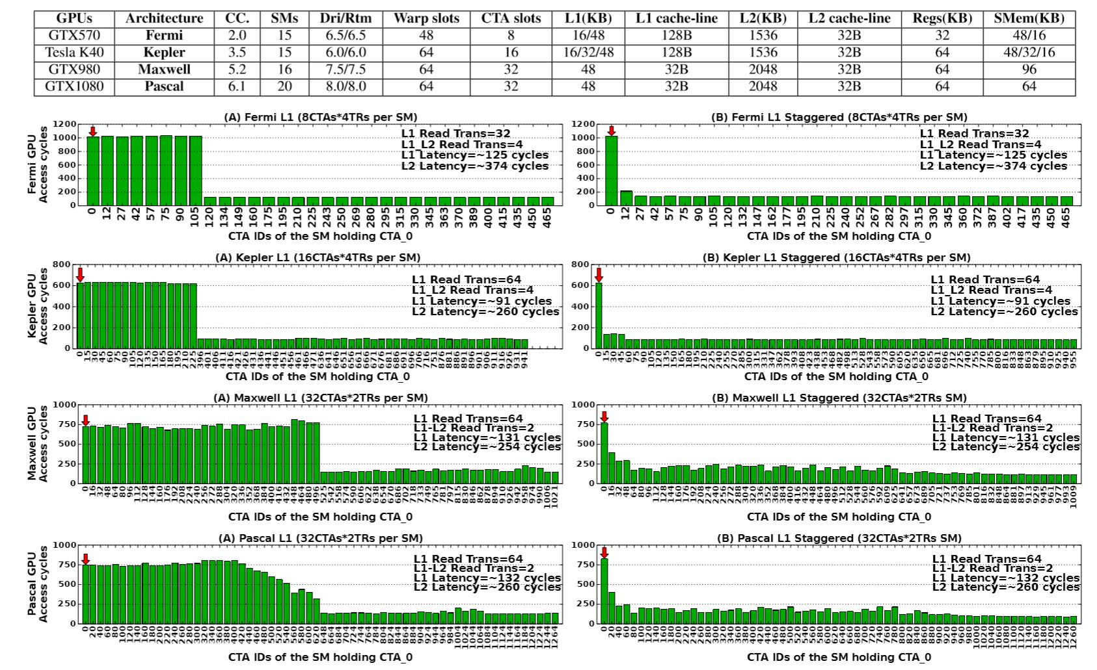
Feasibility to Exploit Inter-CTA Reuse On L1
Figure. (A) Default scenario for temporal locality; (B) Staggered scenario for spatial locality.
Notes:
1. Figure 2 shows the average memory access delay for the CTAs dispatched to a particular SM that accommodates the ﬁrst CTA (i.e., CTA-0) under two setups: (A) default CTA scheduling,and(B)staggeredexecution.WedenotethisSM as “SM 0”. The x-axis represents the CTA-IDs dispatched to SM 0. We also use CUDA proﬁler to proﬁle two extra cache metrics (i.e., L1 Read Trans and L1 L2 Read Trans).
1. This is proved by the observation that only CTAs in the ﬁrst turnaround experience high access latency caused by the
global memory loads (e.g.,∼750 cycles on Pascal).
3. Trans reported by the proﬁler: for Fermi and Kepler, one 128B L1 miss is equivalenttofour32BL2readtransactions;whileforMaxwelland Pascal, the L1/Tex uniﬁed cache is partitioned into two sectors with each sector generating a 32B L1 miss, leading to two L2 read transactions. It is speculated that these sectors are private to particular CTA-slots following certain mapping mechanism.
Temporal:
To verify whether spatial locality can be exploited at L1 cache by the CTAs that are dispatched to the same SM simultaneously (i.e., in the same turnaround), weenablestaggeredexecution(Line7-9inListing3)todisalign their memory accesses so that the simultaneous memory requests from the concurrent CTAs cannot be aggregated at L1.
1200 cycles. So the memory load from global will arrive L1 before the concurrent CTAs of this turnaround access to it.
Observed locality: GTX750Ti (a ﬁrst generation Maxwell GPU with CC-5.0). Two general patterns: (1) For the architectures in Table 1, CTAs in the ﬁrst turnaround generally followsround-robin(RR),butnotforthoseintheremaining turnarounds. They follow a more “demand-driven” policy; (2) On GTX750Ti, CTAs are randomly assigned to SM 0 within each individual turnaround instead of following any speciﬁc rule. Further investigations on real-world GPU applications conﬁrm that the default hardware CTA scheduler is actually close to pattern (2) where the ﬁrst turnaround does not necessarily follow RR either.
For example, it only executes 60 CTAs not 64 of them.

Slide 7
Inter-CTA locality Potential
Observation: inter-CTA reuse accounts for a very significant portion of the overall data reuse: on average 45%.
But are they all exploitable?
Notes:
1. which is based on the data reuse of all the memory requests generated from SMs before they enter L1 cache. Since the current GPU proﬁlers cannot track the address and source (e.g., CTA-id) of a speciﬁc memory request, for demonstration purposes only, we use GPGPU-Sim [21] to track the data reuse of all memory access requests and estimate the percentage of inter-CTA reuse among the overall data-reuse
Indepdent of cta scheduler or cache design. 33 common GPU applications.
2. Areusefor33commonGPU applications.Itclearlydemonstratesthattheinter-CTAreuse in these applications accounts for a very signiﬁcant portion of the overall data-reuse (on average 45%). This indicates that strategies aiming to improve inter-CTA reuse may lead to dramatic overall performance beneﬁt, which goes beyond the conventional approaches that only attempt to promote intra- and inter-warp data reuse [16, 34–36].

Slide 8
Where Inter-CTA Locality Originates From
Five Categories of inter-CTA reuse sources
Algorithm related: algorithm design.
Examples: MM, KMN, DCT
Cache-line related: cache design
Examples: SYK, NBO, ATX
Data related: irregular data structures
Examples: BFS, HST, BTR
Writing related: irrelevant writing from another CTA
Examples: NW
Streaming
Examples: BS, SAD, DXY
Notes:
1. This scenario occurs when the memory access behavior is not perfectly coalesced or fully aligned with the cache-line boundary (e.g., threads accessing halo region or user-deﬁned object array) and is especially prevalent in architectures having large L1 cache-line sizes (e.g., Fermi and Kepler). Typical examples include SYK, NBO, ATX.
2. irrelevantwritingfromanother CTA to the same cache-line (write no-allocate write-evict
3.

Slide 9
Basic Design Strategy
Exploitable: algorithm-related and cacheline-related
Non-exploitable: data-related, write-related and streaming
Notes:
Create the reuse. Have an order then I can prefetch it.

Slide 10
Partitioning => Inverting => Binding
Partition: for each original CTA, finding map from CTA-id to Cluster-id
Inverting: for each cluster, using (Cluster-id + In-cluster-id + Mapping method) to find the original kernel CTA-id.
Binding: for each CTA in the new kernel, find its Agent_id’s corresponding Cluster-id and In-cluster-id.
Notes:
The main idea of this is to use a new kernel to execute the original kernel with locality information, guaranteeing no repetition, no missing task item and workload balance. This does not assume any CTA scheduling policy.

Slide 11
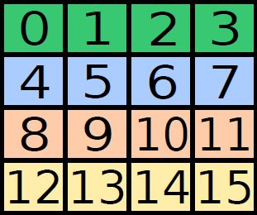
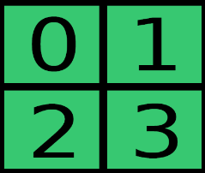
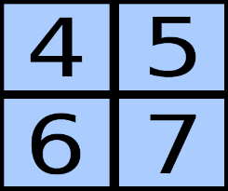
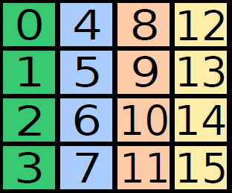
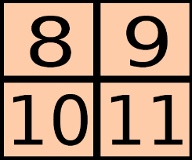
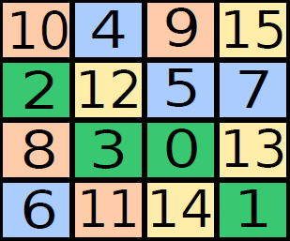
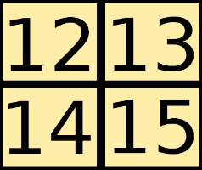
S1: Partition CTAs ac. inter-CTA locality
CTA
C0
Inter-CTA reuse
C1
Partition
C2
C3
Notes:
This is the orginal kernel index mapping. The same color represents the inter-cta reuse.
We propose a partition theroy in the paper to make sure workload is balanced among cluters, the max difference between any two clusters is 1.
With balanced workload.

Slide 12
S2: Inverting partition relation
C0
C0(0,1,2,3)
C1
C1(0,1,2,3)
C2
C2(0,1,2,3)
C3
C3(0,1,2,3)
Notes:
Once we have cluster id and in-cluster id , we can use an invert function to find their correpsonding original CTA-ID. For example, …. Previous studies have commonly use an explict FIFO queue or task queue to describe this mapping which incurs storage overhead, time overhead( atomoic). We construct the formula for this inversion function without building queue.

Slide 13
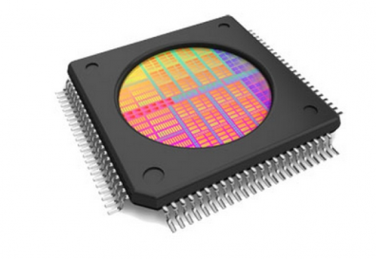
S3: Binding clusters to SMs
CTA-0
C0
SM-0
CTA-1
SM-1
CTA-2
C1
CTA-3
SM-2
CTA-4
C2
CTA-5
SM-3
CTA-6
C3
CTA-7
Old Kernel
New Kernel
Notes:
The new CTAs to excute al the task items in its corresponding clusters.
CTAs in new kernel.
At this point, we have no idea on what is cluster id and in-custer id and hwo they map to the orignal kernel (inverting). Now I have CTAs fromt the new kernel on each SM. We first get their SM-ID and since cluster and SM is assumed to be 1 to 1 mapping here, we can get the cluster id. But we don’t the incluster id and how it is mapped back to original kernel. Now we do bidding to find out agent_id. Later, when we really execute it, we will use agents to traverse all the talks in the cluster, then we will know in-cluter-id and mapping it back to original id. In this way, we don’t have to maintain a queue.

Slide 14
Binding: How to Distinguish Agents on an SM
Fermi & Kepler (static binding to hardware warp slots):
Maxwell and Pascal (dynamic binding to hardware warp slots):
New Contributions:
Notes:
<<<a,b,1>>>
Don’t know how many agents on this SM.
Don’t know in-cluster id and who to execute.
Overlappig or task missing. Cant accurately execute the task.

Slide 15
Overall Mapping Flow from N to O
CTA-0
C0
SM-0
CTA-1
CTA-2
C1
SM-1
CTA-3
SM-2
CTA-4
C2
CTA-5
Old Kernel
CTA-6
SM-3
C3
CTA-7
New Kernel
Notes:
Created two binkding strategies: RR based, agent-based

Slide 16
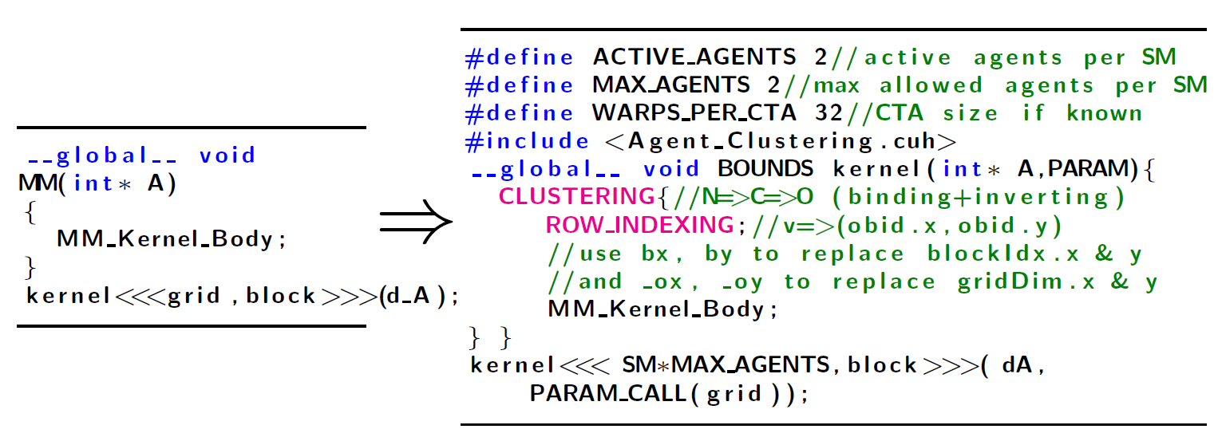
Simple Code Transformation

Slide 17
Runtime Framework
A coarse-grained inter-CTA locality estimation method
(a) If posing a new execution order and L1 hit rate is significantly changed ---> algorithm- or cacheline-related
(b) If turning off L1 cache but L2 access is significantly reduced ---> cacheline-related;
(c) But if L2 access remains similar but coalescing degree is high ---> streaming
; if coalescing degree is low ---> data-related
(d) Reference evaluation: if a kernel reads or write to the same array but with shifted or skewed references ---> write-related

Slide 18
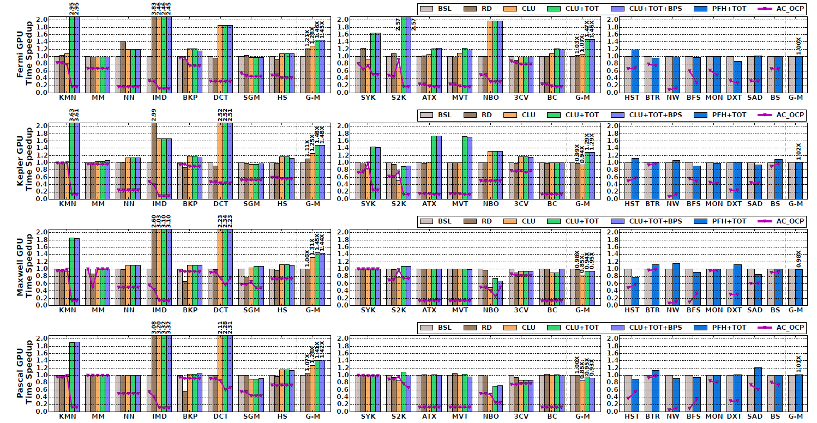
Performance Improvement
Algorithm-related
Cache-line-related
Others
Achieves an average of 1.46x, 1.48x, 1.45x, 1.42x (up to 3.83x,3.63x,3.1x, 3.32x) for algorithm-related applications on Fermi, Kepler, Maxwell and Pascal platforms.
Notes:
Extensive evaluation across different gernations of nvida gpu hardware show significant speedup.

Slide 19
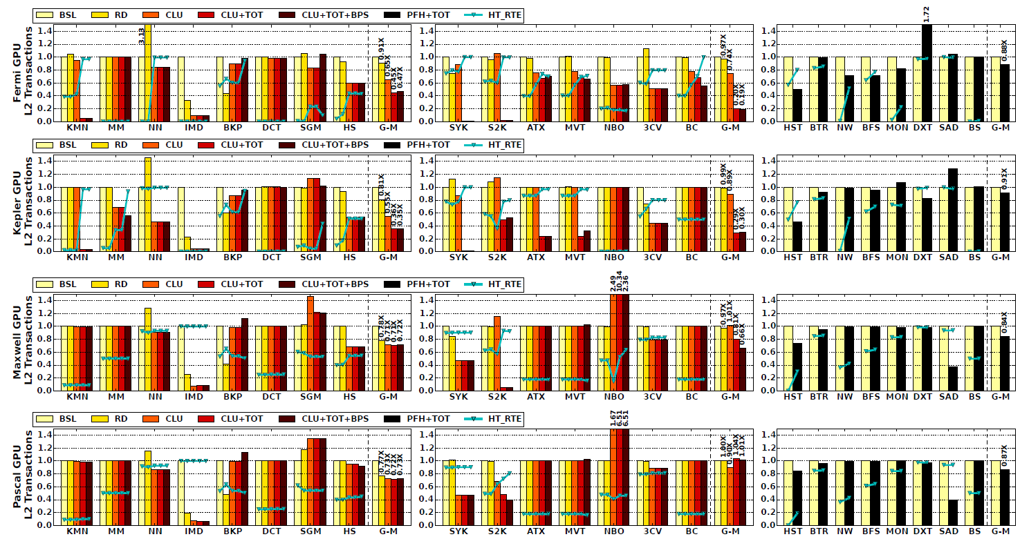
Cache Performance Improvement
Algorithm-related
Cacheline-related
Others
Reduces L2 transactions by an average 55%, 65%, 29% and 28% for algorithm-related applications on the four platforms.
Notes:
Cache performance doesn’t decide the overall performance due to the latency hiding massive multi-threading.

Slide 20
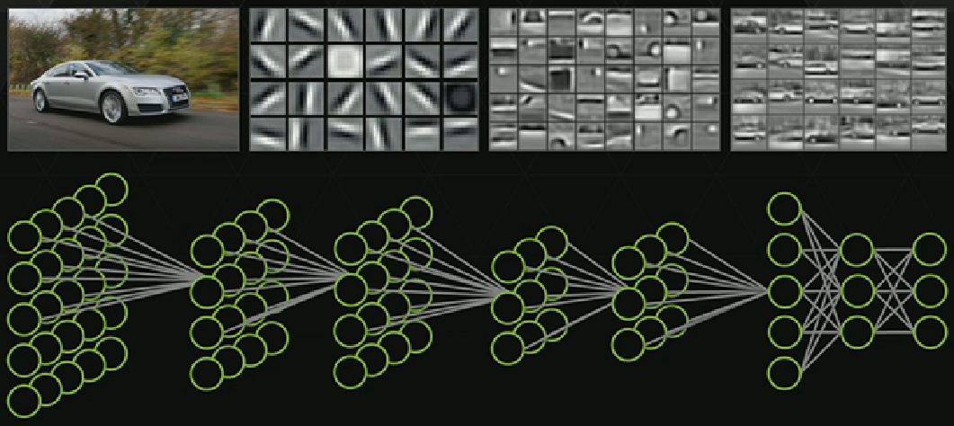
Utilization in CNN & DNN
Mapping feature-maps to CTAs, inter-CTA locality can be exploited by our method.
New GPUs tend to allocate more CTAs per SM (less warps per CTA), thus our method is promising.
Representing a future programming and optimization direction.
Notes:
There is a tradeoff-space an be explored between inter-CTA optimization and intra-CTA optimizaiton.

Slide 21
Locality-Aware CTA Clustering for Modern GPUs
ASPLOS’17,
Xi’An, China
Ang Li, Shuaiwen Leon Song
Pacific Northwest National Laboratory (PNNL)
Weifeng Liu (University of Copenhagen),
Xu Liu (William&Mary),
Akash Kumar (TU Dresden)
Henk Corporaal (TU Eindhoven)

Slide 22
Necessary Info for Binding
CTA-0
CTA-1
CTA-2
CTA-3
CTA-4
CTA-5
CTA-6
CTA-7
To correctly execute (no repetition, no missing task), each CTA must know
Which SM I am currently running on?
On this SM, how to distinguish with other CTAs?
Fermi & Kepler Architecture: static binding to hardware warp slots
Maxwell & Pascal Architecture: dynamic binding to hardware warp slots
Notes:
Don’t know how many agents on this SM.
Don’t know in-cluster id and who to execute.
Overlappig or task missing. Cant accurately execute the task.

Slide 23
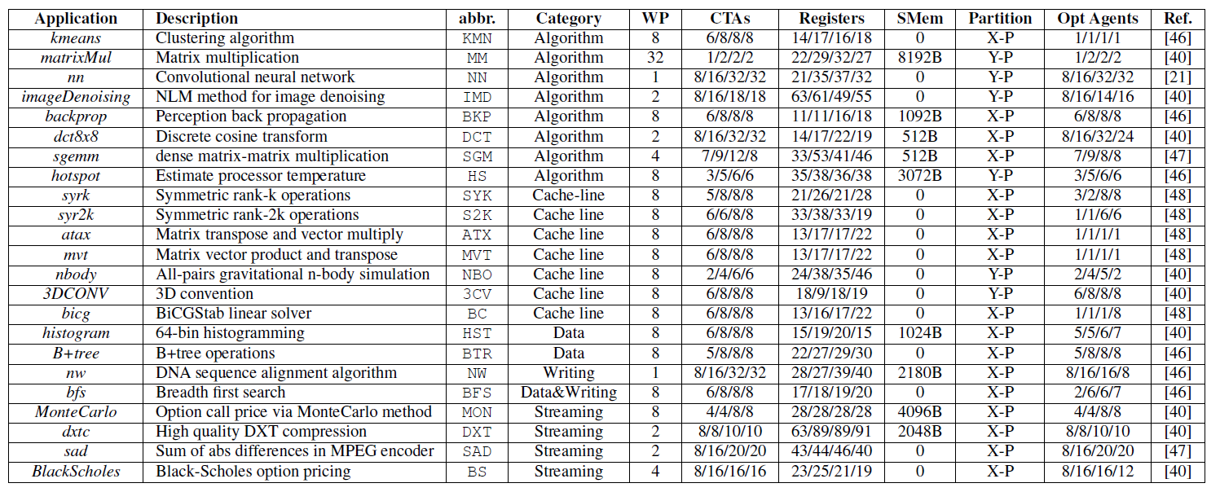
Evaluated Applications

Slide 24
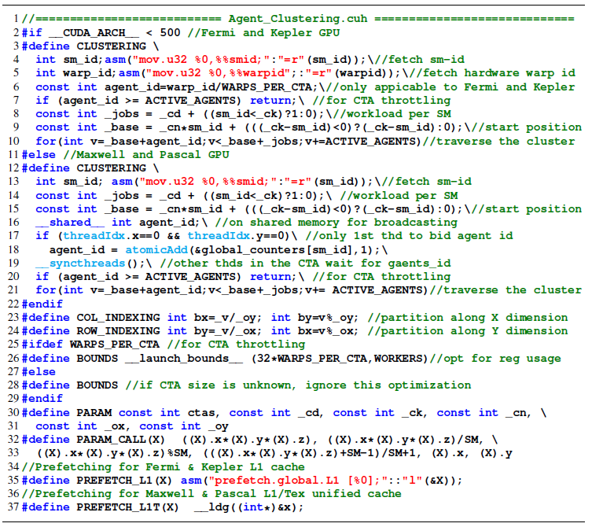
Header File

